Slide 1
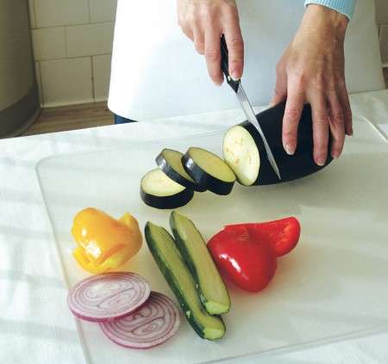
CHOP
To cut into small pieces

Slide 2
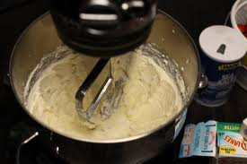
CREAM
To work sugar and fat together until the mixture is soft and fluffy

Slide 3
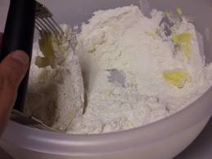
CUT IN
To cut fat into flour with a pastry blender or two knives

Slide 4
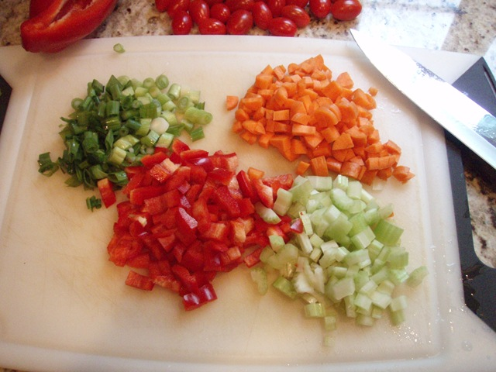
DICE
To cut into very small cubes, about ¼”

Slide 5
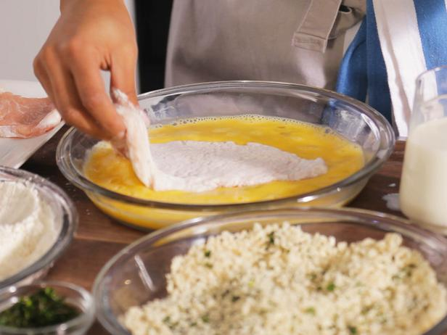
DREDGE
To coat food heavily with other ingredients

Slide 6
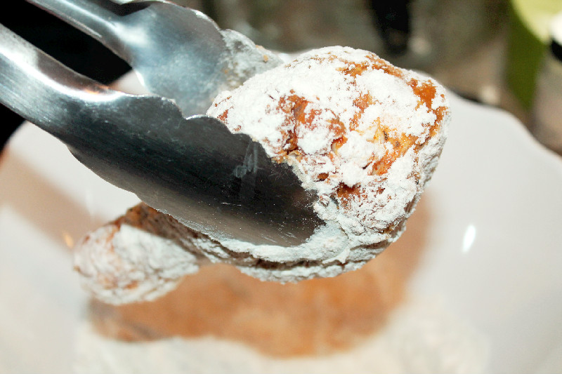
FLOUR
To sprinkle or coat with a powdered substance, often breadcrumbs or seasonings

Slide 7
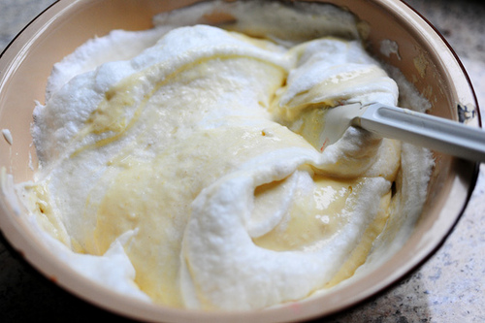
FOLD
To mix ingredients gently by turning one part over another

Slide 8
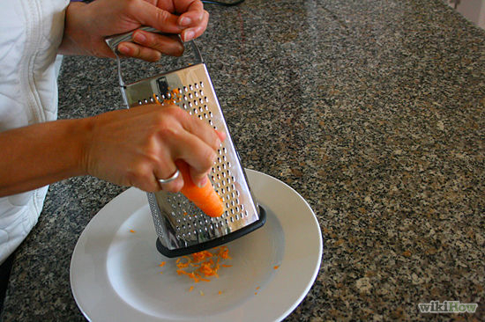
GRATE
To finely divide food in various sizes by rubbing it on a surface with sharp projections

Slide 9
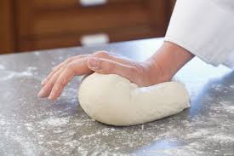
KNEAD
To work dough to further mix ingredients and develop gluten

Slide 10
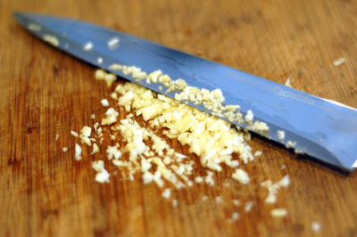
MINCE to cut food as finely as possible

Slide 11
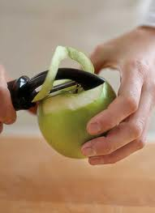
PEEL
To remove or strip off the skin or rind of a fruit or vegetable

Slide 12
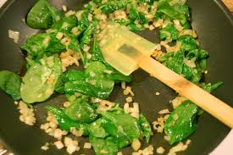
Sauté
To brown or cook foods in a small amount of fat using low-med heat

Slide 13
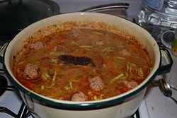
SIMMER
To cook just below the boiling point

Slide 14
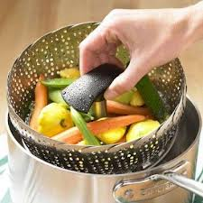
STEAM
To cook by vapor produced when water is heated to the boiling point

Slide 15
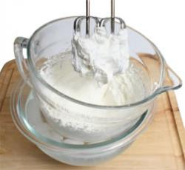
WHIP
To beat rapidly to introduce air bubbles into the food

