Slide 1
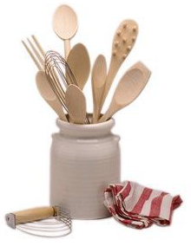
What Is It?!?
Kitchen Lab Equipment

Slide 2
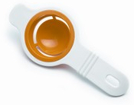
1. Egg Separator

Slide 3
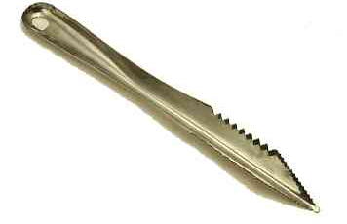
2. Apple Corer

Slide 4
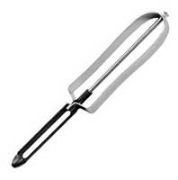
3. Vegetable Peeler

Slide 5
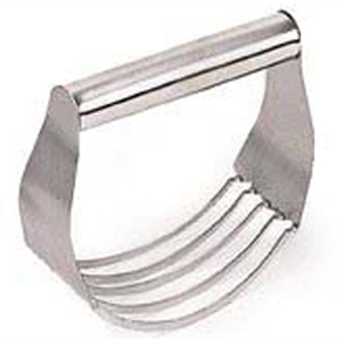
4. Pastry Blender

Slide 6

5. Spatula

Slide 7
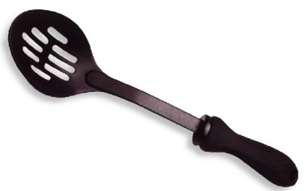
6. Slotted Spoon

Slide 8
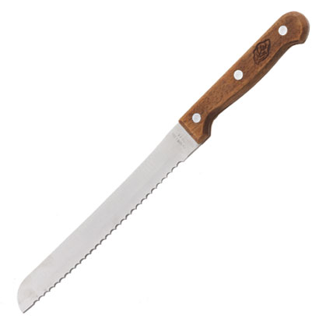
7. Bread Knife

Slide 9
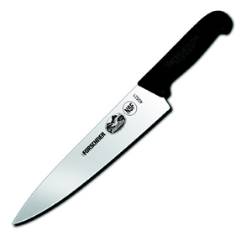
8. Chef’s Knife

Slide 10
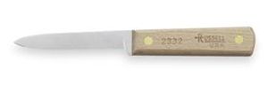
9. Paring Knife

Slide 11
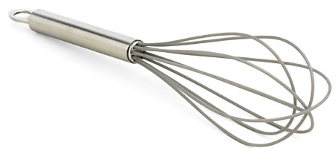
10. Whisk

Slide 12
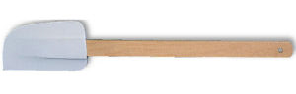
11. Rubber Spatula

Slide 13
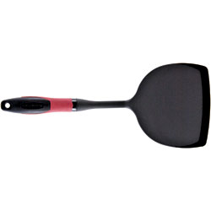
12. Turner

Slide 14
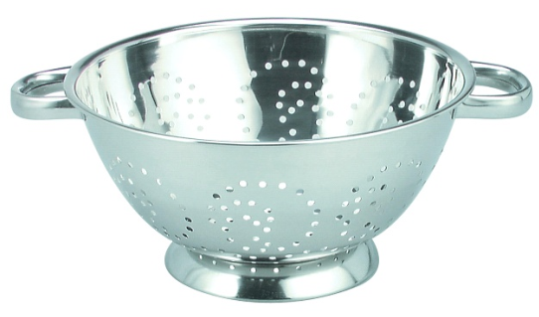
13. Colander

Slide 15
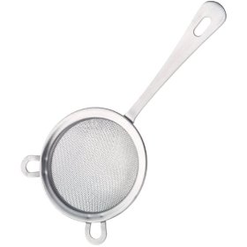
14. Strainer

Slide 16
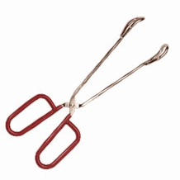
15. Tongs

Slide 17
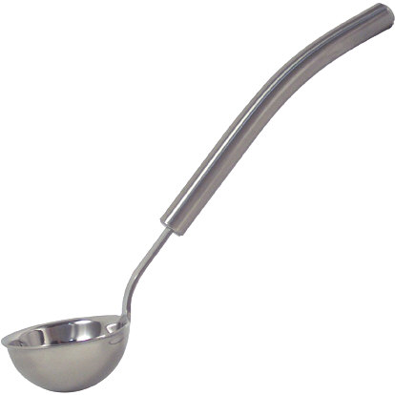
16. Ladle

Slide 18
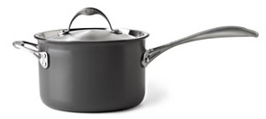
17. Saucepan

Slide 19
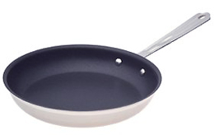
18. Skillet

Slide 20
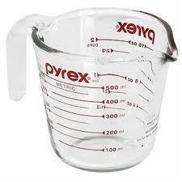
19. Liquid Measuring Cup

Slide 21
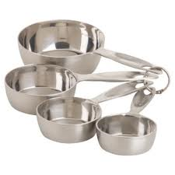
20. Dry Measuring Cups

Slide 22
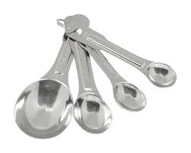
21. Measuring Spoons

Slide 23
Drawer 1:
Hint: Ingredients (You start with ingredients FIRST!)
1 Cup Liquid Measuring Cup (Small)
2 Cup Liquid Measuring Cup (Medium)
4 Cup Liquid Measuring Cup (Large)
Staple Ingredients:
•1 Flour •1 Cooking Spray •1 Baking Soda
•1 Sugar •1 Vanilla •1 Baking Powder
•1 Salt (Canister) •1 Oil •1 Set Salt/Pepper Shakers

Slide 24
Drawer 2:
Hint: Things that protect us
4 Hot Pads (2 Squares & 2 Gloves)
2 Cooling Racks
2 Cutting Boards

Slide 25
Drawer 3:
Hint: Only 3 things total in the drawer
1 Electric Mixer
2 Beaters

Slide 26
Drawer 4:
Hint: Cover the Stovetop (These will cover all 4 burners on the stovetop)
1 Large Pot with Lid
1 Medium Saucepan with Lid
1 Small Saucepan with Lid
1 Large Skillet
1 Small Skillet

Slide 27
Drawer 5:
Hint: Clean with 5 Fingers-(You must use all 5 fingers on both hands to wash the dishes and clean the kitchen
1 Dish Soap
1 Dish Drainer with Mat
1 Supply Tray
1 Sanitizer Spray Bottle
2 Drain Plugs
1 Scrub Brush

Slide 28
Drawer 6:
Hint: Set The Table-(Dishes you set the table with-The 6 looks like a chair you would sit in to eat at the table)
5 Large Drinking Cups • 5 Large Plates
1 Pitcher • 5 Cereal Bowls
5 Small Plates • 5 Custard Cups
5 Medium Plates • 1 Extra Blender Cup and Lid
5 Mugs

Slide 29
Drawer 7:
Hint: Round things are in this drawer
3 Metal Mixing Bowls
4 Plastic Mixing Bowls
4 Glass Mixing Bowls
1 Colander
1 Strainer
1 Sifter
1 Steamer

Slide 30
Drawer 8:
Hint: Measuring and Mixing Equipment-The round circles in the 8 look like measuring cups
2 Sets of Dry Measuring Cups
(1/4 c., 1/3 c., 1/2 c., 1 c.)
2 Sets of Measuring Spoons
1/4 tsp., 1/2 tsp., 1 tsp., 1 Tbsp.)
2 Turners • 2 Mixing Spoons
2 Spatulas • 1 Whisk
2 Rubber Spatulas

Slide 31
Drawer 9:
Hint: Non-Sharp specialty equipment-(they have only 1 job)-The 9 is round and NOT sharp
1 Pair of Tongs • 1 Vegetable Scrubber/Brush
1 Egg Separator • 1 Slotted Spoon
1 Pastry Brush • 1 Ladle
1 Rolling Pin • 1 Pasta Scoop
1 Garlic Press

Slide 32
Drawer 10:
Hint: Things that go IN the oven-The 1 looks like the handle, the 0 looks like the stovetop and the dots look like the oven controls
1 Muffin Tin (6 count) • 1 Round Glass Dish
1 Muffin Tin (12 count) • 1 Square Metal Pan
1 Cookie Sheet • 1 Pizza Pan
1 Square Glass Dish

Slide 33
Drawer 11:
Hint: Sharp specialty equipment-(they have only one job)-the ones look like a sharp knives
1 Can Opener • 1 Vegetable Peeler
1 Pizza Cutter • 3 Biscuit Cutters
1 Apple Corer • 1 Pair of Kitchen Shears
1 Grater • 1 Thermometer w/Cover
1 Pastry Blender

Slide 34
Drawer 12:
Hint: Kitchen utensils-the last drawer-the last things you need before you eat
5 Butter Knives • 1 Large Chopping Knife
5 Salad Forks • 1 Medium Serrated Knife
5 Spoons • 1 Small Paring Knife
2 Large Serving Spoons

