Slide 1
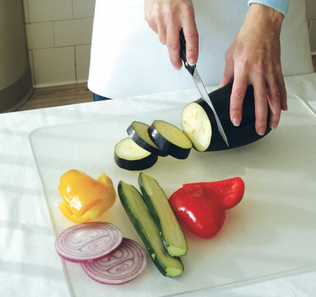
CHOP To cut into small pieces

Slide 2
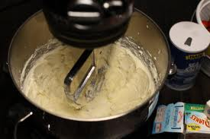
CREAM To work sugar and fat together until the mixture is soft and fluffy

Slide 3
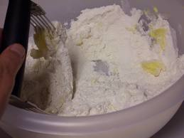
CUT IN To cut fat into flour with a pastry blender or two knives

Slide 4
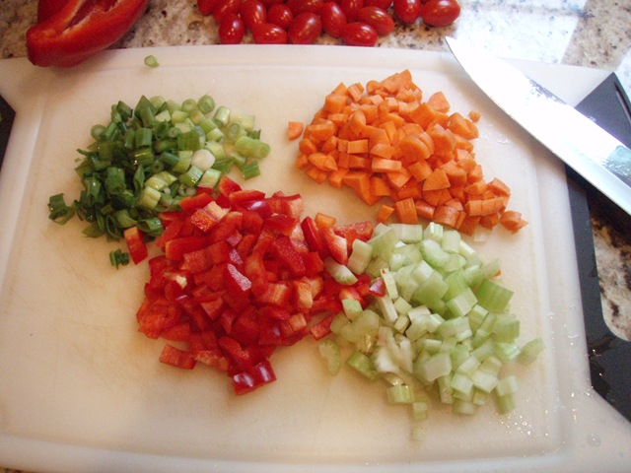
DICE To cut into very small cubes, about ¼”

Slide 5
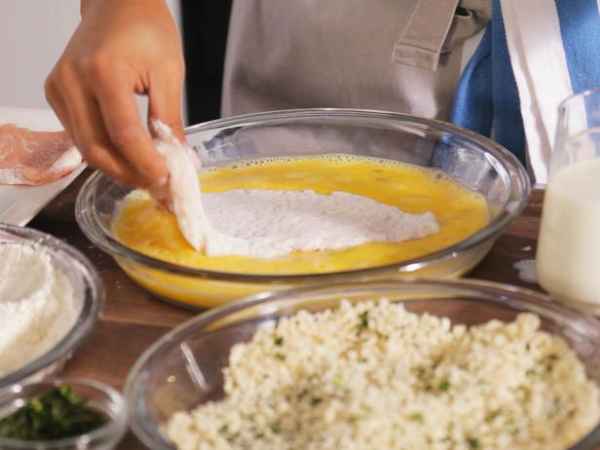
DREDGE To coat food heavily with other ingredients

Slide 6
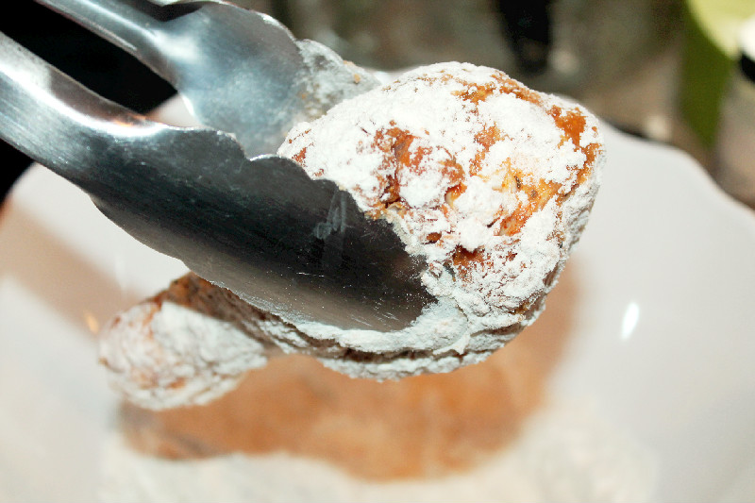
FLOUR To sprinkle or coat with a powdered substance, often breadcrumbs or seasonings

Slide 7
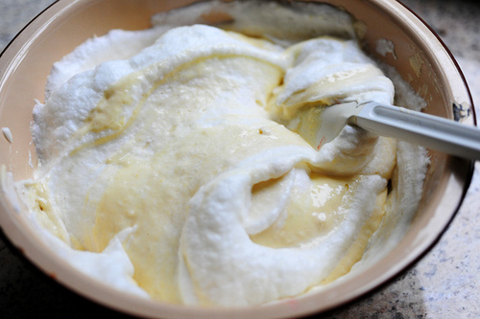
FOLD To mix ingredients gently by turning one part over another

Slide 8
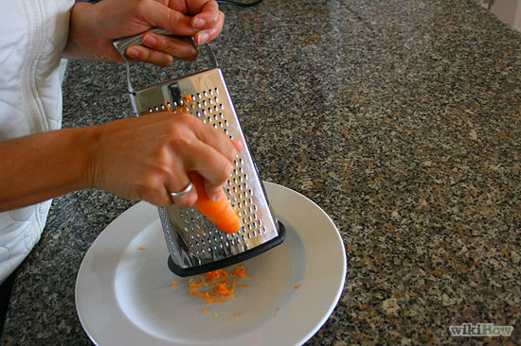
GRATE To finely divide food in various sizes by rubbing it on a surface with sharp projections

Slide 9
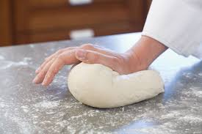
KNEAD To work dough to further mix ingredients and develop gluten

Slide 10
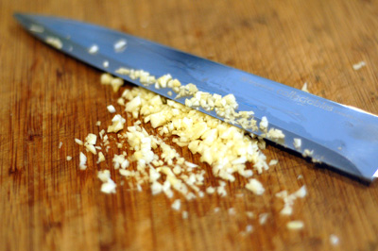
MINCE to cut food as finely as possible

Slide 11
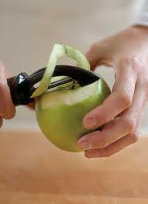
PEEL To remove or strip off the skin or rind of a fruit or vegetable

Slide 12
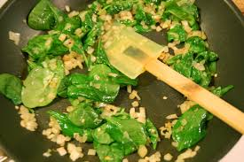
Sauté To brown or cook foods in a small amount of fat using low-med heat

Slide 13
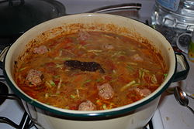
SIMMER To cook just below the boiling point

Slide 14
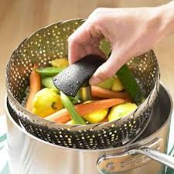
STEAM To cook by vapor produced when water is heated to the boiling point

Slide 15
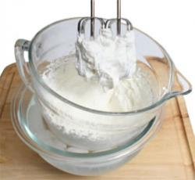
WHIP To beat rapidly to introduce air bubbles into the food

