Slide 1
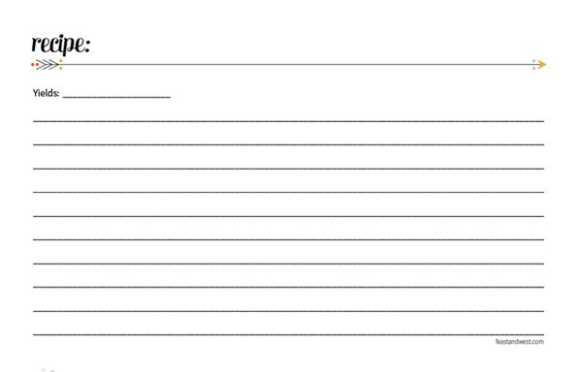
Reading a Recipe and Measuring
List the FOUR parts of a recipe:
  List and amounts of ingredients
  Step-by-step instructions
  Essential info about temperature and equipment
  Number of servings

Slide 2
2. What are the EIGHT steps to following a recipe correctly?
  Read the recipe carefully before beginning
  Check to see if you have all the ingredients
  Pre-heat the oven if needed
  “Gather” all equipment needed
  Complete preparation of specific ingredients (EX: Chopped Nuts, Melted Chocolate, etc.)
  Measure exactly!
  Mix carefully, following each direction
  Bake or cook at temperature and time directed

Slide 3
What is the most important step and why?
  #1! (Reading the recipe)-so you know what you need to do and what ingredients you need
Before cooking, you should wash your hands for at least how long?
  20 seconds

Slide 4
5. What should you NEVER do when measuring flour?
  Pack or tap the cup (it releases the air needed in the measurement)
  How should you measure flour instead?
  Spoon in the flour then level it off

Slide 5
6. What is the most efficient way to measure the following measurements of dry ingredients?
  4 Tbsp. = ___________________
  3/4 c. = ___________________
  3 tsp. = ___________________
  1/8 c. = ___________________
1/4 c.
1/2 c. + 1/4 c.
1 Tbsp.
2 Tbsp.

Slide 6
When cutting a recipe in half, or when doubling a recipe:
The cooking TEMPERATURE remains the same, but the amount of INGREDIENTS, SIZE of the cooking pan and the length of TIME will be affected.
8. When baking with a glass dish, you need to reduce (lower) the oven temperature by:
25⁰

Slide 7
Equivalents & Abbreviations
T., Tbsp., or tbsp = tablespoon
t., or tsp. = teaspoon
Min. = minute
Oz. = ounce
Qt. = quart
Pt. = pint
Gal. = Gallon
Hr. = hour
Doz. = dozen
C. = cup
lb. or # = pound
Pkg. = package

Slide 8
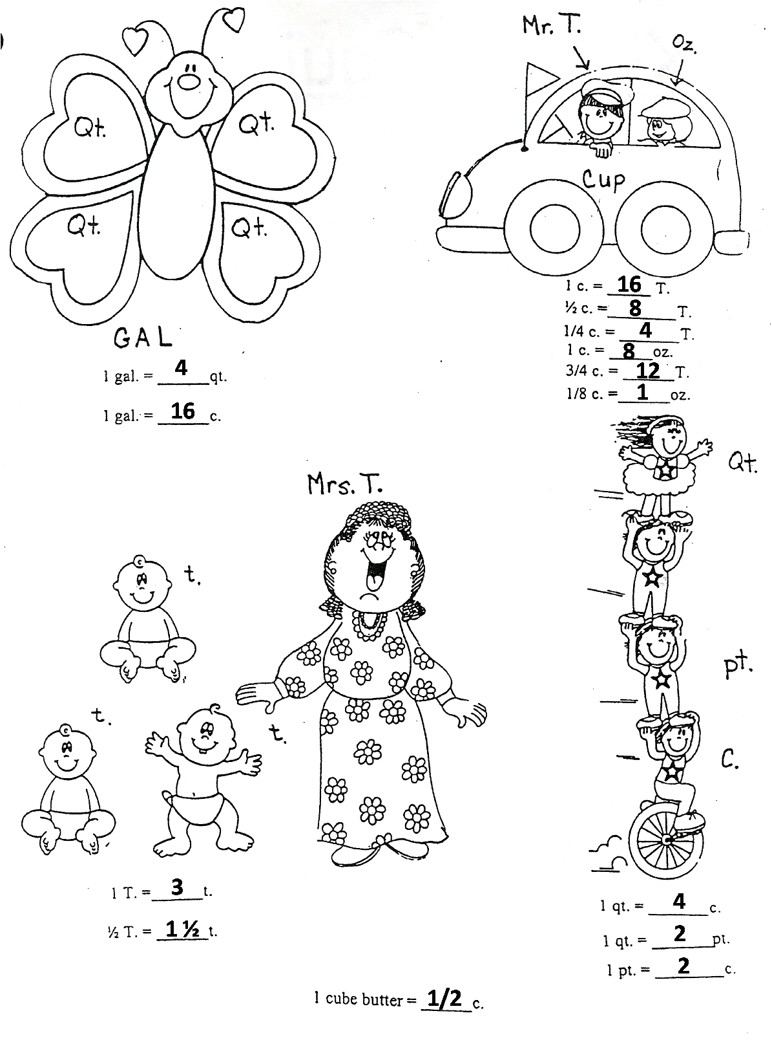
Mrs. T. and Her Babies
Helpful Hints:
T. = Tablespoon
t. = teaspoon
Mrs. T. has 3 baby t.’s
There are 3 little t.’s with 1 big T.
Equivalents To Remember:
1 Tablespoon = 3 teaspoons
1/2 Tablespoon = 1 ½ teaspoons

Slide 9
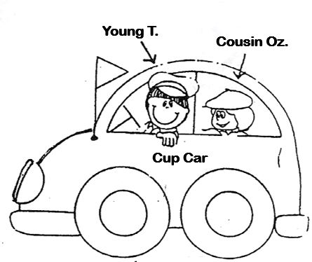
Young T. and Cousin Oz.
Helpful Hints:
Young T. just got his drivers license-He is 16 (16 Tablespoons)
He now gets to drive the “Cup Car” (1 Cup)
Cousin Oz. is half as old as Young T.-He is only 8 (8 Ounces)
It takes 8 ounces to fill up the “Cup Car” (8 oz. = 1 c.)
Equivalents To Remember:
8 Ounces = 1 Cup
1 Cup = 16 Tablespoons
3/4 Cup = 12 Tablespoons
1/2 Cup = 8 Tablespoons
1/4 Cup = 4 Tablespoons
1/8 Cup = 2 Tablespoons

Slide 10
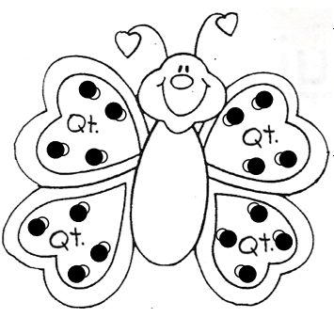
GAL the Butterfly
Helpful Hints:
GAL stands for Gallon
GAL’s wings are so QT! (Quart)
4 Wings = 4 Quarts
Small Circles Represent 1 C.
Equivalents To Remember:
4 Cups = 1 Quart
4 Quarts = 1 Gallon
16 Cups = 1 Gallon

Slide 11
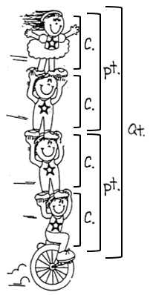
The Cup Kids
Helpful Hints:
Each Kid represents 1 cup
Equivalents To Remember:
2 Cups = 1 Pint
2 Pints = 1 Quart
4 Cups = 1 Quart

Slide 12
Other Important Equivalents To Remember
1 stick of butter/margarine = 1/2 cup
5 Tbsp. + 1 tsp. = 1/3 cup
8 oz. = 1 c.
16 oz. = 1 lb.

