Slide 1
CARBOHYDRATES
Simple and Complex

Slide 2
Intro to the Six Essential Nutrients
Nutrients are substances found in food that are essential for growth and energy.
There are SIX basic essential nutrients:
Carbohydrates
Lipids
Protein
Vitamins
Minerals
Water

Slide 3
Carbohydrates (Carbs)
We get most of our carbs from the grains group.
Almost all of our carbohydrates come from plant food sources.

Slide 4
Carbohydrates (Carbs)
The main function of Carbohydrates is to provide energy.
Carbohydrates provide 4 calories per gram.
If we eat more carbs than our bodies need for energy, they get stored as fat.
Carbohydrates are found in grains, fruits, vegetables, legumes and sugar.
Carbohydrates can be broken down into three categories:
Simple Carbs (Sugars)
Complex Carbs (Starches)
Fiber

Slide 5
Simple Sugars
These are broken down and digested very quickly.
Examples include: table sugar, fruit, fruit juice, sugary drinks, milk

Slide 6
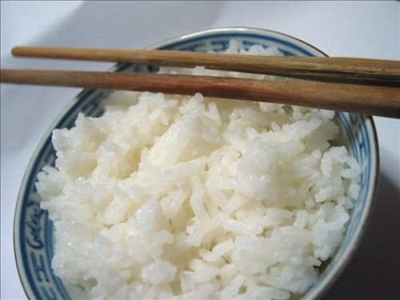
Complex Starches
These take longer to digest and provide sustained energy.
Examples include: whole grains, beans/legumes, brown rice, pasta

Slide 7
Fiber
Complex carbohydrate that helps in the digestion process.
Foods high in fiber include: fruits and vegetables (especially the skins or peels), whole grains, beans/legumes, bran cereals

Slide 8
Types of Sugar
SUGAR | OTHER NAME | FOOD SOURCES
Glucose | “Blood Sugar” | Fruit, Veggies, Grains
Sucrose | “Table Sugar” | Table Sugar, Sugar Cane
Fructose | “Fruit Sugar” | Fruit
Maltose | “Malt Sugar” | Grains
Lactose | “Milk Sugar” | Milk

