Slide 1

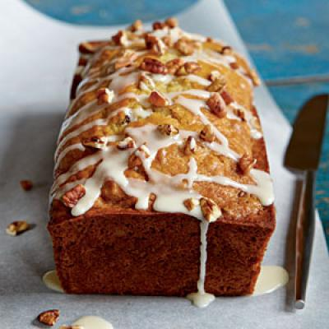
Breads
Free Powerpoint Templates

Slide 2
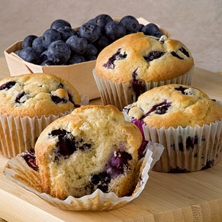
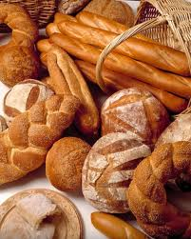
Two Basic Forms of Baked Goods
Quick Breads
Yeast Breads
They are fast or “quick” (less than an hour to bake)
They use baking soda or powder for leavening
They do NOT need to rise or proof
They take longer to make and bake
They use yeast for leavening
Requires kneading to develop gluten
They need to rise or proof

Slide 3
Quick Bread
The basic ingredients and their purposes in quick bread are:
• Flour: | Body/Structure
• Leavening Agents: | Makes the quick bread rise (Baking powder/baking soda)
• Salt: | Flavor
• Sugar: | Browning/Flavor
• Fat: | Tenderness/Richness
• Liquid: | Moisture

Slide 4
Yeast Bread
The basic ingredients and their purposes in yeast bread are:
• Flour: | Body/Structure
• Yeast: | Provides Leavening
• Salt: | Controls Yeast
• Sugar: | Feeds Yeast
• Fat: | Tenderness
• Liquid: | Dissolves and activates yeast
• Egg: | Color, texture and nutrients

Slide 5
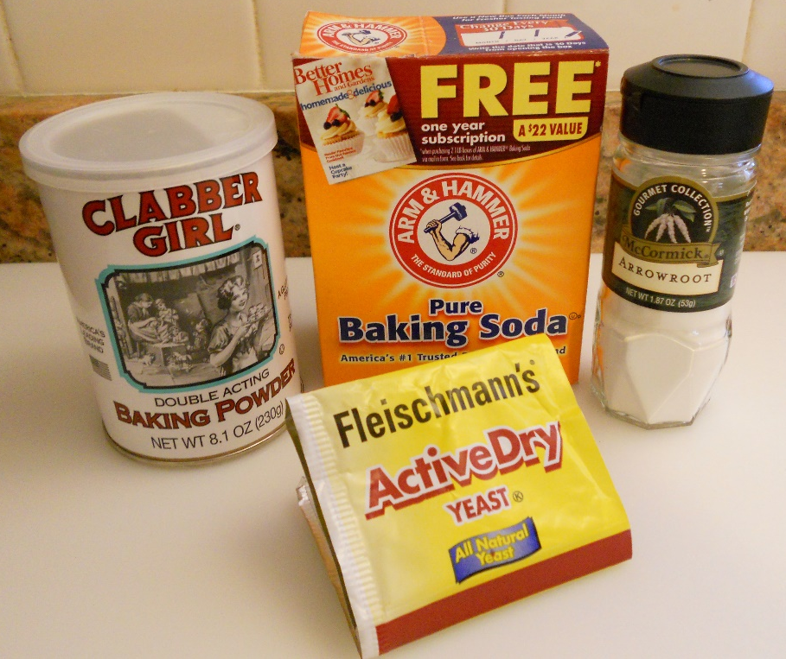
Leavening Agents
Leavening agents are substances used in batters and doughs that cause them to rise or expand, usually because CO2 is produced.
Common leavening agents include yeast, baking powder, baking soda, air and eggs.

Slide 6
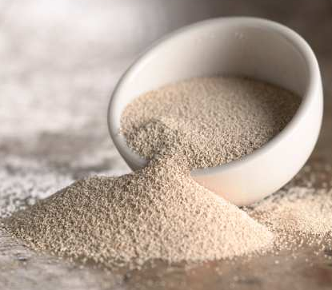
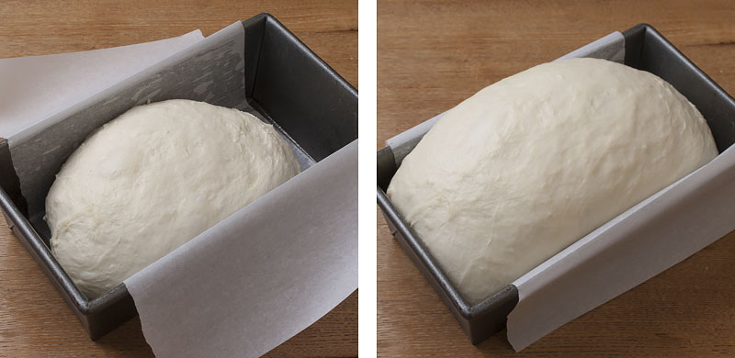
Yeast
The liquid used to activate the yeast should be between 115°F-125°F.
  If the water is too hot, it will kill the yeast.
  If the water is too cold, the yeast will not activate.
Sugar helps feed the yeast and salt controls the growth of the yeast.
Yeast breads require time to proof or rise. This is called “proofing.”

Slide 7
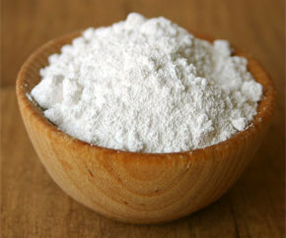
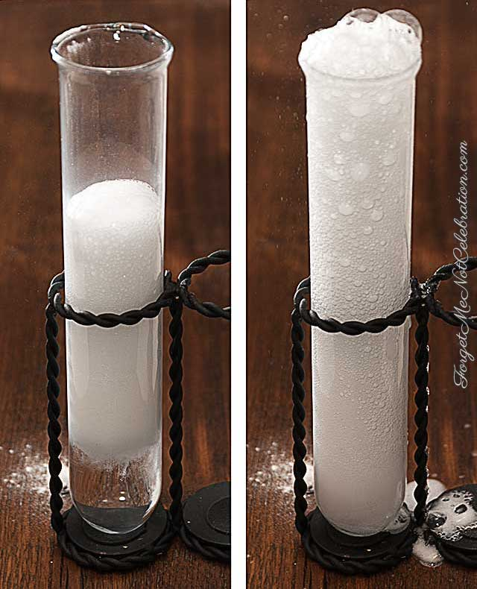
Baking Soda/Powder
These leavening agents require an acid in order to react or produce CO2.
Baking soda must have an acid from an outside source like vinegar, honey or lemon juice.
Baking powder already has a powdered acidic agent mixed in with it. All it needs is moisture to react.
These leavening agents produce a fast or “quick” reaction so the food product that uses them must be baked quickly.
Notes:
Baking soda is pure sodium bicarbonate. When baking soda is combined with moisture and an acidic ingredient the resulting chemical reaction produces bubbles of carbon dioxide that expand under oven temperatures, causing baked goods to rise.
The reaction begins immediately upon mixing the ingredients, so you need to bake recipes which call for baking soda immediately, or else they will fall flat!
Baking powder contains sodium bicarbonate, but it includes the acidifying agent already (cream of tartar), and also a drying agent (usually starch).
Single-acting powders are activated by moisture, so you must bake recipes which include this product immediately after mixing.
Double-acting powders react in two phases and can stand for a while before baking.

Slide 8
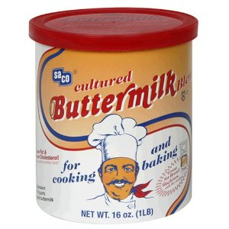
Common Acids Used In Food to Produce Leavening
Sour Cream
Sour Milk (Buttermilk)
Vinegar
Cream of Tartar
Honey
Molasses
Lemon Juice

Slide 9
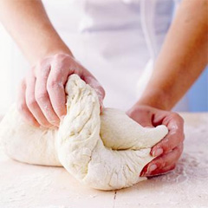
Gluten and Kneading
Gluten: when water is mixed with flour, the proteins in the flour give strength and elasticity to batters and doughs. This is usually done by stirring or kneading.
Kneading: to work a dough with the palms of the hands to develop gluten.

Slide 10
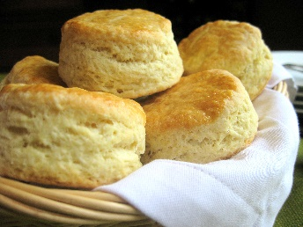
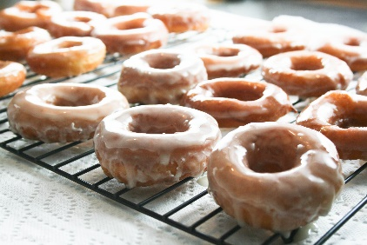
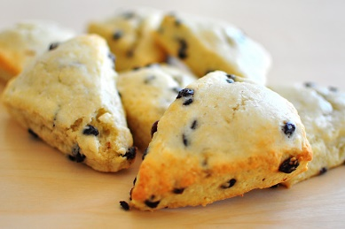
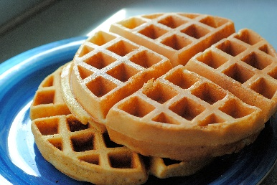
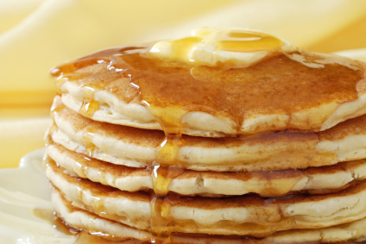
Types of Quick Breads
Dough
*Requires Kneading
  Biscuits
  Scones
  Doughnuts
Batter
*Requires Stirring
  Waffles
  Pancakes
  Muffins

Slide 11
Muffin Method
Combine all dry ingredients together into a bowl.
In a separate bowl, blend all of the liquid ingredients together, (including fat).
Make a well in your dry ingredient bowl and pour the liquid in the well.
Stir until dry ingredients are moistened.
Notes:
11

Slide 12
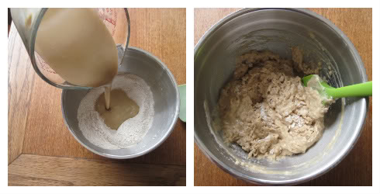
Muffin Method
Notes:
12

Slide 13
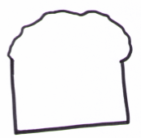
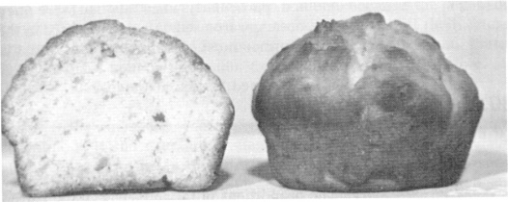
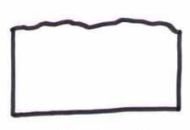
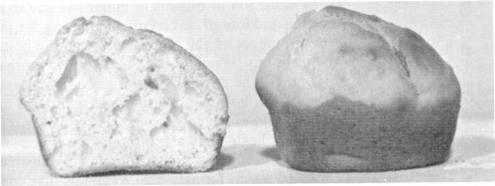

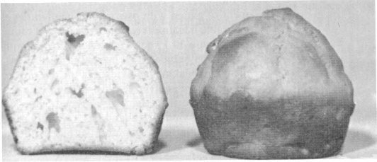
Muffin Method
The Perfect Muffin:
1. Will have a cauliflower top
2. Will have some, but few, tunnels in the interior.
3. Will be tender.
The Under-Mixed Muffin:
1. Will have low volume.
2. Will have a flat surface.
3. Will be very crumbly.
The Over-Mixed Muffin:
1. Will have a peaked top.
2. Will be very tough.
3. Will have large tunnels in the interior.

Slide 14
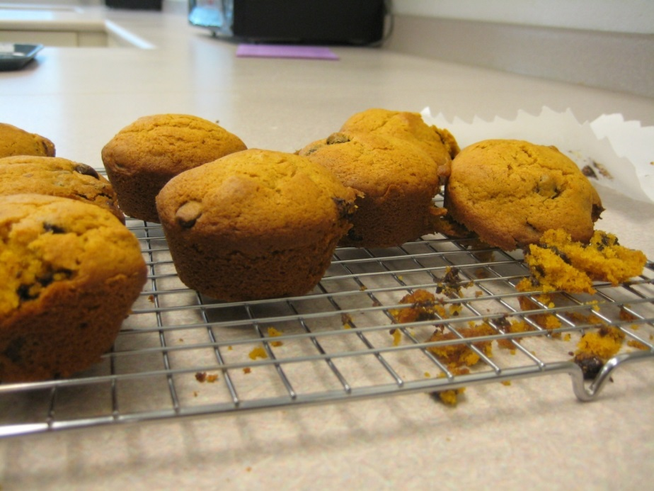
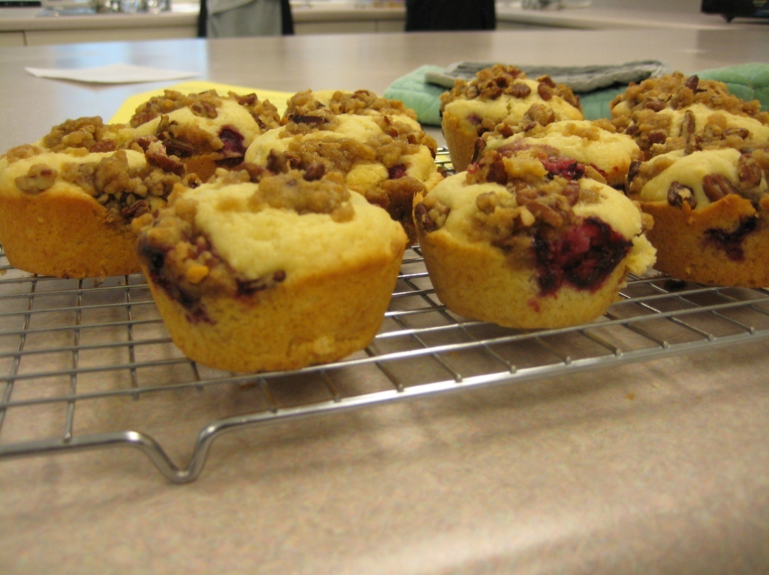
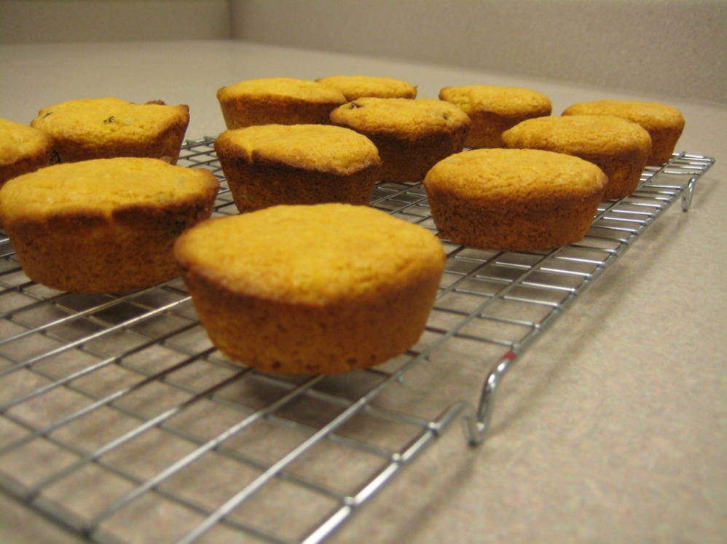

Slide 15
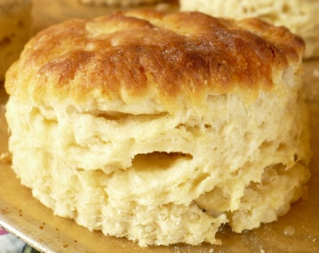
Biscuit Method
Combine all dry ingredients.
Cut-in the fat until there are crumbs.
Add the liquid and stir until a dough forms.
Knead the dough so gluten will form.
Roll out the dough and cut into biscuits with biscuit cutter.
Place on a greased cookie sheet.

Slide 16
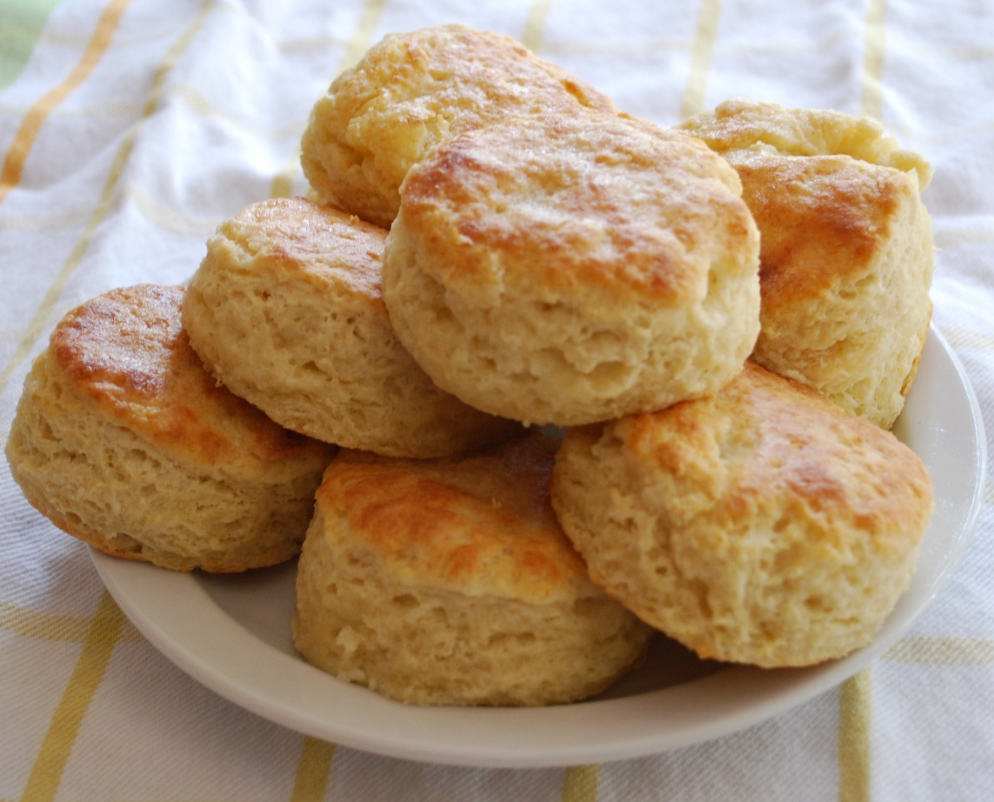
Biscuit Method
The Perfect Biscuit:
1. Will have a flat top.
2. Will have straight sides.
3. Will be flaky with layers.
Notes:
16

Slide 17
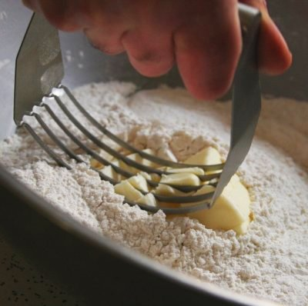
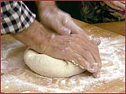
Most important steps in biscuit making:
Cutting-In the Fat
(To Create the Layers)
2. Kneading
(To Develop Gluten)
Notes:
17

Slide 18
