Slide 1
Rice and Pasta
Types and Cooking Methods

Slide 2
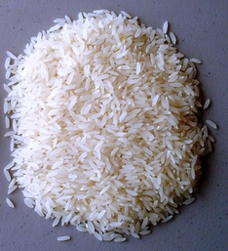
TYPES OF RICE
Conventional Rice
Short
When cooked it is moist and tender

Slide 3
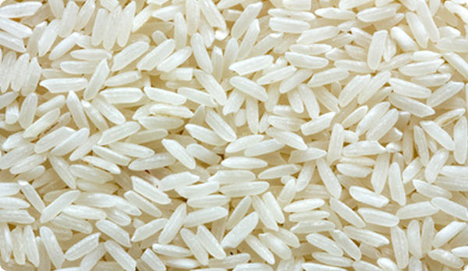
TYPES OF RICE
Long Grain Rice
Long
When cooked it is light and fluffy

Slide 4
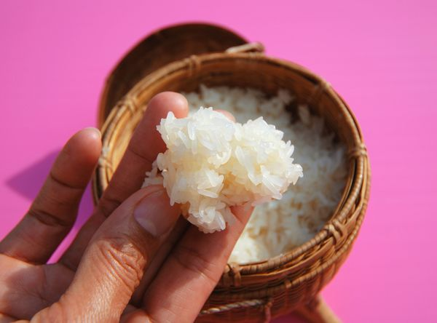
TYPES OF RICE
Short Grain Rice
Short and plump
When cooked it is soft and clings together (“sticky rice”)

Slide 5
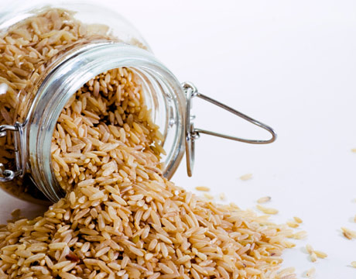
TYPES OF RICE
Brown Rice
Chewy texture
“Nut-like” flavor
Has the MOST fiber!

Slide 6
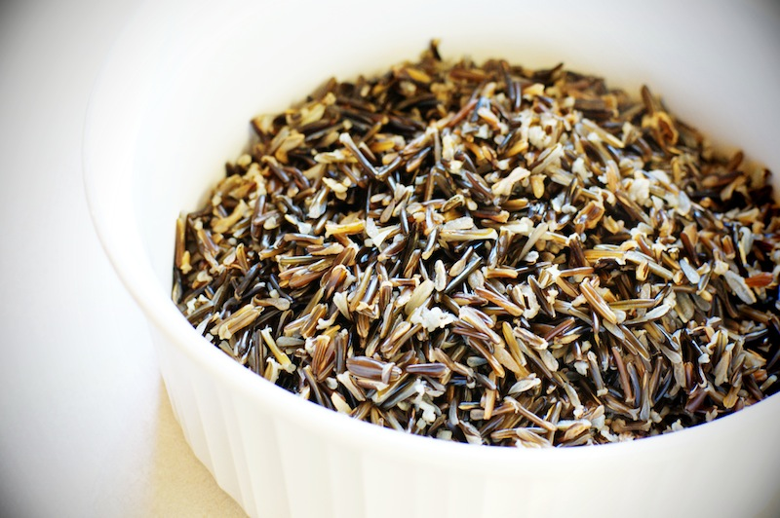
TYPES OF RICE
Wild Rice
Long, dark and streaky in color
Distinct flavor

Slide 7
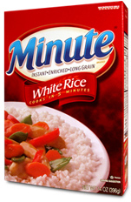
TYPES OF RICE
Instant/Pre-Cooked Rice
Cooked then dehydrated
Reduces cooking time

Slide 8
COOKING RICE
Use about 2 CUPS of water for every cup of rice.
Bring WATER to a boil.
Add rice and COVER the pan.
Bring water back up to a BOIL.
Reduce heat and SIMMER.
Check for DONENESS. The rice should be TENDER but firm and there should be no water left.
If some water remains, continue cooking, but REMOVE the lid.

Slide 9
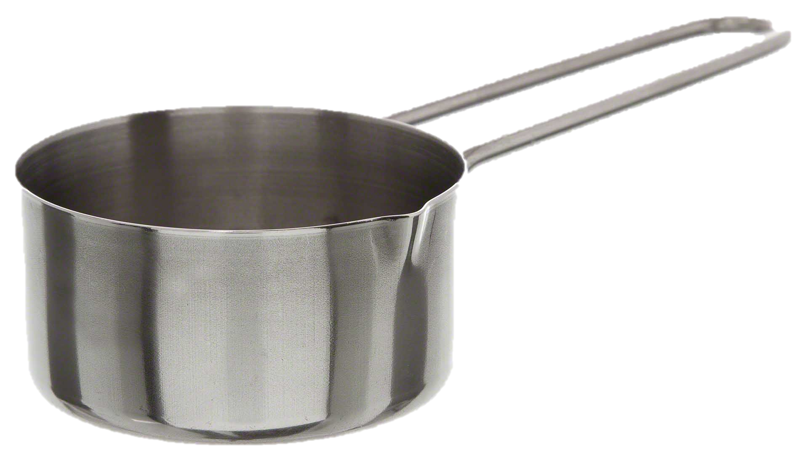
RICE YIELD RATIO
1 cup uncooked rice
=
3 cups cooked rice
1:3 Ratio

Slide 10
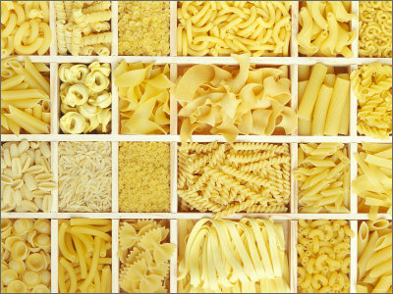
TYPES OF PASTA

Slide 11
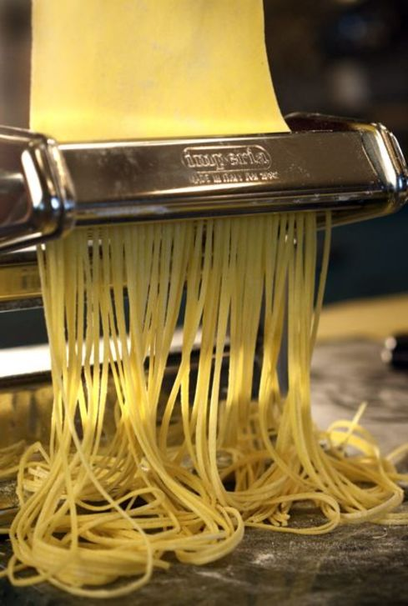
TYPES OF PASTA
Fresh Pasta
Made from scratch from a simple dough
Kneaded then rolled out and cut by hand or with pasta makers/molds

Slide 12
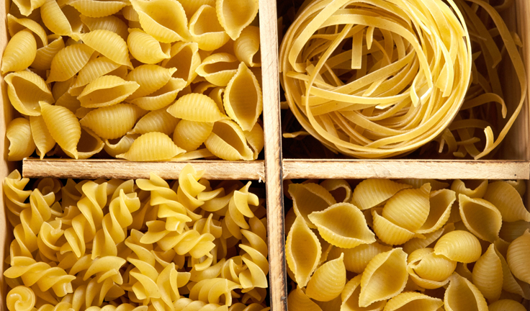
TYPES OF PASTA
Dry Pasta
Dough is pushed through molds and then dried for several days
Can be stored almost indefinitely

Slide 13
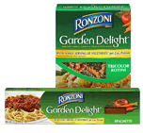
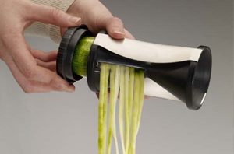
TYPES OF PASTA
Vegetable Pasta
Dry pasta enriched with vegetable products
OR
Fresh vegetables used in place of dough

Slide 14
COOKING PASTA
Use about 1 QUART of water for every 4 ounces of dry pasta.
Bring water to a BOIL.
Add pasta SLOWLY to boiling water so boiling does not stop.
Do NOT COVER the pan.
Stir pasta FREQUENTLY while it’s cooking.
Cook pasta to AL DENTE stage (pasta remains firm to the bite).
Drain pasta in a COLANDER.
To keep pasta WARM, set the colander over a pan of hot water and cover with the colander.

Slide 15
PASTA YIELD RATIO
1 cup uncooked pasta
=
2 cups cooked pasta
1:2 Ratio

