Slide 1
LIPIDS
Fats and Oils

Slide 2
Classification of Nutrients
Carbohydrates
Lipids – 9 calories per gram
Protein
Vitamins
Minerals
Water

Slide 3
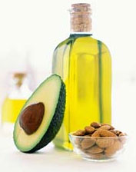
LIPIDS
Most concentrated source of food energy
Provide 9 calories per gram

Slide 4
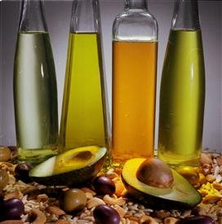
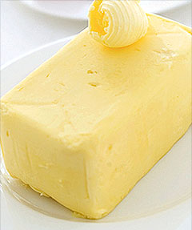
FATS & OILS
Lipids that are liquid at room temperature are called oils.
Examples: vegetable oil, canola oil, olive oil, etc.
Lipids that are firm at room temperature are called solid fats.
Examples: lard, butter, shortening, etc.

Slide 5
FUNCTIONS OF LIPIDS
Carries Vitamins K, A, D, E
Provides a reserve store of energy
Promotes healthy skin
Promotes normal cell growth

Slide 6
FUNCTIONS OF LIPIDS
Acts like a “cushion” to protect organs
Acts like a heat regulator and insulator

Slide 7
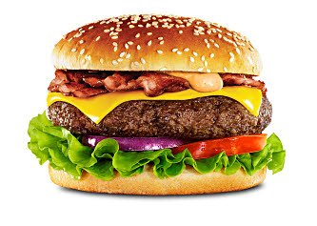
FUNCTIONS OF LIPIDS
Adds flavor to food
Satisfies hunger and helps you feel full longer

Slide 8
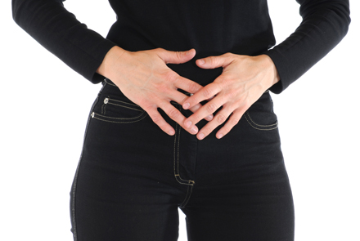
CHOLESTEROL
A fat-like substance needed for essential body processes.
Helps with the digestion of fat and production of Vitamin D.

Slide 9
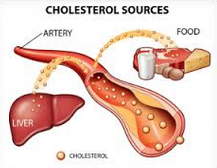
CHOLESTEROL
Adults make all the cholesterol they need, mostly in the liver.
All animals also make cholesterol.

Slide 10
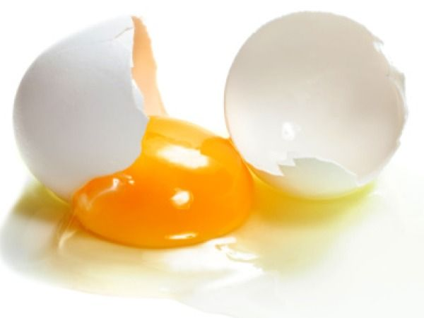
CHOLESTEROL
Eating meat, poultry and fish means you will consume “extra” or unneeded cholesterol.
Foods high in cholesterol:
Egg Yolks
Liver/Organ Meats
Some Shellfish

Slide 11
LDL’s & HDL’s
Cholesterol circulates in the blood stream in chemical “packages” called lipoproteins.
Two Types:
LDL (Low-Density Lipoprotein)
HDL (High-Density Lipoprotein)

Slide 12
LDL’s “Losers”
Takes cholesterol from the liver to wherever it’s needed in the body.
LDL cholesterol is considered bad because if too much is circulating, it builds up in the artery walls.
Increases the risk of heart disease, stroke and obesity.

Slide 13
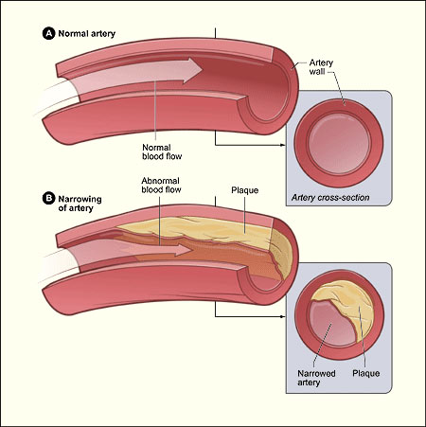
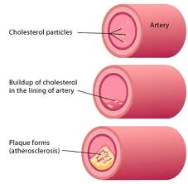

Slide 14
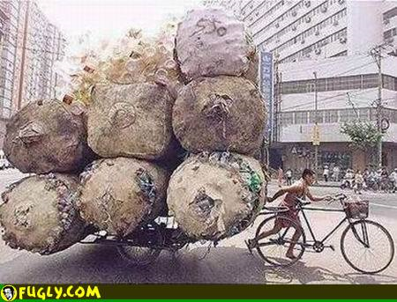
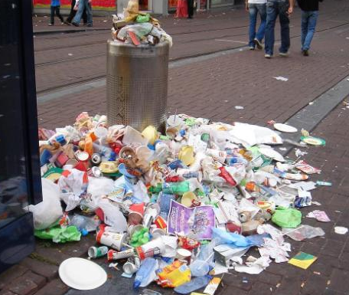
DELIVERY MEN
When LDL’s have too much cholesterol to cart around, it builds up in the arteries and starts to clog them up.

Slide 15
HDL’s “Heroes”
HDL cholesterol is considered good because it picks up excess cholesterol and take it back to the liver keeping it from causing harm.

Slide 16
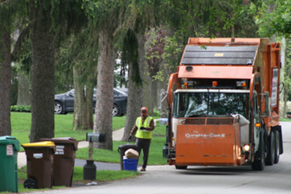
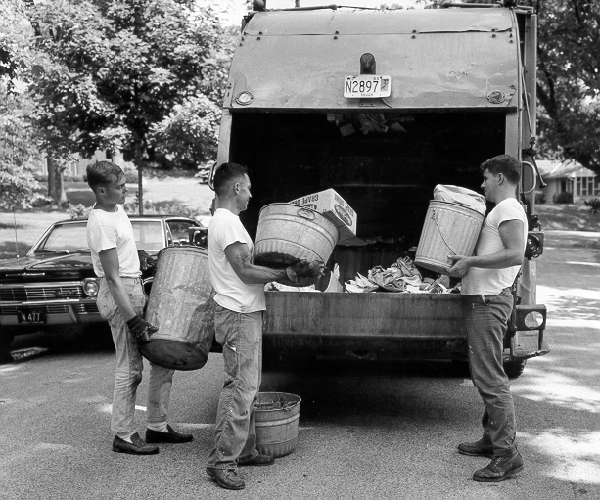
GARBAGE MEN
The HDL’s go around and pick up all the excess cholesterol clogging up the arteries and take it back to the liver.

Slide 17
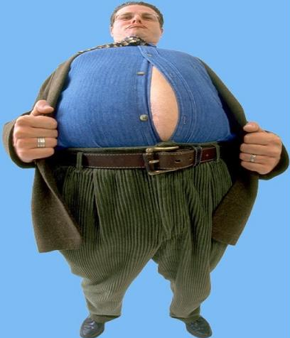
TOO MUCH FAT
High lipid/fat diets are linked to:
Increased Cholesterol
Heart Disease
Obesity
Cardiovascular Related Problems

Slide 18
LOWERING FAT & CHOLESTEROL
Exercise
Replace solid fats with oils
Choose lean cuts of meat
Steam, boil or bake foods instead of cooking them in oil or fat
Season vegetables with herbs and spices rather than with sauces, butter or margarine

Slide 19
LOWERING FAT & CHOLESTEROL
Try lemon juice or oil based salad dressing instead of cream based ones
Switch to low-fat or fat-free milk
Substitute low-fat yogurt in recipes that call for sour cream or mayonnaise
Remove skin from poultry before cooking
Replace egg yolks with egg whites

