Slide 1
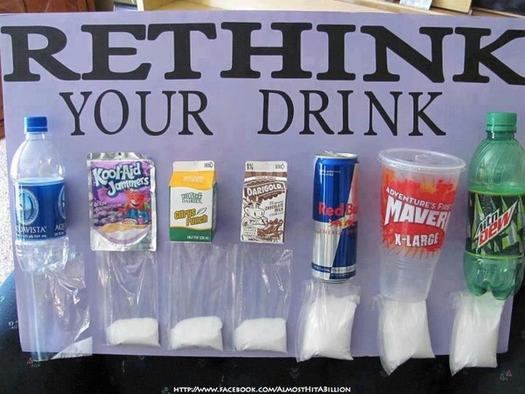
Rethink Your Drink Project Examples

