Slide 1
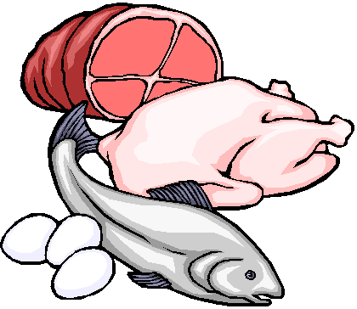
PROTEIN

Slide 2
Food fact
Proteins contain 4 calories per gram.
Protein is a very important nutrient. It makes up most of our body cells, tissues and fluids.

Slide 3
Protein Deficiency -Leads to Kwashiorkor in children Happens mostly in impoverished countries where there is a lack of protein rich foods. -It also can lead to stunted growth.

Slide 4
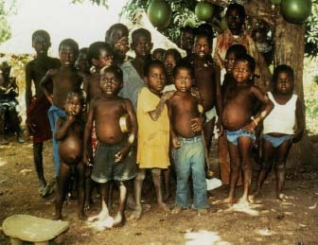
Kwashiorkor

Slide 5
Protein deficiency in adults could lead to: -ANEMIA -Marasmus-the Greek word for “dying away” -Infections

Slide 6
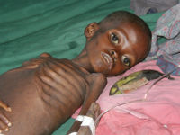
Marasmus Greek for “dying away”

Slide 7
-10-15 % of calories come from protein each day

Slide 8
From the moment of conception, proteins form the building blocks of most body structures. For example, to build a bone or a tooth, cells first lay down a matrix of the protein collagen and then fill it with crystals of calcium, phosphorus, magnesium, fluoride, and other minerals.

Slide 9
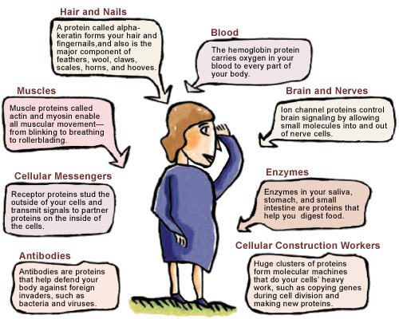
Functions of Proteins

Slide 10
Protein
Proteins provide 4 calories per gram.
The main function of protein is to build and repair body tissues.
If carbohydrates and fat are not available, your body will use protein. Is this a good thing?
You must eat protein daily to replace the wear and tear on the body tissues.
We get most of our protein from the PROTEINS (duh!) food group.

Slide 11
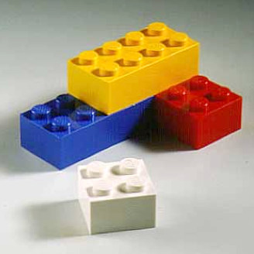
Amino Acids
5. Amino acids are the “building blocks” of protein.
There are 9 essential amino acids.
Essential means that your body MUST have them.

Slide 12
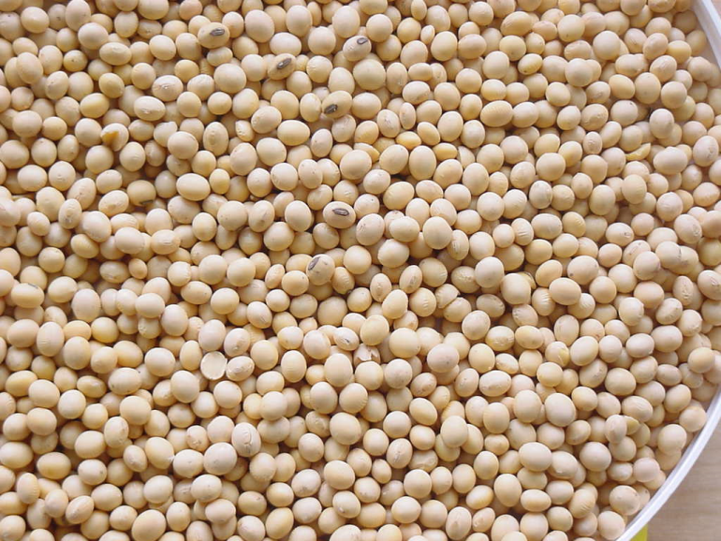
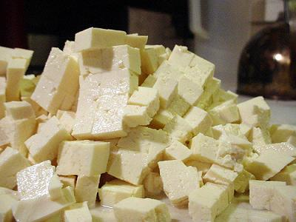
Complete Proteins
8. Complete proteins contain all 9 of the essential amino acids.
Complete proteins come from animal food sources.
Tofu (from soybeans) and Quinoa are the only complete proteins from a plant source.
Notes:
Tofu is a complete protein because of the way it is processed. Soy beans alone are not a complete protein.

Slide 13
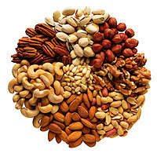
Incomplete Proteins
11. Incomplete proteins do NOT contain all of the essential amino acids.
Incomplete proteins come from plant food sources.
Examples of incomplete proteins could be:
Grains
Beans
Nuts/Seeds
Rice
Wheat

Slide 14
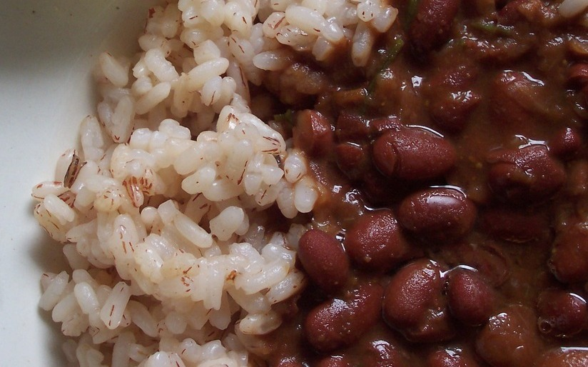
COMPLEMENTARY PROTEINS
14. Incomplete proteins can be combined to create a Complementary protein.
Examples include:
Beans and Rice
Peanut Butter and Whole Wheat Toast
Bean Soup with a Wheat Roll

Slide 15
Protein supplements -Help build muscle (muscle work builds muscle; protein supplements do not) -spare bodies protein while loosing weight -strengthen fingernails

Slide 16
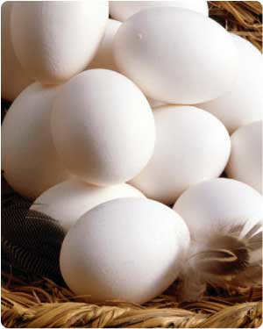
Eggs

Slide 17
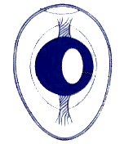
Parts of the Egg
Air Pocket
Albumin (Egg White)
Two parts: thin and thick
Yolk
High in fat and Cholesterol
Chalazae
Keeps the yolk centered
Shell
Protects the egg contents

Slide 18
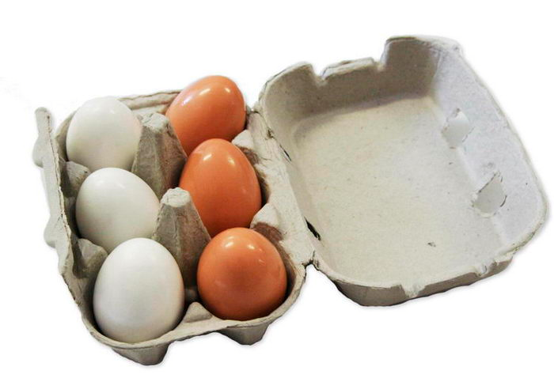
Storing Eggs
Eggs are very porous. They should be stored in their original carton. The cardboard helps block unwanted odors from seeping into the eggs.
Eggs have an expiration date printed on the carton. They usually last several weeks.

Slide 19
Cooking Eggs
Methods of cooking eggs include:
When eggs are cooked, they coagulate. This means that the liquid transforms into a solid.
Hard Cooked
Soft Cooked
Scrambled
Fried
Poached

Slide 20
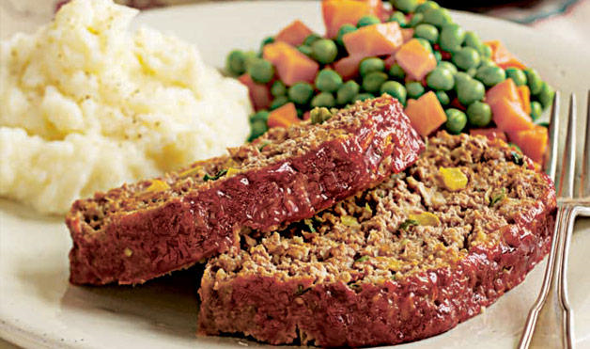
Functions of Eggs
5. Eggs perform different jobs in different foods. These include:
Binder Example: Meat Loaf

Slide 21
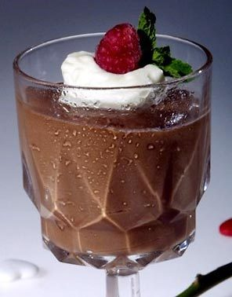
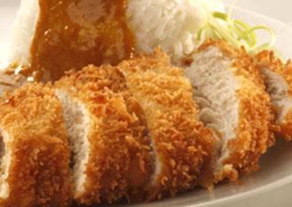
Thickener Example: Pudding
Coating Example: Breaded Chicken

Slide 22
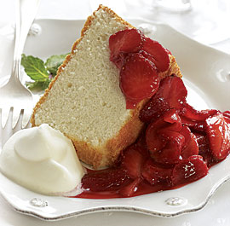
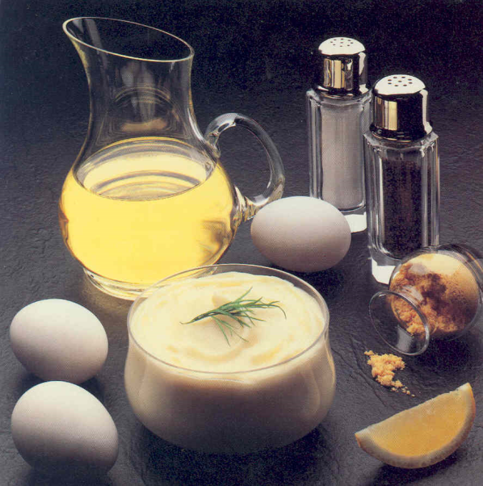
Leavening Agent Example: Angel Food Cake
Emulsifier Example: Mayonnaise
*Emulsifiers make two unmixable substances mix. (Oil and vinegar, grease and dish soap)

Slide 23
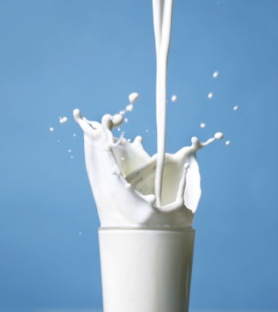
Milk

Slide 24
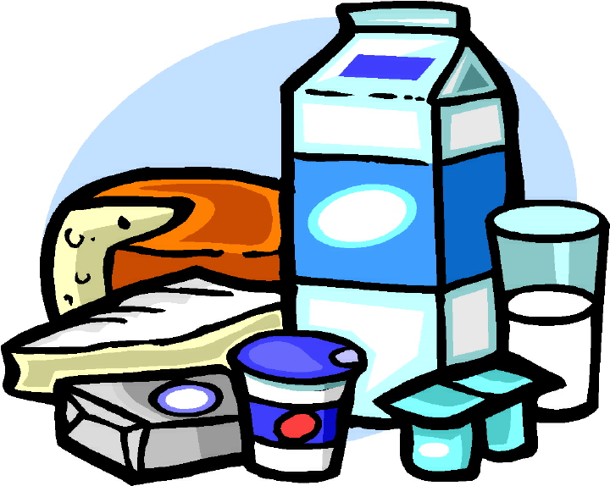
DAIRY
1. Milk and DAIRY products, (yogurt, cheese, etc.) are excellent sources of complete proteins because they come from animal sources.

Slide 25
Nutrients In Milk
2. By law, milk must be fortified with Vitamins A and D.
Fortified means that “extra” has been added to the product.
You can also get Vitamin D from sunlight. That is why it is sometimes called the “Sunshine Vitamin.”
Milk products also provide important minerals like Calcium, Iron and Phosphorus to help build healthy bones and teeth.

Slide 26
Processing Milk
6. Milk goes through several treatments before it is safe to drink. Two of these processes are:
Pasteurization: milk that has been heat treated to remove or kill harmful organisms.
Homogenization: the fat particles in milk have been broken down and evenly distributed so they cannot join together again.

Slide 27
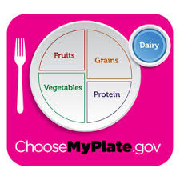
MyPlate & DAIRY
7. MyPlate teaches us to choose LOWFAT dairy.. Lowfat dairy is considered 1% .
8. Lowfat dairy products have the SAME amount of calcium and vitamins/minerals as whole milk products.

Slide 28
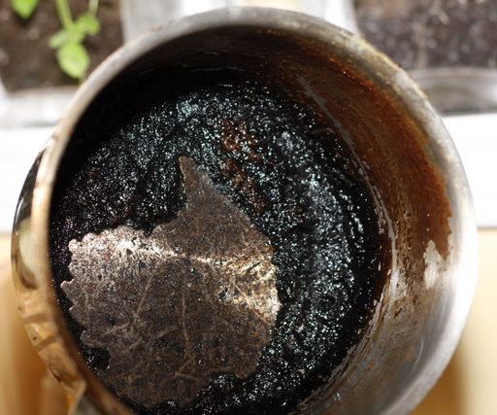
Cooking Milk
9. Milk products scorch easily.
10. Scorching occurs when the proteins in milk are overcooked. They fall and cling to the bottom of the pan. They create a thick, black layer that is difficult to remove.

Slide 29
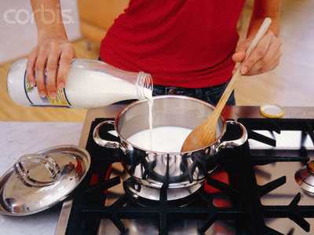
Cooking Milk, cont.
11. To prevent scorching, cook milk on low heat and stir it constantly to prevent the proteins from collecting on the bottom of the pan.
12. Heating milk in the microwave will also prevent scorching.

