Slide 1
Food and Nutrition I
State Test Review
Day 1

Slide 2
Kitchen Equipment
Bread knife
Serrated edge for cutting bread
Colander
Drains liquids; has larger holes than a strainer
Cutting board
Protects counter when cutting and chopping foods
For proper sanitation should be plastic instead of wood
French/chef’s knife
Large triangular blade, wide at handle and narrow at the tip
Used for slicing, cutting, chopping and dicing

Slide 3
Glass baking dish
Reduce temperature in oven 25 degrees F
Ladle
Small bowl at the end of a long handle
Used for dipping hot liquid from a pan
Meat thermometer
Measures internal temperature of meat and poultry
Oven thermometer
Measures internal temperature of ovens
Pancake turner
Used to lift and turn flat foods such as hamburgers and pancakes
Pastry blender
To cut fat into flour

Slide 4
Paring knife
To cut or peel small food items
Refrigerator/freezer thermometer
Used to measure internal temperature of refrigerator/freezer
Rubber scraper
Has a rubber end
Used to scrape out food from bowls, measuring cups, etc.
Slotted spoon
Spoon with holes
Used to take solids out of liquids
Straight edge spatula
Used for leveling off or spreading frosting.

Slide 5
Strainer
Wire mesh that separates liquid from food
Usually has small size holes
Tongs
Used to grip and lift hot foods
Vegetable peeler
A tool used to take off the outer surface of vegetables and fruit
Wire whisk
Used for blending liquids
Wooden Spoon
For cooking on top of the stove.

Slide 6
Microwaves
Microwaves are attracted to what type of food?
Fat
Sugar
Water molecules
Microwaves cause molecules to vibrate. Vibration creates friction, which produces the heat that cooks the food.
Microwave safe containers include:
Microwave safe plastic, paper, glass
NO METAL
Define Standing Time:
the time food continues to cook after the microwave has stopped
What increases cooking and standing time?
Quantity and volume

Slide 7
For best results when cooking in a microwave remember to:
A. Stir and rotate food for even cooking
B. Covering foods holds moisture in and helps foods to cook more evenly and prevent splattering. Cover with plastic wrap, paper towel, wax paper or lid.
C. Cook in shallow round/ring container for even cooking
To prevent burns from microwaves
A. Lift cover or plastic away from you
B. Piercing items can prevent exploding or
splattering
C. Use hot pads/pot holders
Microwave cooking does not brown foods or give a crisp crust.

Slide 8
Safety Guidelines and Safe Work Habits
Electrical appliances:
Use dry hands, stand on dry floor, keep away from water
Plug cord into electrical appliance before plugging into power source.
Knives:
Dull knives are more dangerous and less efficient
Grease Fires:
Cover with lid, baking soda or salt, or a fire extinguisher
Avoid flour or sugar or water or cornstarch
Poisonings and contamination:
Do not mix chlorine with ammonia products-creates toxic, deadly gas/fume
Store cleaning supplies away from foods and in the original container
Burns:
Lift lids on hot foods away from you
Saucepan handles point away from the front of the range
Keep clothing away from direct heat
Use hot pads or oven mitts for handling hot baking pans.
Falls:
Clean up spills immediately to avoid falls
Use a step stool to reach items in high cupboards
Store heavy items on lower shelves.

Slide 9
First Aid
Cuts and Burns
1. Severely bleeding – apply direct pressure over wound
2. first-degree burn – place under cold,
running water
Electrical Shock
1. Avoid any water and electrical contact,
2.Use dry hands to disconnect power source
3.Disconnect power source before approaching
injured person

Slide 10
Sanitation Standards
Hand Washing:
Wash with soap & hot water 20 seconds minimum
Wash after sneezing, using the restroom, coughing or touching the face, changing diapers, and touching raw meat
Wear gloves when cut on hand or open sores are present
Wear gloves when you aren’t going to cook food after touching it.
Work Surfaces:
Keep all work surfaces clean.
Disinfect work surfaces to prevent cross-contamination.
Clothing
Change dirty aprons often-carries bacteria
Appropriate clothing includes clean clothing and apron. Cover or tie back hair with appropriate hair restraints before working with food.

Slide 11
Sanitation Standards cont.
Tasting Foods
Use clean spoon and use only once
Pests and insects
Avoid crumbs or spills
Keep staples in airtight container
Dispose of garbage properly
Dish Washing Order
Rinse and scrape first
Glassware
Silverware
Dinnerware
Wash pots and pans last

Slide 12


Slide 13
Cleaning chemicals
Always use cleaners and sanitizers according to manufacturers’ directions.
Clean the surface.
Rinse the surface.
Sanitize the surface,
then allow the surface to air dry.

Slide 14
Procedure for storing dishes & utensils
Utensils and equipment should be stored in ways that prevent contamination.
Store utensils and equipment that touches food at least six inches off the floor.
Store glasses and cups upside down on a clean, sanitized surface, and store utensils with handles up.

Slide 15
Handling Trash & Garbage
Garbage can contaminate food and equipment if it isn’t handled safely. Remove garbage from prep areas as quickly as possible.
Do not clean garbage containers near food prep or food storage areas.
Clean the inside and outside of garbage cans often.
Close the lids on outdoor containers.

Slide 16
Food-Borne Illness:
Result from eating contaminated foods containing poisonous toxins
Fever, headache and digestive troubles are symptoms of food-borne illness.
General conditions for bacteria growth:
Warmth, food, moisture
Food with food-borne illness:
Not always off-odor or off-flavor
Often look and smell normal
When in doubt, Throw it out!

Slide 17
Microbes
A microbe is anything too small to be visible to the naked eye.
Three types of microbes found in food are bacteria, viruses and fungi (yeast and mold).
Foods like milk/dairy, meat, fish, eggs, poultry, shellfish/crustaceans, baked potatoes, tofu, sprouts, cooked rice, beans and vegetables, sliced melons or tomatoes and lettuce are susceptible to bacterial growth.

Slide 18
Types
Botulism:
Associated with improperly canned foods, specifically low-acid foods.
E-coli:
Bacteria spread by air from soil, ground and fecal matter to food sources. Usually found in undercooked ground beef, unpasteurized milk, fruit juices, fresh fruits and vegetables. E-coli will be killed by cooking or heating to a high enough temperature.
Hepatitis A:
Virus from fecal matter transferred by human contact, usually through improper hand washing.
Salmonella:
Bacteria often found in raw poultry and eggs.
Staphylococci:
Bacteria spread through human mucous contact to food sources.

Slide 19
Types
Norovirus
Associated with raw produce, contaminated water, and foods that are not reheated after contact with an infected handler.
Clostridium Perfringens
Associated with meats, poultry, gravy, dried or precooked foods, time/temperature abused foods.
Campylobacter SPP
Usually found in raw and undercooked poultry, unpasteurized milk, and contaminated water.

Slide 20
Groups most vulnerable
Population groups most vulnerable to food borne illness include:
Young children
Older adults,
Pregnant women,
People with Immune systems weakened by disease or medical treatment-
"YOPI's" [Young, Old, Pregnant, and Immune-Compromised].

Slide 21
Prevention
Preparation:
Proper hand washing
Washing cutting boards with soap and hot water
Storage
Store raw meat, poultry in refrigerator so they do not drip or touch other foods
Never place cooked food on plates that held raw meat, poultry or seafood.
Throw away any food with an off odor and do not taste or use.
Do not buy or use bulging cans.
Frequently clean and sanitize work surfaces.
Always wash hands, cutting boards, etc. with hot soapy water after they come in contact with raw meat, poultry or seafood.

Slide 22
Prevent Food-borne Illness contamination
Wash hands before putting on gloves and when changing to a new pair of gloves.
Only use single-use gloves when handling food. Gloves should fit your hand.
Change gloves when they get dirty or torn, before beginning a new task, or after handling raw meat, seafood, and poultry.
Wear bandages over wounds and use a water-proof finger-cover over bandages and under gloves.

Slide 23
Temperature Zones
Danger zone:
Between 41-135° F.
Foods should not be left in danger zone for more than 2 hours
Foods held in the danger zone for longer than 4 hours should be thrown out. In the industry, restaurants get 4 hours since food is delivered in a refrigerated truck and moved directly to the refrigerator in the restaurant. Home use it is 2 hours.
Cooking:
Cook to proper internal temperatures (use meat thermometer)
Ground meats (pork, beef, veal, lamb) to 155°F
All poultry (whole or ground): to 165°F
Seafood, beef, veal, lamb, pork: at least 145°F
Egg yolks and whites cooked until firm
Reheating foods:
Bring sauces, soups, to a boil when reheating; heat other leftovers to 165° F

Slide 24
Cold storage of foods
40° F or below
Cooling foods:
Place food in shallow dishes and refrigerate immediately
Keep freezer temperature at 0 degrees Fahrenheit to keep foods frozen solid.
Keep hot foods hot and cold foods cold.

Slide 25
Thawing Foods
In the refrigerator for 2-3 days. This is the safest method.
In a sink of cold, running water. Or a sink full of cold water, changing the water every 30 minutes. Use food immediately.
In the microwave, if using the food immediately.
Never defrost frozen foods at room temperature.

Slide 26
Temperature Control
Foods that require time or temperature controls for safety are (TCS) foods (temperature controls for safety)
Any type of food can be contaminated, but some types allow more microbe/pathogen growth.
The best way to control pathogen growth in these items is to control time and temperature.
Foods like milk/dairy, meat, fish, eggs, poultry, shellfish/crustaceans, baked potatoes, tofu, sprouts, cooked rice, beans and vegetables, sliced melons or tomatoes and lettuce are susceptible to bacterial growth.

Slide 27
ABBREVIATIONS
Tablespoon = T, Tbs., Tbsp.
Teaspoon = t. or tsp
Gallons = gal.
Pound = lb. or #
Cup = c.
Quart = qt.
Ounce = oz.
Pint = pt.
Temperature = temp.
Minute = min.
Calorie = cal.
Hour = hr.

Slide 28
EQUIVALENTS
3t = 1 T
4T = ¼ cup
2 c = 1 pt
4 qt = 1 gal
16 c = 1 gal
1/8 c = 2 T
4 c = 1 qt
2 pt = 1 qt
1/3 c = 5 1/3 T
½ c = 8 T
1 c = 16 T
¾ c = 12 T
60 min = 1 hr
8 fl oz = 1 c
½ c = 1 cube/stick butter
16 oz = 1 lb

Slide 29
Measuring
Use dry measuring cups for dry ingredients and level with a straight edge spatula.
Use liquid measuring cups for liquid ingredients. Measure at eye level on a flat, level surface.
Brown sugar is packed and leveled in dry measuring cups.
Shortening is pressed into dry measuring cups and leveled; or use water displacement method.
Use most effective tools for measuring. For example: use ¼ cup rather than 4 Tbsp.
Use measuring spoons for ingredients less than ¼ cup.
Do not measure directly over the mixing bowl.

Slide 30
DOUBLING AND CUTTING RECIPES
Cooking temperature remains the same
The amount of ingredients changes
Length of cooking time changes
Size of pan will be affected

Slide 31
Double and Halving
Half 1 qt = 2 cups
Half 2/3 c = 1/3 cup
Half 1 1/3 c = 2/3 cup
Half 1 T = 1 ½ tsp
Double ¼ c = ½ cup
Double ¾c = 1 ½ cups
Double 2 T = ¼ cup
Double 1/3 c = 2/3 cup

Slide 32
Food Preparation Terms:
Chop: Cut into small pieces
Cream: to work sugar and fat together until the mixture is soft and fluffy
Cut in: to cut fat into flour with a pastry blender or two knives
Dice: to cut into very small cubes
Dredge: to coat food heavily with flour, breadcrumbs or cornmeal
Flour: to sprinkle or coat with a powdered substance, often with crumbs or seasonings
Fold in: to mix ingredients by gently turning one part over another
Grate: to finely divide food in various sizes by rubbing it on surface with sharp projections

Slide 33
Knead: to work dough to further mix the ingredients and develop the gluten
Mince: to cut or chop food as finely as possible
Peel: to remove or strip off the skin or rind of some fruits and vegetables
Sauté: to brown or cook foods with a small amount of fat using low to medium heat
Simmer: to cook just below the boiling point
Steam: to cook by the vapor produced when water is heated to the boiling point
Whip: to beat rapidly to introduce air bubbles into food

Slide 34
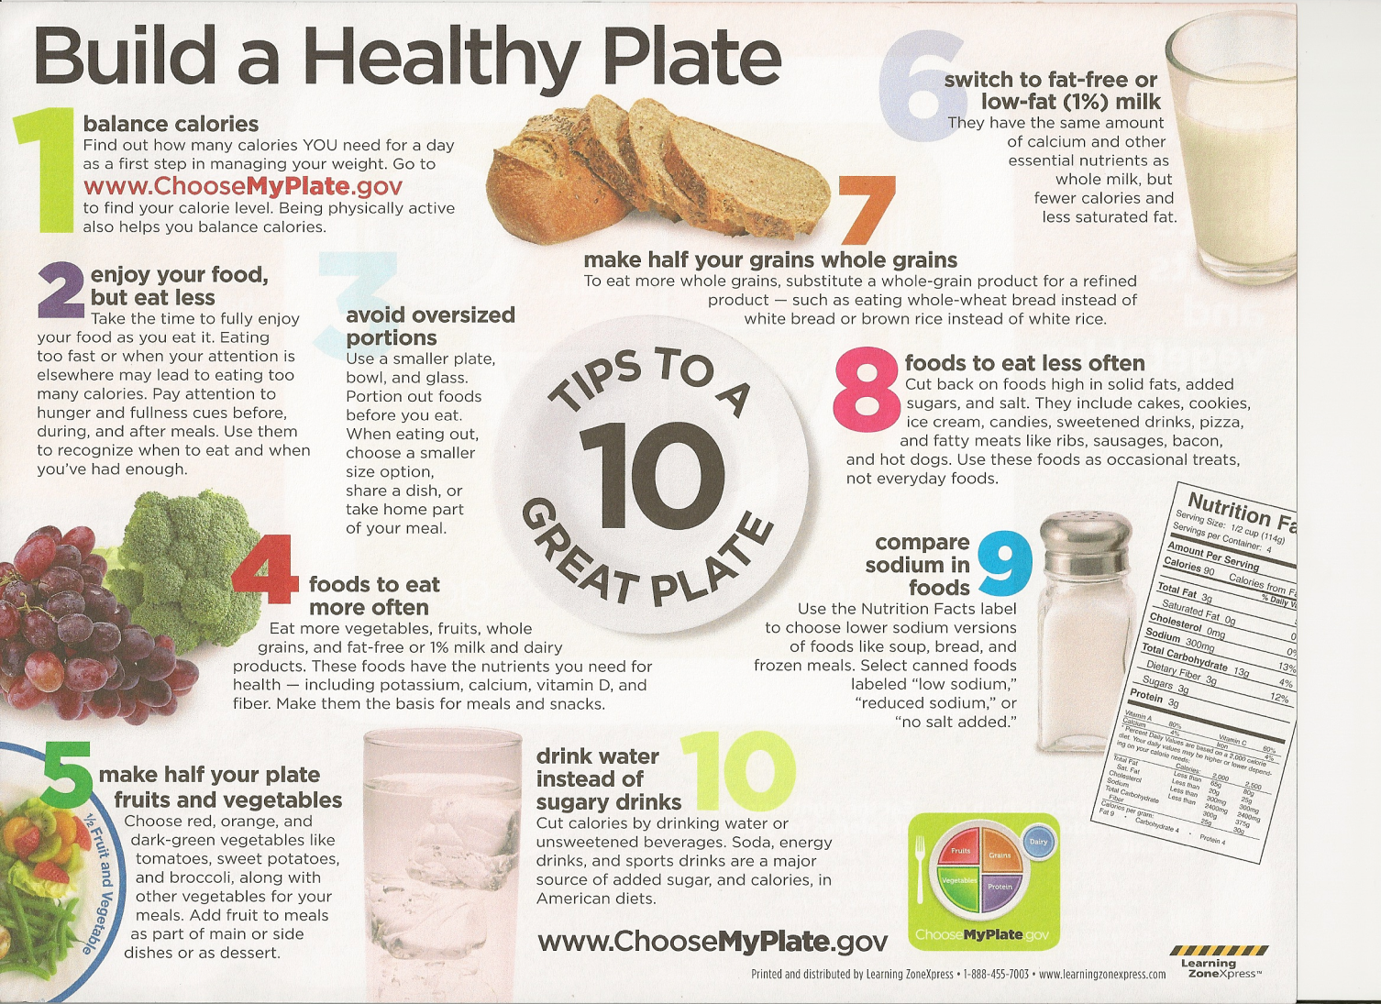

Slide 35
Other tips from ChooseMyPlate
11. Vary your protein food choices
It is recommended we eat at least 8 oz of seafood per week.
12. Eat the right amount of calories for you
13. Be physically active your way

Slide 36
6 DIETARY GUIDELINES
Eat nutrient dense foods. - Provides vitamins, minerals and other beneficial substances with relatively few calories.
Balance calories to manage weight.
Monitor food and beverage intake, physical activity, and body weight.
Reduce portion sizes.
When eating out, make better choices.
Limit screen time.
Reduce sodium, fats and added sugars, refined grains and alcohol.

Slide 37
Increase vegetables, fruits, whole grains, milk, seafood (8 oz. of seafood per week) and use oils in place of solid fats.
Choose seafood products in place of some meat/poultry. (At least 8 oz. per week for teens/adults.)
Build healthy eating patterns that meet nutritional needs over time at an appropriate calorie level.
Include physical exercise as part of healthy eating patterns. (Children and teens should be physically active for at least 60 minutes every day.)
Average American diet has more fat, sodium, sugar and calories than recommended.
Average American diets are lower in fiber and whole grains than recommended.
Salt and sodium are usually added to processed foods and beverages and diet drinks.
High consumption of salt and sodium are contributing factors to high blood pressure.

Slide 38
MyPlate

Slide 39
Grains Group
Choose 100% whole grain cereals, breads, crackers, rice and pasta.
Check the ingredients list on food packages to find whole grain foods.
Make at least half of your grains whole grains.

Slide 40
Protein Group
Choose a variety of foods including seafood, beans and peas, nuts, lean meats, poultry and eggs.
Keep meat and poultry portions small and lean.
Try grilling, broiling, poaching or roasting. These methods do not add extra fat.

Slide 41
Vegetables Group
Chose fresh, frozen, canned, or dried fruits and vegetables.
Eat more red, orange, and dark green vegetables, such as tomatoes, sweet potatoes, and broccoli in main and side dishes.

Slide 42
Fruit Group
Use fruit as snacks, salads or desserts.
Choose whole or cut-up fruits more often than fruit juice.
Make half your plate fruits and vegetables.

Slide 43
Dairy Group
Low-fat or fat-free dairy products have the same amount of calcium and other essential nutrients as whole milk, but less fat and calories.
Switch to low-fat or fat-free dairy products. Get your calcium rich foods.

Slide 44
All Groups are Important!
All food groups are important to good health.
Each food group provides some, but not all of the nutrients you need.
No one single food or food group can provide all nutrients.
Eating a variety ensures you get all nutrients

Slide 45
Healthy Eating Patterns
Reading and understanding food labels
Portion control
Functions and caloric value of the 6 nutrients
People have different caloric needs depending on age, gender and activity level.

Slide 46
Nutrient Carbohydrates
Primary function is to provide energy
Carbohydrates have 4 calories per gram
Complex carbohydrates
Known as starches
Whole grains, cereal products, dried beans, rice, vegetables, pasta
Fiber is a form of a complex carbohydrate.
Simple carbohydrates
Known as sugars, fruit
Carbohydrates include: sucrose (table sugar), fructose (fruit sugar), lactose (milk sugar), maltose (malt sugar) and glucose (blood sugar).

Slide 47

Whole Grain
Endosperm: starch, protein
Germ: unsaturated fatty acids, “B” Vitamins, Vitamin E, iron, zinc, other trace minerals
Bran: fiber, vitamins, minerals

Slide 48
Fiber
20-35 grams daily (National Cancer Institute recommends)
Roughage
Attracts water to our intestines, and moves food through the intestines faster
Keeps bowel movements soft, reduces constipation
Cellulose = nondigestible fiber
Food high in fiber: fruits, vegetables (especially skins/peels), whole grains, legumes, bran cereal, dry beans, split peas, lentils.
Reduces risk of diverticulosis, colon & rectal cancer
To add fiber to a recipe add: bananas, berries, replace flour with part whole wheat flour, wheat germ

Slide 49
Types of Rice
Types of rice include: brown, instant, long grain and short grain.
Brown rice is the whole grain form of rice.
Instant rice is precooked and then dehydrated.
Long grain rice stays dry and fluffy.
Short grain rice sticks together and is also known as “sticky rice”.

Slide 50
Rice Cooking Method
Bring water to a boil.
Add rice, cover the pan and reduce heat to a simmer.
Do not remove the lid while rice is cooking.
One cup of uncooked rice makes three cups of cooked rice. (Ratio is 1:3).

Slide 51
Pasta
Pasta dishes are usually low cost entrees.
Store dry pasta in a tightly covered container at room temperature. Fresh or cooked pasta should be stored in a closed container in the refrigerator.
Pasta Cooking Method:
Bring water to a boil.
Slowly add pasta so the boiling does not stop.
Cook uncovered until pasta is al dente (firm to the tooth), stirring occasionally.
One cup of uncooked pasta makes two cups of cooked pasta. (Ratio is 1:2).Pasta test for doneness – al dente: meaning firm to the tooth

Slide 52
Quick Breads
Non-yeast, leavened flour based products
Quick and easy to prepare
Under-mixing cause quick breads to be crumbly, dry and have very few tunnels.
Over-mixing causes tough products and tunnels
Function of ingredients:
Flour: main ingredients, gives structure
Liquid: provides moisture
Fat: provides tenderness, richness, and some flavor
Salt and sugar: taste/flavoring (sugar browning too)
Leavening agents: make the bread rise. Ex -baking powder, eggs, baking soda, and steam
Examples of quick breads:
Muffins - Pancakes -Waffles
Biscuits -Cornbread -Popover

Slide 53
Water – most essential nutrient
Carries water soluble vitamins C and B through the body
Carries waste through the body
Regulates body temperature
Prevents dehydration
Body cannot survive without water
Dehydration = lack of water
Prevent dehydration: drink water and other fluids frequently – don’t wait to be thirsty
8 – 8oz cups (64 oz) of water recommended daily
Urine should be pale yellow (lemonade)
Dark urine is indication of dehydration

Slide 54
Exercise Hydration
For short duration exercise (<60 minutes) water is a good choice to drink before, during and after exercise.
For moderate to high intensity activities lasting longer than 60 minutes sports drinks will help replace carbohydrate loss and electrolyte balance.
Drink according to thirst during the day and include fluids with meals.
Drink 8-20 oz of water an hour before exercise.
Continue drinking during exercise, up to 16-24 oz of fluid per hour (4-6 oz every 15 minutes).

Slide 55
Vitamins
Vitamin C: Helps to form collagen which holds the cells together and aids in healing. Prevents scurvy.
Folate (folacin/folic acid) is one of the B Vitamins. Folate helps prevent neural tube birth disorders, such as spina bifida. Neural tube damage occurs during the first weeks of pregnancy before a woman may realize she is pregnant. Meeting the folate requirement before becoming pregnant is essential for prevention.
Vitamin A: Enhances hair, skin and helps prevent night blindness. Sources: Red, orange and dark green vegetables.
Vitamin D: Manufactured by the body with exposure to sunlight. Works with the body to build and maintain healthy bones and teeth; usually added to milk products. It is also called the “Sunshine Vitamin”.
Vitamin E: Protects membranes of white and red blood cells.
Vitamin K: Helps blood to clot.
Fat Soluble – A,D,E,K
Water Soluble – B, C

Slide 56
Minerals
Most minerals help build strong bones and teeth. Others are used to make substances that the body needs.
Minerals are usually needed in tiny amounts, but are critical to health.
Macro minerals are needed in great quantities in the body.
Calcium deficiency causes osteoporosis which causes bones to gradually lose their minerals. This causes bones to become weak and frail. Good sources of calcium are found in dairy products.
Trace/micro minerals are needed in smaller quantities, but are just as essential as macro minerals. Iron deficiency causes anemia, or low red blood cell formation. Animal products provide excellent sources of iron.

Slide 57
Electrolytes
Electrolytes help maintain the fluid balance in the body, help maintain the heartbeat and help muscle and nerve action.
Electrolytes easily become imbalanced in cases of dehydration, illness and diarrhea.
Electrolytes like potassium can be found in bananas and potatoes.
For sodium there is so much in the food supply that it’s more of a concern to have too much.
Label reading is a good way to identify which foods have high amounts.
If an athlete is trying to replace sodium, then some saltier foods are ok and also foods like bread and milk contain some sodium.

Slide 58
Nutrients provided by fruits & vegetables
Vitamins, Minerals, Fiber, Water
Vegetables provide the following nutrients: Vitamin A, Vitamin C, potassium, folic acid, Vitamin D, calcium, magnesium, fiber and water
Vegetables contain no cholesterol and are low in calories, fat and sodium.
Vary your vegetables.

Slide 59
Preserving nutrients
Air, heat and water destroy nutrients in vegetables.
Wash vegetables to remove pesticides and dirt that might remain on the skin.
Cooking Methods:
Eating them raw
Cook in larger rather than smaller pieces when possible.
Microwave
Use small amount of water and cook only until fork tender.
Steam
Save the cooking liquid to use in soups or gravies for added
Bake/Roast nutrients.
Stir Fry
Simmer
Sauté

Slide 60
Selection
Select fresh fruits and vegetables that are firm, free from decay, crisp, smooth, dense (heavy for size), free from bruises and have good color.
Seasonal fruits and vegetables are lower in cost, plentiful and have better quality.
Buy only what you will be able to store and use. They will last about 1 week in the refrigerator.
Fruits ripen and spoil faster at room temperature.
Choose whole or cut-up fruits more often than fruit juice.

Slide 61
Farm to Table
Food doesn’t start at the supermarket or restaurant.
The five farm to table steps include:
Farm (use of good agricultural practices)
Processing (monitor at critical control points)
Transportation (use clean vehicles and maintain the cold chain)
Retail (follow the food code guidelines)
Table (always follow the four C’s of safety- clean, cook, control cross contamination, chill).

Slide 62
Oxidation
When most fresh fruit is cut, the surface will turn brown. This is called oxidation and is caused by an enzyme in the fruit.
Prevent oxidation of fresh fruits by dipping or covering fruit with liquid containing ascorbic acid. Another way to prevent oxidation is to wait to cut the fruit until ready to eat.

Slide 63
Protein
The primary function of protein is to build and repair body tissues.
Protein provides 4 calories per gram.
Keep meat and poultry portions small and lean.
Include at least 8 oz. of cooked seafood per week.
Amino acids are the building blocks of protein.
There are 22 amino acids. 9 are considered essential. The body cannot manufacture essential amino acids so they must be obtained from food.
Complete proteins contain all 9 of the essential amino acids in the right ratio for our body to use.
Incomplete proteins contain some, but not all, of the amino acids.

Slide 64
Complete, Incomplete, Complimentary
Animal foods source such as meat, chicken, fish and milk products contain complete protein.
Soy foods such as tofu, tempeh, soy nuts and edamame also contain complete protein.
Quinoa is considered a complete protein, but is not as high in protein as animal sources or soy, so is not included as a protein food in MyPlate.
Incomplete proteins are from other plant sources: grains, dried beans, nuts and seeds.
Incomplete proteins can be combined to create a complementary protein. For example: beans with rice; peanut butter with whole wheat bread.
Complementary proteins are a grain combined with any nut, seed or legume.

Slide 65
Function of Eggs
Binder (Meat loaf)
Thickener (Pudding)
Coating (Breading on Chicken)
Leavening agent (Angel Food Cake)
Emulsifier (Mayonnaise)

Slide 66
Eggs
Methods of cooking eggs: hard cooked, soft cooked, scrambled, fried, and poached.
Eggs are toughened by heat or by long exposure to heat.
Store eggs in the original container in the refrigerator. When properly stored in the refrigerator, eggs may be stored for several weeks.

Slide 67
Milk
To prevent scorching heat at low temperature and constant stirring; or heat in the microwave
Pasteurized milk = heat treated to remove harmful organisms
Homogenized milk = fat particles mechanically broken down and evenly distributed so the fat will not separate out
Procedure for white sauce: moderate temperature and stirring constantly
Milk should stay fresh 5-7 days after date stamped on the carton.
3 cups from the milk group is recommended for teens and adults.
Eat calcium rich foods in the Dairy Group. Switch to fat free or low fat milk.
Milk is fortified with vitamins A and D.

Slide 68
Most of the nutritional benefits of drinking raw milk are available from pasteurized milk without the risk of disease that comes with drinking raw milk.
Raw milk made into other products like soft cheese, ice cream, and yogurt, can still cause dangerous illnesses. When consuming these products, make sure they are made from pasteurized milk. Raw, unpasteurized milk can carry dangerous bacteria such as Salmonella, E. coli, Campylobacter, and Listeria, which are responsible for causing numerous foodborne illnesses.
Milk replacements such as almond milk, soy milk, or rice milk are comparable with milk in regards to nutritional value and are a viable substitute for people with special dietary needs.
Reduce fat in recipes by using a lower fat content milk. For example: substitute yogurt for mayonnaise or sour cream, substitute fat-free (skim) or low-fat (1%) milk for whole milk.

Slide 69
Fats
Functions:
Carrier for fat soluble vitamins (ADEK)
Adds flavor to foods
Supplies energy
Protects internal organs from shock and injury.
Insulates the body from shock and temperature changes.
Promotes healthy skin.
Satisfies hunger and helps you feel full longer.
Fats provide 9 calories per gram. It is the most concentrated source of energy.
Choose lean meats and lower fat dairy products.
Replace solid fats with oils.
Oils are not a food group, but they help deliver essential nutrients.

Slide 70
Cholesterol
Cholesterol is essential for many body processes. Cholesterol produces hormones and bile acids. It is found in animal tissues, but is never present in plants.
The body has High Density Lipoprotein-(HDL) cholesterol and Low Density Lipoprotein-(LDL).
HDL cholesterol is considered “good/healthy” cholesterol because it transports excess cholesterol found in the blood stream back to the liver. LDL’s take cholesterol from the liver to wherever it is needed in the body. LDL cholesterol is considered “bad/loser” cholesterol because if too much LDL cholesterol is circulating in the blood stream, it can build up in the arties and increase the chance of heart disease or stroke.
High levels of LDL cholesterol is one factor related to heart disease and obesity.

Slide 71
Saturated, mono-unsaturated, poly-unsaturated
Most solid fats are high in saturated fats and are solid at room temperature.
Saturated Fats:
Raise the LDL and HDL levels of cholesterol in the blood.
Examples of saturated fats include: meat, poultry skin, whole milk, tropical oils, butter, shortening and lard.
Polyunsaturated Fats:
Lower both the LDL and HDL cholesterol levels in the blood.
Examples of polyunsaturated fats include: corn oil, soybean oil and safflower oil.
Monounsaturated Fats:
Lower LDL and raise HDL levels of cholesterol in the blood.
Examples of monounsaturated fats include: olive oil, olives, avocados, peanuts and canola oil.

Slide 72
Calories per gram
9 calories per gram of fat
4 calories per gram of protein
4 calories per gram of carbohydrate
[((gram of fat) x 9)/(total calories)] x 100
Gets percentage of calories from fat.
[((gram of Carbs) x 4)/(total calories)] x 100
Gets percentage of calories from carbs.
[((gram of protein) x 4)/(total calories)] x 100
Gets percentage of calories from protein.

Slide 73
Know This
Ammonia and Chlorine make a toxic noxious gas that can be deadly.
20-35 Grams of Fiber needed daily
Water Soluble Vitamins – B and C (B Vitamins include Riboflavin, Cobalamin, Thiamin, Niacin, Pyrodoxine, Folic Acid)
Fat Soluble Vitamins – ADEK
Dark Green, Red, and Orange Vegetables need to be eaten more
Store cleaning supplies away from food.
50-60% Carbohydrates, 15-20% protein, 25-35% fat
NEVER store cleaning chemicals near food. Always store cleaning chemicals away from food!

Slide 74
Functions of Nutrients
Water – Hydrates (prevents dehydration), carries water soluble (B&C) vitamins, Carries waste through the body, Regulates body temperature. (most important nutrient)
Fats - Carrier for vitamins A, D, E, and K, Reserve supply of energy, Adds flavor in food, Satisfies hunger, Protects internal organs from shock and injury, Insulates the body from shock and temperature changes, Promotes healthy skin, Satisfies hunger and helps you feel full longer.
Protein – Builds and repairs body tissues

Slide 75
Functions of Nutrients cont.
Minerals – builds and strengthens bones and teeth
Vitamins –body processes that are regulated by vitamins: nerves, muscles and skin. Folate (folacin/folic acid) prevents neural tube birth disorders.
Carbohydrates – main energy source, fiber

Slide 76
What to do
for a minor burn?
Place burn under cool
water for 10-15 min.
Cool water reduces skin damage and minimizes pain.
Never use butter, lotions, or ointments
This seals in heat and hurts more!
Don’t break blisters. This can cause
Infection.

Slide 77
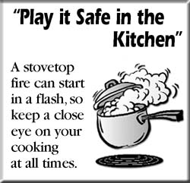
How to Prevent
Kitchen Fires
Never leave cooking unattended!
Stay alert!
Turn off stove when finished
Keep dish towels away from stove tops

Slide 78


Prevent Fires
in the Kitchen
5. Keep a fire extinguisher in the kitchen
And know how to use it.
Don’t overload electrical
outlets

Slide 79
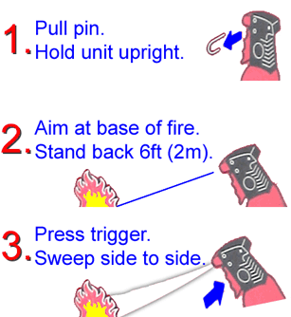
Do You Know
How to Use a
Fire Extinguisher?
PASS
1. Pull the Pin
2. Aim at the base of the fire
3. Squeeze
Handle
4. Sweep nozzle back and forth

Slide 80
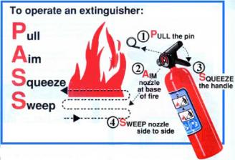
Remember:

Slide 81


Knife Safety
Do
Don't
Use a sharp knife
Cut away from you
Store knives separately
Use a PLASTIC cutting board (Non-Porous)
Try to catch a falling knife
Put knives in bottom of
sink of soapy water
Wash knives in dishwasher

Slide 82

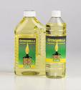


Never Mix
Cleaning
Chemicals!
If you mix Ammonia (a smelly cleaning product)
And Chlorine
(Clorox) you get a dangerous surprise!
Ammonia + Chlorine = Poisonous Gas
+
=
Chlorine gas has been used during wars as a chemical Weapon!
Notes:
Chlorine Gas C12 is very dangerous! If you remember it was used as a chemical weapon during WWI and by the Nazis during WW II.

Slide 83
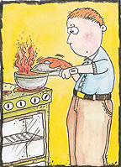
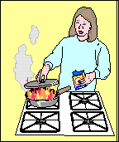
What Should You Do If You Have a Grease Fire?
Turn off Stove
Use an oven mitt
Put a lid on the pan
Smoothers fire!
Turn off stove
Use an oven mitt
Sprinkle with
Baking Soda!

Slide 84
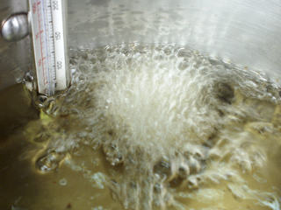
Never, Never, Never!
Never put these on Grease Fire:
Water
Flour
Sugar
Never Put Water
On a Grease Fire!
Hands,
Arms and
Faces get
Burned! Grease
Gets on the
Stove and
Starts a fire!
The
Grease Will
Bubble Violently and
Explode!

Slide 85
Food and Nutrition I
State Test Review

