Slide 1
Utah Health Department
Additional items to teach with ServSafe Food Handler for students seeking Food Hander Permit
Notes:
Transparent light effect
(Basic)
To reproduce one of the shapes on this slide, do the following:
On the Home tab, in the Slides group, click Layout and then click Blank.
On the Home tab, in the Drawing group, click Shapes, and then under Basic Shapes click Oval (first row, second option from the left).
Press and hold SHIFT to constrain the shape to a circle, and then drag to draw a circle on the slide.
On the Home tab, in the bottom right corner of the Drawing group, click the Format Shape dialog box launcher. In the Format Shape dialog box, click Line Color in the left pane, and then select No line in the Line Color pane.
Also in the Format Shape dialog box, click Fill in the left pane, select Gradient fill in the Fill pane, and then do the following:
In the Type list, select Radial.
Click the button next to Direction, and then click From Center (third option from the left).
Under Gradient stops, click Add gradient stop or Remove gradient stop until three stops appear in slider.
Also under Gradient stops, customize the gradient stops that you added as follows:
Select the first stop in the slider, and then do the following:
In the Position box, enter 0%.
Click the button next to Color, and then under Theme Colors click Dark Blue, Text 2, Lighter 60% (third row, fourth option from the left).
In the Transparency box, enter 80%.
Select the second stop in the slider, and then do the following:
In the Position box, enter 50%.
Click the button next to Color, and then under Dark Blue, Text 2, Lighter 40% (fourth row, fourth option from the left).
In the Transparency box, enter 70%.
Select the third stop in the slider, and then do the following:
In the Position box, enter 100%.
Click the button next to Color, and then under Theme Colors click Dark Blue, Text 2, Lighter 40% (fourth row, fourth option from the left).
In the Transparency box, enter 100%.
On the Home tab, in the Drawing group, click Shape Effects, point to Soft Edges, and then click 10 Point.
To reproduce the other shapes on this slide, do the following:
Select the circle on the slide. On the Home tab, in the Clipboard group, click the arrow under Copy, and then click Duplicate. Repeat this process to create a total of 10 circles.
On the slide, drag the circles to position them at random intervals.
For each circle, press and hold SHIFT and then drag the adjustment handles to resize as needed.
To reproduce the different color and transparency effects in each of the shapes, do the following:
Select the shape. On the Home tab, in the bottom right corner of the Drawing group, click the Format Shape dialog box launcher.
In the Format Shape dialog box, click Fill in the left pane, select Gradient fill in the Fill pane. Under the Gradient stops, click Add gradient stop or Remove gradient stop until three stops appear in the slider, and then do the following:
For the first and third (small circle below larger circle) circles from the left:
Select the first stop in the slider, and then do the following:
In the Position box, enter 0%.
Click the button next to Color, and then under Theme Colors click Dark Blue, Text 2, Lighter 60% (third row, fourth option from the left).
In the Transparency box, enter 90%.
Select the second stop in the slider, and then do the following:
In the Position box, enter 50%.
Click the button next to Color, and then under Dark Blue, Text 2, Lighter 40% (fourth row, fourth option from the left).
In the Transparency box, enter 85%.
Select the third stop in the slider, and then do the following:
In the Position box, enter 100%.
Click the button next to Color, and then under Theme Colors click Dark Blue, Text 2, Lighter 40% (fourth row, fourth option from the left).
In the Transparency box, enter 100%.
For the second circle from the left, do not change the Gradient stops settings in the Format Shape dialog box.
For the fourth circle from the left (large circle above third circle):
Select the first stop in the slider, and then do the following:
In the Position box, enter 0%.
Click the button next to Color, and then under Theme Colors click Dark Blue, Text 2, Lighter 60% (third row, fourth option from the left).
In the Transparency box, enter 80%.
Select the second stop in the slider, and then do the following:
In the Position box, enter 50%.
Click the button next to Color, and then under Dark Blue, Text 2, Lighter 40% (fourth row, fourth option from the left).
In the Transparency box, enter 70%.
Select the third stop in the slider, and then do the following:
In the Position box, enter 100%.
Click the button next to Color, and then under Theme Colors click Dark Blue, Text 2, Lighter 60% (third row, fourth option from the left).
In the Transparency box, enter 100%.
For the fifth circle from the left:
Select the first stop in the slider, and then do the following:
In the Position box, enter 0%.
Click the button next to Color, and then under Theme Colors click Dark Blue, Text 2, Lighter 40% (fourth row, fourth option from the left).
In the Transparency box, enter 88%.
Select the second stop in the slider, and then do the following:
In the Position box, enter 50%.
Click the button next to Color, and then under Dark Blue, Text 2, Lighter 40% (fourth row, fourth option from the left).
In the Transparency box, enter 71%.
Select the third stop in the slider, and then do the following:
In the Position box, enter 100%.
Click the button next to Color, and then under Theme Colors click Dark Blue, Text 2, Lighter 40% (fourth row, fourth option from the left).
In the Transparency box, enter 100%.
For the sixth circle from the left:
Select the first stop in the slider, and then do the following:
In the Position box, enter 0%.
Click the button next to Color, click More Colors, and then in the Colors dialog box, on the Custom tab, enter values for Red: 227, Green: 209, Blue: 143.
In the Transparency box, enter 84%.
Select the second stop in the slider, and then do the following:
In the Position box, enter 50%.
Click the button next to Color, click More Colors, and then in the Colors dialog box, on the Custom tab, enter values for Red: 223, Green: 205, Blue: 75.
In the Transparency box, enter 85%.
Select the third stop in the slider, and then do the following:
In the Position box, enter 100%.
Click the button next to Color, click More Colors, and then in the Colors dialog box, on the Custom tab, enter values for Red: 214, Green: 195, Blue: 84.
In the Transparency box, enter 100%.
For the seventh circle from the left:
Select the first stop in the slider, and then do the following:
In the Position box, enter 0%.
Click the button next to Color, and then under Theme Colors click Dark Blue, Text 2, Lighter 60% (third row, fourth option from the left).
In the Transparency box, enter 60%.
Select the second stop in the slider, and then do the following:
In the Position box, enter 50%.
Click the button next to Color, and then under Dark Blue, Text 2, Lighter 40% (fourth row, fourth option from the left).
In the Transparency box, enter 60%.
Select the third stop in the slider, and then do the following:
In the Position box, enter 100%.
Click the button next to Color, and then under Theme Colors click Dark Blue, Text 2, Lighter 40% (fourth row, fourth option from the left).
In the Transparency box, enter 100%.
For the eighth circle from the left, do not change the Gradient stops settings in the Format Shape dialog box.
For the ninth circle from the left (small brown circle below larger blue circle):
Select the first stop in the slider, and then do the following:
In the Position box, enter 0%.
Click the button next to Color, click More Colors, and then in the Colors dialog box, on the Custom tab, enter values for Red: 227, Green: 209, Blue: 143.
In the Transparency box, enter 70%.
Select the second stop in the slider, and then do the following:
In the Position box, enter 50%.
Click the button next to Color, click More Colors, and then in the Colors dialog box, on the Custom tab, enter values for Red: 223, Green: 205, Blue: 75.
In the Transparency box, enter 85%.
Select the third stop in the slider, and then do the following:
In the Position box, enter 100%.
Click the button next to Color, click More Colors, and then in the Colors dialog box, on the Custom tab, enter values for Red: 214, Green: 195, Blue: 84.
In the Transparency box, enter 100%.
For the tenth circle from the left (large blue circle above ninth circle):
Select the first stop in the slider, and then do the following:
In the Position box, enter 0%.
Click the button next to Color, and then under Theme Colors click Dark Blue, Text 2, Lighter 60% (third row, fourth option from the left).
In the Transparency box, enter 80%.
Select the second stop in the slider, and then do the following:
In the Position box, enter 50%.
Click the button next to Color, and then under Dark Blue, Text 2, Lighter 40% (fourth row, fourth option from the left).
In the Transparency box, enter 74%.
Select the third stop in the slider, and then do the following:
In the Position box, enter 100%.
Click the button next to Color, and then under Theme Colors click Dark Blue, Text 2, Lighter 40% (fourth row, fourth option from the left).
In the Transparency box, enter 100%.
To reproduce the background on this slide, do the following:
Right-click the slide background area, and then click Format Background. In the Format Background dialog box, click Fill in the left pane, select Gradient fill in the Fill pane, and then do the following:
In the Type list, select Radial.
Click the button next to Direction, and then click From Center (third option from the left).
Under Gradient stops, click Add gradient stop or Remove gradient stop until two stops appear in the slider.
Also under Gradient stops, customize the gradient stops that you added as follows:
Select the first stop in the slider, and then do the following:
In the Position box, enter 0%.
Click the button next to Color, click More Colors, and then in the Colors dialog box, on the Custom tab, enter values for Red: 65, Green: 68, Blue: 97.
Select the second stop in the slider, and then do the following:
In the Position box, enter 99%.
Click the button next to Color, and then click Black, Text 1 (first row, second option from the left).

Slide 2
How Food Becomes Unsafe
Caused by Microorganisms – tiny forms of like so small you can’t see, taste or smell.
Microorganisms include bacteria, viruses, parasites, fungi & mycotoxins.
Growth is affected by 6 conditions: Food, Acidity, Temperature, Time, Oxygen & Moisture (FAT TOM)
Time and Temperature are most easily controlled.
To control bacterial growth in TCS food, minimize the time the food is in the danger zone.
Some bacteria produces toxins and spores – these may not be destroyed by normal cooking temperatures.

Slide 3
High Risk Populations
Those at a higher risk for getting a foodborne illness include:
Preschool-age children
Elderly
People with compromised immune systems

Slide 4
Foodborne Illness
FDA has identified 5 pathogens that are highly contagious and can cause server illness:
Salmonella Typhi
Escherichia coli (E-coli)
Shigella
Hepatitis A
Norovirus

Slide 5
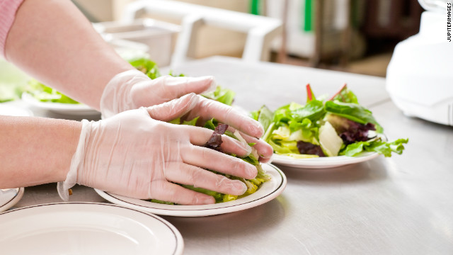
Report Infected Wounds
Always tell your manager if you have an infected lesion on your hands or wrists, unless covered by a finger cot and glove.
Cover wounds on the arm with an impermeable cover such as a bandage. It must be completely covered.

Slide 6
How and When to Wash Your Hands
Double hand washing is required when using the restroom.
Employees must wash their hands in the restroom and wash them a second time before returning to food handling.

Slide 7
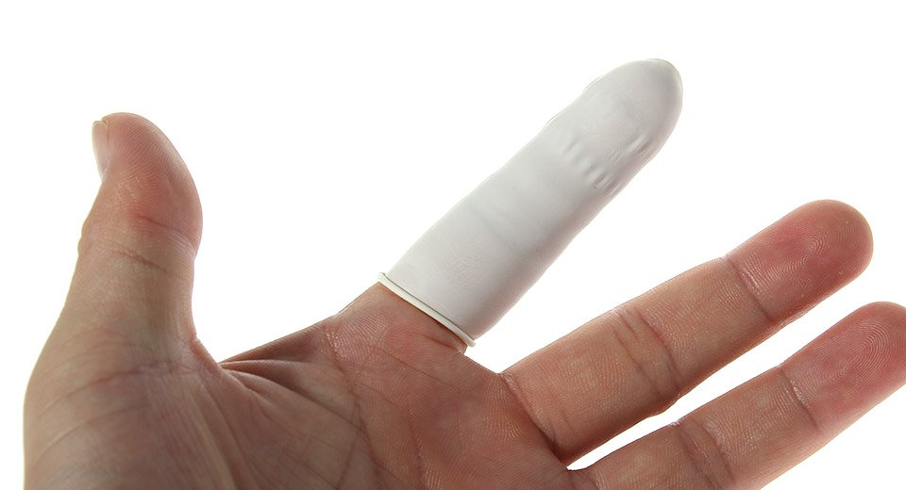
Cover Hand Wounds
A hand cut or sore must be cleaned, bandaged, covered with a finger cot and a glove to present contamination.
Any wound not covered, must be reported to a manager.

Slide 8
Where you Can Eat, Drink, Smoke and Chew Gum or Tobacco
Eating, drinking, chewing gum or tobacco should be away from food prep areas.
Smoking is only permitted outdoors at least 25 feet away from any entrance.

Slide 9
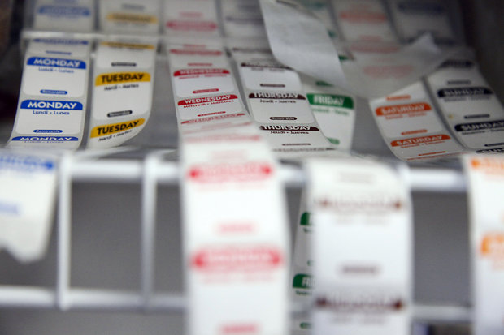
Date Marking
When date marking food, remember that ready-to-eat TCS foods (foods greatly affected by time and temperature) may be held for 7 days if kept at 41F or lower.

Slide 10
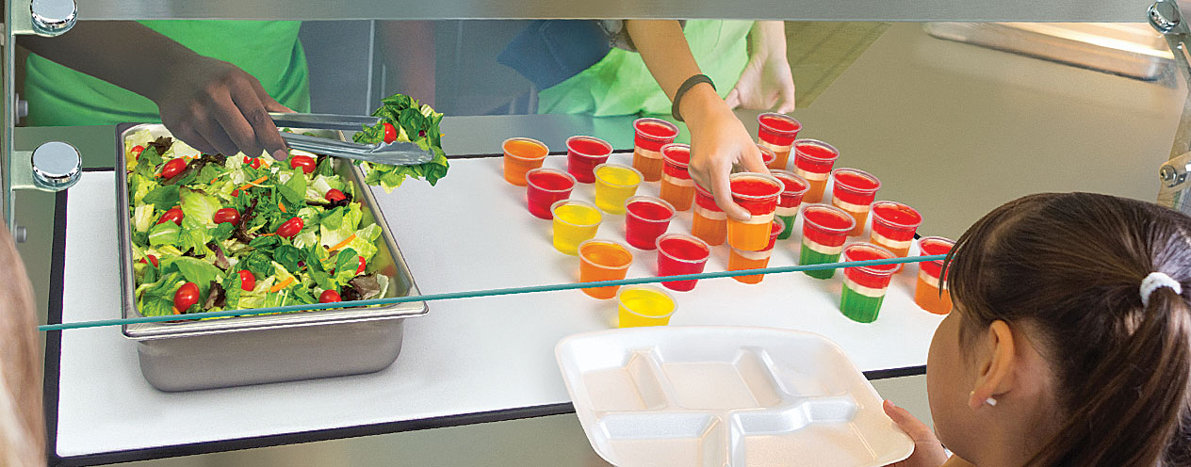
Holding Food without Temperature Control
Cold Food may be held without temperature control for up to 6 hours if the following conditions are met:
The food is held at 41F or lower before removing from refrigeration.
The food is labeled with discard time (6 hours after removed from refrigeration)
Food temperature does not exceed 70F.
Sold, served or discarded within 6 hours

Slide 11
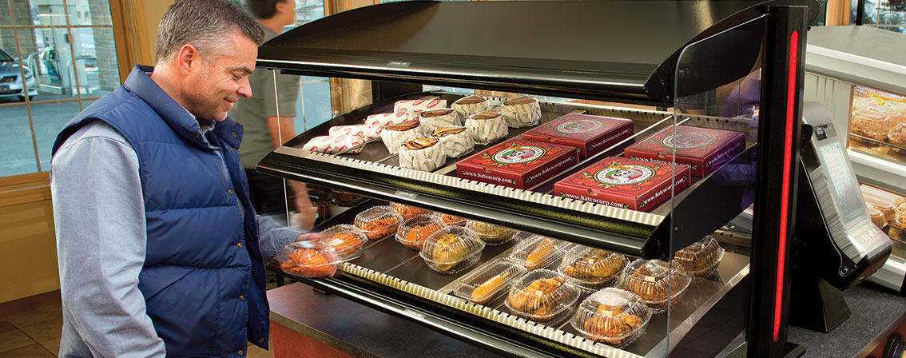
Holding Food without Temperature Control
Hot food may be held without temperature control for up to 4 hours if you met these conditions:
Food is held at 135F or higher before removing it from temperature control.
The food is labeled with a discard time (4 hours after removal from temperature control).
The hot food must be sold, served or discarded within four hours.

Slide 12
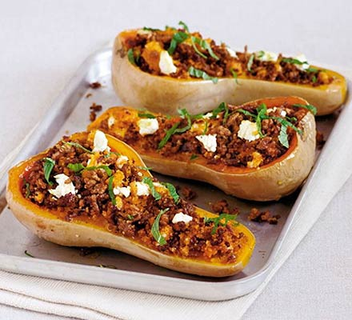
Cooking TCS Foods
Shell eggs for immediate service must be cooked to 145F
Shell eggs that will be hot-held for service must be cooked to 155F
Stuffed foods must be cooked to 165F

Slide 13
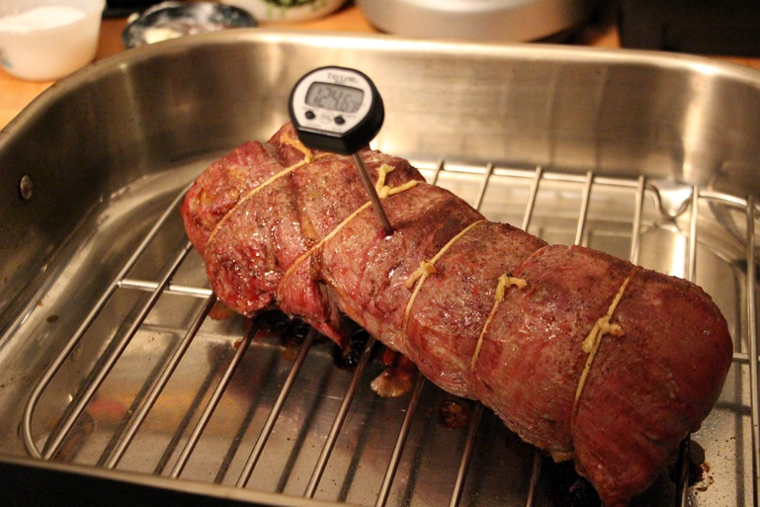
Cooking Requirements for Specific Types of Food
Once the correct temperature has been reached, you must hold the food at this temperature for a specific amount of time.
Roasts cooked to lower temperatures must maintain those temperatures for a longer period of time to ensure safety.

Slide 14
Chemical Sanitizing
Three common types of chemical sanitizers
Chlorine 50-99 parts per million (ppm)
Iodine 12.5-25 ppm
Quats – varies, follow directions
Effectiveness determined by concentration, temperature, contact time, water hardness and pH.
Follow directions

Slide 15
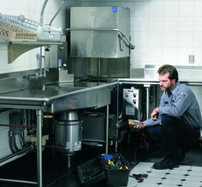
Dishwasher Operation
Check temperature, pressure, sanitizer levels and concentration.
Use test strips to check sanitizer concentration on chemical sanitizing machines.
Follow directions

Slide 16
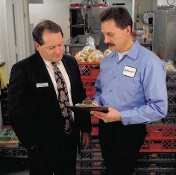
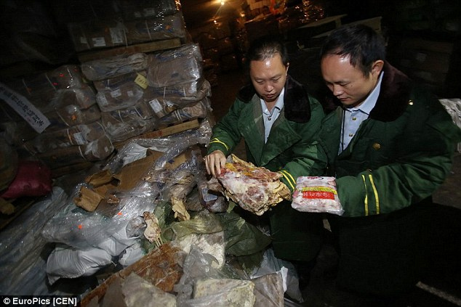
Approved Suppliers
Food must be purchased from approved, reputable suppliers.

