Slide 1
Small Appliances and Equipment
Objective 3: Select and explain the appropriate use and care of small appliances and equipment for specific product preparation and culinary applications.

Slide 2
Food processor
A versatile kitchen appliance that can quickly and easily chop, slice, shred, grind, and puree almost any food. It is different than a blender because you can chop, grind and puree without adding additional liquid. It is also used to make piecrusts, bread and pasta dough. Grains, nuts and meats can be ground with this versatile piece of kitchen equipment

Slide 3
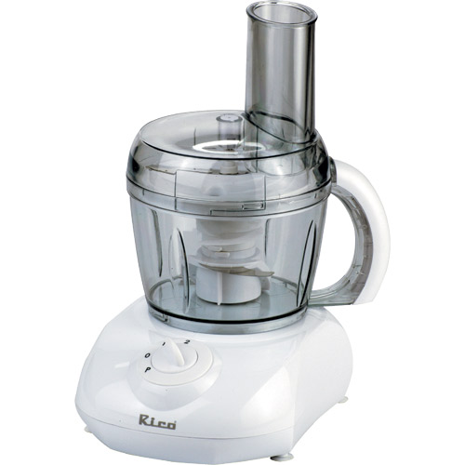
Food Processor

Slide 4
Food Processor
https://www.youtube.com/watch?v=iT5QX9rWTFQ

Slide 5
Immersion blender
An immersion blender, or stick blender is a kitchen appliance to blend ingredients or puree food in the container in which they are being prepared. It can quickly and easily chop, grind, and puree almost any food. Immersion blenders are often used to emulsify salad dressings and pureed sauces and soups.

Slide 6
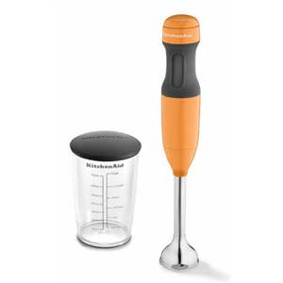
Immersion Blender

Slide 7
Immersion Blender
https://www.youtube.com/watch?v=gw4dqIkgF1o

Slide 8
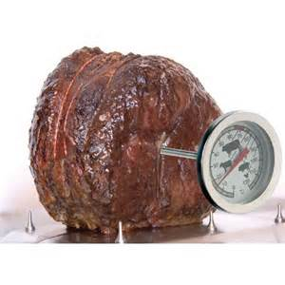
Internal temp thermometers/calibration
Insert thermometer into the thickest part of the food without touching bone or fat, when checking the temperature

Slide 9
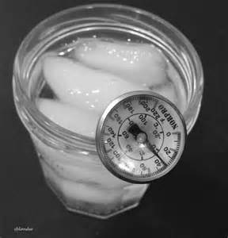
Calibrate meat thermometer
Insert thermometer into a glass of ice. Check temperature
If it is 32*F, then it is OK. If not, use a wrench to adjust
Screw on the thermometer to 32. Then you know that it
Is calibrated correctly for measuring all foods.

Slide 10
Scale
Because weighted measure (grams, ounces) is much more accurate than volumetric measurements (cups, tablespoons, teaspoons) a scale should be used in recipe preparation whenever possible. More consistent results will occur with the use of a scale and recipes can be easily scaled to fit any number of servings

Slide 11
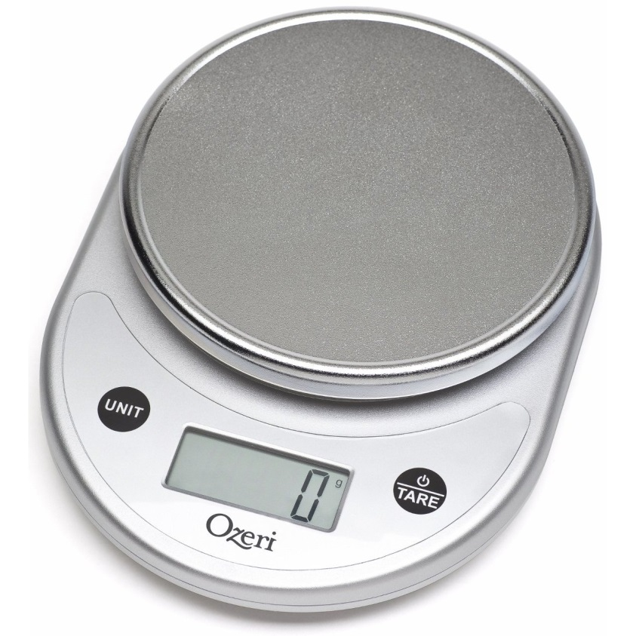
Digital Scale

Slide 12
Baking Scale
https://www.youtube.com/watch?v=1BEadsFfr2s

