Slide 1
Food-Borne Illness
Review

Slide 2
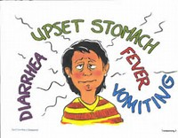
Review What You Learned in Foods 1
Define the term Food-Borne Illness?
What are the General Symptoms experienced with a food-borne illness?
Notes:
1.Define food borne illnesses: An illness results from eating contaminated foods.
2. What are the General Symptoms experienced with a food-borne illness? Fever, headache & digestive troubles.

Slide 3
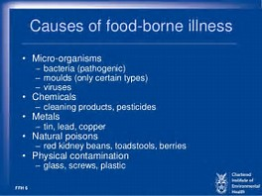
Food-Borne Illness Review
There are three categories for causes of food-borne illness. Provide examples of items found in these three categories.
Physical:
Chemical:
Biological:
Notes:
Physical: Hair, metal shavings, fingernails, pieces of glass, etc.
Chemical: Cleaning products
3. Biological: Pathogens & micro-organisms

Slide 4
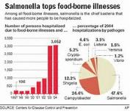
Food Borne Illnesses
What is Salmonella associated with?
What is E-coli associated with?
What is Botulism associated with?
What is Hepatitis A associated with?
What is Campylobacter associated with?
What is Staphylococcus associated with?
Notes:
What is Salmonella associated with? Fresh poultry & raw eggs.
What is E-coli associated with? Undercooked ground beef, unpasteurized milk, fruit juices & produce.
What is Botulism associated with? Improperly canned foods, specifically low-acid foods.
What is Hepatitis A associated with? Not washing your hands after going to the bathroom & then touching food, equipment & utensils.
What is Campylobacter associated with? Unpasteurized dairy products, contaminated water, poultry & produce.
What is Staphylococcus associated with? Food workers that carry staph in their nose, mouth & from infected cuts.

Slide 5
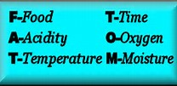
Food Borne Illness
Bacteria need FATTOM before they can grow, what is FATTOM?
F
A
T
T
O
M
Notes:
FATTOM – F – Food, A – Low Acid, T – Temperature, T – Time, O – Oxygen & M - Moisture

Slide 6
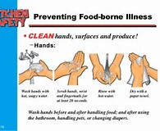
Preventing Food Borne Illness
Personal Hygiene is important to preventing food-borne illness. Answer the following:
How long should you wash your hands for?
What should be done during that time?
What should you do about your hair?
Notes:
Wash hands for a minimum of 20 seconds. Hands should be scrubbed, under fingernails, between fingers, backsides of hands & up past the wrists.
Hair should be controlled in a hat, covered or pulled back.

Slide 7

Personal Hygiene and
Food Borne Illness
Personal Hygiene is important to preventing food-borne illness. Answer the following:
What else should you wear? Why?
What should I use if I am working on ready-to-eat foods?
What should I do if I have a cut on my hand?
Notes:
1. Clean apron because clothes can carry bacteria.
2. Wear gloves which should be changed with each new task or after 4 hrs. continuous use.
3. Wear a bandage on the cut and then wear a glove over the bandage.

Slide 8
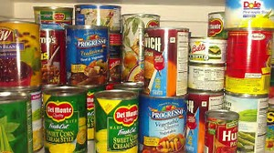
Storing Foods and
Food Borne Illness
What does the term FIFO mean & explain how to use it?
How should I label food that I am storing?
What should I do with a can that is bulging?
What are TCS Foods? What temperature should they be at?
How can I cool foods?
What are my Time & Temperature requirements when cooling foods?
Notes:
First In First Out – Foods should be stored with the oldest food to come out for use first.
Name of food & the discard date.
Throw it out
TCS means Time/Temperature Control Safety. They should be kept at 40 degrees or lower OR above 135 degrees or higher.
Divide foods into smaller portions & shallow containers, cool with ice baths, stirring with a chill whip or using a chill blaster.
I must cool foods from 135 down to 70 degrees within 2 hrs and from 70 down to 40 within 4 hrs.

Slide 9
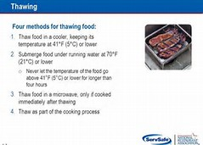
Thawing Food and
Food Borne Illness
There are four different acceptable ways to properly thaw food, List them below.
Name the recommended first way?
Name three more & give particulars that must be done when using these methods?
Notes:
Thaw in a refrigerator on the bottom shelf.
In cool running water or a cool bath changing water every 30 min.
In a microwave, which must be then cooked immediately.
As part of the cooking process & must be cooked thoroughly & temped.

Slide 10
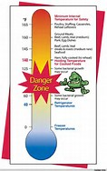
Food Temperatures
What is the Temperature Danger Zone?
What temp do I cook: Seafood, whole cuts of pork, beef, veal & lamb to?
How long should that temp be held for?
What temp do I cook: Ground meats, except poultry to?
What temp do I cook: All poultry to?
What temp do I cook: Reheated foods to?
Notes:
41 degrees to 135 degrees
145 degrees
15 seconds
155 degrees
165 degrees
165 degrees

Slide 11
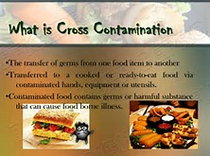
Cross Contamination and Food Borne Illness
What does the term Cross-Contamination mean?
Name three items that can cause cross-contamination?
What is the difference between clean & sanitation?
What are the 4 “C’s” to preventing food-borne illness?
Notes:
Is how bacteria can spread. It occurs when pathogens from unclean objects, people, or food touch cooked or ready-to-eat foods.
Hands, Utensils, Equipment, Raw Meat or Low-Acid foods.
Clean – to remove visible soil & food particles. Sanitize – to use heat or chemical agents to reduce pathogens.
Cook, Clean, Chill & Control cross-contamination.

