Slide 1
Rhythm…

Slide 2
PRINCIPLES OF DESIGN…
The designer works with the 5 tools or elements of design: line, form, color, space and texture. But now they must follow the “RULES” about using those tools. The rules are called the principles of design.
There are 5 principles of design:
balance proportion/scale rhythm harmony emphasis

Slide 3

Rhythm
Rhythm is defined as continuous, recurrent, or organized movement.
It allows for underlying unity and variety in a design.
We can create rhythm in 5 different ways…

Slide 4
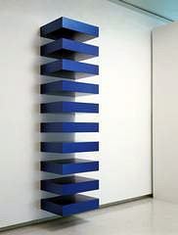


Rhythm by Repetition…
Can be achieved through…
Repeated lines, shapes and forms, colors, textures, or patterns.

Slide 5



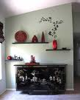

Repetition

Slide 6
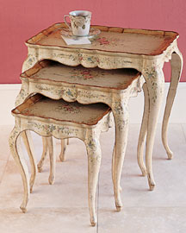
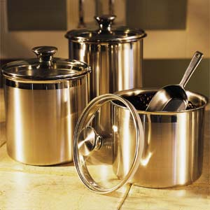

Rhythm by Gradation…
Completed by increasing or decreasing one or more qualities, such as height or width or overall size.

Slide 7

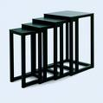


Gradation

Slide 8
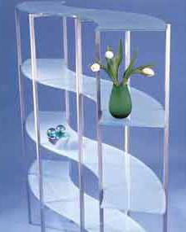


Rhythm by Transition…
Often subtle.
Leads the eye in a gentle, continuous, uninterrupted visual flow from one area to another or object to another. Arches are much smoother, less abrupt, than doorways with square corners.
Curved lines are a sign of transition.

Slide 9



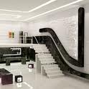
Transition

Slide 10
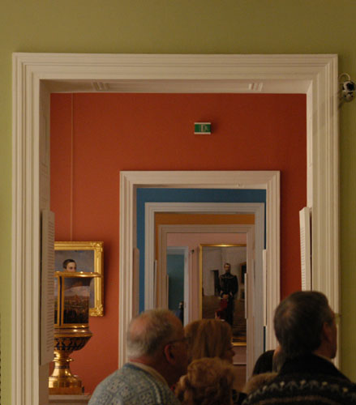

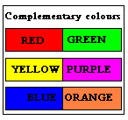
Rhythm by Opposition…
The direct placement of lines, forms, or colors to create
opposition by an abrupt change.
Ornate objects placed in simple backgrounds
Old versus new
Complementary colors next to each other
Intersecting lines
Square corners

Slide 11




Opposition

Slide 12
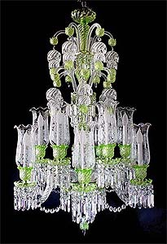
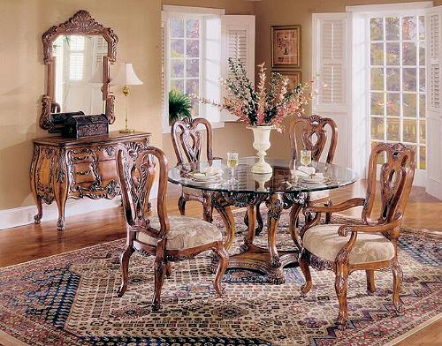

Rhythm by Radiation…
All parts of a composition are balanced and repeated around a
central axis.
Petals of a daisy
Chairs around a table
Circular objects such as plates, bowls, light fixtures, textile patterns, hanging plants and chandeliers
Not used as frequently as other types.

Slide 13


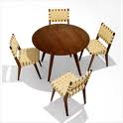

Radiation

Slide 14
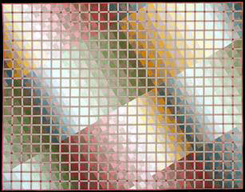
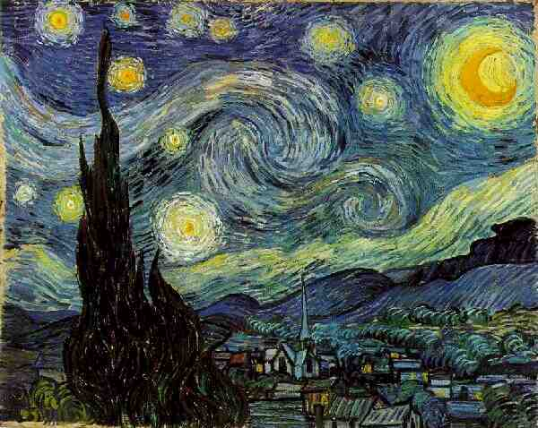
The key to rhythm is continuity….
The organized movement of recurring or developing patterns into a connected whole.
It’s all about the movement of your eyes on an object or around a room!

Slide 15
Rhythm Review
Name the types of rhythm in the following pictures. . .
Repetition
Gradation
Transition
Opposition
Radiation

Slide 16
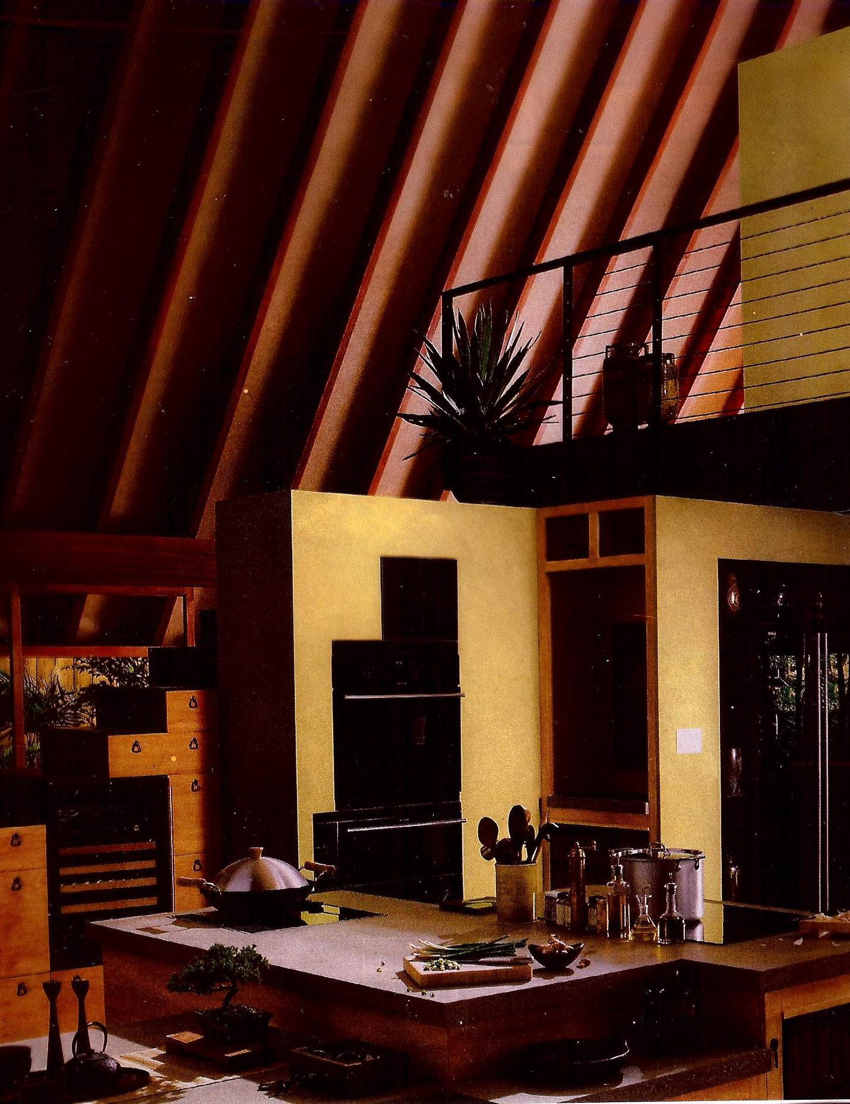
Rhythm Review 1

Slide 17
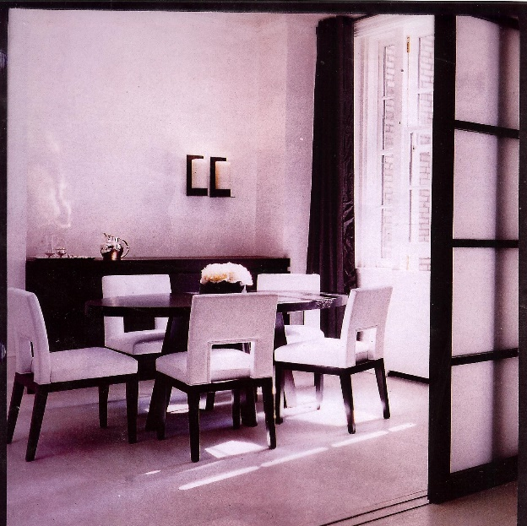
Rhythm Review 2

Slide 18
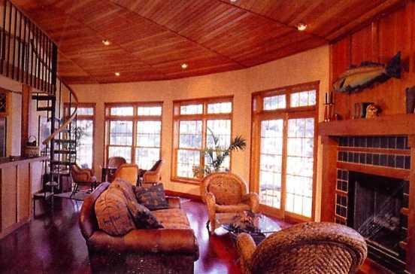
Rhythm Review 3

Slide 19
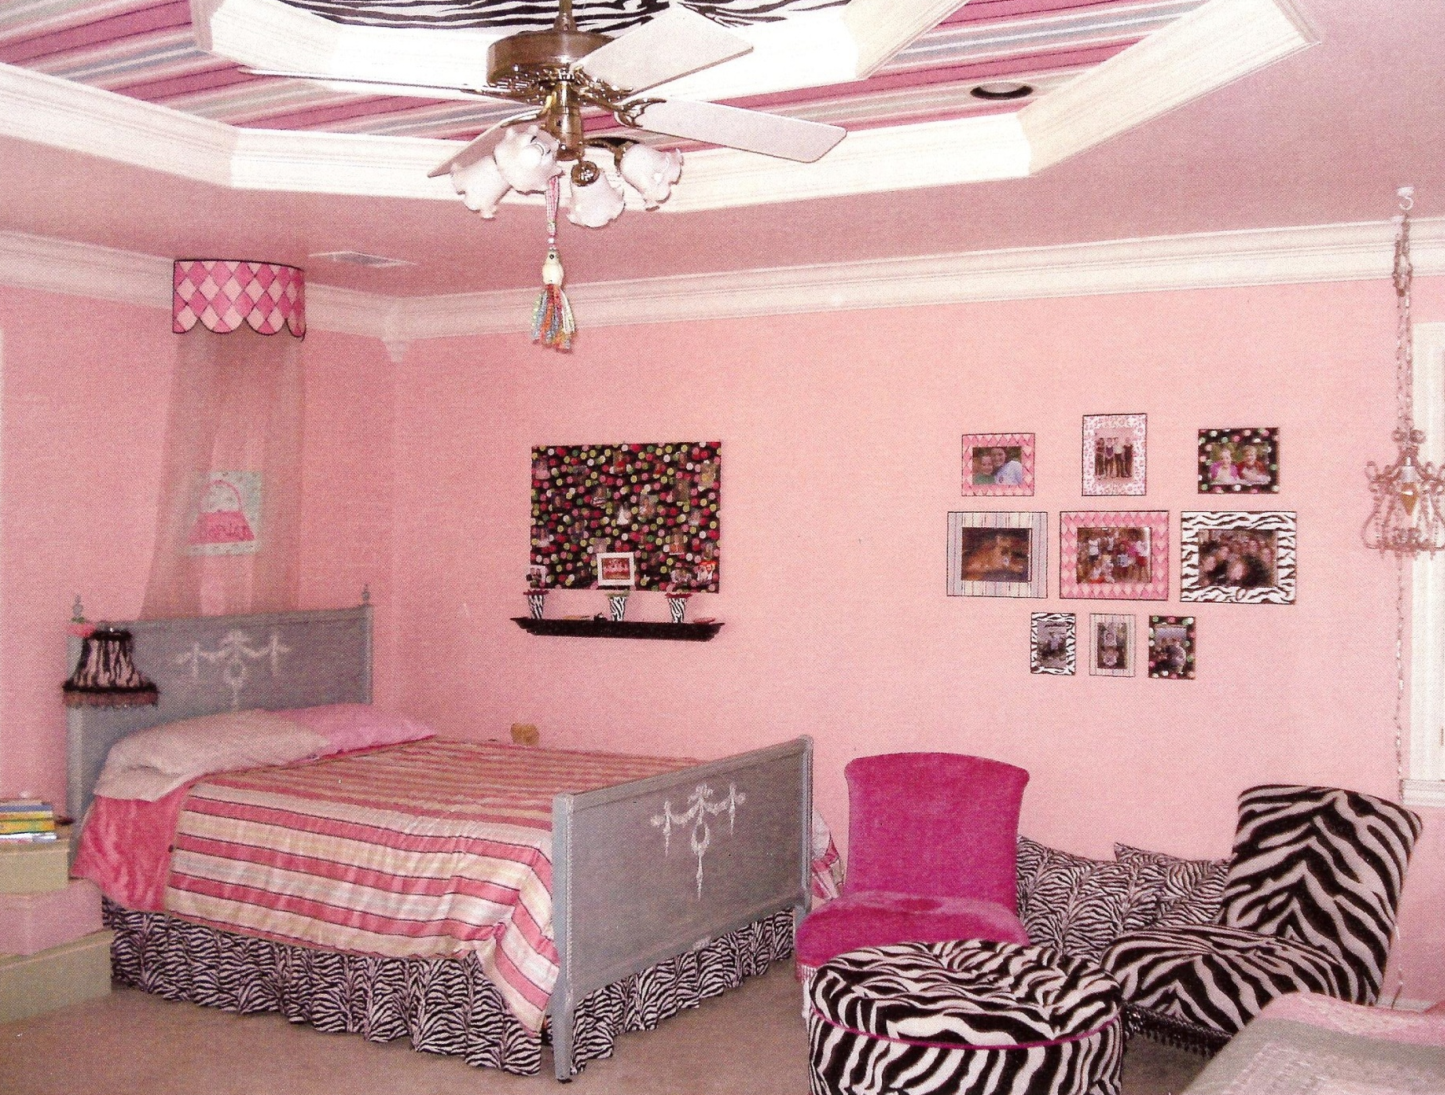
Rhythm Review 4

Slide 20
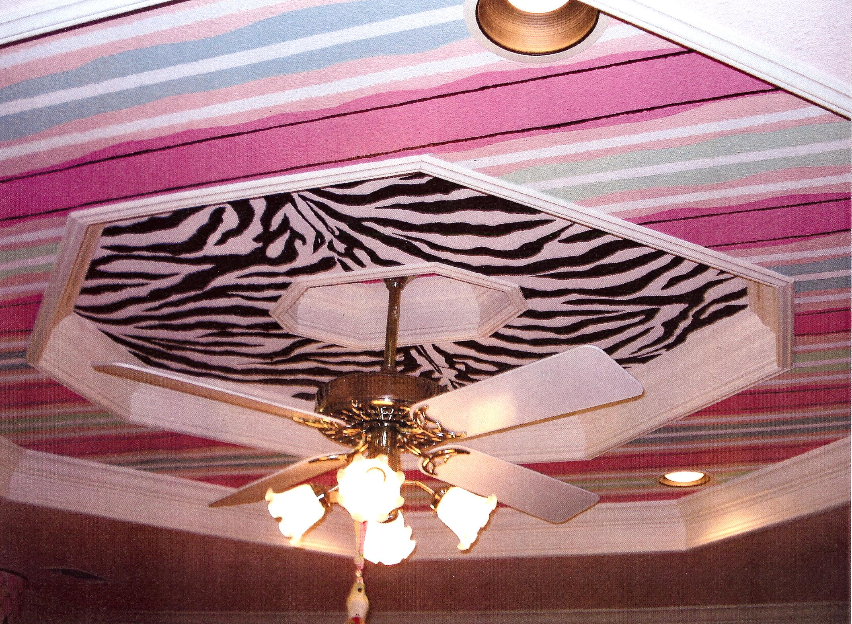
Rhythm Review 5

Slide 21
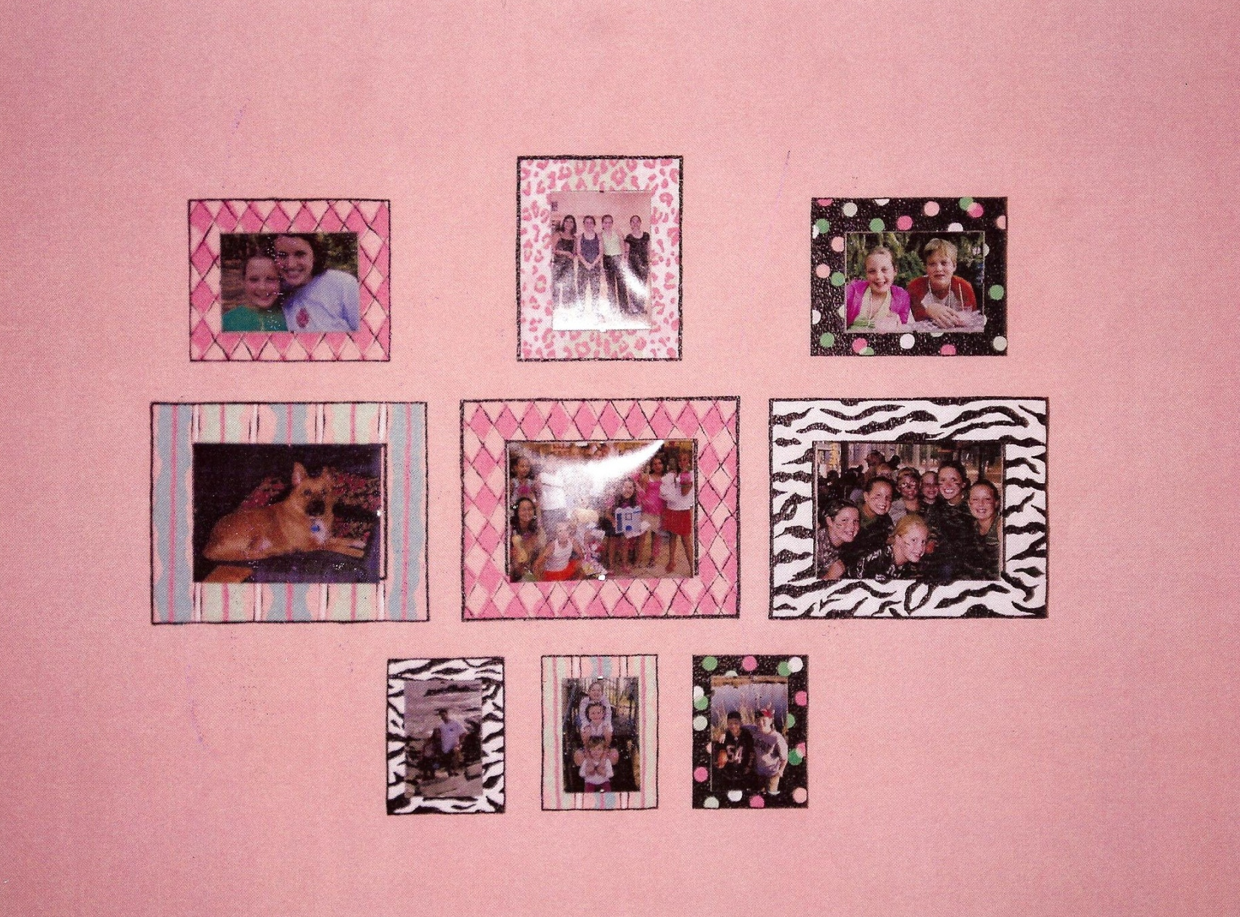
Rhythm Review 6

