Slide 1
Furniture Styles

Slide 2
Why Designs Change
Change in Taste- Taste changes from era to era. The changes are influenced by lifestyle, fashion, and needs.
Materials and Manufacturing- New techniques influence new design. For example-Traditional wood chairs were carved. However, we now can make plastics chairs from molds. As new material is developed, furniture makers experiment with different processes of using material.
Lifestyle Changes- Styles not only reflect the time but the lifestyle of the people who use the furniture

Slide 3
Understanding Furniture Styles
Overlapping Style Period
There is no definite beginning or end to a furniture style time period. Styles develop gradually.
Often a certain country or region sets the fashion for others.
Going Through the Stages
Most period begin with simple, basic designs and as time goes by designers tend to add more decorative features.
Formal vs. Informal
Formal furniture-originated mainly in Europe in the 18th century. Can be ornate or classical lines but all were considered elegant since they were created for the wealthy
Informal-Typically made with simple hand tools. Appearance was plainer, smaller versions of formal styles.

Slide 4
Designs that Last
Well designed furniture survives over the years.
Reproductions- Accurate copy of an original.
Antique- Furniture made in an earlier time period. A piece of furniture must be over a 100 years old to be classified as an antique. If an antique has been refinished or changed it maybe less valuable.

Slide 5
Colonial
1600-1780

Slide 6
Colonial Period
1600-1780
American furniture that was primarily influenced by English Styles
Adapted the styles for practical everyday use.
Often simpler than European furniture.
The furniture style in the 17th century is often referred to as Jacobean.

Slide 7
17th Century
Jacobean- style was heavy and rectangular with geometric or floral carvings
Chair Table- Chair that had a large back that could be tipped forward to form a table
Trestle Table- Table with long rectangular top and a wide vertical support at each end
Trundle Bed- lower bed that can be stored under a higher bed. Made due to limited house space.
Stools and Benches were more common than chairs
Chairs that were used had straight backs and no cushions
Often painted wood furniture black, yellow, or red
Chests were commonly used because there was no closets
Homes were sparsely furnished

Slide 8
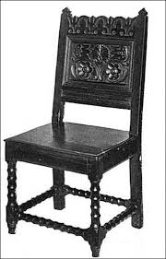
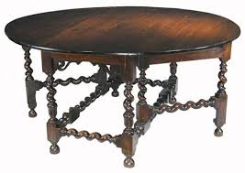
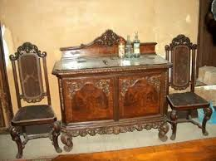
Jacobean

Slide 9
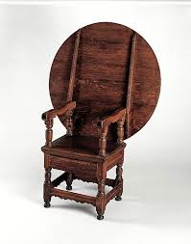
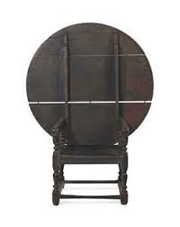
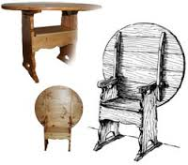
Chair Table

Slide 10
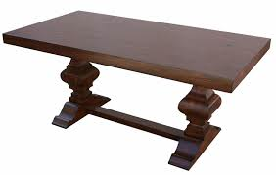
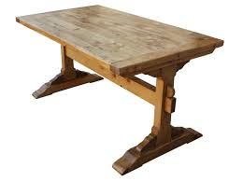
Trestle Table

Slide 11
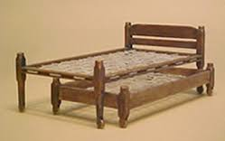
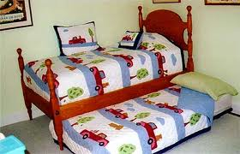
Trundle Bed

Slide 12
GEORGIAN STYLE

Slide 13
William & Mary Style
1700-1725
Named from royal couple who began rule of England in 1689.
Styles influenced by Dutch and French
Chairs reflect strong Asian influence. Curved back replaces straight back of Jacobean.
New “lightness” to furniture not seen before
Fine carvings and trims
Velvets and Silks use for upholstery

Slide 14
William & Mary Style cont.
Gateleg Table- a table with legs on each side that swing out to support drop leaves that are pulled from the sides
Highboy- chest of drawers mounted on legs
(The highboy is an example of furniture refinement. Ex. Previously there was the chest and the cupboard and they are now replaced with the highboy)
Rushes- stems from marsh plants that seats on chairs were woven from making them more comfortable.
Veneer- A thin layer of more expensive wood was glued to the top of less expensive wood.

Slide 15
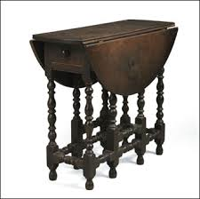
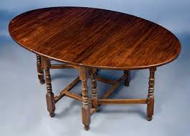
Gateleg Table

Slide 16
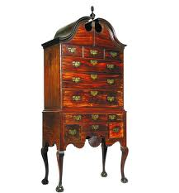
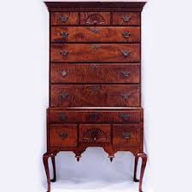
High Boy

Slide 17
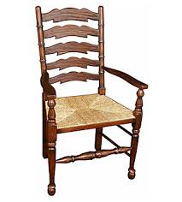
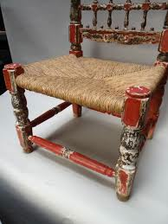
Rushes

Slide 18
Queen Anne Style
1720-1755
Curved lines rather than straight
Graceful, slender and flowing
Influences from furniture in the Netherlands and Asia.
Upholstered furniture became widely available making it more comfortable than ever before.

Slide 19
Queen Anne Style
Cont.
Cabriole Leg- leg of table that curves out at the middle and then tapers inward just above an ornamental foot.
Japanning- The process of wooden surfaces having glossy black lacquer added to them. Gave an oriental look.
Wing chair- An arm-chair with a high back and high sides.
Windsor Chair- Chair that turned legs and spindle back insert into a saddle-shaped plank seat.

Slide 20
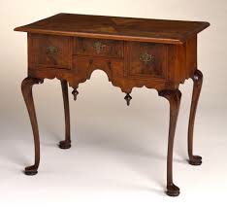
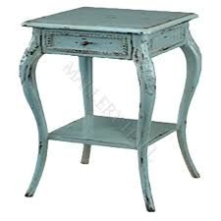
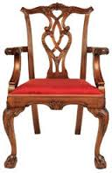
Cabriole Leg

Slide 21
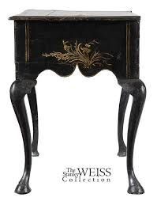
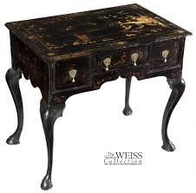
Japanning

Slide 22
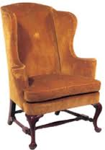
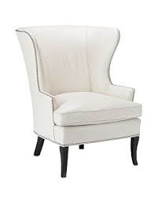
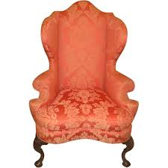
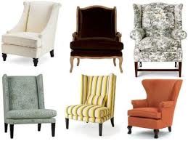
Wing Chair

Slide 23
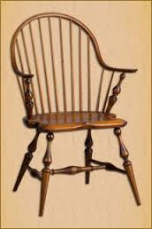
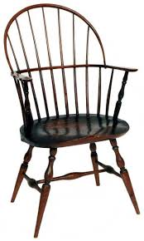
Windsor Chair

Slide 24
Chippendale Style
1755-1780
Two developments that influenced furniture design: Thomas Chippendale’s book of furniture design and mahogany
Chippendale was a popular cabinetmaker and furniture designer.
Chippendale’s distinctive features:
Earlier Features: S-Shaped chair and table legs ending in claw-and-ball feet
Later Features: Straight oriental-inspired straight legs
Camel Back Sofa
Carved decorations including shells, leaves, and flowers
Heavier and more solid appearance than Queen Anne Style

Slide 25
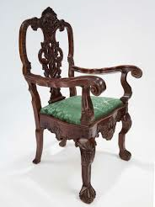
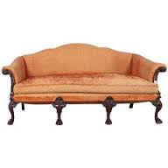
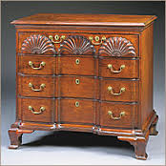
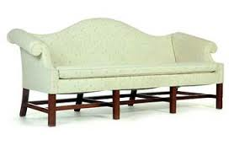
Chippendale Furniture

Slide 26
Postcolonial
1780-1840

Slide 27
Postcolonial
1780-1840
Colonists declaration of independence in 1776 brought about many political and lifestyle changes
After the Revolutionary War, there were changes in furniture style
Europe and America were influences by the delicate, balanced lines of classic ancient Greece and Rome.
This was referred to as Neoclassicism
Two styles were predominate- Federal and the Empire

Slide 28
Federal Style
1780-1820
Federal Style: Used to describe the furniture of the earlier classical styles and describe architecture of the time.
Most popular in New York, Washington, and Philadelphia
Architecture was straight lines and unclutters.
Designs were small and rectangular.
Furniture was light, delicate and symmetrical

Slide 29
Empire Style
1820-1840
Gets its name from the French emperor Napoleon I.
Last 20 years of the Neoclassical Style
Elaborate and dramatic
Most famous designer was Duncan Phyfe
-Used leaves, swans, eagles and dolphins, dog and lion paws
-Pedestal tables with curved legs and brass feet
-Chairs with backs shaped like a lyre- a musical instrument resembling a small harp

Slide 30
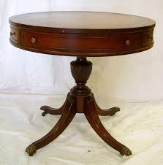
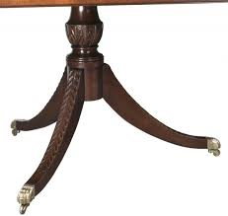
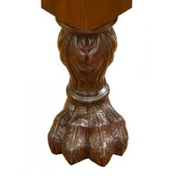
Duncan Phyfe

Slide 31
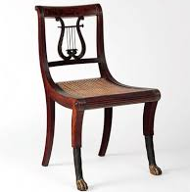
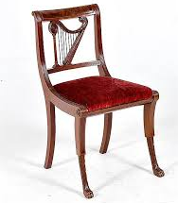
Duncan Phyfe Chair

Slide 32
Shaker Furniture
1800S
Created by Shakers- Religious group that settled in New England
Plain and simple style with graceful lines
Was not very popular in 1800s but is today

Slide 33
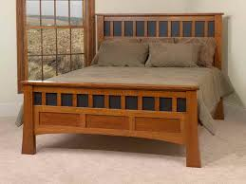
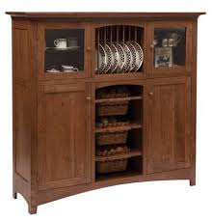
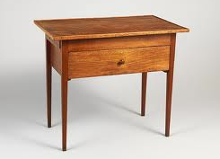
Shaker Furniture

Slide 34
Victorian
1840-1900

Slide 35
Victorian
1840-1900
Inspired by England’s Queen Victoria
Furniture was similar to Victorian architecture
Revival styles and influences include Gothic, Rococo, Italian Renaissance.
Advances in technology allowed pieces to be very ornate, elaborate, and fancy.
Sofas and chairs can be recognized by their curving lines, floral patterns, and rich upholstery.
Tables, desks and cabinets were heavy and ornate looking
Dark reddish brown wood finishes with high luster.

Slide 36
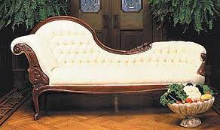
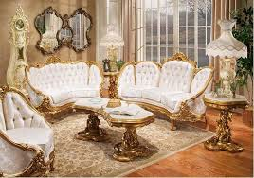
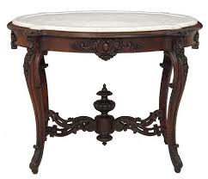
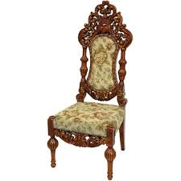
Victorian Furniture

Slide 37
Design Reform
At the end of Victorian Period designers reacted against excessive ornate designs and moved to a more natural use of materials and hand-crafted furnishings
Famous reformer was William Morris who emphasized function and simplicity and brought about the Modern Period

Slide 38
Modern
1901-Present

Slide 39
Modern Period
1901-Present
Designers are interested in simpler and abstract forms
They did not resemble anything from the past
Newly invented material
Little decoration on furniture

Slide 40
International
Plain, functional style developed by Walter Gropius and his school of design- “Bauhaus” in 1919
Belief that furniture should not include details that did not contribute the the function
Non-Traditional
Early designers abandoned natural materials , i.e. wood, and used metal, steel, chrome.
More modern Scandinavian designers returned to wood use
Molded plastic and glass
“Machine-Made” look

Slide 41
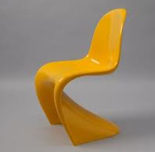
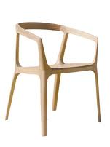
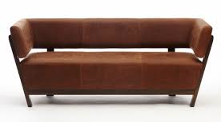
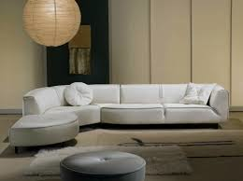
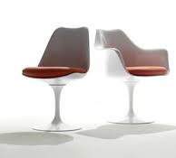
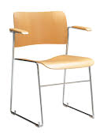
International style

Slide 42
Contemporary
Softening the hardness of Modern
Hard to identify because we are too close to judge it yet
Some identifiable points for contemporary furniture:
- Not confined to one nation. Rarely embodies traditional or national design so it is hard to tell the origin
- Marble, wood, glass, stone, and plastic
-Shapes stand out in simple backgrounds and are designed for human form. Bold design
Modular Furniture- Standardize pieces that can fit together in a variety of ways. May serve as more than one purpose.

Slide 43
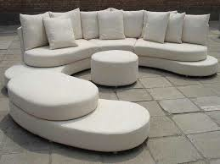



Contemporary style

