Slide 1
Developmental Tasks
How to Progress from Childhood to Adulthood

Slide 2
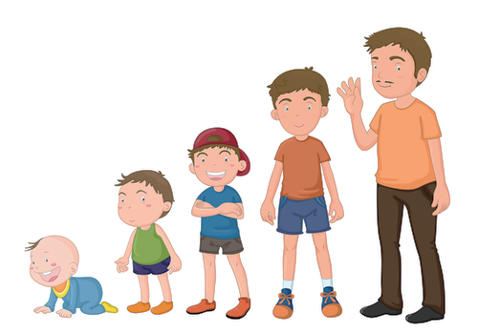
What Are Developmental Tasks?
Skills required for successful progression from childhood into adulthood.

Slide 3
TASK 1
Develop mature relationships with peers of both genders.

Slide 4
TASK 2
Adopt a gender role.

Slide 5
TASK 3
Accept your body as it is and make the most of what you have.

Slide 6
TASK 4
Become emotionally independent from parents and other adults.

Slide 7
TASK 5
Prepare for marriage and family life.

Slide 8
TASK 6
Select and prepare for a career.

Slide 9
TASK 7
Adopt priorities in keeping with personal goals and societal expectations.

Slide 10
TASK 8
Adopt socially responsible behavior.

Slide 11
The teenage years are to figure out:
Who am I?
How do I relate to others?
What can I do or become?
What do I value?

Slide 12
Where are YOU on the road?

Slide 13
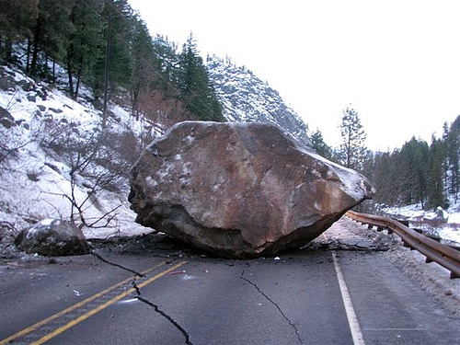
What Are “Roadblocks”?
Obstacles that come into our path that stop or interrupt our progress down the road of life.

Slide 14
“Roadblocks” are created by:
Nature
Other’s Choices
Our Choices

Slide 15
What are “Roadblocks” that impede your progress?

Slide 16
Common Major Roadblocks
Crisis/Trauma
Divorce
Death
Severe Illness
Abuse
Teen Pregnancy
Drugs/Alcohol
Addictions/OCD Behavior

Slide 17
Dealing with “Roadblocks”
Teens will need to STOP and deal with the roadblocks in order to move forward successfully.
Sometimes you can handle it on your own, but sometimes you will need help to move past the obstacles.
Who can you turn to for help in getting past your “roadblocks”?

Slide 18
Road Map Assignment
Using the paper, create a personal Road Map to chart major “milestones” and “roadblocks” in your life such as starting school, moving, musical recitals, sports events, joining a team, making or losing a friend, family events such as births, marriages, divorces, etc.
These events, both good and bad, have led your development and growth towards where you are today. Be creative! If you wish to draw pictures or other symbols, you may. Be sure to put the age that you were when these events happened. Start at birth and continue through today. You must have at least 20 significant events.

