Slide 1
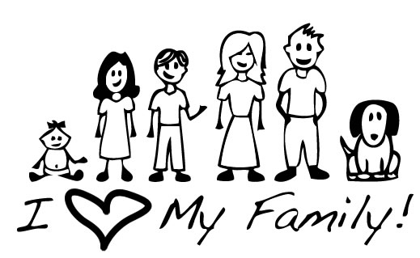
FAMILY
RELATIONSHIPS

Slide 2
What Is A Relationship?
An interaction between two or more people.
Who Does A Family Relationship Involve?
* Parents * Aunts and Uncles
* Siblings * Cousins
* Grandparents * Others?

Slide 3
Roles/Responsibilities of Teenagers
* School
* Household Responsibilities
* Family Time
* Employment

Slide 4
What is your role/responsibility in your family?
* How would you describe it?
* How do you think it came about?
* What life experiences have helped to shape it?

Slide 5
How can your attitude and behavior affect your family relationships?
They will either help STRENGTHEN or DESTROY
them.

Slide 6
Ways to STRENGTHEN Family Relationships:
* Showing appreciation
* Giving affection
* Being committed
* Spending time together
* Building traditions
* Utilizing creative problem solving
* Practicing constructive communication

Slide 7
Ways to DESTROY Family Relationships:
* Refrain from giving affection
* Withholding emotions
* Avoiding certain family members
* Using destructive communication
* Withdrawal from family

Slide 8
Personal Reflection
How is your personal attitude and behavior affecting your family?

Slide 9
IF YOU WANT
MORE FREEDOM,
YOU MUST BE
MORE RESPONSIBLE.
FREEDOM WANTED
*Who you hang out with
*What you do
*When you come home
RESPONSIBILITY REQUIRED
*Choose good friends
*Don’t get into trouble
*Come home at a reasonable time
Notes:
Example: You want the freedom to make your own decisions about when you come home, who you hang out with, what you do. What is the responsibility associated with those freedoms? You have a responsibility not to get in trouble with you freedom. You have a responsibility not to abuse it.

Slide 10
* Being responsible builds trust.
* Trust gains you more freedom.
* What you do with your freedom builds more trust.
* If you are trustworthy, you will have more responsibilities.
Responsibility, Trust and Freedom
Responsibility
Trust
Freedom
Trust

Slide 11
Maslow’s Hierarchy of Needs
Esteem Needs
Love and Belonging
Needs
Safety Needs
Physical Needs
Self-Actualization
Notes:
Maslow wanted to understand what motivates people. He believed that people possess a set of motivation systems unrelated to rewards or unconscious desires. People are motivated to achieve certain needs. When one need is fulfilled, a person seeks to fulfill to next one, and so on.

Slide 12
* Developed by Abraham Maslow, a psychologist researching human motivation and potential.
* Physical needs (at the base of the pyramid) must be met before any others can be achieved.
* As teens grow and mature, they become more responsible to provide for their own needs.
*Teens can help meet the basic needs of others in the family.
Maslow’s Hierarchy of Needs

Slide 13
Physical Needs
*Air
*Food
*Water
*Clothing
*Shelter
*Warmth
*Sleep
Notes:
People with lack of shelter, clothing and food focus on this level. The need to fulfill such needs will become stronger the longer they are denied. For example: The longer a person goes without food, the more hungry they will become. People often neglect some of the basic needs in normal life when they eat junk food, go without sleep , don’t exercise.

Slide 14
Safety Needs
*Personal Security
*Financial Security
*Stability
*Health and Well-being
*Order
*Law
*Freedom from fear
Notes:
Strongest in children. One must satisfy lower level basic needs before progressing on to meet higher level growth needs.

Slide 15
Love and Belonging Needs
*Friendship
*Comradeship
*Family
*Affection
*Love
Notes:
Love and belonging needs to be met in work groups, family, friends and romantic relationships. Humans need to love and be loved by others. Deficiencies within this level can impact the individual’s ability to form and maintain emotionally significant relationships. If unfulfilled, may rush to fulfill this need resulting in less than ideal partner.

Slide 16
Esteem Needs
* Achievement
*Mastery
*Independence
*Status
*Prestige
*Self-respect
*Respect from others
Notes:
People act form their ego needs. They value the opinions of others, in order to believe in themselves. Life experiences (road blocks) can cause a person to fluctuate between levels of the hierarchy.

Slide 17
Self-Actualization Needs
*Realizing personal potential
*Self-fulfillment
*Seeking personal growth
*Pursuing peak experiences
Notes:
Maslow noted only one in a hundred people become fully self-actualized because our society rewards motivation primarily based on esteem, love and other social needs. Examples: Best at athletics, painting, inventions, etc..

Slide 18
Building Family Traditions

Slide 19
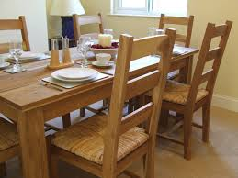
* Behaviors and activities you participate in over and over again.
* Traditions can be big or small and are unique to each family.
What are Traditions?

Slide 20
* Provides a source of identity
* Strengthens family bonds
* Offers comfort and security
* Opportunity to teach values
* Chance to pass on cultural heritage
* Connects the generations
* Creates lasting memories
Why are Traditions Important?
Notes:
http://www.artofmanliness.com/2013/10/09/creating-a-positive-family-culture-the-importance-of-establishing-family-traditions/

Slide 21
What Are Some Of Your Favorite Family Traditions?

Slide 22



Family Crest Assignment

Slide 23
Instructions
* In your packet, turn to the page with a shield drawn on it.
* Divide your shield into FOUR equal sections to create your family crest.
* In each section, draw a picture that represents one idea about your family.

Slide 24
Ideas Include:
* Flags that represent the countries your families came from.
* Pictures of foods that are common to your ethnicity.
* Pictures that represent your first of last name.
* Drawings that depict favorite family events, celebrations or traditions.
Be Creative and Use Color!

