Slide 1
Emotions & Uncontrolled Emotions

Slide 2
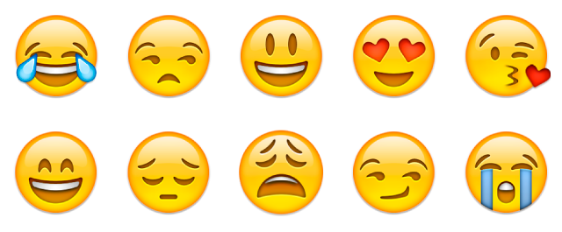
Basic Human Emotions
Happiness
Sadness
Love
Hate
Anger
Fear

Slide 3

Expressing Emotions
People express emotions in a variety of ways.
How do children express emotions?
How do teens express emotions?
How do adults express emotions?
We learn how to control and express our emotions appropriately as we grow older.
Do you express your emotions differently around different people? (Family, friends, work, school, etc.)

Slide 4



Consequences of Uncontrolled Emotions
Legal
Results in choosing behaviors that are against the law.
Mental
Factors that affect an individual emotionally because of the behavior.
Social
Effects on the community, family and individuals because of the behavior.

Slide 5



Consequences of Uncontrolled Emotions
Ethical
Moral and religious values that are violated because of the behavior.
Physical
Harm or injury that can come to people because of the behavior.
Financial
Dollar costs to individuals and communities as a result of behavior.

Slide 6
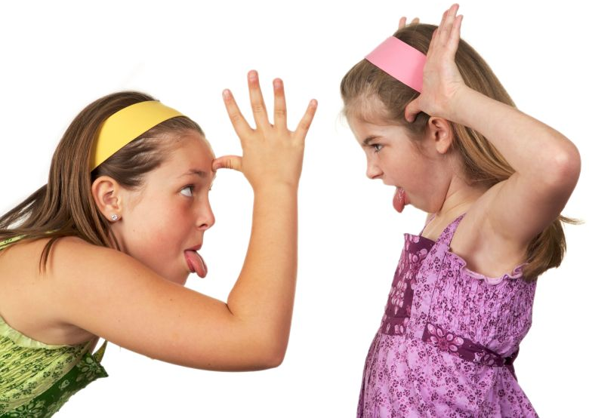
Types of Behavior
Emotions are usually expressed through three main types of behavior:
Passive
Aggressive
Assertive

Slide 7
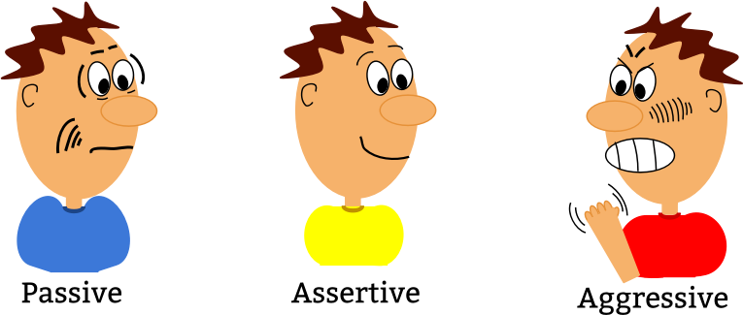
Passive
These are people who let others walk all over them.
They follow the “crowd” and allow others to make decisions for them.
They lack the courage to express inner feelings.
They are followers.
They allow passivism to control their emotions and are disappointed in how they are manipulated by others.
They see something wrong, but do nothing about it.

Slide 8
Examples of Passive Behavior
I saw a boy take the teachers wallet. He told me that if I told, he and his friends would beat me up after school. So, believe me, I won’t tell!
Some kids called me a nerd, but I ignored them.
My teacher thought it was me who was talking and gave me detention. I didn’t want to get my friend in trouble so I’ll just go along with it.

Slide 9
Aggressive
These individuals are always looking for a fight.
Whether or not it is their business, they are right in the middle of it.
They are masters at verbal or physical battle.
They thrive on intimidating others.
They believe that aggression breeds aggression.
They often bring out the worst in OTHERS.

Slide 10
Examples of Aggressive Behavior
Jim hit me, so I hit him back.
My sister wouldn’t do the dishes for me, so I called her a name I can’t repeat!
My boyfriend just broke up with me because he likes another girl. So, I’m going to tell all my friends what kind of guy he really is!

Slide 11
Assertive
These individuals calmly, but insistently, state their feelings in a non-emotional way.
They do not allow others to manipulate, intimidate or control their behavior.
They use “I” Messages (I think, I feel, I am, I don’t, I want, I won’t, I will, etc.)
If this individual is in a threatening situation, they will walk away and seek help if appropriate.
They tell someone if the situation is harmful, dangerous or against the law.

Slide 12
Examples of Assertive Behavior
I don’t like it when you don’t do your homework and want to copy mine.
Some kids called me a nerd, but I ignored them.
My locker was robbed! I reported it to the vice principal.
Instead of getting angry, I feel we need to sit and discuss how to solve the problem.

Slide 13
One of the hardest emotions to control or express positively is ANGER!

Slide 14
Hot Anger
Explosive Anger
Usually comes from feelings kept inside
Hurtful to others
People “blow up” at others

Slide 15
Cold Anger
Stored inside
Not shared with others
Self-destructive / “eats away” at people
Feelings are not dealt with
Physical symptoms

Slide 16
Warm Anger
Appropriate anger
Expression of anger in a calm way
It’s okay to feel angry, but deal with it appropriately without hurting yourself or others

Slide 17
Uncontrolled anger can lead to arguments, physical fights, abuse, assault and self-harm.
On the other hand, well-managed anger can be a useful emotion that motivates you to make positive changes.

Slide 18

Physical Effects of Uncontrolled Anger
Headache • Depression
Digestion Problems • High Blood Pressure
Insomnia • Skin Problems (Eczema)
Anxiety • Heart Attack/Stroke

Slide 19
Expressing Anger in a Healthy way
Walk away from the situation until you have control of your emotions.
Recognize and accept the emotion.
Try to pinpoint the exact reasons why you feel angry.
Problem solve strategies for dealing with the situation in advance.
Do something physical like exercise or playing a sport.
Seek help if needed.

