Slide 1
STRESS
&
STRESS MANAGEMENT

Slide 2

WHAT IS STRESS?
The body’s reaction to pressure, either mentally or physically.
Two Types of Stress:
  Eustress (Good Stress)
    Weddings, special date, birth of a baby, etc.
  Distress (Bad Stress)
    Examples: Death in the family, divorce, injury, etc.

Slide 3
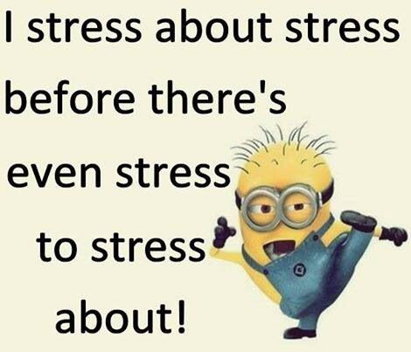
STRESSORS
Things or events that cause us stress.
Stressors are found everywhere and we cannot always get rid of or avoid them. But, the way we deal with them will make them either positive or negative.
Common Stressors:
  School, family, friends, work and others.

Slide 4
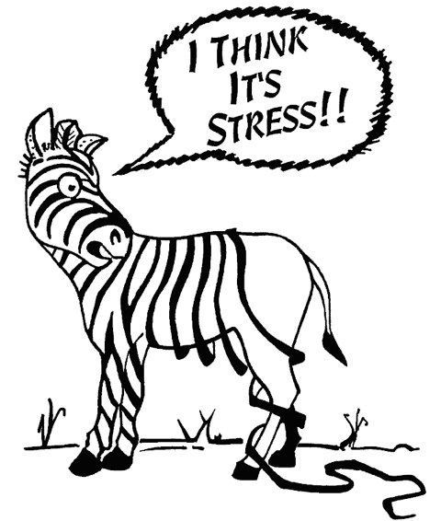
SIGNS OF STRESS
Physical: tiredness, injury, insomnia, headache, tense muscles, etc.
Emotional: worrying, irritability, crying, feeling anxious, nightmares, depression, etc.
Behavioral: acting-out, inability to eat, extreme anger, hitting/punching, nail biting, nervous twitch, etc.

Slide 5

MANAGING STRESS
Acknowledge It
Good Diet
Regular Sleep
Exercise
Building Good Relationships
Get Organized

Slide 6
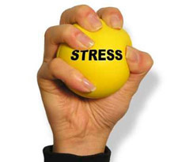
MANAGING STRESS
Make a “To-Do” List
Don’t Procrastinate
Mentally Count Down
Take a Break
Laugh
Say “NO” to Things
Listen to Music
OTHERS?

