Slide 1
Communication

Slide 2
Styles of Communication
Child-Like
The easiest and most natural communication to use.
Very immature method and the least effective when you are an adult.
Characteristics:
Self-centered • Interrupting
No listening • Acting out of control
Whining • Yelling
Name calling • Throwing tantrums
Giving Orders • Topping / “One Upping”

Slide 3
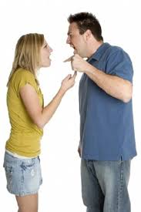
Styles of Communication
Parent-Like
Nothing to do with actually being a parent. (Two year olds are pro!)
Tries to direct others behavior.
Only effective because it usually gets someone else to comply or give in.
Characteristics:
Giving instructions • Demanding
Directing • Ordering
Not listening • Punishing

Slide 4
Styles of Communication
Adult-Like
Highest level of communication and the most effective.
It takes time to learn and use.
Involves active listening.
Characteristics:
Open two-way communication
All take responsibility for comments/actions
All remain calm and control strong emotions
Respect for each other’s feelings
All have a “win-win” attitude

Slide 5
Types of Communication
Constructive
Positive communication that contributes to a meaningful exchange of ideas and builds up yourself and others.
Examples:
Giving positive & encouraging messages
Sending clear messages
Keeping the confidences (appropriate secrets) of others
Using tact (saying something sensitive without hurting or offending)
Using “I” Messages
Asking questions
Being honest & open
Speaking with respect
Using active listening skills

Slide 6
Types of Communication
Destructive
Negative communication that “tears down” yourself and others
Examples:
Insults, harassment & teasing
Threatening
Lying & accusing
Using “You” Messages
Swearing
Sarcasm
Gossip
Topping
Not listening

Slide 7
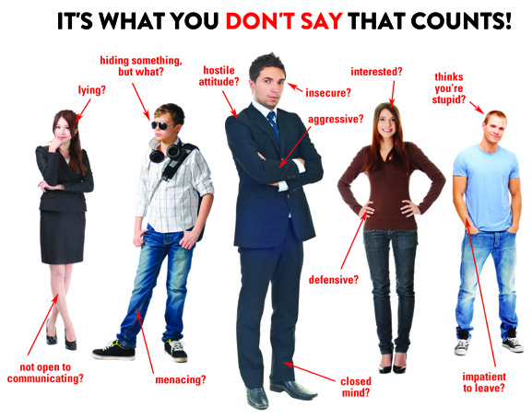
Types of Communication
Non-Verbal
The way a person expresses themselves through movement, posture and facial expression.
Can often be misread and misunderstood.
Possible to send one type of verbal message and a different type of non-verbal message at the same time.

Slide 8
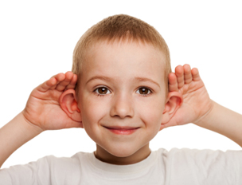
Active Listening Skills
Pay attention.
Look at the speaker / eye contact.
Stop other tasks and listen.
Listen with appropriate body language.
Give verbal clues that show you are listening.
Don’t interrupt.
Don’t let your emotions get in the way.
Don’t rush the conversation.
Put the phone away!
Don’t shift your attention to your own problems.

