Slide 1
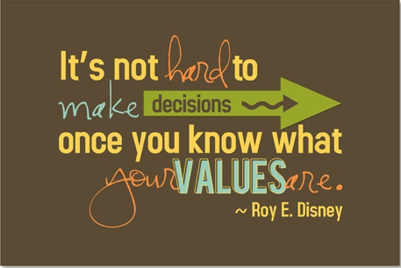
Values and Goals

Slide 2
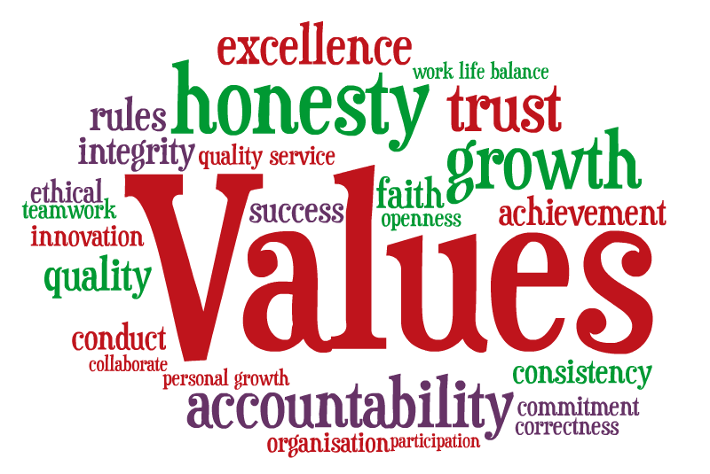
What are Values?
Anything in life that is important to us.
They determine how we live and how we tell the difference between right and wrong.

Slide 3
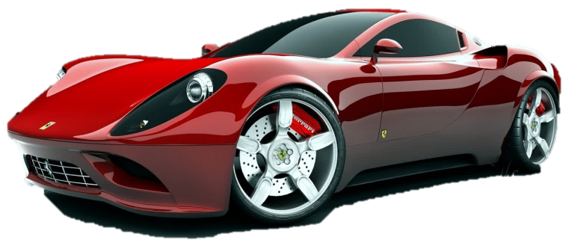
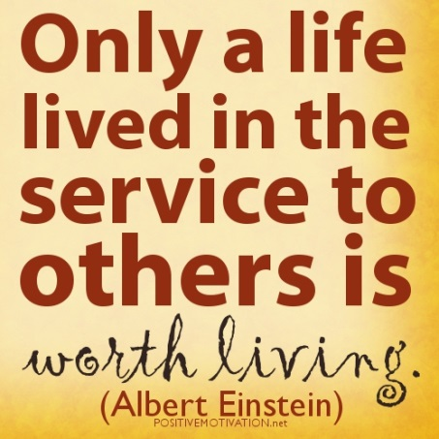
Two Types of Values
Tangible
  Material things in our lives
  Usually cost money to obtain
  Examples: jewelry, cars, clothes, etc.
Intangible
  Non-material things in our lives
  Usually can’t be bought with money
  Examples: love, honesty, kindness, etc.

Slide 4
VALUE CYCLE
Personal Choice
Acting Against Your Values
Acting Within Your Values
Feel Guilt
Feel Ashamed
Legal Problems
Lose Trust
Lose Self-Esteem
Clear Conscience
Self-Confidence
Peace of Mind
Gain Trust
Build Self-Esteem
Consequences:
Unhappiness
Lowering of Values to Justify Actions
Consequences:
Happiness and Contentment for Keeping Values Intact

Slide 5

What are Goals?
Plans you make to help you reach or accomplish something in the future.

Slide 6
Two Types of Goals
Short-Term Goals:
  Usually accomplished quickly (1-3 days)
  Examples: Doing dishes, finishing a paper, etc.
Long-Term Goals:
  Usually takes longer to accomplish (Months-Years)
  Examples: Graduating from High School, getting a job, etc.
Achieving your short-term goals will help you reach your long-term goals.

Slide 7

Setting Successful Goals
All goals should be:
  Realistic
  Measurable
  Specific

Slide 8
Don’t give up what you want MOST for what you want right now.

