Slide 1
Career Investigation
Family and Human Services Pathway

Slide 2
Career Investigation Project Outline:
Discuss CTE College and Career Pathways – (Family and Human Services Pathway)
Participate in a career related self-assessments
Research and explore a career of choice based upon self-assessment results
Create a plan for achieving your goal
Learn skills critical for entering the work force
Participate in a mock interview

Slide 3

CTE College and Career Pathways

Slide 4


Pathways will help you to prepare for family life, work life and careers in FACS by:
Providing opportunities to develop the knowledge, skills, attitudes and behaviors needed through character development, creative and critical thinking, interpersonal communication, practical knowledge and vocational preparation.
Notes:
…will help to prepare you for family life, work life, and careers in family and consumer sciences by:
-Providing opportunities to develop the knowledge, skills, attitudes, and behaviors needed through
-Character development, creative and critical thinking, interpersonal communication, practical knowledge, and vocational preparation.

Slide 5

Pathways in Family and Consumer Sciences:
Consumer Economics Services
Early Childhood Education
Family and Human Services
Fashion Design, Manufacturing & Merchandising
Food Science, Dietetics & Nutrition
Food Services and Culinary Arts
Interior Design
Notes:
…will help to prepare you for family life, work life, and careers in family and consumer sciences by:
-Providing opportunities to develop the knowledge, skills, attitudes, and behaviors needed through
-Character development, creative and critical thinking, interpersonal communication, practical knowledge, and vocational preparation.

Slide 6
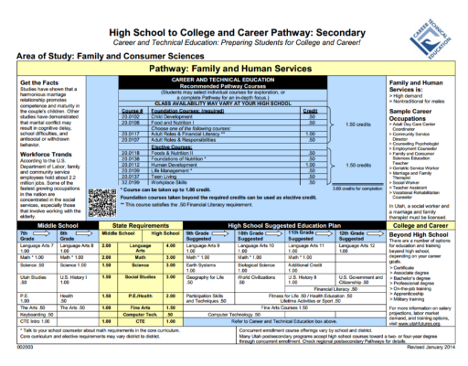
Concentrators vs. Completers:
Concentrators: Students that complete 1.5 credits in a Pathway
Completers: Students that complete 3 credits in a Pathway
Completers get a medallion at graduation!
Start planning now!
Notes:
Concentrator vs completer
Concentrators: Completes 1.5 credits in a pathway
Completers: Completes 3 credits in a pathway , completes the pathway

Slide 7
Career Related Self-Assessments

Slide 8

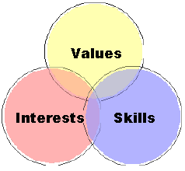
Self- Assessments:
-Personal Interests
-Values
-Aptitudes
-Skills
-Personality Traits
-Learning Styles
Notes:
Interest Profiler: https://utahfutures.org/assessments/interest-profiler
Color Code: Use hardcopy
Multiple Intelligence- be sure to look at the tab “What are multiple intelligences?”: http://www.bgfl.org/bgfl/custom/resources_ftp/client_ftp/ks3/ict/multiple_int/questions/choose_lang.cfm
Interest Profiler: http://www.mynextmove.org/explore/ip

Slide 9
Research and Explore Career Options

Slide 10

Career Research Project:
-Job Descriptions/Overview
-Skills/Abilities
-Entry Level Positions/Advancement
-Job & Employment Outlook
-Education & Preparation Needed
-Wages/Salary

Slide 11
Create a Plan!

Slide 12

Career Planning:
*Plans for high school
*Further education/training
*Extra curricular activities

Slide 13
Skills Critical in the Work Force

Slide 14

Critical Work Force Skills:
*Dress/Grooming
*Positive Attitude
*Work Ethic
*Responsibility
*Dependability
*Integrity
*Communication
*Teamwork
*Planning
*Adaptability
Notes:
*Dress/grooming- the clothing you wear and your personal hygiene. Dress for the job you want, not the job you are interviewing for.
*Positive attitude- having an uplifting future vision, no matter how bad the current circumstance,
*Work ethic- the importance of work and its ability to strength character through getting the job done
*Responsibility- to being accountable for something
*Dependability- being consistent and reliable in work
*Integrity- obedience to moral and ethical principles and being honest
*Communication- expressing your ideas, thoughts, expressions, feeling and emotions in appropriate ways
*Teamwork- a coordinated effort of individuals as part of a group to work together
*Planning- preparing for what is coming up
*Adaptability- being capable to adjust

Slide 15
Mock Interviews

Slide 16
Mock Interview Preparation:
*Speak clearly and use proper grammar, word usage, and pronunciation
*Use appropriate body language
*Posture
*Mannerisms
*Eye contact
*Wear appropriate clothing
*Prepare yourself with
background knowledge
*Provide clear and concise answers
*Shake the hand of your interviewers at the beginning and end of the interview

