Slide 1
Teens & Parents: How to Earn Your Parent’s Trust

Slide 2

Communicate (Use Adult-Like Communication)
Use I-Messages. If you have something to discuss with your parents, make sure that you get it out and tell them. Respect each other. Let them share their opinions with you. Try not to talk back or use snide comments if your parents say something you don't particularly agree with! This may just earn you the trust you would like.

Slide 3

Always Listen To Them
Use Active Listening Skills. You're not the only one with opinions - your parents have opinions too. Explain to your parents that you want to hear what they think of your situation or what you are going through. Always take what they say into mind.

Slide 4

Give Specific Details
Be sure you have all the details about any place you're going to. This way you can tell your parents exactly what is going to happen. You will need to let them know who will be there, what adults will be there, what the activity involves, and what time it will be over. They want to know you are safe when you are away from them.

Slide 5

Be Honest
Lying is a horrible thing to do. If you lie, you're only making problems bigger, and if you lie, your parents will never trust you. This is a fact. If you've done something wrong, lying about it won't make matters better for anyone - including yourself - in the long-term. And it's the long-term that generates trust.

Slide 6

Stay On Task
If you are asked to do something by your parent, do it right away without any questions and stay on task while you do it. Don’t whine about it or say you will do it later, just do it!!

Slide 7
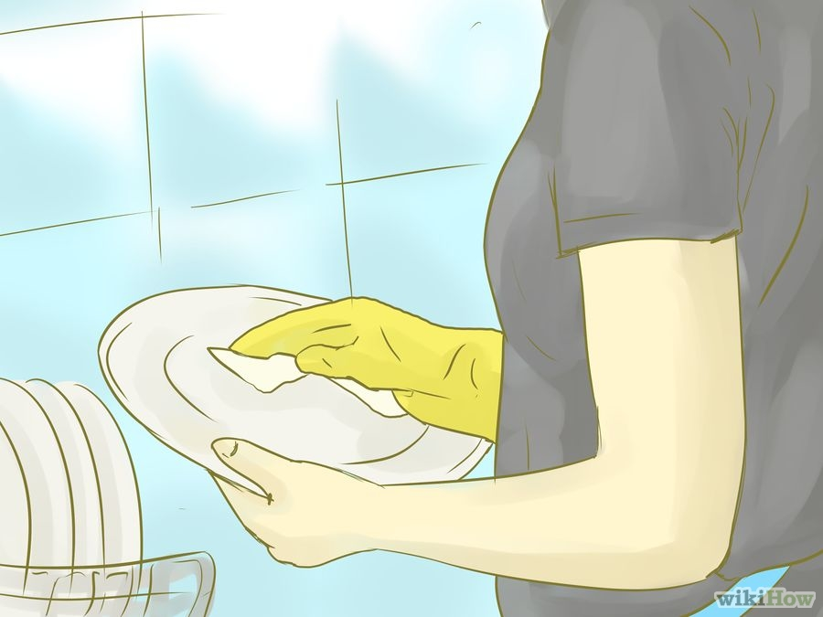
Help Without Being Asked
Show them you are responsible by doing your chores before they have to ask. Ask your parents if they need help with something. But don't constantly ask. It will make you seem too nice or annoying.

Slide 8

Be A Good Student
Do the best you can do in school. Do all your assignments, turn them in on time and do
your homework without being asked. Let them see you are trying to be responsible.

Slide 9

Choose Friends Of Good Character
Your parents want to know you have the good decision making skills of choosing friends or people to hang out with that are only going to be a positive influence in your life.

Slide 10

Follow The Rules
Every time you follow a rule or meet an expectation, the baseline trust and respect expand. Even if the party is "just getting started," go home when you're supposed to. Even better, be home before you are asked to be home. Remember: is one trivial party going to be worth the trouble and distrust you're going to get (in)?

Slide 11

Think Twice
If you have to think twice about something, don't do it. Doing something that is illegal or against the rules will be one of the fastest ways to lose your parents’ trust. The key is remembering trust builds slowly and can be broken down easily. For every five times you do the right thing, it only takes one poor decision to undo the trust you’ve built. It’s much easier to keep the trust you already have than trying to regain their trust once you’ve lost it!

Slide 12

Control Your Emotions
Keep your cool if your parents don't let you do something. Shouting back and arguing gives a bad impression and makes you look like a 2 year old. After all, they may be right in not letting you do that activity.

Slide 13

Show That You Care
Demonstrating to your parents that you care about them, yourself, and your relationship is an important element of your two-way trust relationship. Showing that you care may take on many different forms, but doing and saying things that you know will make them feel good is a place to start.

Slide 14

Show Respect
This goes both ways. You need to give your parents respect and they should do the same for you. Recognize that while you may be in different positions and coming from different points of view, each deserves to be treated with respect.

Slide 15

Trust Your Parents
Trust builds trust, and trusting them will help encourage them to trust you. In fact, you may find that you do not feel like you trust them right now; it is normal to feel that way. Trust is a two-way relationship, not a one-way feeling, so you will need to work on trust on your end as well.

Slide 16
How To Get Your Parents’ Trust Back If You’ve Lost It

Slide 17

Apologize
Apologize for violating their trust. A sincere apology can go a long way to making your parents trust you again. The best apology acknowledges your wrongdoing, restates what happened clearly, acknowledges the nature of the hurt or harm done, asks for forgiveness, and proposes a means of avoiding the error in the future.
Notes:
Try not to expect anything in return. Though it would be nice if the apology immediately fixed everything, that is unlikely to happen. It’s possible that your parents may not know the best way to respond to your apology. The words you use are less important than speaking genuinely. Another part of apologizing is forgiving yourself.

Slide 18

Ask What Will Rebuild Their Trust
The most obvious way to figure out how to get your parents’ trust back is simply to ask them what you can do. They may not have an answer ready, but tell them that they can think about it and let you know at a later time.

Slide 19

Understand Their Rules and Expectations
If you know what your parents don’t want you to do, it is easier to avoid doing it. If you are unsure about their exact rules or expectations, ask them. If your violation of trust is recent, you should be extra vigilant about any activities that may be considered off-limits.

Slide 20

Demonstrate Responsible Actions
Do your chores. Pick your brother up from school on time. Offer to help with the dishes after dinner. Showing responsibility for everyday things can help your parents think of you as a responsible person. This alone may not be enough to rebuild trust, but combined with other actions, these small steps can help.

Slide 21

Alter Your Actions
If there was a specific person, habit, activity, or event that broke you and your parents’ trust relationship, avoid it at all costs. If you feel that you need help avoiding it, ask for help.

Slide 22

Set Personal Boundaries
Become aware of who and what negatively influences you. If there is a particular friend who leads you to make bad decisions, it may be time to move on or take a break from that friendship.

Slide 23

Repair The Damage
If you caused damage to property, you need to do what you can to repair the damage. This may mean doing what you can yourself—painting over spray-painted graffiti, hammering out a dented car panel, or cleaning toilet paper out of trees. However, it may also mean offering to pay for the cost of repairs, as with a car accident. Accepting financial responsibility can go a long way towards showing that you understand the consequences of your actions.

Slide 24

Always Be Completely Honest
Regaining their trust after lying may take a long time. If you violated your parents’ trust by lying to them, particularly if you have had a history of lying, then you need to make a practice of being completely honest all of the time. Demonstrating a commitment to complete honesty will enable you to slowly rebuild trust.

Slide 25

Control Your Emotions
Often the situations and experiences that disrupt a trust relationship are motivated by rash or emotional decisions. Trying to act rationally and control your feelings may help you become more trustworthy. If you do not feel like you can control your emotions on your own, consider meeting with a therapist to discuss strategies for coping.

Slide 26

Hang in there!
Don’t give up. If your parents still don't seem to trust you, prove to them that you are capable and deserving of their trust. You have to get out there and show them just who you are and why they should trust you. Trust-building is not an end in and of itself. It is an ongoing process. It may take a long time. But in the long run it will be worth it!

