Slide 1
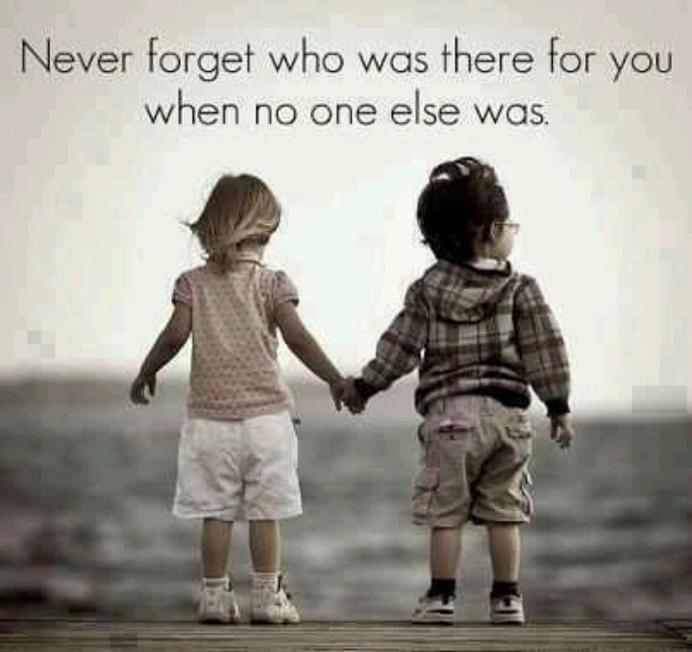
Siblings

Slide 2
Sibling Relationships
  *Siblings are Brothers
  and Sisters
  (Including Step and Half)

Slide 3
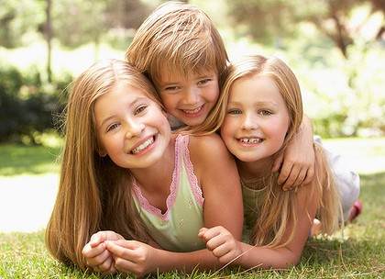
Sibling Roles
  *Siblings play many roles throughout our lives:
Playmate
Companion
Teacher
Learner
Protector
Dependent
Role Model
Intimidator
Brown-noser
Aggressor
Victim
Tattle-tale
Baby
Adversary
Notes:
It is inevitable that children will take on different roles in the family. These roles create balance within the family and allow each child to receive attention from their parents without direct competition.

Slide 4
Next to the parent-child relationship, the sibling relationship is probably the strongest.
They have deep sharing of emotions.
Teaching and socializing is often the role of the older brother or sister.
The older sibling is not only a teacher, but a caretaker and companion.

Slide 5

Sibling Rivalry
What is Sibling Rivalry?
Competition or jealousy among children of the same family for their parents’ affections or for dominance.
It is extremely common and it sometimes persists into adult life.

Slide 6
Sibling Rivalry
What are common causes of sibling rivalry?
Age
Developmental stage
Personality
Need for attention from parents
Need for protection from parents

Slide 7
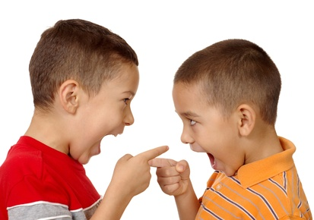
Sibling Relationship Questionnaire
Do you have siblings? How many? Name and describe.
What role does each of your siblings play in your family?
How is your relationship with each sibling?
How does your sibling relationships affected your family?
How can your sibling relationships affect your career?
How can your sibling relationships affect the community?

Slide 8
Birth Order
The order in which you and your siblings are born.
Can have an impact on your personality and development.

Slide 9
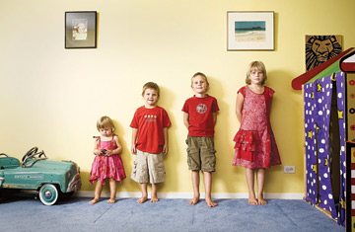
Things to Remember about Birth Order:
There are exceptions in every trait.
Focus on positive traits of each birth order.
Become aware of your uniqueness
Use the information to understand yourself, siblings and others.
Do not use traits as labels or stereotypes.

Slide 10
The Oldest Child
These children quickly learn how to please their parents- becoming conscientious, organized and reliable and serving as surrogate parents to younger parents.

Slide 11
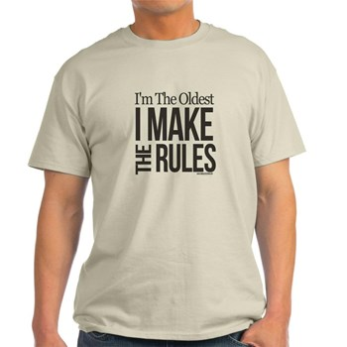
Oldest Child Characteristics:
Guinea pigs
Perfectionists
Reliable
Conscientious
List makers
Well-organized
Critical
Scholarly
Loyal
Serious
Goal-oriented
People pleasers
Conservative
Supporters of law and order
Believers in authority and ritual
Self-reliant
Controlling

Slide 12
Top Careers for First-Borns
Government
Engineering
Information Technology
Science
100% of Astronauts who’ve gone into
space were either eldest children or eldest sons

Slide 13
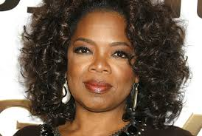
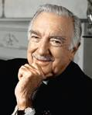
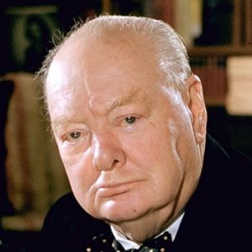
Famous First-Borns
Oprah Winfrey
One of the most influential and wealthy women in the world.
Walter Cronkite
Famously reported the assassination of President JFK AND the 1969 moon Landing.
Winston Churchill One of the greatest wartime leaders in history.

Slide 14
The Middle Child
Difficult to categorize, they avoid being boxed in and have a more go-with-the-flow attitude than their older siblings. They tend to be unbiased and levelheaded and are good at negotiations, most likely from playing mediator between their siblings.

Slide 15
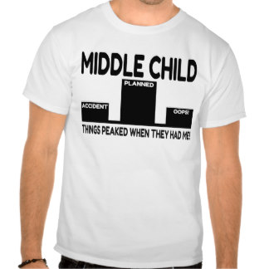
Middle Child Characteristics:
Independent
Loyal to peer group
Good friends
Finds companionship outside the home
Sometimes feels left out of their own family
Follows the crowd
Competes for attention
Peacemaker
Somewhat Rebellious

Slide 16
Top careers for middle and second children
Public Service
Education
Law Enforcement
Caretaking
Construction
65% of middle children put money into their savings accounts each month.
They are also more likely to be asked for money from a sibling.

Slide 17
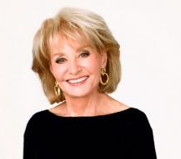
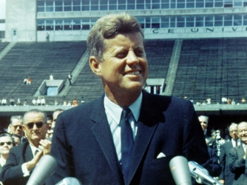
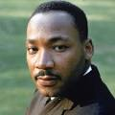
Famous Middle Children
Barbara Walters
First women to co-host a nightly evening news show.
Martin Luther King JR
Leader of the civil rights movement.
John F. Kennedy
P.O.T.U.S 1961-1963.

Slide 18
The Youngest Child
“The Baby”
These children usually receive the least discipline, the fewest responsibilities and the biggest audience. As a result of being babied, they tend to be tender and altruistic. They learn that being funny and adorable gains attention and approval.

Slide 19
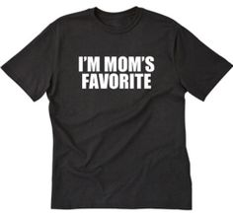
Youngest Characteristics
Messy
Class clowns
Attention-Seeking
Personable
Manipulators
Affectionate
Absentminded
Carefree
Not taken seriously
Manipulative
Charming
Blame others
Shows off
People persons
Good salespersons
Uncomplicated
Self-Centered
Fun-Loving
Outgoing

Slide 20
Top Careers For Youngest Children
Design
Editing
Writing
Sales
Art
Information Technology
85% of youngest children suffer from nightmares.

Slide 21
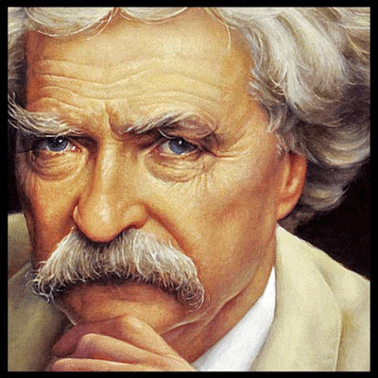
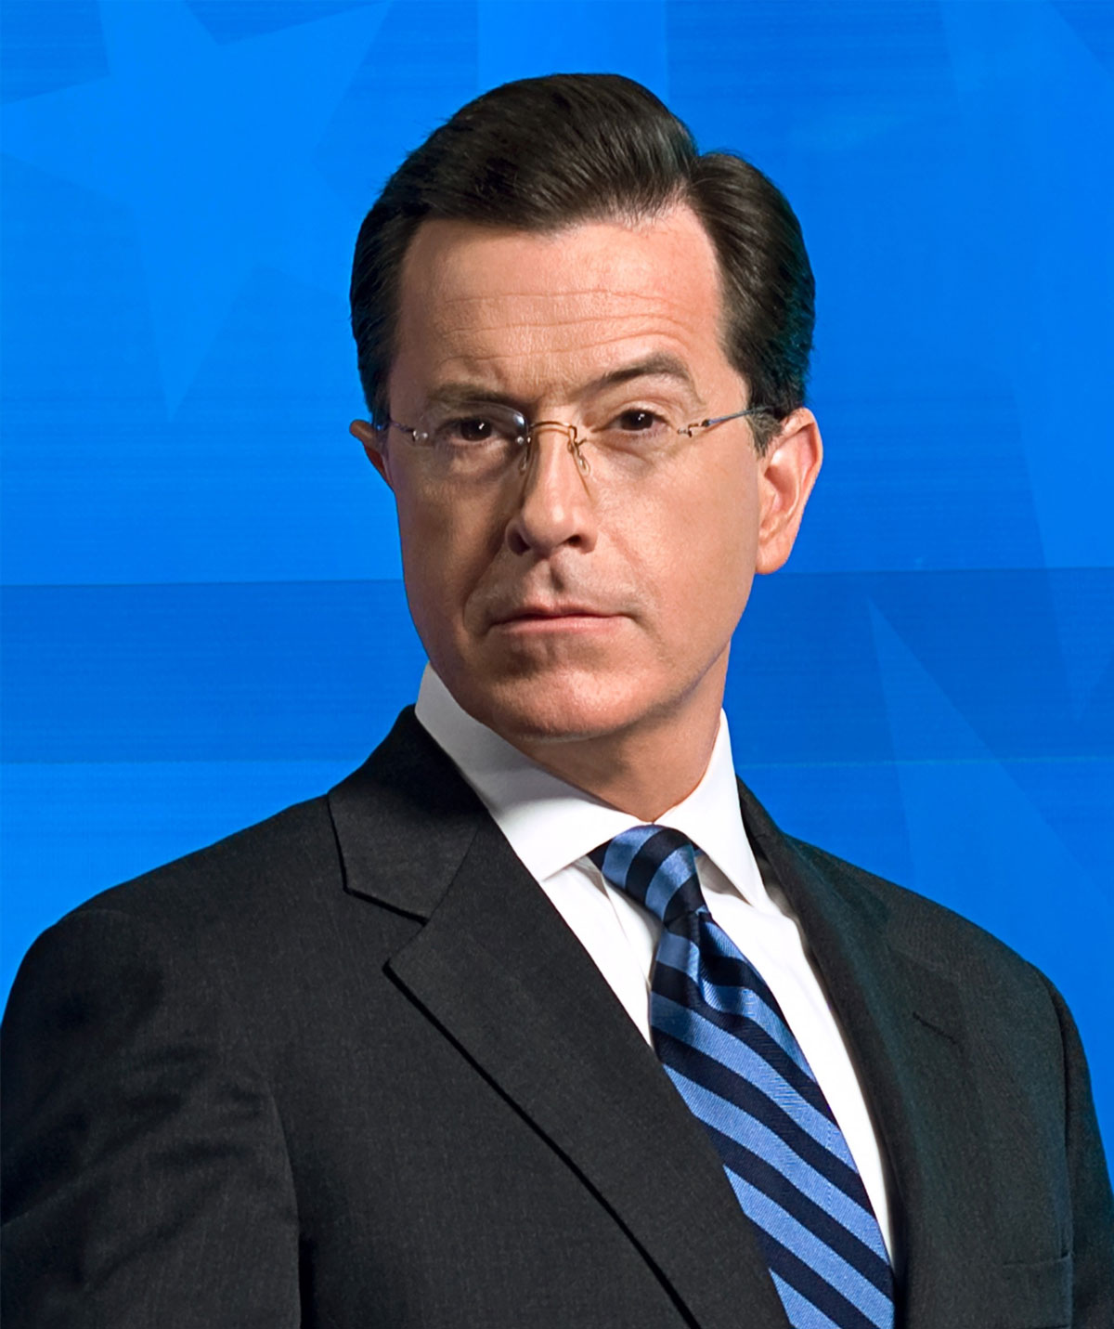
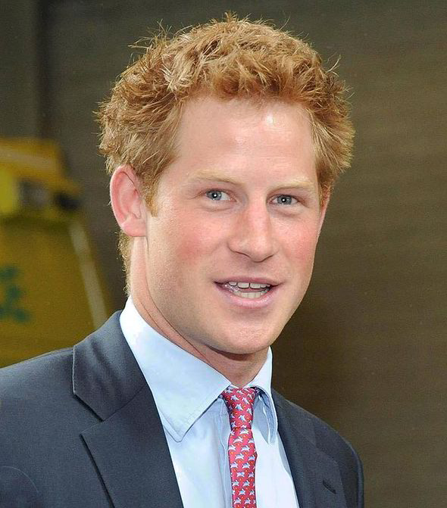
Famous Youngest Children
Mark Twain
American author and humorist.
Stephen Colbert
Newsman and youngest of 11 siblings.
Prince Harry
Youngest of the two English Princes.

Slide 22
The Only Child
These children are typically mature for their age due to time spent with adults. Many are high achievers, with a few rebelling and following their own path.

Slide 23
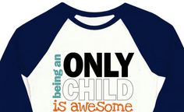
Only Child Characteristics
Mature
Perfectionist
Conscientious
Diligent
High Academic Achievement
Organized
Pays attention to detail
Confident

Slide 24
Top Careers For Only Children
Law Enforcement
Information Technology
Nursing
Engineering
18% of households are one-child families

Slide 25
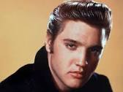
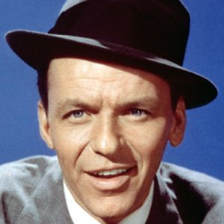
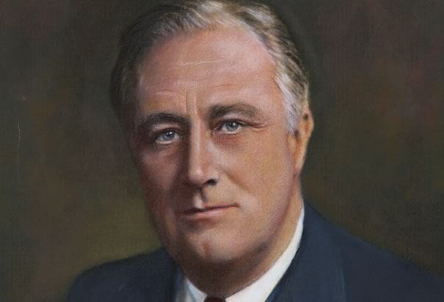
Famous Only Children
Elvis Presley
The best-selling solo artist in the history of music.
Frank Sinatra
Defined an entire genre of popular music.
Franklin D. Roosevelt
Longest serving P.O.T.U.S.
1933-1945

Slide 26
Making Your Birth Order Work for You
The following slides have some suggestions for making your birth order work in your best interest.
People who are wise learn to make their birth order work for them and to their advantage.

Slide 27
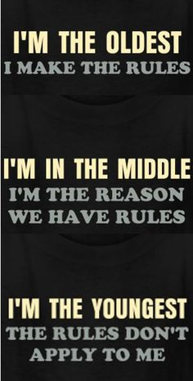
Tips for the First Born Child
Don’t overextend yourself
Learn to say no—you can’t do everything
Don’t expect so much from yourself. You don’t have to be perfect.
Don’t be afraid of being a detail person.
Take problem solving step-by-step

Slide 28
Tips for the First Born Child
Don’t let others pressure you into making decisions. Take your time.
Try to develop a sense of humor and laugh at your mistakes.
Never apologize for being conscientious or over organized.

Slide 29
Tips for the Middle Child
Use your people skills to see both sides of issues and deal with life as it really is.
If you are a free spirit, fight to keep your unique qualities.
Middle children grow up thinking that no one ever listened to them and they never had a chance to express their ideas. Share your ideas!

Slide 30
Tips for the Middle Child
Enjoy your many friends, but don’t spread yourself too thin.
Don’t compare yourself to others—just be you!
Don’t think only firstborns are leaders; you understand, negotiate, and compromise. Try being a leader!

Slide 31
Tips for the Youngest Child
Accept responsibility for yourself!
Many lastborn are messy; learn to pick up after yourself.
Choose jobs where you interact with people because you will do well!
Be less self-centered and offer to help others.

Slide 32
Tips for the Youngest Child
Don’t blame others if you’re the one who really caused the situation.
Your gift of humor will be an asset; use it correctly. Don’t be an attention seeker.
Give others a chance to share the limelight. Concentrate on asking others about them!
Lastborn tend to be the most compatible.

Slide 33
WHAT IS YOUR TEACHER?
Can You Guess?

Slide 34
An Oldest Child Teacher
  Creates complicated projects for students to complete
  They like structure and order in the classroom
  They are happiest when students are sitting in nicely arrange desks, in a straight line
  Students are quiet and do as they are told
  The oldest child teacher becomes frustrated when the lesson plan is interrupted

Slide 35
A Middle Child Teacher:
  Is interested in the psychological well being, as well as the academic achievement, of the student
  They seek out the rebellious students in hope of influencing them in a more positive direction
  They try to achieve order through mutual respect and understanding
  They are sometimes strict, but sometimes easy going about classroom rules

Slide 36
A Youngest Child Teacher:
  More creative, fun loving and adjust well to noise and disorder.
  Activities are fun and spontaneous
  Student choose their own seats and have a lot of choice in classroom decision making
  Teachers allow students to take more responsibility so they won’t have to do everything themselves
  Sometimes activities go awry because of poor classroom management skills

