Slide 1




Types of Friends
And
Social Media
On the front of this unit in the packet, write at least 3 qualities you think a “good” friend should have.
Notes:
Before beginning the presentation, and after students have written down the qualities they think a “good” friend should have, ask students to assess if they possess those specific qualities?

Slide 2
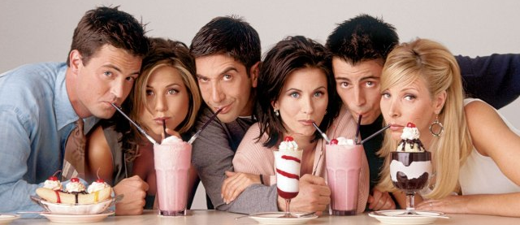
Friends
Friends are:
  Trusted companions
  People you can share your joys and frustrations with
  People who believe in you

Slide 3
Types of Friendships
Acquaintances
  People you recognize, but don’t really know.
  These are people you say “Hello” to in the hall, but you don’t make a point to see them socially. They can be classmates you recognize, friends of friends, neighbors who live in your area, people who ride the same bus as you, etc.
  Peers are usually acquaintances.
    A group with a commonality
    Usually your same age
    Shares common interests

Slide 4

Types of Friendships
Casual Friends
  People you share a common interest with like school or activities.
  It’s someone you’re assigned to work with on a science project, someone who is on the soccer team with you, attends your church, etc.

Slide 5
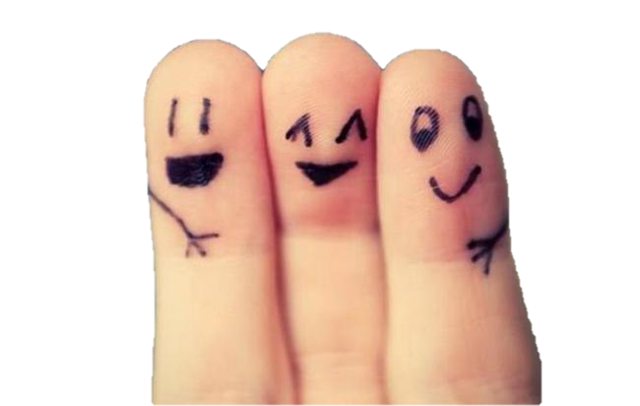
Types of Friendships
Close Friends
  Friends you hang out with and share some emotions/personal experiences with.
  These are friends you hang out with, go to the movies with, whose homes you visit and who you invite into your home. You share your feelings, thoughts and ambitions and can argue and express different opinions without being afraid of ruining the friendship.

Slide 6

Types of Friendships
Intimate Friends
  Friends you have had for a long period of time with whom there is a deep sharing of emotions and personal experiences.
  These friends have the freedom to tell you the truth, no matter how it may affect you. They know all about you and you know all about them. Intimate friends don’t just appear in our lives, but develop through the other stages of friendship.

Slide 7
Friendships
  Friends can be peers and peers can be friends. BUT…friends are not always peers and peers are not always friends.
  Friendships are the foundation for love and commitment.
  Friends need to develop a good RAPPORT: (Understanding each other in a close relationship).

Slide 8
Friendships
  Next to parents, friends have the greatest influence on your behavior.
  Choosing your friends is one of the MOST critical decisions you will ever make!
  Remember, friends are role models. Who are you allowing to affect your behavior? What kind of friend are you going to be?

Slide 9
Needs that Friends Meet:
  Disclosure: someone to talk to and confide in.
  Feedback: someone to help analyze what your situations and feelings are.
  Empathy: someone to care about you
  Trust: someone who keeps things confidential
  Social Interest: someone to go places with

Slide 10
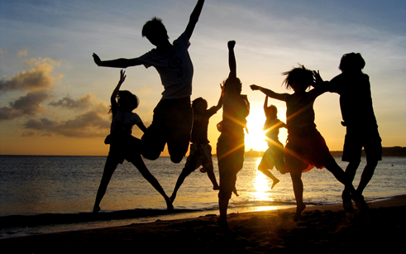
Group Friendships Give:
Encouragement
Safety
Identity
Learning
Discovery
Closeness

Slide 11
Friendship and YOU
What are the qualities you look for in a good friend?
When does an acquaintance become a “friend”?
Do your friendships typically develop quickly or slowly? Why is this?
What are some of the difficulties in becoming friends with someone you don’t know very well?
What are some behaviors you expect from your friends?
What are some behaviors you would not tolerate in terms of friendship?
How does one’s ability to listen and communicate impact friendship development?
Notes:
Each table take one of the questions and discuss. Then share with the class. Think, Pair, Share.

Slide 12
Friendship Tips
Choose steady friends who like you for who you are, not inconsistent ones who like you for what you have.
Make as many friends as you can, but never center your life on them.
Stop trying to be “popular”. Just be yourself, be nice to everyone, and good things will follow.

Slide 13
Friendship Tips
Be quick to forgive your friends faults, just as you hope they’ll forgive yours.
If people are gossiping about you or you’re being bullied, confront the bully or find a way to live above it.
When it comes to friendships, stop competing or comparing and start thinking “win-win.”
Remember, you and your friends may change and pursue different interests and that’s okay.

Slide 14

How to be a GOOD friend
Listen to each other
Don’t put each other down or hurt each other’s feelings
Try to understand each other’s feelings and moods
Help each other solve problems
Give each other compliments
Disagree without hurting each other

Slide 15

How to be a GOOD friend
Be dependable
Respect each other
Be trustworthy
Give each other room for change
Care about each other
Keep promises and confidences

Slide 16
Making and Being a Friend
Be Slow to Judge
  Try not to judge others based on first appearance or first impression. Go outside your comfort zone and get to know new people. There is always more to a person than you think. “Strangers are just friends waiting to happen.”

Slide 17
Making and Being a Friend
Make the Effort
  Sometimes you have to be proactive and make the effort first. Don’t just wait for friends to come to you.

Slide 18
Making and Being a Friend
Look for Chances to Build Relationships
  Don’t forget the small stuff matters. Find ways to make relationships stronger: do small acts of kindness, say you’re sorry, be loyal, keep promises, listen, etc.

Slide 19
Making and Being a Friend
Make Yourself More Likable
  You can’t make people like you. But, you can make yourself more likable. Become aware of your weaknesses and try to improve upon them.

Slide 20
Making and Being a Friend
Be Inclusive
  Don’t be afraid to allow new people into your “group”. You never know what you could be missing out on.

Slide 21
Making and Being a Friend
Treat Unkindness with Kindness
  It’s easy to be nice to people who are nice to you. The challenge is being nice to the mean people. But, it goes a long way in changing behavior.

Slide 22
Making and Being a Friend
Lift Others
  Are you the negative friend who brings others down? Or, the positive friend lifting others up? Who do you want to be?

Slide 23
Listening
Being a good friend means being a good listener. Here is a review of active listening skills:
  Listen with more than just your ears. Your body language should also communicate real interest.
  Give verbal clues that show you are listening closely to what your friend is saying.
  Do not interrupt.
  Don’t shift the attention from your friend’s problem to one of your own.

Slide 24
Listening
More listening tips:
  Do not spend too much time planning your next response that you don’t hear what is being said.
  Try not to let your emotions get in the way of hearing.
  Don’t rush the conversation.
  Don’t try to solve the problem. Just be there as a support. Your friend needs to find the solution on their own.

Slide 25
Toxic
Friends

Slide 26

What is a Toxic Friend?
Unsupportive
• Takes, Takes, & Takes
Stifling
Gives Nothing Back
Unreliable
Overly Demanding

Slide 27

Warning Signs of a Toxic Friend
They talk about everyone…EVEN YOU!
Her neighbor is stupid. Your cousins are fat. His coworkers are nosey. And did you hear about who Stacy was hanging out with last night?
Here’s a clue, if your friend gossips about everyone don’t think for one moment that they aren’t gossiping about you!

Slide 28
Their “world” is always worse than yours.
Drama, drama, drama!!!
You mention how you were late to an important meeting because you forgot to fill up the tank, and you had to stop and get gas.
Toxic friend tells you, “That’s nothing! This one time I was late to work because my boyfriend took my car to go somewhere and he didn’t come back on time and I had to report it stolen because I forgot that he still had the car…..” (You get the point.) Whatever you say is “nothing” because their life is always so much worse.

Slide 29
Your positives are their negatives.
You just got a promotion. Toxic friend doesn’t congratulate you; instead he points out how you’ll have to work more and you probably didn’t get that much of a raise anyway. He also mentions how others at work will probably hate you because you are now their boss.
They cannot be happy for you because it did not happen to them.

Slide 30

Their motto is “Just Kidding! I Love You!” or “No offence, but…”
You are eating a cheeseburger and she calls you a cow…Just Kidding!
He says, “No offence, but your shirt is really ugly!”
They always insult you, but say “Just Kidding” afterwards.
Guess what…..it’s still an insult!

Slide 31
How to Handle a Toxic Friend?
Recognize the toxicity.
  Realize that they are toxic. How do you really feel when you are around them? They may not be toxic to others, but they are to you.

Slide 32
How to Handle a Toxic Friend?
Take responsibility.
  By continuing a toxic friendship, you’re allowing your friend to hurt you, but you’re also hurting yourself.
  Are you a people pleaser? Do you have a hard time standing up for yourself?
  Even though we want to our friends to like us and to have them rely on us, take responsibility for toxic friendships and how they make you feel.

Slide 33
How to Handle a Toxic Friend?
Set boundaries.
  Make your own self-care more important than pleasing the toxic friend.
  Even though it is hard, SAY NO!!!!

Slide 34
How to Handle a Toxic Friend?
Talk to your nontoxic friends.
  See if they can help you gain an objective opinion about your toxic friend.
  Do not use it as a gossip session to talk about or bag on your toxic friend. It is meant for asking advice and gaining new insight into the friendship.

Slide 35
How to Handle a Toxic Friend?
Suggest help.
  Although it is a sensitive subject, you may suggest that your toxic friend seek help to sort out their career, emotions, family, etc.
  Suggest help in a loving way and tell them that you will be supportive every step of the way.

Slide 36
How to Handle a Toxic Friend?
End the friendship.
  It is difficult to end any friendship. It is not fun and it hurts. However, the friendship is doing more damage and hurting worse than the breakup will be.

Slide 37


Slide 38
Social Media & Friendship
How does social media impact friendships?
Pro’s | Con’s
Improves relationships and helps to make new friends | Less to say in person/lack of in-depth conversation
Can enable face-to-face meetings | False sense of true friendship by how many “friends” or “likes” they have
Helps people become connected with social groups | More comfortable posting inappropriate content that can never be taken back
Notes:
http://socialnetworking.procon.org/
http://friendship.about.com/od/Social_Networking/tp/Ways-Social-Networking-Ruins-Friendship.htm
http://www.cbc.ca/news/health/social-media-affecting-teens-concepts-of-friendship-intimacy-1.2543158

Slide 39

Cautions of Social Media
Possible consequences of using social media negatively include:
  Social rejection
  Bullying/Cyberbullying
  Gossiping
  Sexual harassment
  Abuse
Notes:
Be careful of what you put into print/photo’s online. Once it is out there it is out there and there is NO retrieval. DO NOT put anything online that you would not say to the person face-to-face. Think about the consequences of what you put online- How is it going to make others feel? Is it really important to post? Could it impact someone’s future? Could it impact your future?
This is where we can reinforce Passive, Aggressive, Assertive behaviors.

Slide 40
Cyberbullying
Notes:
Be careful of what you put into print/photo’s online. Once it is out there it is out there and there is NO retrieval. DO NOT put anything online that you would not say to the person face-to-face. Think about the consequences of what you put online- How is it going to make others feel? Is it really important to post? Could it impact someone’s future? Could it impact your future?
This is where we can reinforce Passive, Aggressive, Assertive behaviors.

Slide 41
Social Media & Your Future
Your use of social media can impact your future opportunities. Think about the consequences BEFORE putting something online!
  How is it going to make others feel?
  Is it really that important to post?
  Could it impact your future career/life?
  Could it impact someone else's future? (Friends, family, co-workers, etc.)
Notes:
Be careful of what you put into print/photo’s online. Once it is out there it is out there and there is NO retrieval. DO NOT put anything online that you would not say to the person face-to-face. Think about the consequences of what you put online- How is it going to make others feel? Is it really important to post? Could it impact someone’s future? Could it impact your future?
This is where we can reinforce Passive, Aggressive, Assertive behaviors.

Slide 42
What will your digital reputation be?
Notes:
Be careful of what you put into print/photo’s online. Once it is out there it is out there and there is NO retrieval. DO NOT put anything online that you would not say to the person face-to-face. Think about the consequences of what you put online- How is it going to make others feel? Is it really important to post? Could it impact someone’s future? Could it impact your future?
This is where we can reinforce Passive, Aggressive, Assertive behaviors.

