Slide 1
BOOM!
BOOM!
Peer Pressure & Refusal Skills
You can do this!

Slide 2
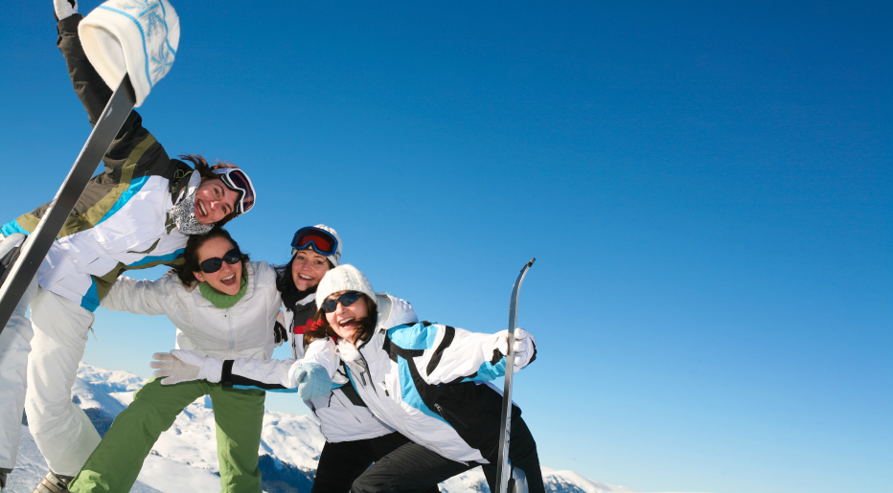
Friendships make up a valuable, positive element in our lives. The three components of good friendships are:
Belonging & Acceptance
Sharing of Feelings & Experiences
Sense of Personal Worth

Slide 3
A Need to Belong
Feeling Lonely: Not feeling like you are part of a group-large or small. You feel left out or overlooked altogether when you really want to feel included in the group.
Being Alone: You choose to be alone. It’s a positive time for self. Choosing to be alone doesn’t mean someone feels rejected or lonely.
Feeling Rejected: others prefer not to be with you. When you try to join in but are shut out.

Slide 4
Reasons for Rejection
Physical handicaps
Super smart
Learning disabilities
Ethnic origins
Religious beliefs
Gender
Geography (where you live)
Family income
Skill level
Inappropriate behaviors
Family structures
Do you ever feel affected by any of these?
Do you ever reject others because of these?

Slide 5
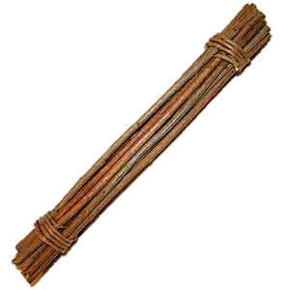
Aesop’s Fable
There was once a group of friends. They really did care about the welfare of each other, but they caused each other great trouble by their constant fighting and arguing.
One day as a member of this group told a parent about their problem, the parent called all the friends together and showed them a bundle of sticks. “Which of you friends can break this bundle of sticks?” he asked them.
All the friends tried in turn, but not one of them could do it. Then the parent untied the bundle and gave each friend a single stick. “See if you can break that,” he said. Of course, they could easily do that. “Each of you alone, without friends or associates might be weak. Each might be as easy to injure as one of these sticks. But if you will be friends and stick together, supporting each other and ceasing to fight, you will be as strong as the bundle of sticks.”

Slide 6
Benefits of Group Association
Gives self-esteem.
Reduces stress.
Offers opportunities for social and leadership skills.
Understands social expectations.
Provides identity and emotional security.
Satisfies a sense of belonging and unity.

Slide 7
Types of Groups
Sports
Character Building
Service
Church
Causes or concern centered
Neighbors
Activity-centered
Basketball, soccer, etc.
Scouts, Boys/Girls Club
Kiwanis, Rotary
Church Youth groups, church teams
Environments, social issues
Neighborhood watches, projects
Chess, bridge, book clubs, hobbies, etc.

Slide 8
Warning!!
Does the group threaten me if I don’t do what they say?
Does the group engage in any illegal activity?
Does the group demean others?
Does the group promote prejudice?
Does the group engage in secret behavior they don’t want others to know about?
If yes to any of the above, it’s probably not a positive group to join.

Slide 9
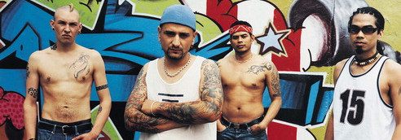
Why Do Teens Join Gangs?
Friendship
Identity
Something to do
Feeling of power
Excitement
Money
Protection
A sense of belonging
Pressure to join is so strong, teens feel they have no choice.
What is a GANG?
“A gang is a group of people who form an allegiance to the exclusion of others, for a common purpose, and who engage in violent, unlawful, or criminal behavior.” (Governor’s Task Force on Gangs, State of Utah, 1994)

Slide 10
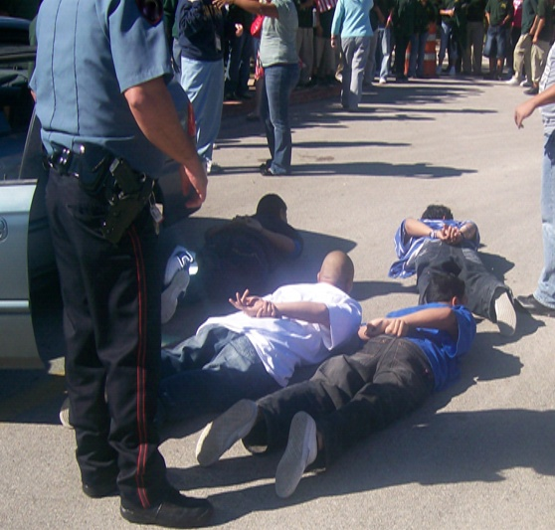
Consequences of Gang Membership
Almost guaranteed incarceration
Become wounded or killed
Hurt or kill others
Probably make little money
Causes great family trauma, or lose family ties altogether
Drop out of school, jeopardizing future
Close off other opportunities for future options

Slide 11
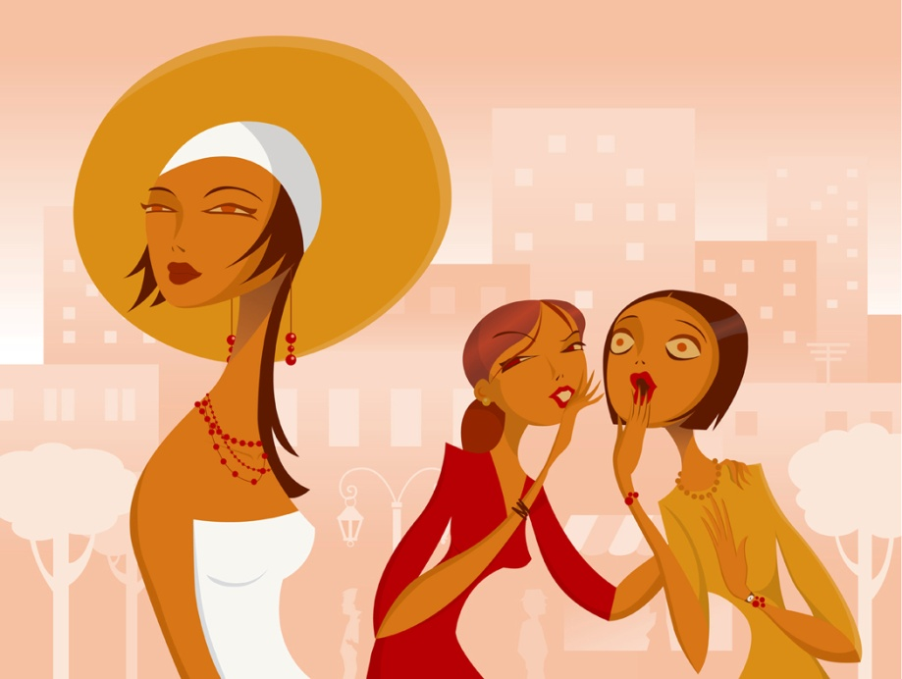
Many teens confuse friendship with peer pressure, or going along with the crowd.
Peer Pressure

Slide 12
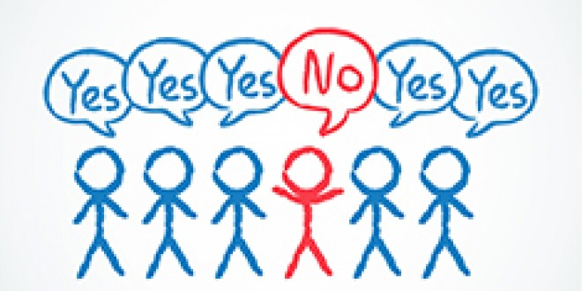
Ways of Recognizing Peer Pressure
Going along with the crowd.
Having the group make decisions for you.
Believing that everybody is doing it.
Negative Peer Pressure Positive Peer Pressure
Doing things you really don’t want to do
Doing something only to be part of the crowd
Loss of self control
Personal Conflict (right vs. wrong)
Judged by actions of group
Pressure into doing good things
Influences you to stick to your values/goals
Helps you listen to your feelings
Helps others by setting a good example
Judged by actions of group

Slide 13
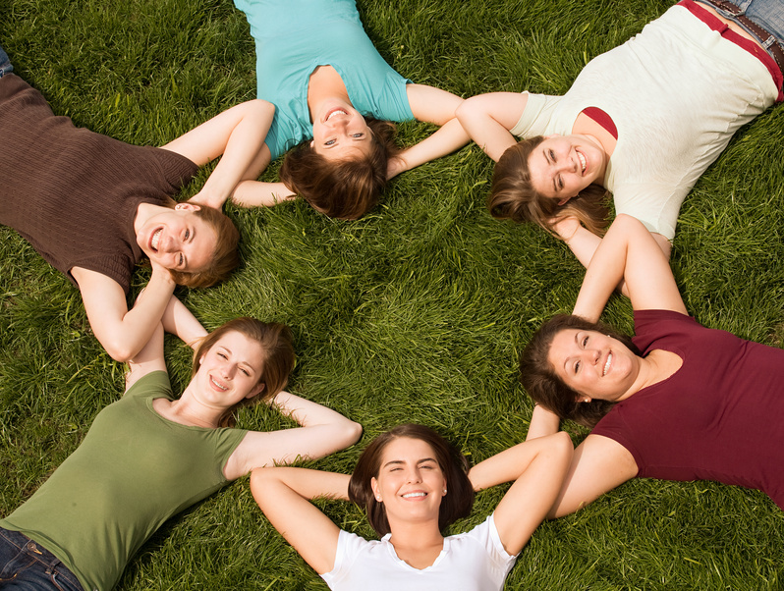
People who feel good about themselves don’t fear group rejection.

Slide 14
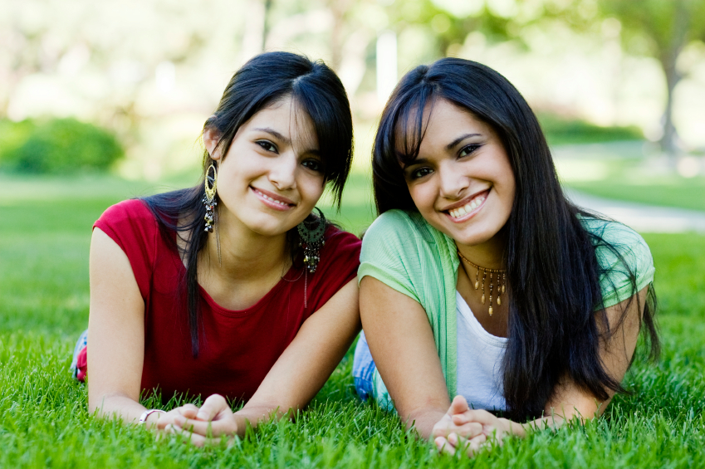
Looking Logically at Peer Group Rejection
It’s a threat designed to take away YOUR self control
It does NOT mean rejection by everyone

Slide 15
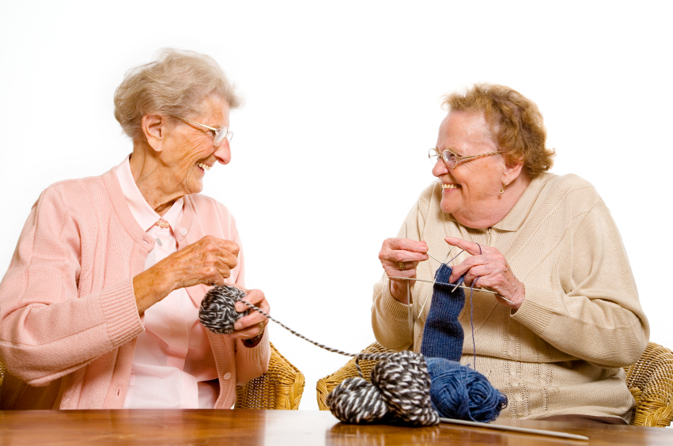
If you feel good about yourself, others will notice.

Slide 16
REFUSAL SKILLS
REFUSAL SKILLS
Ways to stand up for yourself

Slide 17
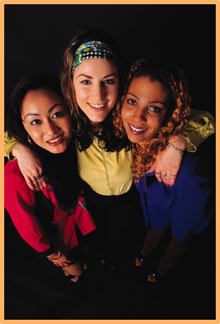
Ways You Can Deal with Peer Pressure
Make your own decisions.
Know who you are and who you want to be.
Set realistic positive goals.
Weigh the consequences of your actions.
Say no!
Be persistent.
Terminate the conversation.
Don’t be defensive.

Slide 18
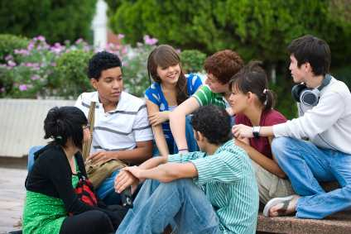
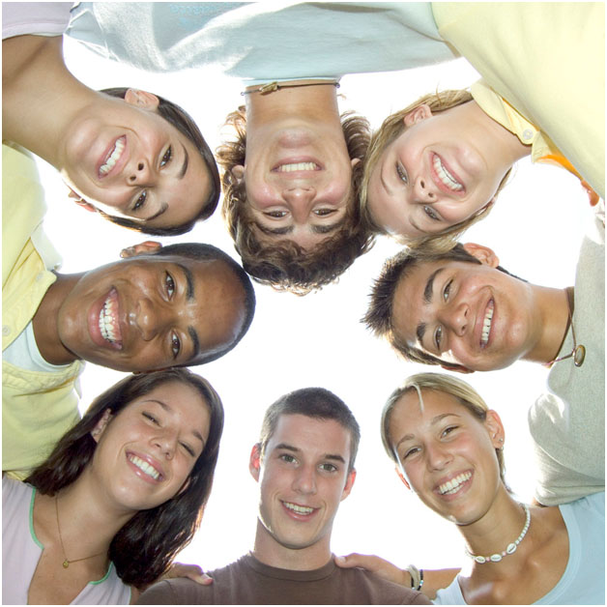
Basic Guidelines for Saying “No”
Stay calm
Make eye contact
Be assertive
Repeat if necessary
Walk away
Broken record technique
Find a friend who feels the same way you do, or recruit an ally.
Give reasons or excuses
Avoid the situation
Change the subject
Take a stand
Take a pledge
It’s the Law

Slide 19

8 Groups: 8 Decisions
Decision #1: School
Decision #2: Friends
Decision #3: Parents
Decision #4: Siblings
Decision #5: Addictions
Decision #6: Self Worth
Decision #7: Dating/ Sex
Decision #8: Job Opportunities
In your group you will come up with 3 situations dealing with that decision where a teenager would need refusal skills. Then come up with the “Good Idea” “Bad Idea” for the situations.

