Slide 1
Demands of Parenthood & Child Abuse

Slide 2
Teen Parenthood Pre-Test
(True or False)
True
True
True
True
True
True
Teen mothers are twice as likely to die in childbirth.
A child born to a teen mother is twice as likely to die before the age of one.
Teen mothers are twice as likely not to finish high school.
One-half of all welfare payments go to families with teen mothers.
20% of teen mothers are pregnant again within two years.
82% of girls who gave birth at age 15 or younger were born to teen parents.

Slide 3
Teen Parenthood Pre-Test, cont.
(True or False)
True
False
False
True
Most teen pregnancies happen by mistake – they were not planned.
If a boy has already made plans for further education after high school, he should not have to worry about marrying a girl, even if she is pregnant.
If a girl is pregnant, but the boy doesn’t want her to have the baby, he is not responsible for supporting the child financially.
If the father wants custody and the mother doesn't, the father gets custody, because it's his baby.

Slide 4
Teen Parenthood Pre-Test, cont.
(True or False)
False
False
False
False
True
If a girl gets pregnant a guy does not need to worry about it if he does not like the girl.
If a guy does not have a regular job, he will not be responsible for child support.
If a couple breaks up after the girl is pregnant, the guy has no responsibility for the child.
It's a girl's fault if she gets pregnant. It's not the guy's problem.
The divorce rate is greater for couples with a pre-marital pregnancy than for those who conceive after marriage.

Slide 5
Teen parenthood…
so what?
“It’s never going to happen to me!”

Slide 6
Four in ten girls get pregnant at least once before age 20.

Slide 7
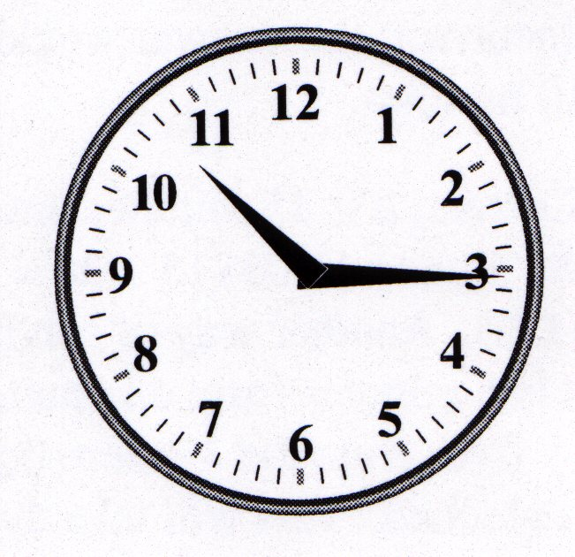
In the U.S., a teenager becomes pregnant every 26 seconds. That means 100 girls give birth each hour!

Slide 8
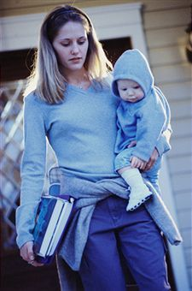
Consequences of Teen Parenthood:
Less likely to complete high school
Dependence on welfare
Single parenthood
More likely to have more children sooner on a limited income
More likely to abuse or neglect the child

Slide 9

Teen Parenthood Demands
Physical
  Teen bodies are still growing themselves which makes it harder to support the growth of another body at the same time.
  Do you know what your body needs to create a NEW healthy person?

Slide 10

Teen Parenthood Demands
Mother’s Health Risks
  premature labor
  prolonged labor
  anemia or toxemia
  higher death rate
  STI’s

Slide 11
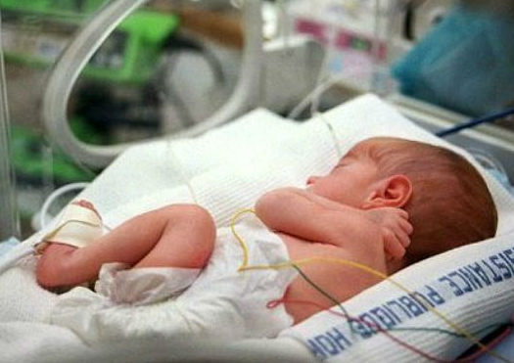
Teen Parenthood Demands
Baby’s Health Risks
  low birth weight (<5.5 lbs)
  organs not developed
  lung problems, bleeding
  more likely to die in first month of life

Slide 12

Teen Parenthood Demands
Financial
  Not able to provide the necessary items to raise a child
  Not ready to support a baby, home, spouse
  Future career is jeopardized

Slide 13
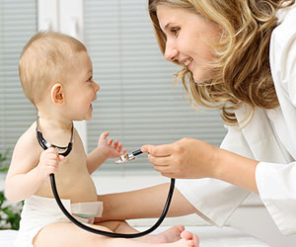
Teen Parenthood Demands
Intellectual
  Understanding the principles and guidelines of child development throughout life
  Most teen parents don’t finish high school, little hope for high paying career & child care is a problem

Slide 14

Teen Parenthood Demands
Emotional
  Difficulty in keeping emotions under control in high-stress situations due to a lack of sleep
  Adolescents still maturing emotionally themselves
  Hormonal swings and mood changes
  Baby depends on them 24 hours a day and teens are searching for independence

Slide 15

Teen Parenthood Demands
Social
  Give up personal free time and activities to put babies needs first
  Life drastically changes and teens don’t want to drag a baby along
  Fun and care-free activities become a thing of the past

Slide 16

Teen Parenthood Demands
Moral
  Teaching values, responsibility, choices and consequences
  Are you ready to be that example for someone else?

Slide 17
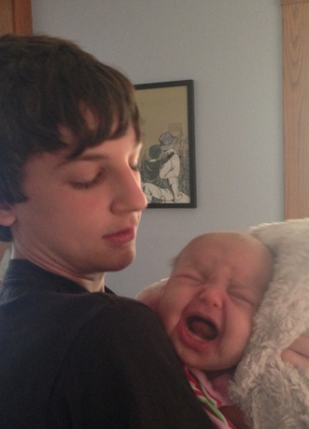
Teen Parenthood Demands
Marriage
  Having a relationship built on trust, fidelity, and commitment.
  Having children can make a strong relationship stronger, but can make weak relationship weaker.

Slide 18
Child Abuse
As a Result of
Teen Parenting

Slide 19
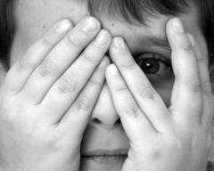
Child Abuse
Any mistreatment or neglect that results in emotional or physical harm or injury.

Slide 20
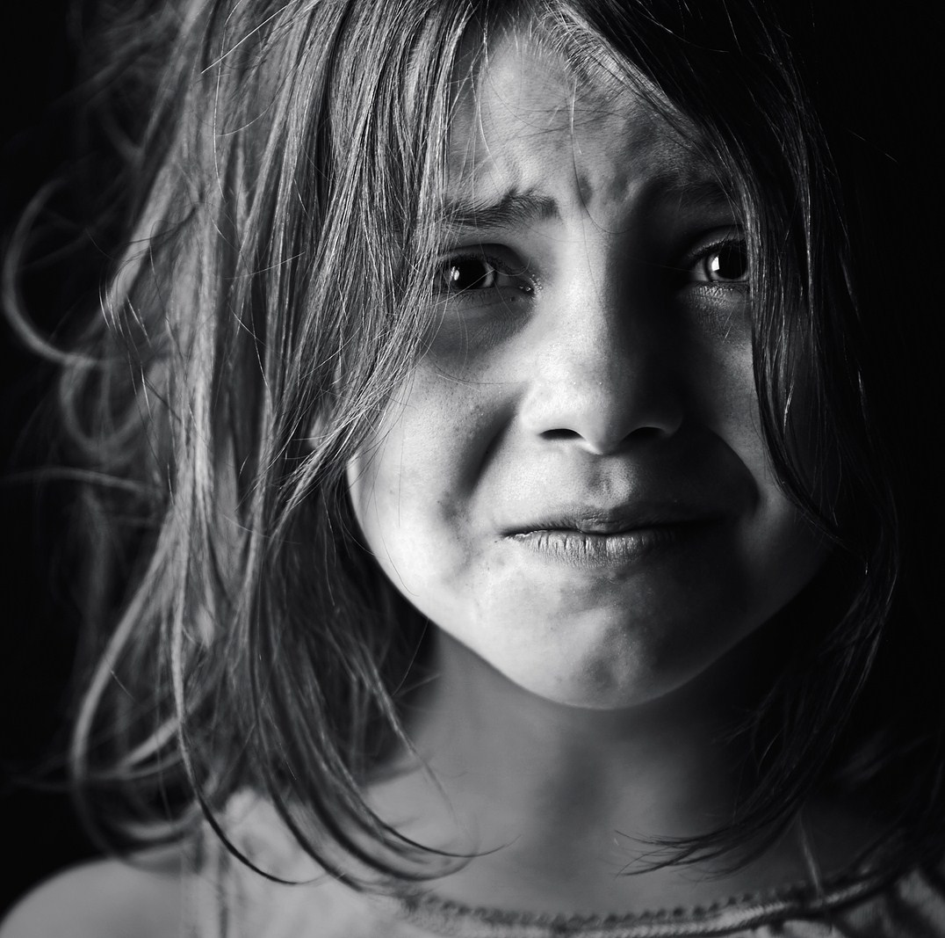
Types of Child Abuse

Slide 21
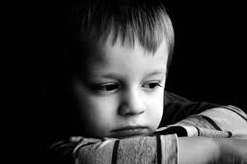
Neglect
Failure of parents or caretakers to provide needed, age appropriate care including food, clothing, shelter, protection from harm, and supervision appropriate to the child’s development, hygiene, and medical care.
Physical indicators of neglect: constant hunger, poor hygiene, excessive sleepiness, lack of appropriate supervision, unattended physical problems or medical needs, abandonment, inappropriate clothing from weather conditions.
Behavioral indicators of neglect: begging for or stealing food, frequent sleepiness, lack of appropriate supervision, unattended physical problem or medical needs, abandonment, inappropriate clothing for weather conditions.

Slide 22
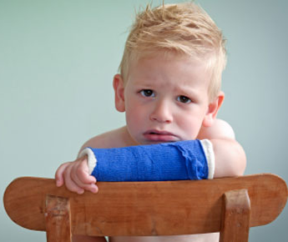
Physical Abuse
Non-accidental injury of a child that leaves marks, scars, bruises, or broken bones.
Physical indicators: unexplained bruises, burns, human bites, broken bones, missing hair, scratches.
Behavioral indicators of physical abuse: wary of physical contact with adults, behavioral extremes (aggressive or withdrawn), frightened of parents, afraid to go home, layered clothing.

Slide 23

Sexual Abuse
Any inappropriate sexual exposure or touch by an adult to a child or an older child to a younger child. This includes, but is not limited to: fondling, sexual intercourse, sexual assault, rape, exposure, and pornography.
Physical indicators of sexual abuse: difficulty in walking or sitting, torn, stained, or bloody underclothing, pain in the genital area, bruises or venereal disease.
Behavioral indicators of sexual abuse: age-inappropriate sexual knowledge/sexual touch, abrupt change in personality, withdrawn, poor peer relationships, unwilling to change for gym or participate in physical activities, promiscuous behavior, drop in school performance/decline in school interest, sleep disturbances, regressive behavior (i.e., bed wetting).

Slide 24
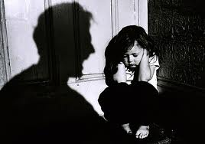
Emotional Abuse
Behavior such as rejecting, terrorizing, berating, ignoring or isolating a child that causes serious impairment of the physical, social, mental, or emotional capacities of the child.
Physical indicators of emotional abuse: speech disorders, lags in physical development, failure to thrive.
Behavioral indicators of emotional abuse: habit disorders (sucking thumb, biting, rocking), conduct disorders (withdrawal, destructiveness, cruelty), sleep disorders or inhibition of play, behavior extremes (aggressive or passive).

Slide 25

Reporting Abuse
Report the abuse!
Under Utah law, everyone has a legal obligation to report suspicion or knowledge of child abuse!

Slide 26

Services Available for Help
Child Abuse/ Neglect Hotline:
1-855-323-3237
St. George Division of Child & Family Services:
1-435-652-2960

Slide 27
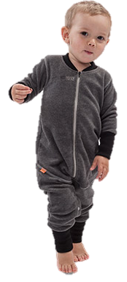


Major Components of Child Abuse
Child + Care Giver + Stress =
Child Abuse

Slide 28
Major Cause of Abuse
By Teen Parents
STRESS!
  Stress related issues:
    Being a new parent, not knowing what to do
    Financial burdens
    School or lack of schooling
    Social isolation—lack of support
    Abuse of alcohol and drugs
    Illness, medical bills
    Lack of sleep

Slide 29
How did you feel hearing the baby cry at the beginning of
the lesson today?
What did it make you want to do?
What did you say to your friends sitting next to you?

Slide 30
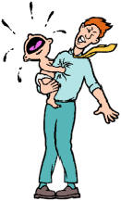
Crying
Unfortunately, uncontrollable crying is the number one factor that leads to child abuse by parents.
(Especially teen parents!)

Slide 31



Remember…
Infants are too young to understand requests.
Make up your mind that you are there to help the baby, not necessarily to stop the baby from crying.
Just because it is night time does not mean the baby turns off or switches to your schedule.
Check to make sure the baby’s basic needs are met (Is the baby ill? Could the baby have colic?)

Slide 32
Remember…
When the caregivers are tired:
  They are at a high risk for losing control.
  It is natural to feel frustrated when crying occurs.
  When the baby is crying, choosing options for dealing with the crying are not easy to see or think of, so plan what you will do to keep from losing control before you are faced with the situation.

Slide 33
Coping With Crying
Wrap the baby snugly in blankets (swaddling).
Feed the baby.
Burp the baby.
Give the baby a pacifier.
Turn off the lights and gently rub the baby’s back.
Let someone else tend the baby for awhile.
Walk with the baby
Rock the baby.
Dance with the baby.
Bounce the baby gently in your arms or on your knee.
Take the baby for a stroller ride.
Take the baby for a ride in the car.
Make sure the temperature of the room is comfortable.
Turn on the TV so the baby can look at if for a few minutes.
Take the baby outside for a breath of fresh air.
Turn on a music mobile or music box.
Change the baby’s diaper.
Give the baby a warm bath.
Lay down and place the baby on your stomach/chest and rub his or her back.
Let the baby sit in a baby swing.
Provide white noise for the baby (radio, vacuum, TV, etc.)
Divert the baby’s attention with a toy.
Sing to the baby.
Rub the baby’s back.

Slide 34
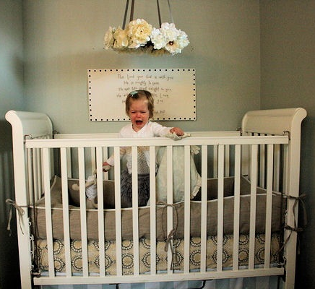
More Coping With Crying
After checking to make sure the baby is not hungry, wet, or in danger, place him or her in the crib, close the door, and call a friend to talk for a minute. Be sure to check the baby at least every 10 minutes.

Slide 35
Shaken Baby Syndrome
Shaken Baby Syndrome (SBS) results from the vigorous shaking of an infant or young child by the shoulder, arms or legs.
A single shaking episode usually results in whiplash-induced bleeding in and around the brain and can lead to death or permanent brain damage.
Infants and young children are more susceptible to SBS because their heads are disproportionately large in relation to their bodies, and their shoulders and neck muscles are weak and underdeveloped.

Slide 36
NEVER EVER SHAKE A BABY!!!

Slide 37
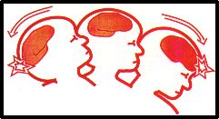
When a young child is shaken, the head whips back and forth, slamming the brain against the hard skull, causing bruising, bleeding and swelling inside the brain.
In addition to shaking, don’t ever toss a baby either. The dangers of tossing a child can lead to eye, brain and neck damage.

