Slide 1

Early Intimacy
& STI’S

Slide 2

Myth #1: Everyone’s doing it!
FACT: EVERYONE IS NOT DOING IT!
1. T or F: The vast majority of high school students are having sex.
Answer: FALSE
2. T or F: Having sex as a teen is becoming more and more common.
Answer: FALSE

Slide 3
Myth #2: Your sex drive is so strong you can’t control it.
FACT: YOU CAN CONTROL YOUR URGES!
Between stimulus and response, humans have the freedom to choose (self-awareness, conscience, imagination, will power).

Slide 4
Myth #3: Sex is safe.
FACT: There is no such thing as safe sex!
3. Question: What does STI stands for?
Answer: sexually transmitted infections
4. Question: Each year, what % of sexually active teens get an STI?
Answer: 25%
5. T or F: The younger you are, the more susceptible you are to sexually transmitted infections.
Answer: True

Slide 5
6. T or F: Sexually transmitted infections can often lie dormant for years without signs or symptoms.
Answer: True
7. T or F: You can get an STI from oral sex.
Answer: True
8. Question: Approximately ____ teenage girls get pregnant every year in the U.S 80% are unplanned.
Answer: 3 million

Slide 6
9. T or F: A girl can get pregnant the first time she has sex.
Answer: True
10. Question: What % of guys who get a girl pregnant end up marrying the girl.
Answer: 20%
11. T or F: Abstinence as a teen is the only protection that is 100% safe from disease, pregnancy, and emotional scarring.
Answer: True

Slide 7
12. T or F: Only about 1 in 10 (10%) teens who have had sex, wish they had waited.
Answer: False- about 50% do
13. T or F: Sex is a physical action so there aren’t any emotional regrets from early intimacy.
Answer: False- many teens become depressed and suffer from a low self-esteem, or feel disappointed, hurt and betrayed.

Slide 8
“One’s philosophy is not best expressed in words; It is expressed in the choices one makes. In the long run, we shape our lives and we shape ourselves. The process never ends until we die. And the choices we make are ultimately our responsibility.”
~Eleanor Roosevelt

Slide 9

Why do Teens Become Sexually Active?
To be more sophisticated or to appear more grown up and cool
To prove their love for another person
To become more popular
Peer pressure and acceptance
To find love, attention, warmth and affection
Believing “Everyone else is doing it”
7. Being pregnant is exciting, attention getting, and I will have a sweet baby to love and who will love me
8. To rebel against parents
Curiosity
Which of the reasons listed above are good enough for you to put your future physical and emotional health at risk?

Slide 10

Holding Hands
Making Out
SEX
Kissing
Petting
1…2…3…4…5…6…7…8…9…10
Intimacy Funnel
Commitment Funnel
Holding Hands
Level 1
Dating
Kissing
Level 2
Going Steady
Making Out
Level 3
Courtship
Petting
Level 4
Engagement
Progression
To
Physical Intimacy
Sex
Level 5
Marriage
Where does the “Danger Zone” start?
Notes:
-The speed down each funnel varies- can take years, can happen in one night
-Girls are usually more interested in the commitment funnel and guys are usually in control
-Guys are usually more interested in the intimacy funnel and girls are usually in control
-The earlier you go do the funnel, the harder gravity pulls.
-The more you date one person, the more slippery the funnel becomes
-It’s easier to end a relationship than it is to go back up the funnel
-Once down a funnel, the funnel becomes more and more slippery (Personal Experience: First guy I kissed- dated nearly a month. Second guy- 3 days.)
-Society has given different perceptions for different genders based on how many times they have been down the funnel- guys are studs and girls are sluts.

Slide 11


Slide 12
Progression to Physical Intimacy
The further individuals move toward physical intimacy, the harder it is to stop and there is a lessened desire to maintain control of their feelings.
It is easy to move up the scale, but it is very difficult to move backwards after being at a higher level.
Couples who move slowly toward physical intimacy give the relationship time to grow into a stronger friendship.

Slide 13
The Not-So-Fun
Facts of Life
Sex: The Consequences

Slide 14
Teen Pregnancy is NOT the worst thing that could happen to you if you become sexually active…

Slide 15
STI’s
Sexually Transmitted Infections
Not spread by toilet seats, towels, doorknobs, hot tubs or swimming pools.

Slide 16
What are STI’s?
Sexually Transmitted Infections (STI’s) are infections which are capable of being spread from person to person through: Sexual intercourse , AND oral, anal, genital, or digital contact, AND IV drug use/blood to blood contact
There are three categories of STI’s:
BACTERIAL (Can be cured if caught early enough)
VIRAL (Have NO cure…yet, but are controllable)
PARASITIC (Can be cured if caught early enough)

Slide 17
Consequences of Contracting an STI
Some are incurable.
Some cause cancer.
Some cause complications that affect the ability to reproduce.
Some can be passed from an infected female to her child before, during or after birth.

Slide 18
Abstinence
Abstinence is the BEST way to prevent exposure to an STI. Abstinence is:
The deliberate decision to avoid harmful behaviors, including sexual activity before marriage and the use of tobacco, alcohol, drugs or other harmful activities.

Slide 19
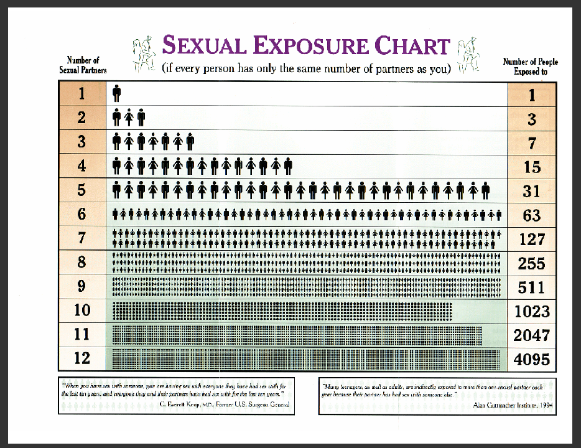

Slide 20
Review of Human Anatomy

Slide 21
Female Anatomy

Slide 22
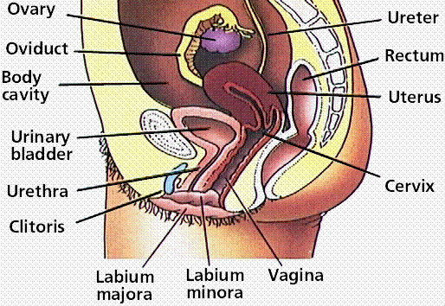
Ovary
Ureter
Fallopian Tube
Fallopian Tube
Rectum
Body Cavity
Uterus
Bladder
Cervix
Urethra
Labia
Vulva
Vagina
Labia
Vulva

Slide 23
Male Anatomy

Slide 24
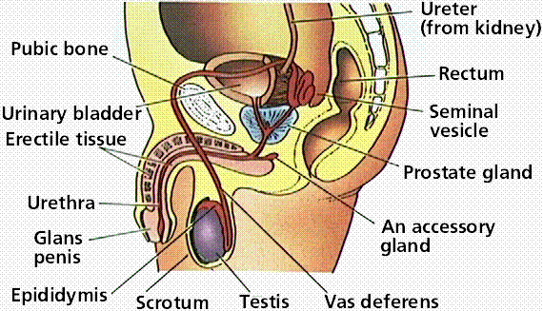
Ureter
Pubic Bone
Rectum
Bladder
Seminal Vesicle
Erectile Tissue
Prostate Gland
Urethra
Penis
Cowper’s Gland
Penis
Epididymis
Scrotum
Vas deferens
Testicle

Slide 25
HIV/AIDS
Definition: | A severe virus that destroys your immune system (Acquired Immuno Deficiency Syndrome)
Type: | Viral
Cause: | through direct contact of infected by anal, vaginal or oral sex, blood transfusion, contaminated hypodermic needles, exchange between mother and baby during pregnancy, childbirth, or breastfeeding, or other exposure to one of the above bodily fluids.
First Symptoms: | NONE! HIV virus stays hidden on average for 10 years, so even if a teen contracts the virus, it may not show up for YEARS!
Later Symptoms: | Infection: fevers, sweats, swollen glands, chills, weakness, and hair loss
Treatment: | There is NO KNOWN CURE!
If left untreated: | DEATH

Slide 26
Genital Herpes
Definition: | a viral infection characterized by outbreaks of painful sores on the genitals
Type: | Viral
Cause: | Spread during contact with an infected person who is secreting the virus in fluids from lesions or mucous membranes.
First Symptoms: | NONE! Most people with genital herpes have no symptoms.
Later Symptoms: | cluster of blister-like lesions in the genital area (head of penis, labia, anus, cervix) which spread and merge, break and crust over within 4 to 15 days. The fluid from these itching, painful sores is highly infectious.
Treatment: | Treatment is aimed at relieving symptoms. The antiviral drugs acylovir, valacyclovir, and famciclovir may be prescribed to lessen the duration and severity of outbreaks. Once infected, a person carries the virus permanently in a latent form in the nerve cells; there is no cure.
If left untreated: | Painful and severe outbreaks. If spread to a baby, can result in physical or mental damage.

Slide 27
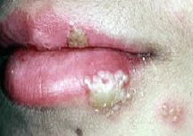

Slide 28
Hepatitis
Definition: | Inflammation of the liver
Type: | Viral
Cause: | Spread through bodily fluids exchange during sexual contact, sharing needles/syringes, or from an infected mother to her baby at birth.
First Symptoms: | NONE! It produces an initial acute phase with few symptoms. If any symptom is realized, they tend to be similar to flu like symptoms
Later Symptoms: | Gradually the conditions worsen and theses symptoms are experienced: jaundice (yellowed skin, mucous membranes and eye-whites), light colored stools that may contain pus, dark urine, itching, hives and severe liver damage (cirrhosis)
Treatment: | No cure, but a vaccine can slow the damage and inflammation
If left untreated: | DEATH

Slide 29
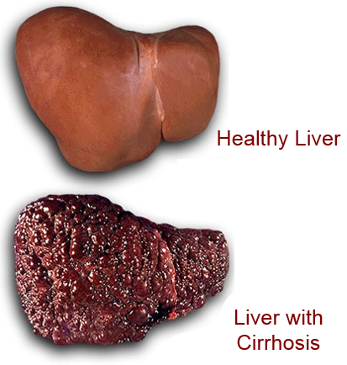

Slide 30
HPV/Genital Warts
Definition: | a type of wart found on or in the genitals
Type: | Viral
Cause: | often passed along during sexual intercourse, but not all those who have genital warts are going to know they are infected until the warts are bigger and a little more painful.
First Symptoms: | NONE! About two-thirds of people who have sexual contact with a partner with genital warts will develop warts, usually within 3 months of contact
Later Symptoms: | painless bumps, itching, and discharge
Treatment: | No cure, but antibiotic cream can help relieve symptoms
If left untreated: | Can cause cervical cancer, anal cancer and cancer of the penis.

Slide 31
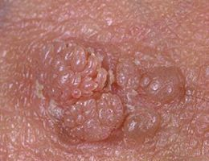

Slide 32
Gonorrhea
Definition: | A sexually transmitted disease caused by the bacterium Neisseria gonorrhoeae, characterized by inflammation of the mucous membranes of the genital and urinary tracts
Type: | Bacterial
Cause: | spread through sexual contact and bodily fluid exchange
First Symptoms: | NONE! Most people who are infected have no symptoms!
Later Symptoms: | Burning sensation when urinating, increased vaginal/penis discharge, thick discharge from penis and vagina
Treatment: | Antibiotics can successfully cure this in adolescents and adults; However, drug resistant strains are increasing. It is important to take all of the medication prescribed to cure gonorrhea. Although medication will stop the infection, it will not repair any permanent damage done by the disease.
If left untreated: | Infertility/damage to reproductive systems, epididymitis (painful infection of testicles), can be life threatening.

Slide 33
Syphilis
Definition: | caused by the bacterium Treponema pallidum. a wormlike, spiral-shaped organism. It infects the person by burrowing into the moist, mucous-covered lining of the mouth or genitals. The spirochete produces a classic, painless ulcer known as a chancre.
Type: | Bacterial
Cause: | passed from person to person through direct contact with a syphilis sore. Sores occur mainly on the external genitals, vagina, anus, or in the rectum. Sores also can occur on the lips and in the mouth.
First Symptoms: | NONE! Many people infected with syphilis do not have any symptoms for years. (Time between infection and start of first symptom can range from 10 to 90 days.)
Later Symptoms: | Primary, secondary, and latent stages will appear, then heal without treatment, however it is still having a damaging affect internally. Firm, round, small, and painless chancres can turn into large devastating ulcers during the tertiary stage.
Treatment: | A single intramuscular injection of penicillin, an antibiotic, will cure a person who has had syphilis for less than a year.
If left untreated: | Severe damage to internal organs and other body tissues which can result in death.

Slide 34
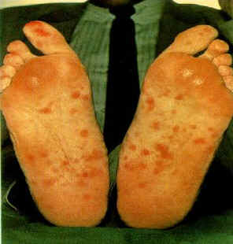
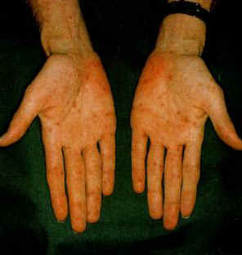

Slide 35
Chlamydia
Definition: | Is a bacterium that can cause a sexually transmitted infection common among young adults and teenagers
Type: | Bacterial
Cause: | Transmitted through sexual contact with an infected person
First Symptoms: | NONE! Many people don’t know they have Chlamydia, because although they are infected, they many not have any symptoms.
Later Symptoms: | In women, symptoms of chlamydia may include: An unusual vaginal discharge Bleeding between menstrual periods Burning with urination Abdominal pelvic pain In men, symptoms of chlamydia may include: Discharge from the penis Swollen and painful testicles Burning with urination Itching/burning around urethrea
Treatment: | Can be cured and treated with antibiotics
If left untreated: | Increased risk for HIV/AIDS, women can get PID, infants of infected mothers can develop dangerous eye infections.

Slide 36
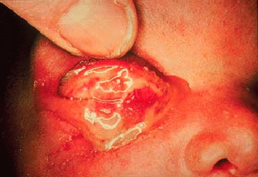

Slide 37
Pelvic Inflammatory Disease (PID)
Definition: | a general inflammation of the pelvic cavity that can lead to infertility.
Type: | Bacterial complication from contracting other STI’s
Cause: | Complications from Chlamydia and Gonorrhea
First Symptoms: | NONE! May include abdominal pain, lower back pain, bleeding between periods, fever
Later Symptoms: | abdominal pain and fever and foul-smelling vaginal discharge, internal abscesses (puss filled pockets that are hard to cure)
Treatment: | Antibiotics
If left untreated: | Fallopian tube scarring, infertility, higher risk of miscarriage or ectopic pregnancy, long-lasting chronic pelvic pain.

Slide 38
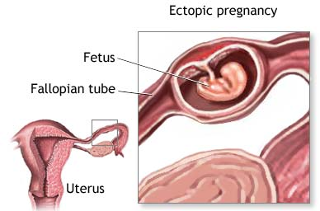

Slide 39
Pubic Lice
Definition: | Tiny insects that attach themselves to the skin and hair in the pubic area (Also know as Crabs)
Type: | Parasitic
Cause: | Very easily spread during sexual contact , or other kinds of close physical contact including sharing clothing or bed linens
First Symptoms: | None
Later Symptoms: | Intense itching in genital areas, rash, mild fever, feeling run-down, irritability
Treatment: | Prescription strength shampoos and creams, may need to apply medicine from head-to-toe more than once. Stronger medication may also be prescribed.
If left untreated: | Can spread from pubic hair to other hairy areas. Can spread from person to person through close physical contact.

Slide 40
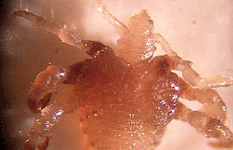
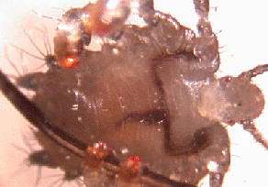

Slide 41
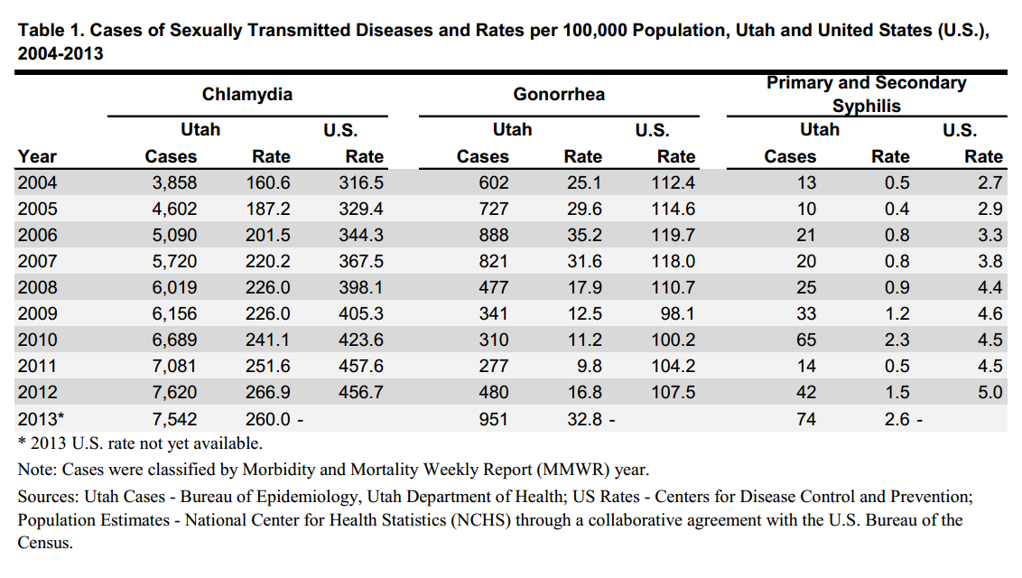

Utah Stats

Slide 42
STATS
Every year, there are approximately 15 million new cases of STD’s (41,000 per day) (8,000 teens per day)
2/3 of all STD’s occur in people 25 years of age or younger.
1 in 4 sexually active teens is infected with an STD
Less than ½ of adults ages 18-44 have ever been tested for an STD

Slide 43
CONCLUSION
(Solution)
Commit to abstinence before marriage and fidelity after marriage.
Just say NO!

Slide 44
Refusal Skills
Say “NO” | “No, I don’t want to.”
Change the Subject | “Let’s go to a movie.”
Reverse the Pressure | “If you really loved me, you wouldn’t ask.”
Use Broken Record Technique | Repeat the same answer over and over. “No, No, NO, NO!”
Avoid the Situation | Make an alternative suggestion first.
Walk Away | Just walk way and get out of the situation.
Delay | “Let’s wait.”
Give Reasons Why You’re Saying “NO” | “I’m not ready yet; I want to wait for marriage.”

