Slide 1
Etiquette
With Mrs. Milburn

Slide 2
Food Fact, Standard 5
Many U.S. table manners originated in Old England with the Anglo-Saxons, about 1000 A.D.

Slide 3
Food Fact
To eat soup, you dip the spoon in the soup away from you and eat from the side of the spoon.
Do not slurp or tilt the bowl.

Slide 4
Good Table Manners!
Video

Slide 5
What we know about manners?
Origin of forks
Compare cultures
What cultural practices do you know of?

Slide 6
Where do we need manners?
Let’s talk about where we use these manners
Sneezing/coughing rules
Use your words! (please, thank you, please pass, may I, excuse me)
Pass to the right (counterclockwise)

Slide 7
The Top Ten
Chew with your mouth closed
Avoid slurping (drink soup from the side of the spoon)
Don’t use your utensils like a shovel
Don’t pick your teeth at the table
Use your napkin!
Wait until you’re done chewing to take a drink
Cut only one piece of food at a time
Butter each piece of bread
Posture! No ___________ on the table.
“Excuse me” and “please pass,” “thank you!”

Slide 8
Rules for Place Settings
Generally: forks on the left, spoons and knives on the right
FORKS
Drinks on the right
1” from the table edge
Napkins never cover your silverware

Slide 9
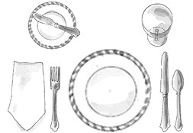
BASIC Remember: FORKS

Slide 10
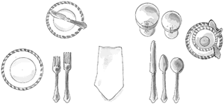
Informal

Slide 11
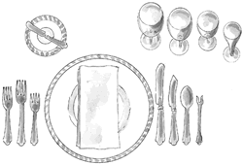
FORMAL

