Slide 1
Fashion careers
Jan 2016

Slide 2
“Utah’s Own” Fashion and Products
“Utah is a four-season world-class travel destination and a premier global business destination. At the nexus of both is the nation’s preeminent outdoor products and recreation industry.
Utah’s vibrant outdoor business community has a workforce that is eight times more concentrated than the nation and produces everything from award-winning carbon fiber composite bicycle rims and water skis to essential clothing and outdoor products. In Utah we not only enjoy top tier outdoor products and the best in fashion, we design them for the world to enjoy. Utah is the proud home to many fine companies designing truly world-class products. The following pages showcase a very small selection of fashion and products from Utah-based companies such as Black Diamond, Salomon, Ogio, Utah Woolen Mills, Kuhl, Petzl, Easton, Mr. Mac, Albion and many other fine firms…names you already know or definitely should!”
  Utah Governor’s Office of Economic Development

Slide 3
Notes:
Adobe statistics

Slide 4
Need for a Skilled Work Force
Utah Outdoor Retailers Trade Show
Brings 46,000 people
Generates $40 million for the local community
Every month 2-3 outdoor businesses move to Utah looking for a work force.
“Utah is looked upon as an ideal place to operate such companies”
  Joel Joseph, Chairman of the Made in the USA Foundation
  Salt Lake Tribune
Notes:
We provide skilled employees for the work force needed

Slide 5
Outdoor Products
Provides 6.1 million American jobs
$646 billion in outdoor rec spending each year
  3rd largest area of annual consumer spending
$39.9 billion in federal tax revenue
    Outdoor Industry Association (OIA)
Notes:
Data for the importance of Outdoor Products alone, this doesn’t even include all of the jobs and money created by the Fashion industry. Need to keep these business in Utah because the demand is so high.

Slide 6
Fashion Industry
Fashion is a global, multi-trillion dollar industry that everyone participates in. According to the BLS on average each household spends $1,700 per year on apparel.

Slide 7
Current Fashion Job Openings in Utah
Salary Estimates and # of current fashion job openings listed on Indeed.com
$20,000+ (848)
$40,000+ (242)
$60,000+ (100)
$80,000+ (42)
$100,000+(19)
This list is not inclusive of all job openings but a sampling of opportunities in the field and the need for prepared students.
Notes:
July 2016

Slide 8
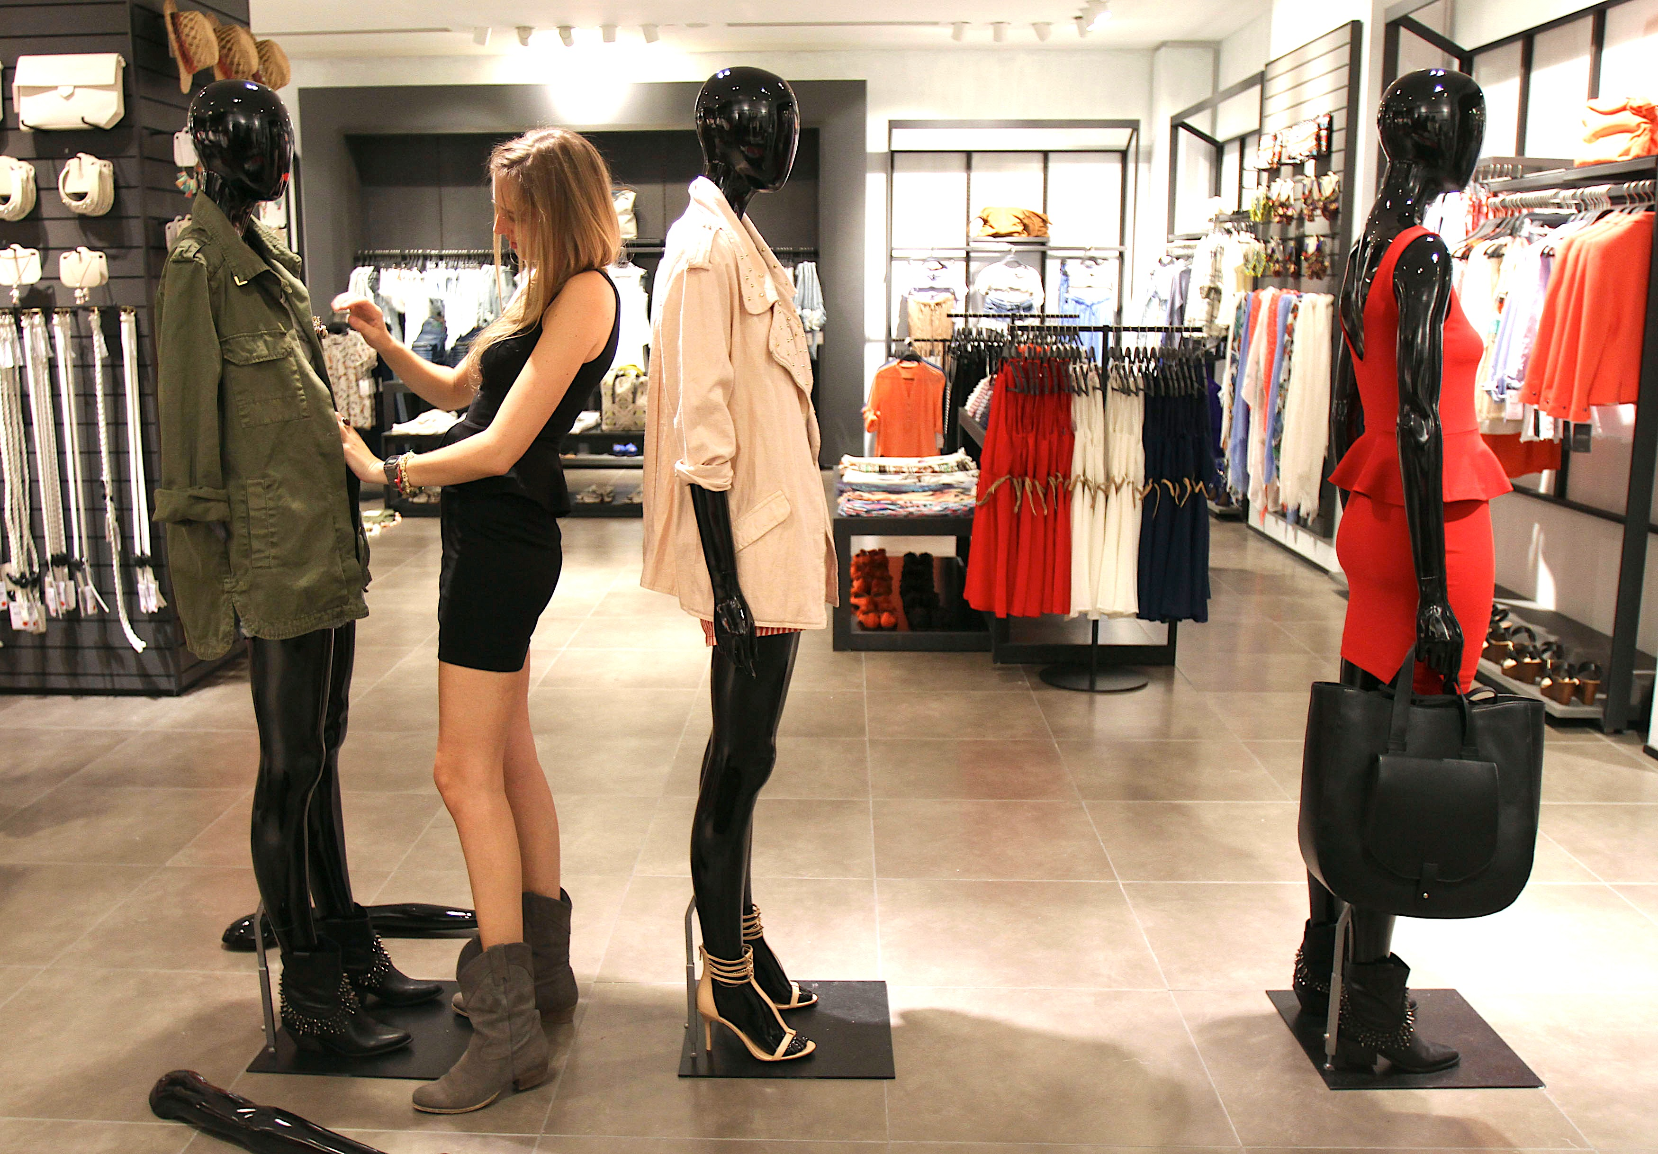
Entry Level Careers
Sewing Machine Operators
  Projected Growth in next 10 years: +10%
  Annual Salary:
    Low $17,400
    Median $23,200
    High $35,300
Retail Sales
  Projected Growth in next 10 years: +20%
  Annual Salary:
    Low $16,500
    Median $21,600
    High $44,300
Notes:
The Projected growth is based on growth in Utah, all of these %s are higher than the national rate by at least 10%

Slide 9
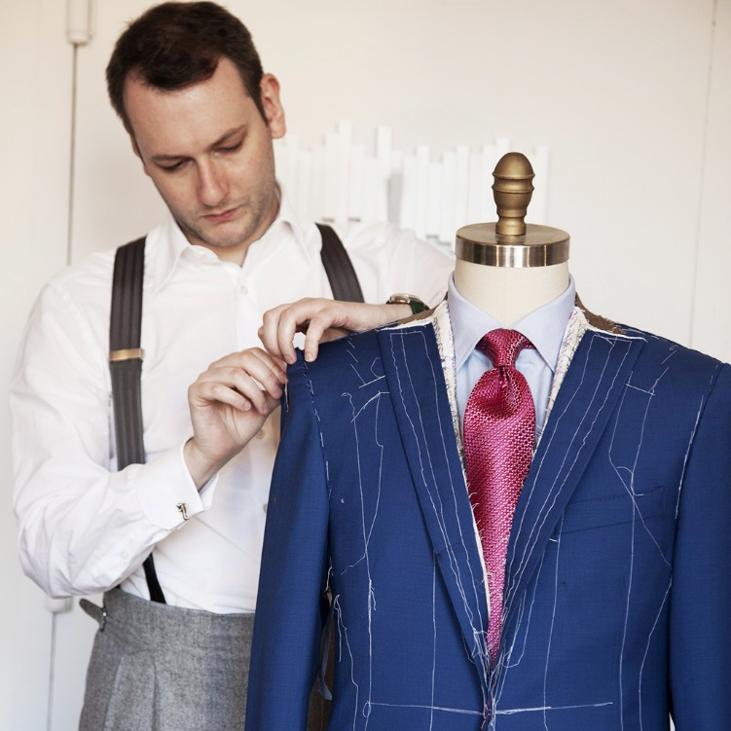
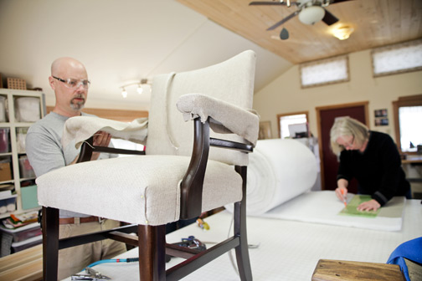
Entry to Mid-Level Careers
Tailors, Dressmakers & Custom Sewing
  Projected Growth in next 10 years: +20%
  Annual Salary:
    Low $17,700
    Median $25,900
    High $37,500
Upholstery
  Projected Growth in next 10 years: 29%
  Annual Salary:
    Low $20,400
    Median $29,600
    High $38,800
      USA High 50,000

Slide 10
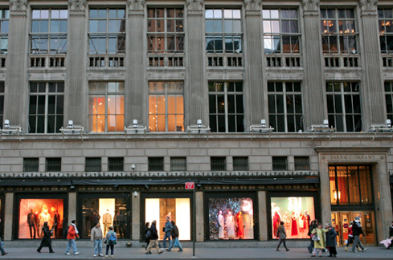
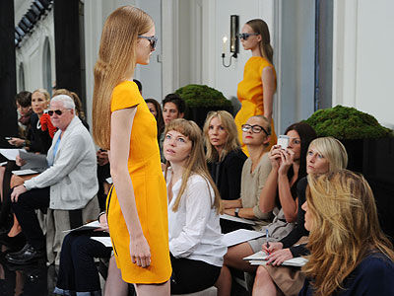
Entry to Mid-Level Careers
Merchandising Display
  Projected Growth in next 10 years: +23%
  Annual Salary:
    Low $20,500
    Median $27,800
    High $44,500
Retail Wholesale Buyers
  Projected Growth in next 10 years: +23%
  Annual Salary:
    Low $30,300
    Median $47,800
    High $81,200
      USA High $93,900

Slide 11
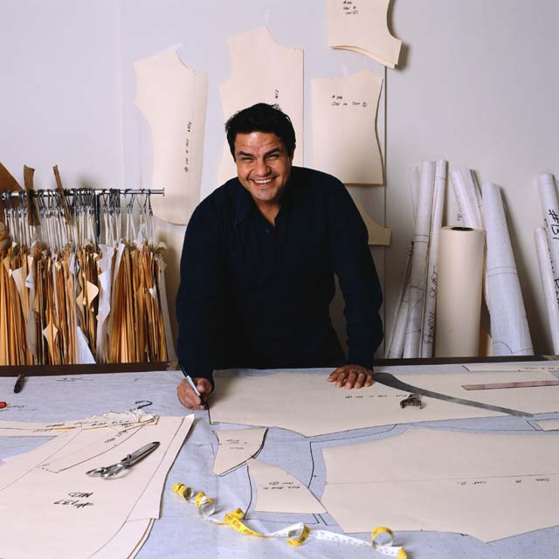
Upper Level Careers
Fashion Design
  Projected Growth in next 10 years: +27%
  Annual Salary:
    Low $24,900
    Median $43,100
    High $75,400
      USA High 129,400
Pattern Makers
  Projected Growth in next 10 years: NA
  Annual Salary:
    Low $22,000
    Median $41,300
    High $82,600

Slide 12
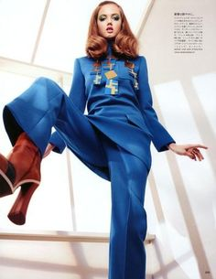
Upper Level Careers
Fashion Editor
  Projected Growth in next 10 years: +18%
  Annual Salary:
    Low $21,400
    Median $45,500
    High $106,600
Marketing Managers
  Projected Growth in next 10 years: 32%
  Annual Salary:
    Low $63,200
    Median $113,00
    High $187,200

Slide 13
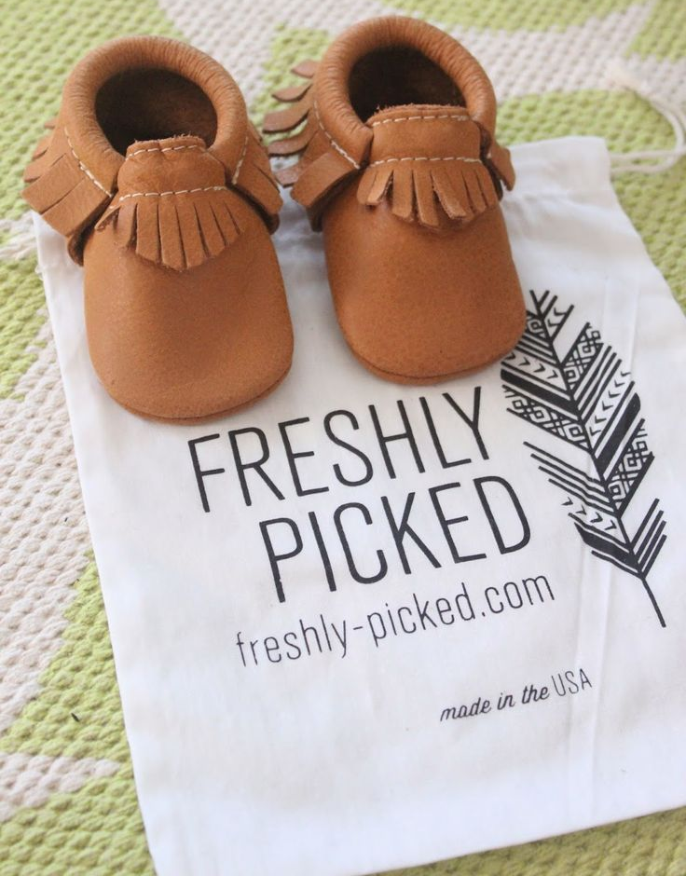
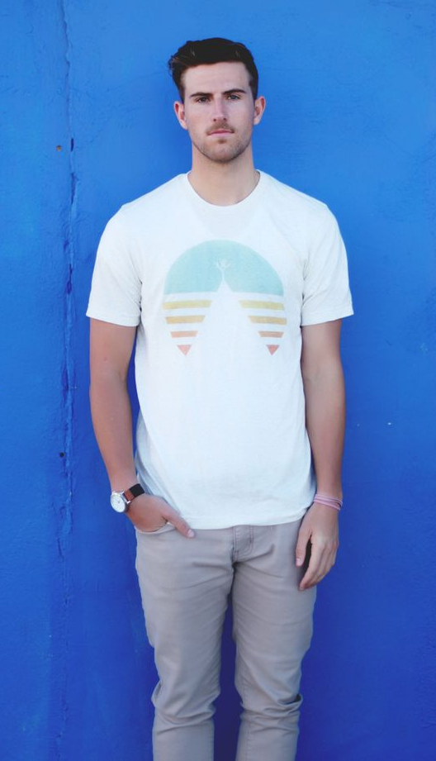
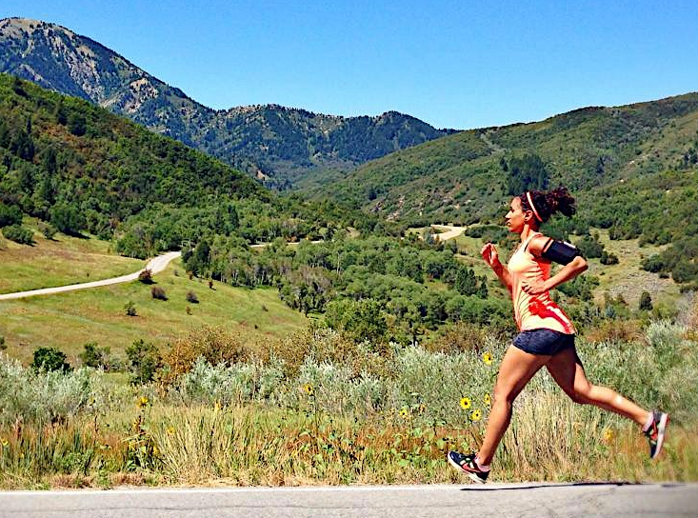
Entrepreneurship
According to the US Chamber of Commerce, Utah is ranked 3rd in the nation for Entrepreneurship and Innovation
  Freshly Picked - specializing in baby moccasins.
  Indy Brand Clothing
  Original Armpack
  Heated Jacket
Notes:
A large number of these entrepreneurs are creating apparel and outdoor products not only for the Utah market but around the world.
All of the companies listed are Utah based.

Slide 14
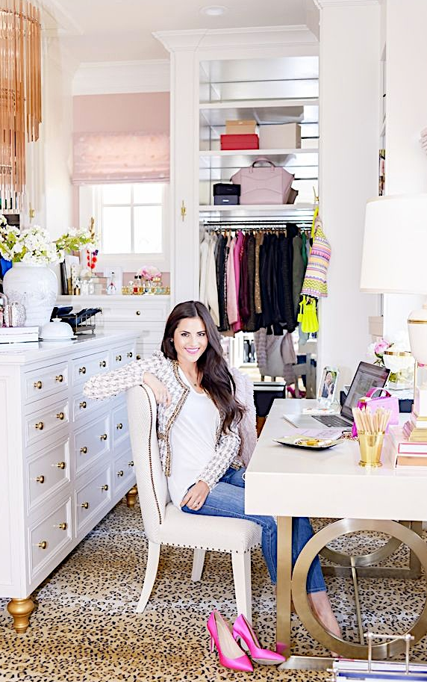
Fashion Bloggers
Another career relatively ignored by the BLS is the Fashion Blogger. These people have huge realms of influence on social media and companies are willing to pay them very well for advertisement.
For example: A well know Utah based fashion blogger, Pink Peonies by Rachel Parcell, started posting her outfits on social media in high school because she had a passion for fashion. She now has 551,000 followers on Instagram and makes at least $960,000 annually from affiliate commissions.

Slide 15
Interior Design Careers
Interior Designer
Graphic Designer
Art Director
Display Designer
Fabricator
Entrepreneur
Notes:
Briefly discuss with students as they write these careers on their paper.
What do you know about this career?
How does it connect like a class like sewing construction and design?
**these careers are the ones in the curriculum guides*** you could add more if you wanted.**

Slide 16
Fashion Design Careers
Fashion Designer
Purchasing
Buyer
Retail Sales
Theater
Entrepreneur
Notes:
Briefly discuss with students as they write these careers on their paper.
What do you know about this career?
How does it connect like a class like sewing construction and design?
**these careers are the ones in the curriculum guides*** you could add more if you wanted.

Slide 17
Research some info……
Job Description
Education and or training needed
Salary
Go to www.bls.gov
Or www.utahfutures.org
Notes:
Research online each of the careers. Use one of the two websites listed.

