Slide 1
I'm sharing some documents I created for standard 3 for Textile Design Entrepreneurship class. Currently my students are working on a sewing project I call "Sew Simple" Their challenge is to take an existing pattern and then make design detail alterations to it and then fabricate it. During this sewing challenge, we take approximately 20 minutes each day to talk/discuss/explore each of the objectives for standard 3. Part of this includes defining sustainability and ethics as it relates to the fashion industry. I have them write an argumentative paper on the topic and then we will debate the topic. The PPT I've included meant to cover several class periods. I don't have notes to go with it. There are links to some videos imbedded into it. I hope they work for you. This ppt is a work in progress as Im still doing the unit. I hope to add 4-5 more slides that focus on fabric technologies and finishes.
Thanks, Amber Williams amwilliams@dsdmail.net

Slide 2
Standard 3
Identify and choose appropriate fabrics as it relates to an end product.

Slide 3
What do you already know about textiles?
Notes:
Objective 1: Review and identify characteristics of natural fibers (e.g. cotton, wool, silk, linen, bamboo).
Objective 2: Review and identify characteristics of synthetic and/or manmade fibers. (Polyester, nylon, rayon, acetate, spandex, acrylic, Olefin, fiberglass)

Slide 4
What stories do your clothes tell?
Notes:
http://wornwear.patagonia.com/

Slide 5
Holy Jackets
Notes:
Holy Jackets on You Tube from Jcrew
Discuss what quality means to different consumers,
What thoughts do students have after seeing this clip?

Slide 6
Fabric Finishes/Fabric Technologies
Stain resistant
Fire resistant
Wrinkle resistant
Waterproof
Notes:
Fashion! Pg 161-164
Students write definitions behind the term for smash book

Slide 7
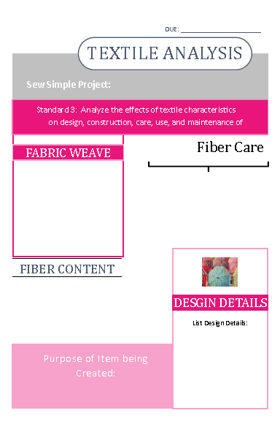
Sew Simple
Take an existing pattern or design and add your own design details to it.
Create your design.
Share your design in class.
Analyze the effects of textile characteristics on design, construction, care, use, and maintenance of products created in class.

Slide 8
What is Sustainability?
Notes:
Define sustainability and ethical practices as they relate to the textile industry.

Slide 9
eth·i·cal ˈeTHək(ə)l/ adjective
Is it ethical for magazines to have their photos altered?
Is it ethical for stores to have their mannequins all be the same size?
Is it ethical to produce a knock-off of a designer’s work?
What is an ethical wage?
What are the ethics surrounding environmental impact?
Notes:
http://www.watchmojo.com/video/id/7291/
http://itaaonline.org/?page=5

Slide 10
What is sustainability and ethical practice in the textile industry?
Notes:
http://www.undressrunways.com/fashion-sustainability/
http://www.meldrenachapin.com/blog/wordpress/2013/05/17/hm-for-sustainability/
http://www.slideshare.net/Deloittesustainability/value-opportunities-in-sustainable-fashion
http://www.theguardian.com/sustainable-business/sustainable-fashion-blog

Slide 11
Sustainability
Notes:
Objective 5: Examine the progression of ethical practices in the textile and apparel industry.
Explore and identify sustainability (public health, welfare, environment)
Environmental responsibility
Human ethical impact of fibers used in the industry. (Labor, Labeling information)

Slide 12
Textile Technology
Notes:
http://www.innovationintextiles.com/smart-textiles-nanotechnology/
Nano Technology

Slide 13
Care Label
Create a care label for your Sew Simple Project

