Slide 1
Performance Troubleshooting across Networks
Joe Breen
University of Utah
Center for High Performance Computing

Slide 2
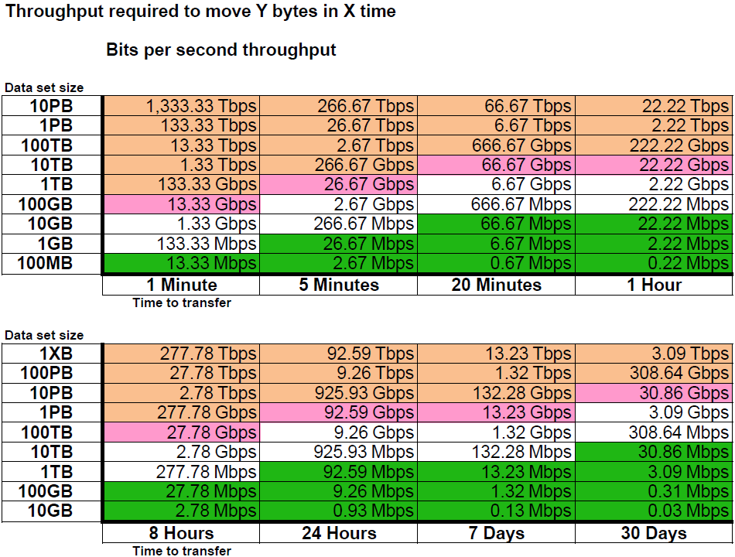
What are User Expectations?
http://fasterdata.es.net/home/requirements-and-expectations/
Notes:
Fasterdata Network Requirements and Expectations
http://fasterdata.es.net/home/requirements-and-expectations/

Slide 3
What are the steps to attain the expectations?
First, make sure the host specs are adequate
Are you shooting for 1G, 10G, 25G, 40G, 100G?
Second, tune the host
most are auto-tuning but higher speeds are still problematic
Third, validate network is clean between hosts
Fourth, make sure the network stays clean

Slide 4
Host specs
Motherboard specs
Higher CPU speed better than higher core count
PCI interrupts tie to CPU processor ==> Try to minimize crossing bus between CPU processors
Storage Host Bus adapters and Network Interface Cards require the correct generation of PCI Express and the correct number of lanes
Notes:
http://fasterdata.es.net/science-dmz/DTN/hardware-selection/motherboard-and-chassis/
http://www.tested.com/tech/457440-theoretical-vs-actual-bandwidth-pci-express-and-thunderbolt/
https://fasterdata.es.net/science-dmz/DTN/hardware-selection/motherboard-and-chassis/
http://darkness.codefu.org/wordpress/2005/08/pci-vs-pci-x-vs-pci-express-2/
https://en.wikipedia.org/wiki/PCI_Express#PCI_Express_3.0
https://fasterdata.es.net/science-dmz/DTN/100g-dtn/
https://fasterdata.es.net/science-dmz/DTN/reference-implementation/

Slide 5
Host specs
PCI bus
What generation of PCI Express (PCIe) and how many lanes?
4, 8, and16 lanes possible
# of lanes supported depends on motherboard and Network Interface Card (NIC)
Speed of lane depends on generation of PCIe
PCIe 2 -> 2.5Gb/s per lane including overhead
PCIe 3 -> 5Gb/s per lane including overhead
Notes:
http://www.tested.com/tech/457440-theoretical-vs-actual-bandwidth-pci-express-and-thunderbolt/
https://fasterdata.es.net/science-dmz/DTN/hardware-selection/motherboard-and-chassis/
http://darkness.codefu.org/wordpress/2005/08/pci-vs-pci-x-vs-pci-express-2/
https://en.wikipedia.org/wiki/PCI_Express#PCI_Express_3.0
https://fasterdata.es.net/science-dmz/DTN/100g-dtn/
https://fasterdata.es.net/science-dmz/DTN/reference-implementation/

Slide 6
Host specs
PCI Implications
PCIe v2 with 8 lanes and greater for 10G
PCIe v3 with 8 lanes and greater for 40G
PCIe v3 with 16 lanes and greater for 100G +
Notes:
http://www.tested.com/tech/457440-theoretical-vs-actual-bandwidth-pci-express-and-thunderbolt/
https://fasterdata.es.net/science-dmz/DTN/hardware-selection/motherboard-and-chassis/
http://darkness.codefu.org/wordpress/2005/08/pci-vs-pci-x-vs-pci-express-2/
https://en.wikipedia.org/wiki/PCI_Express#PCI_Express_3.0
https://fasterdata.es.net/science-dmz/DTN/100g-dtn/
https://fasterdata.es.net/science-dmz/DTN/reference-implementation/

Slide 7
Host specs
Storage subsystem factors
Local disk
RAID6, RAID5 or RAID 1+0
SATA or SAS
Spinning disk vs SSD
Network disk
High speed parallel system vs NFS or SMB mounts,
Notes:
Local Storage:
* http://fasterdata.es.net/science-dmz/DTN/hardware-selection/storage/
* https://en.wikipedia.org/wiki/Serial_ATA
* https://en.wikipedia.org/wiki/Serial_Attached_SCSI
* https://en.wikipedia.org/wiki/Solid-state_drive
Network Storage
NFS:
* v3 https://tools.ietf.org/html/rfc1813
* v4.1 https://tools.ietf.org/html/rfc5661
CIFS/SMB:
* https://en.wikipedia.org/wiki/Server_Message_Block
* https://msdn.microsoft.com/en-us/library/windows/desktop/aa365233(v=vs.85).aspx
* https://technet.microsoft.com/en-us/library/cc939973.aspx
Storage Performance:
* http://www.citi.umich.edu/projects/nfs-perf/results/cel/write-throughput.html
Storage performance testers:
* http://beyondtheblocks.reduxio.com/8-incredibly-useful-tools-to-run-storage-benchmarks
* http://www.clustermonkey.net/FileSystems/benchmarking-parallel-file-systems.html
* http://wiki.opensfs.org/Benchmarking_Basics
* https://www.spec.org/sfs2008/press/release.html
Parallel File Systems
* Parallel NFS: http://www.pnfs.com/
* Lustre:http://lustre.org/
* GPFS:
** https://en.wikipedia.org/wiki/IBM_General_Parallel_File_System
** https://www.ibm.com/support/knowledgecenter/en/SSFKCN/gpfs_welcome.html
Multi-tenancy:
* http://whatis.techtarget.com/definition/multi-tenancy
* https://en.wikipedia.org/wiki/Multitenancy
* http://whatis.techtarget.com/definition/multi-tenancy

Slide 8
Host specs and other
Memory – 32GB or greater
Other factors such as multi-tenancy – how busy is your system?
Notes:
Local Storage:
* http://fasterdata.es.net/science-dmz/DTN/hardware-selection/storage/
* https://en.wikipedia.org/wiki/Serial_ATA
* https://en.wikipedia.org/wiki/Serial_Attached_SCSI
* https://en.wikipedia.org/wiki/Solid-state_drive
Network Storage
NFS:
* v3 https://tools.ietf.org/html/rfc1813
* v4.1 https://tools.ietf.org/html/rfc5661
CIFS/SMB:
* https://en.wikipedia.org/wiki/Server_Message_Block
* https://msdn.microsoft.com/en-us/library/windows/desktop/aa365233(v=vs.85).aspx
* https://technet.microsoft.com/en-us/library/cc939973.aspx
Storage Performance:
* http://www.citi.umich.edu/projects/nfs-perf/results/cel/write-throughput.html
Storage performance testers:
* http://beyondtheblocks.reduxio.com/8-incredibly-useful-tools-to-run-storage-benchmarks
* http://www.clustermonkey.net/FileSystems/benchmarking-parallel-file-systems.html
* http://wiki.opensfs.org/Benchmarking_Basics
* https://www.spec.org/sfs2008/press/release.html
Parallel File Systems
* Parallel NFS: http://www.pnfs.com/
* Lustre:http://lustre.org/
* GPFS:
** https://en.wikipedia.org/wiki/IBM_General_Parallel_File_System
** https://www.ibm.com/support/knowledgecenter/en/SSFKCN/gpfs_welcome.html
Multi-tenancy:
* http://whatis.techtarget.com/definition/multi-tenancy
* https://en.wikipedia.org/wiki/Multitenancy
* http://whatis.techtarget.com/definition/multi-tenancy

Slide 9
Host tuning
TCP Buffers sets the max data rate
Too small means TCP cannot fill the pipe
Buffer size = Bandwidth * Round Trip Time
Use ping for the RTT
Most recent Operating Systems now have auto-tuning which helps
For high bandwidth, i.e. 40Gbps+ NICs, the admin should double-check the maximum TCP buffer settings (OS dependent)
Notes:
http://fasterdata.es.net/host-tuning/background/
Matt Mathis paper

Slide 10
Host tuning needs info on the network
Determine the Bandwidth-Delay Product (BDP)
Bandwidth Delay Product = Bandwidth * Round Trip Time
BDP = BW * RTT
e.g. 10Gbps*70ms =700,000,000bits = 87,500,000Bytes
BDP determines proper TCP Receive Window
RFC 1323 allows TCP extensions, i.e. window scaling
Long Fat Pipe (LFN) – networks with large bandwidth delay.
Notes:
Matt Mathis original paper
* http://ccr.sigcomm.org/archive/1997/jul97/ccr-9707-mathis.pdf
TCP Performance and the Mathis equation
* http://www.netcraftsmen.com/tcp-performance-and-the-mathis-equation/
Enabling High Performance Data Transfers
* https://www.psc.edu/services/networking/68-research/networking/641-tcp-tune
TCP Large Window extensions – window scale and Long Fat Pipes * RFC 1323 - https://www.ietf.org/rfc/rfc1323.txt
A User's Guide to TCP Windows (Von Welch)
http://www.vonwelch.com/report/tcp_windows
Sizing Router Buffers (Appenzeller, Keslassy, McKeown)
http://yuba.stanford.edu/techreports/TR04-HPNG-060800.pdf
Internet Protocol Journal -- TCP Performance (Geoff Huston)
* http://www.cisco.com/c/en/us/about/press/internet-protocol-journal/back-issues/table-contents-5/ipj-archive/article09186a00800c8417.html

Slide 11
Host Tuning
See Notes section for links with details and description
# allow testing with buffers up to 128MB
net.core.rmem_max = 134217728
net.core.wmem_max = 134217728
# increase Linux autotuning TCP buffer limit to 64MB
net.ipv4.tcp_rmem = 4096 87380 67108864
net.ipv4.tcp_wmem = 4096 65536 67108864
# recommended default congestion control is htcp
net.ipv4.tcp_congestion_control=htcp
# recommended for hosts with jumbo frames enabled
net.ipv4.tcp_mtu_probing=1
# recommended for CentOS7/Debian8 hosts
net.core.default_qdisc = fq
Linux
Modify /etc/sysctl.conf with
recommended parameters
Apple Mac
Modify /etc/sysctl.conf with
recommended parameters
# OSX default of 3 is not big enough
net.inet.tcp.win_scale_factor=8
# increase OSX TCP autotuning maximums
net.inet.tcp.autorcvbufmax=33554432
net.inet.tcp.autosndbufmax=33554432
Notes:
Linux:
* http://fasterdata.es.net/host-tuning/linux/
Apple Mac:
* http://fasterdata.es.net/host-tuning/osx/
* https://rolande.wordpress.com/2010/12/30/performance-tuning-the-network-stack-on-mac-osx-10-6/
MS Windows:
* http://www.thewindowsclub.com/window-auto-tuning-in-windows-10
* https://www.speedguide.net/articles/windows-8-10-2012-server-tcpip-tweaks-5077
* MS Win 10 and Server 2016 Powershell Network cmdlets
** https://technet.microsoft.com/en-us/itpro/powershell/windows/netadapter/netadapter
** https://technet.microsoft.com/itpro/powershell/windows/nettcpip/set-nettcpsetting

Slide 12
Host Tuning
See Notes section for links with details and description
MS Windows
Show the autotuning status - "netsh interface tcp show global"
Use Powershell Network cmdlets for changing parameters in Windows 10 and Windows 2016
e.g. Set-NetTCPSetting -SettingName "Custom" -CongestionProvider CTCP -InitialCongestionWindowMss 6
Notes:
Linux:
* http://fasterdata.es.net/host-tuning/linux/
Apple Mac:
* http://fasterdata.es.net/host-tuning/osx/
* https://rolande.wordpress.com/2010/12/30/performance-tuning-the-network-stack-on-mac-osx-10-6/
MS Windows:
* http://www.thewindowsclub.com/window-auto-tuning-in-windows-10
* https://www.speedguide.net/articles/windows-8-10-2012-server-tcpip-tweaks-5077
* MS Win 10 and Server 2016 Powershell Network cmdlets
** https://technet.microsoft.com/en-us/itpro/powershell/windows/netadapter/netadapter
** https://technet.microsoft.com/itpro/powershell/windows/nettcpip/set-nettcpsetting

Slide 13
What does the Network look like?
What bandwidth do you expect?
How far away is the destination?
What is the round trip time that ping gives?
Are you able to support jumbo frames?
Send test packets with the "don't fragment bit set
Linux or Mac: "ping -s 9000 -Mdo <destination>"
Windows: "ping -l 9000 -f <destination>"
Notes:
Matt Mathis original paper
*
PSC pages
* https://www.psc.edu/services/networking/68-research/networking/641-tcp-tune
* http://www.cisco.com/c/en/us/about/press/internet-protocol-journal/back-issues/table-contents-5/ipj-archive/article09186a00800c8417.html

Slide 14
What does the Network look like?
Do you have asymmetric routing?
Traceroute from your local machine gives one direction
Are you able to traceroute from the remote site?
Are they mirrors of each other?
Notes:
Matt Mathis original paper
*
PSC pages
* https://www.psc.edu/services/networking/68-research/networking/641-tcp-tune
* http://www.cisco.com/c/en/us/about/press/internet-protocol-journal/back-issues/table-contents-5/ipj-archive/article09186a00800c8417.html

Slide 15
What does the Network look like?
Determine the Bandwidth-Delay Product (BDP)
Bandwidth Delay Product = Bandwidth * Round Trip Time
BDP = BW * RTT
e.g. 10Gbps*70ms =700,000,000bits = 87,500,000Bytes
BDP determines proper TCP Receive Window
RFC 1323 allows TCP extensions, i.e. window scaling
Long Fat Pipe (LFN) – networks with large bandwidth delay.
Notes:
Matt Mathis original paper
* http://ccr.sigcomm.org/archive/1997/jul97/ccr-9707-mathis.pdf
TCP Performance and the Mathis equation
* http://www.netcraftsmen.com/tcp-performance-and-the-mathis-equation/
Enabling High Performance Data Transfers
* https://www.psc.edu/services/networking/68-research/networking/641-tcp-tune
TCP Large Window extensions – window scale and Long Fat Pipes * RFC 1323 - https://www.ietf.org/rfc/rfc1323.txt
A User's Guide to TCP Windows (Von Welch)
http://www.vonwelch.com/report/tcp_windows
Sizing Router Buffers (Appenzeller, Keslassy, McKeown)
http://yuba.stanford.edu/techreports/TR04-HPNG-060800.pdf
Internet Protocol Journal -- TCP Performance (Geoff Huston)
* http://www.cisco.com/c/en/us/about/press/internet-protocol-journal/back-issues/table-contents-5/ipj-archive/article09186a00800c8417.html

Slide 16
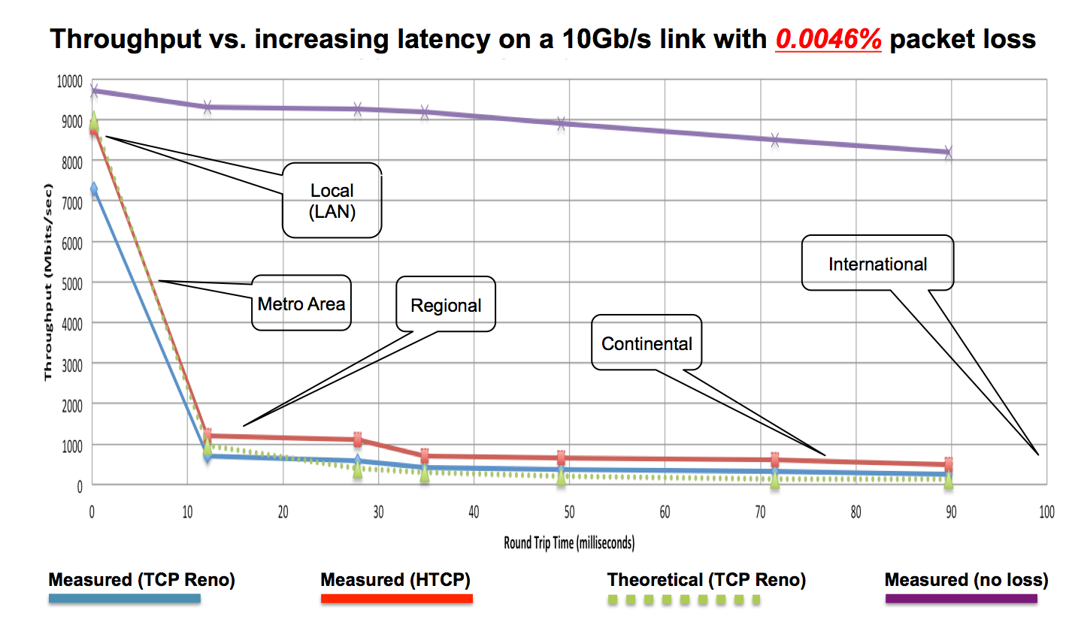
How clean does the network really have to be?
http://fasterdata.es.net/network-tuning/tcp-issues-explained/packet-loss/
Notes:
ES net TCP tuning
http://fasterdata.es.net/network-tuning/tcp-issues-explained/packet-loss/

Slide 17
How do I validate the network?
Measurement!
Active measurement
Perfsonar – www.perfsonar.net
Iperf - https://github.com/esnet/iperf
Nuttcp - https://www.nuttcp.net/Welcome%20Page.html
Passive measurement
Nagios, Solarwinds, Zabbix, Zenoss
Cacti, PRTG, RRDtool
Trend the drops/discards
Notes:
Perfsonar
http://www.perfsonar.net
Iperf
https://github.com/esnet/iperf
Nuttcp
https://www.nuttcp.net
Nagios

Slide 18
How do I make sure the network is clean on a continual basis?
Design network security zone without performance inhibitors
Set up appropriate full bandwidth security
Access Control Lists
Remotely Triggered Black Hole Routing
Setup ongoing monitoring with tools such as perfSONAR
Create a maddash dashboard

Slide 19
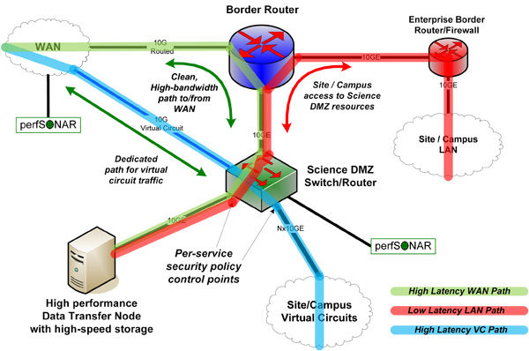
Set up a performance/security zone
Science DMZ architecture is a dedicated performance/security zone on a campus
http://fasterdata.es.net/science-dmz/motivation/
Notes:
Science DMZ
http://fasterdata.es.net/science-dmz/motivation/
Science DMZ: A Network Design Pattern for Data-Intensive Science
https://www.es.net/assets/pubs_presos/sc13sciDMZ-final.pdf

Slide 20
Use the right tool
Rclone - https://rclone.org/
Globus - https://www.globus.org/
FDT - http://monalisa.cern.ch/FDT/
Bbcp - http://www.slac.stanford.edu/~abh/bbcp/
Udt - http://udt.sourceforge.net/

Slide 21
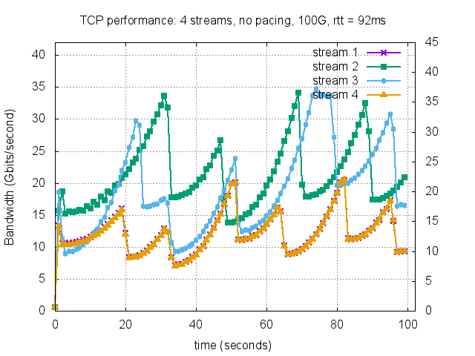
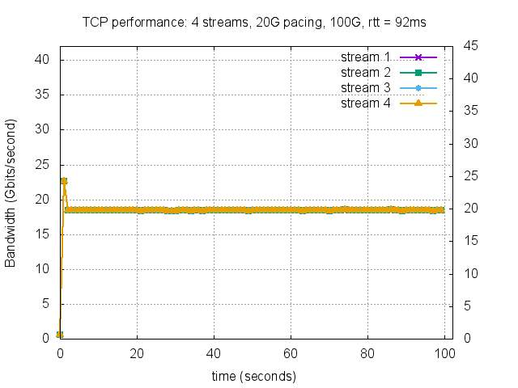
100G Host, Parallel Streams: no pacing vs 20G pacing
Techniques such as Packet Pacing
Credit: Brian Tierney, Nathan Hanford, Dipak Ghosal https://www.es.net/assets/pubs_presos/packet-pacing.pdf
Notes:
Optimizing Data Transfer Nodes using Packet Pacing
https://www.es.net/assets/pubs_presos/packet-pacing.pdf

Slide 22
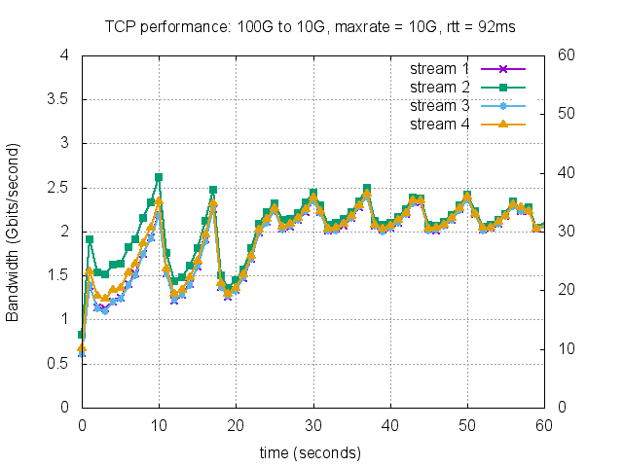
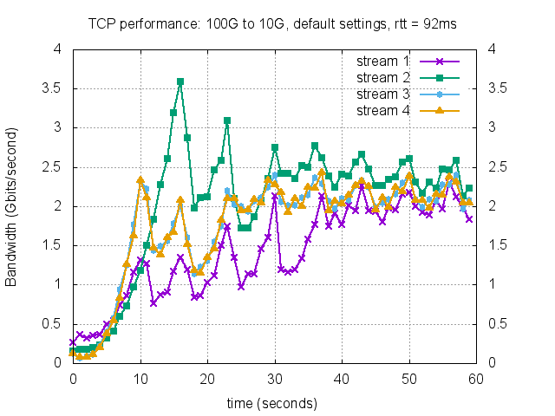
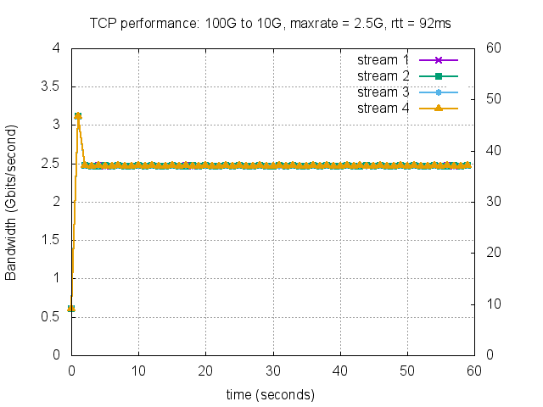
Techniques such as Packet Pacing
Credit: Brian Tierney, Nathan Hanford, Dipak Ghosal https://www.es.net/assets/pubs_presos/packet-pacing.pdf
Notes:
Faster Data Packet pacing (ESnet)
https://fasterdata.es.net/host-tuning/packet-pacing/

Slide 23
Not just about research
Troubleshooting to the cloud is similar
High latency, with big pipes
Latency is not just to the front door but also internal to the cloud providers
Example: Backups to the cloud are a lot like big science flows

Slide 24
Live example troubleshooting using bwctl on perfsonar boxes
Bwctl -s <server_ip> -c <client_ip>

Slide 25
References:
See Notes pages on print out of slides for references for each slide

