Slide 1
The Utah Education Network
Classroom Technology:
What IT Needs to Know

Slide 2
The Utah Education Network
Charice Carroll
Distance Learning Specialist, UEN Technical Services
Kimberly Davis,
Distance Learning Specialist, UEN Technical Services

Slide 3
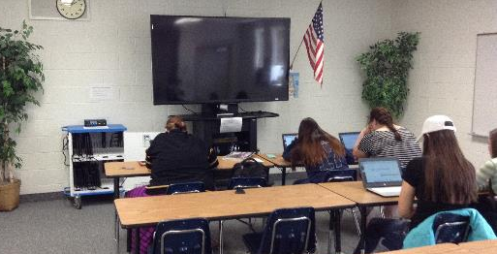
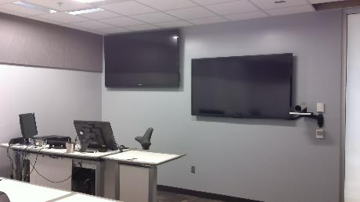
Interactive Video Conferencing (IVC)
Small Groups
Classrooms
Origination/Teaching Rooms
*

Slide 4
IVC Support
Hardware Needs
  Equipment procurement and install
Network
Ongoing classroom facilitation
Instructor training

Slide 5

Desktop Conferencing Tools
Request Service

Slide 6
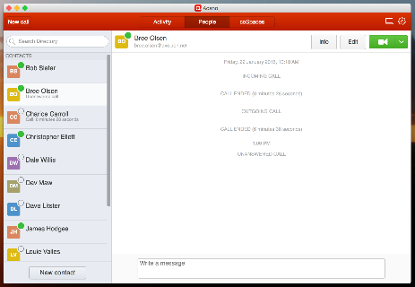
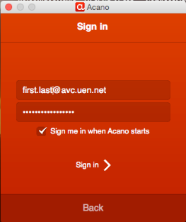
Acano Client
Acano
Installed Client
Cross-platform plus iOS and Android devices
  Build spaces for collaboration
  Person to person communication
Web Interface
  Users are sent a link to directly access the space:
  https://join.avc.uen.net/invited.sf?secret=DqGQU2CSOadX5_hq5elJGA&id=001081239

Slide 7
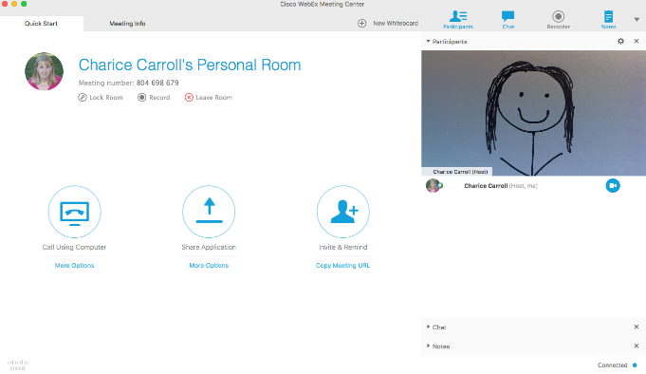
WebEx
Highly interactive meetings
Personal Meeting Room
IVC Integration
Small to medium groups (up to 100)
*

Slide 8
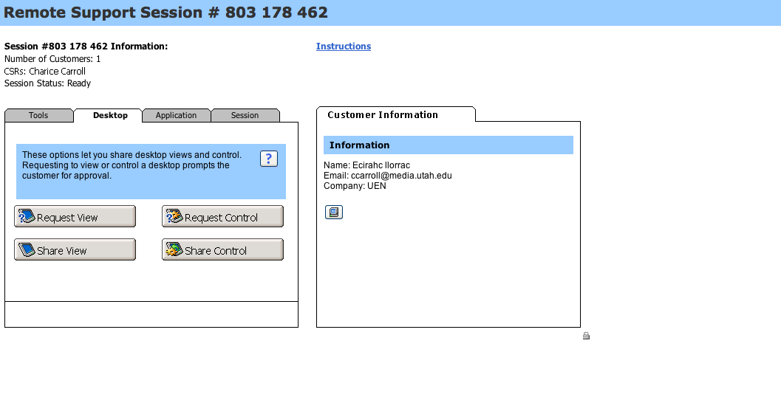
Support Center
Easy remote control of computers
Chat script creation
Cross platform
*

Slide 9
Support for Desktop Conferencing
Hardware Needs
  Camera
  Microphone
Software Installation (if applicable)
Network
Student Privacy
Firewall
Security
*

Slide 10
Collaboration Tools
*

Slide 11
Setup and Support
Network Compatibility
Devices On Same Network
  Student Network or Teacher Network
Device Compatibility
Network Interference
*

Slide 12



Lecture Capture

Slide 13
Supporting Lecture Capture
Hardware Needs
  Camera
  Microphone
Hardware Specifications
Software Installation and Maintenance
Storage and Archiving
Playback
Secure Access
LMS Integration

Slide 14
Boardshare

Slide 15
Supporting Boardshare
Setup Issues
Software Installation
Training and Ongoing Support

Slide 16
Virtual and Augmented Reality
Not a lot of support issues…but fun!
*

Slide 17
Contact Us
Charice Carroll
charice@uen.org
435-979-7121
Kimberly Davis
kdavis@uen.org
435-512-0951
Logix
logistics@uen.org
1-800-863-3496, opt. 3

Slide 18
The Utah Education Network
Thank you for attending.

