Slide 1
Doom and Gloom
Dave Packham

Slide 2
Learn Important Things FIRST

Slide 4
Drone CYA
State Farm sells CYA for drones at $60 - $0 deductible
Also no more FAA registration… its illegal..

Slide 5
Cruise Key

Slide 6
To each ROOM

Slide 7
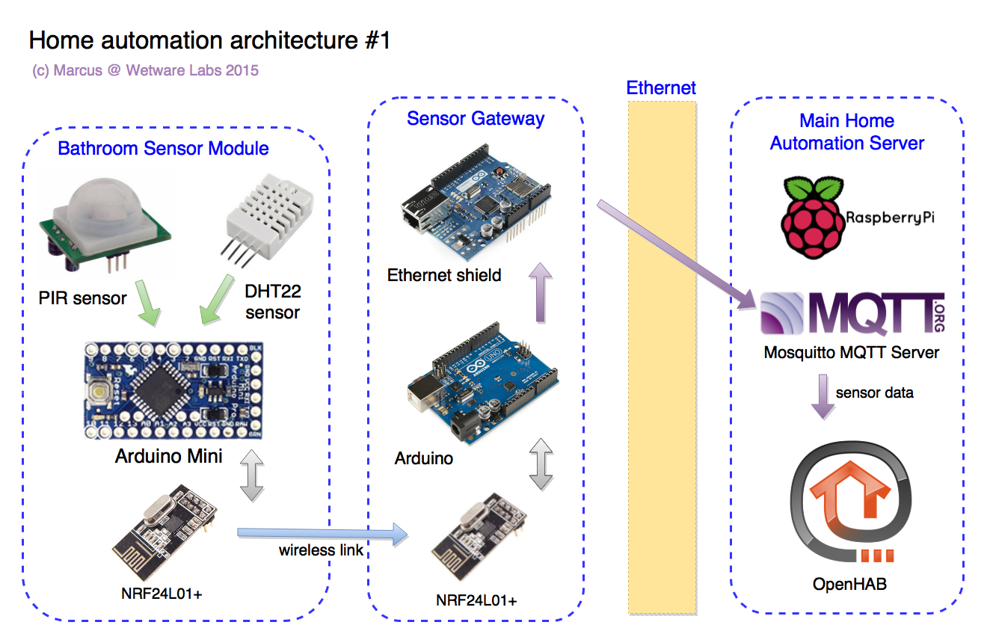
OpenHAB.org

Slide 8
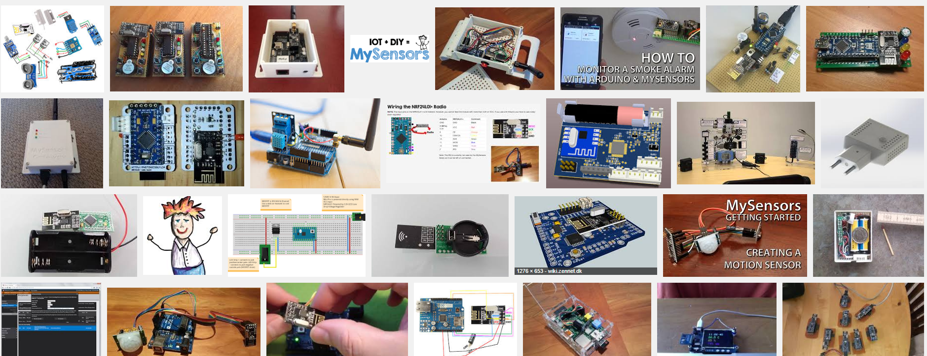
MySensors.org

Slide 9
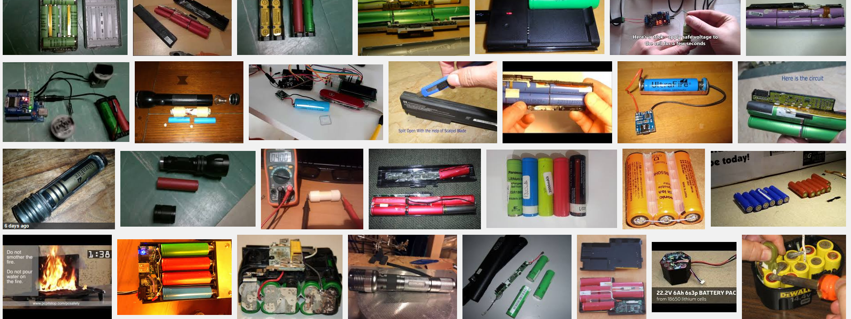
18650 GOLD

Slide 11
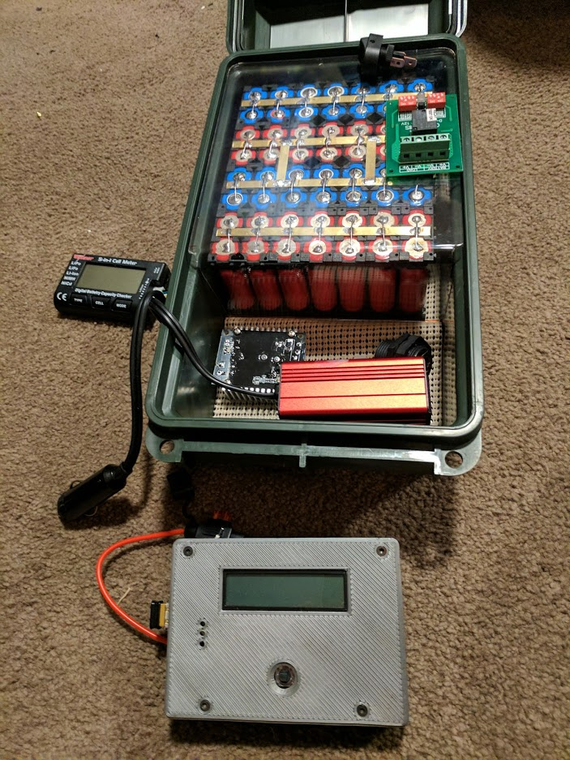
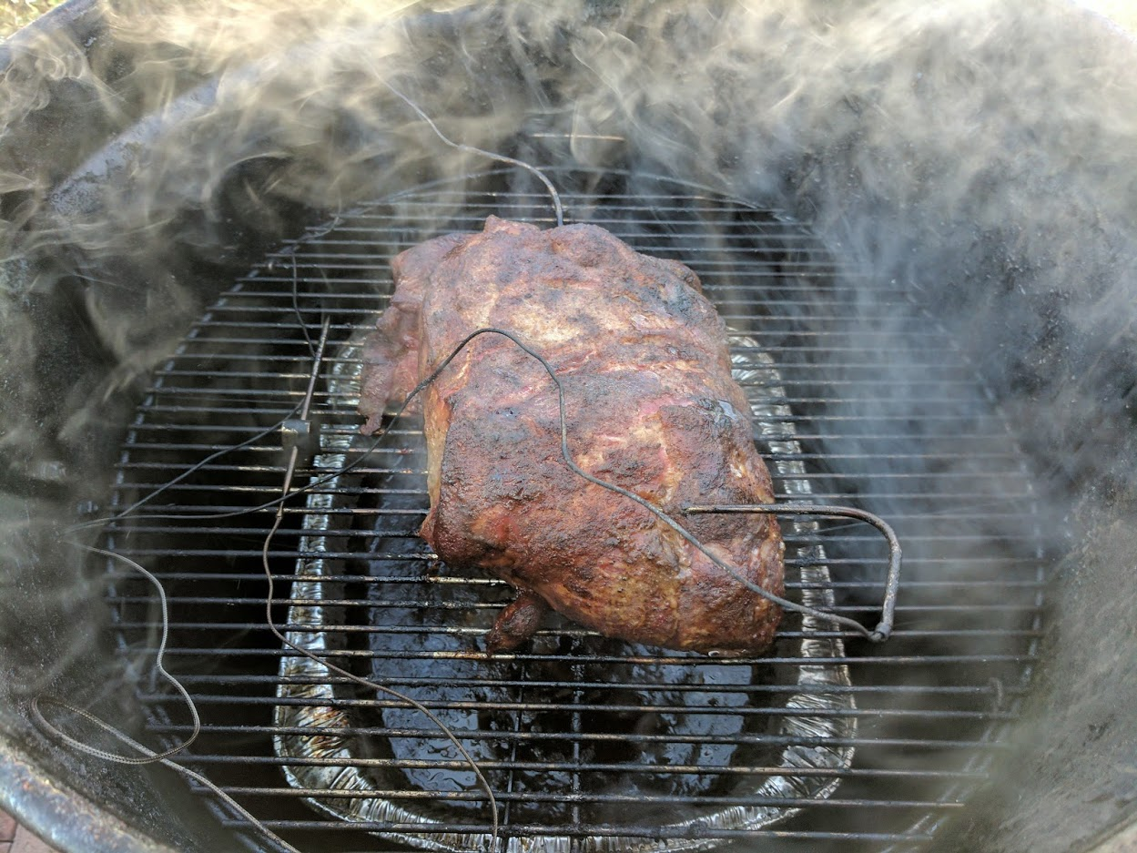

Slide 12
New Building move in… challenges.

Slide 13
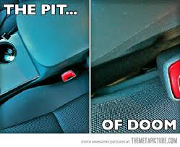
This is true

Slide 14
This is true

Slide 15
Consider the following
“Packets are truth”
Said Chad…

Slide 16
And…
Complexity is NOT solved.
Its MOVED
Said Kelly

Slide 17
We need to be eyes open

Slide 18
TOP 2017 Threats
Supercharged connectivity and the IoT will bring unmanaged risks.
Crime syndicates will take quantum leap with crime-as-a-service.
New regulations will bring compliance risks.
Brand reputation and trust will be a target.
Big er DATA problems
Cloud hacks?

Slide 19
Supercharged connectivity and the IoT bring unmanaged risks
Gigabit connectivity is on the way, and it will enable the internet of things (IoT)
New class of applications that will exploit the combination of big data, GPS location, weather, personal health monitoring devices, industrial production
We're talking about devices that never ever had security designed into them, devices that are out there gathering information.
"Critical infrastructure is one of the key worry areas,"
"We look at smart cities, industrial control systems — they're all using embedded IoT devices. We have to make sure we are aware of the implications of that."

Slide 20
Crime syndicates take quantum leap with crime-as-a-service
criminal syndicates have been operating like startups. But like other successful startups,
they've been maturing and have become increasingly sophisticated.
In 2017, criminal syndicates will further develop complex hierarchies, partnerships and collaborations that mimic large private sector organizations

Slide 21
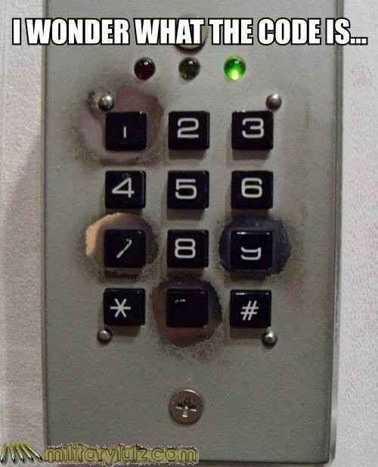

Slide 22
Big Iron competition
"I originally described them as entrepreneurial businesses, startups,"
"What we're seeing is a whole maturing of that space. They've moved from the garage to office blocs with corporate infrastructure. They've become incredibly good at doing things that we're bad at: collaborating, sharing, working with partners to plug gaps in their service."

Slide 23
Money is Money
"They're interested in anything that can be monetized,"
"It doesn't matter whether it's intellectual property or personal details. If there is a market, they will go out and collect that information."

Slide 24
Brand reputation and trust are a target
criminals won't just be targeting personal information and identity theft.
Sensitive corporate information and critical infrastructure has a bull's eye painted on it.
Your employees, and their ability to recognize security threats and react properly, will determine how this trend affects your organization.

Slide 25
People are the problem…
"2017 is really about organizations having to wake up to the fact that people do not have to be the weakest link in the security chain,"
"They can be the strongest link if we do better about understanding how people use technology, the psychology of human behavior."

Slide 26
World's biggest cyberattack sends countries into 'disaster recovery mode'
"unprecedented" in its reach, with more than 200,000 victims in at least 150 countries.
Hospitals, major companies and government offices were among those that were badly affected.
Cybersecurity experts have said the majority of the attacks targeted Russia, Ukraine and Taiwan.
But U.K. hospitals, Chinese universities and global firms like Fedex also reported they had come under assault.

Slide 27
Do you want to be the person saying this to your CISO/president?
We will get a decryption tool eventually, but for the moment, it's still a live threat and we're still in disaster recovery mode
Will you “WannaCry”

Slide 28
How bad was it?
Microsoft said it had taken the "highly unusual step" of releasing a patch for computers running older operating systems including Windows XP, Windows 8 and Windows Server 2003.

Slide 29
The patches won't do any good for machines that have already been hit.

Slide 30
Disruption from an over-reliance on fragile connectivity
Organizations today depend on instant and uninterrupted connectivity, smart physical devices and trustworthy people.
But that dependence makes them vulnerable to attacks on core internet infrastructure, devices used in daily business and key people with access to mission-critical information.

Slide 31
Dependent on the net?
"We've been dependent on the internet for so very long,"
01
"We've gotten to the point where we view it as any other utility.
02
If you suddenly cut of the electricity, it's a major issue.
03
Corporations have backups in place for other utilities generators for instance. No one has really done that for the internet. They just assume it's going to be there."
04

Slide 32
What to work on
To defend yourselves organizations need to rethink their defensive models, particularly regarding business continuity and disaster recovery plans.
Plans that rely on employees working from home won't survive attacks that remove connectivity or that target key individuals.

Slide 33
Revised plans cover threats to physical safety as well as periods of operational downtime caused by attacks on infrastructure, devices or people.

Slide 34
How will you do work without the internet?

Slide 35
For a week?

Slide 36
What goes down after the net recovers
'just-in-time' supply chain models, even brief disruptions can lead to shortages
Financial services institutions are also vulnerable, and outages that target them could lead to cascading failures.
Even government services like law enforcement depend on connectivity for communications

Slide 37
What to do now… not tomorrow
Engage
Engage with internal and external stakeholders to agree to alternative methods of communication
Develop
Develop relationships with regional bodies (e.g., governments, competitors, industry forums) to create new, standardized contingency plans for when internet communications fail
Assess
Assess communications providers' contingency plans; insist that they align with standardized or organizational plans , while partnering to ensure gaps are addressed
Plan
Plan for alternative supply chain models for critical systems and services

Slide 38
New OLD leaks
MySpace, LinkedIn, Tumblr
Dropbox again…

Slide 40
People are the weak link
They can significantly reduce the level of cyber expertise they require and replace that expertise with "muscle."
They can continue to have access to compromised individuals and persuade them to act again.
They can steal mission-critical information while operating at "arm's length."

Slide 41
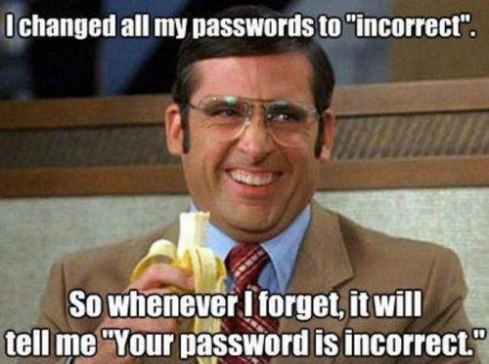

Slide 42
Protect your people
Identify
Identify your mission-critical information assets and the individuals who own and access them.
Invest in
Invest in special measures to protect individuals with privileged access (e.g., instruction in physical security precautions; exposure to social engineering methods).
Implement
Implement mechanisms to protect your organization against the insider threat (e.g., screen prospective employees; embedding appropriate clauses in employment contracts).
Adopt
Adopt a trust-but-verify approach to privileged insiders (e.g., foster a culture of trust, while verifying and monitoring appropriate system access).

Slide 43
Trust in the integrity of information is lost to distortion
To make good decisions, your business depends upon accurate and reliable information.
If the integrity of that information is compromised, so is your business.
Bad data is so bad you don’t even know how bad

Slide 44
Fake news?
At a university?
Nawwwww never

Slide 45
Big data… gets bigger
"With volumes of data increasing to the levels that they are, we've reached a point where it's absolutely impossible for anybody to really, absolutely ensure the integrity of data,

Slide 46
Remember the blood type scenario?
What other big data do you rely on?

Slide 47
Automated misinformation gains instant credibility
Advances in artificial intelligence (AI) personas allows for the creation of chatbots that will soon be indistinguishable from humans.
Attackers will be able to use these chatbots to spread misinformation targeting commercial organizations:
Without ever breaching an organization's digital boundary an attacker could damage that organization's reputation by spreading convincing misinformation about its working practices or products.
A single attacker could deploy hundreds of chatbots, each spreading malicious information and rumors over social media and news sites.

Slide 48
RTO – new meaning
Attacks won't just target reputation.
Fake news can also be used to manipulate a company’s reputation.
German payments company Wirecard AG found that out the hard way in February of last year, when a fake report 'detailed' fraudulent activities by the company.
While the report was later proven fake, the company's share price plummeted and took three months to recover.
How do you think about universities that have hit the press?

Slide 49
How to patch this reputation bug…
Build
Build scenarios covering the spread of misinformation into your overall incident management process.
Extend
Extend monitoring of social media before and after big organizational announcements or events.
Consider
Consider increasing existing social media output to proactively counter the spread of misinformation (e.g., encourage employees to spread legitimate news and report suspicious posts.

Slide 50
block·chain
ˈbläkˌCHān/
noun
a digital ledger in which transactions made in bitcoin or another cryptocurrency are recorded chronologically and publicly.
"we can actually have a look at the blockchain and see evidence of what's going on"

Slide 51
Blockchains… what/why
Many organizations are exploring blockchain technology because it promises to ensure the integrity of transactions without the need for a trusted third party at the center of the exchange.
like any technology, blockchains will be vulnerable to compromise.
Potential vulnerabilities include weak encryption, hashing and key management; poorly written programs; incorrect permissions; and inadequate business rules. In the event a blockchain is compromised,
customer, senior management and user trust in the affected process will be shattered, and will require substantial effort to rebuild.

Slide 52
Deterioration when controls are eroded by regulations and technology
Over the next two years advances in intelligent technologies and the conflicting demands posed by heightened national security and individual privacy will erode organizations' ability to control their own information.

Slide 53
Meanwhile… in Kansas
Technological innovation will continue to outpace regulations.
Increasingly mature AI in automated systems will start to make independent decisions that will contradict defined business rules, disrupt operations and create new security vulnerabilities.

Slide 54
Privacy regulations impede the monitoring of insider threats
According to a study released by McAfee in 2015, 43 percent of data breaches in that year were caused by insiders: users, managers, IT professionals and contractors.
It should come as no surprise, then, that User Behavior Analytics (UBA) tools, which flag anomalous user behavior, have become increasingly popular: a 2016 report by MarketsAndMarkets Research predicted sales of UBA tools would increase nearly 600 percent from $131.7 million in 2016 to $908.3 million by 2021.

Slide 55
But…
But the ISF says new privacy regulations like the GDPR, South Korea's Personal Information Protection Act (PIPA), Hong Kong's Personal Data (Privacy) Ordinance and Singapore's Personal Data Protection Act, have the potential to constrain the use of such tools.
They stipulate that an employers' use of such tools must be controlled and transparent to the user. Under GDPR, for instance, all profiling of employees is forbidden unless the employee is informed of the logic underpinning the process.
Transparency and creating a culture of trust is good, these regulations will position malicious insiders to circumvent UBA.

Slide 56
What to do. What to do
Take legal advice on restrictions regarding user profiling in every jurisdiction in which your organization operates.
Establish a rigorous program (tied to the disciplinary process) that is transparent about any employee monitoring activity.
Make employees aware of insider risk and train them to identify suspicious behavior.
Undertake more regular and stringent audits of access privileges for insiders, assuring appropriate role-based access.

Slide 57
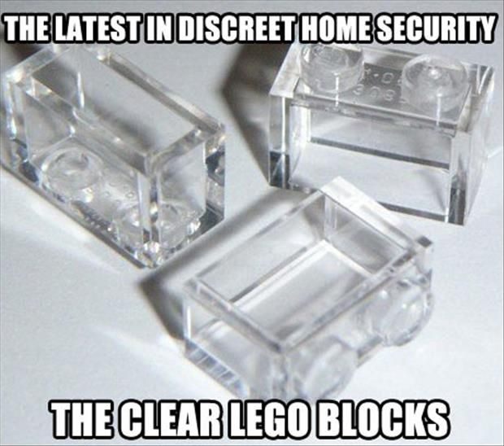
Questions?
Thanks CIO Mag
Random readings
Sophos Security
Hackers News and random IRC channels that I may or may not actually frequent…

