Slide 1
Wired & Wireless & Digital Ceilings
David Barker, DNA Specialist
June 2017

Slide 2
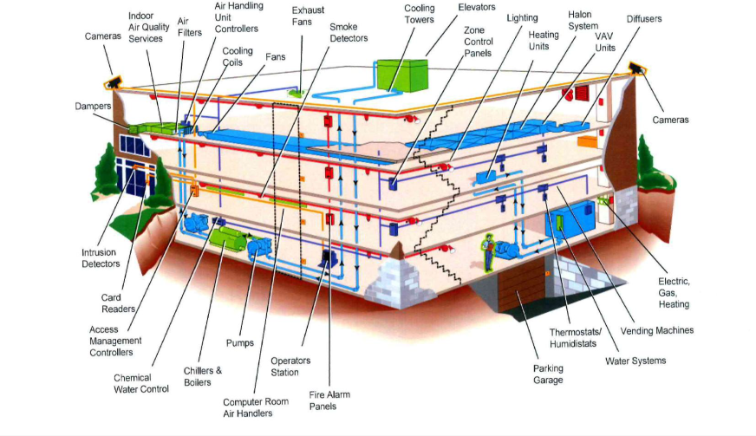
Commercial buildings today
Connecting BILLIONS of devices
Lighting
HVAC
Energy/Metering
Physical Security
Inventory
Sensors
Appliances

Slide 3
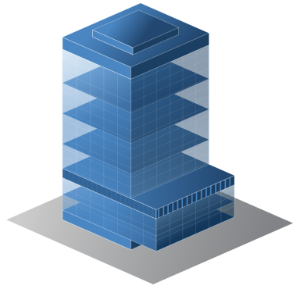
IP and Facility Networks are Converging
IT Services and Technologies
IP Based
Building Services and Technologies
Non-IP
High-speed Internet
Lighting
Wireless
Elevators
VPN
Continual monitoring
IP telephony
HVAC sensors
Audio and video conferencing
Video surveillance
Visitor management
Access
Interactive media
Energy
Digital signage

Slide 4









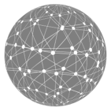




IP Convergence of Workplace Services
High Voltage A/C
BACnet
Cloud Management and Analytics
AV
PBX
Experiences
1995
2005
Late 2000s
2010
2015
Data
Network
IP Telephony
IP Cameras
Audio / Video
Building Mgmt. Systems using
low-voltage PoE
Smart
Lighting with
low-voltage PoE
OpEx

Slide 5
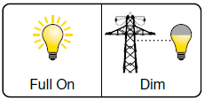
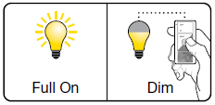
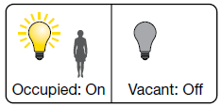


Energy Savings is the biggest driver for Smart Lighting
Lighting uses 40% of a buildings energy and up to 80% savings are possible with integrated controls
Control Typev | Savings (%)
No Control | 0%
Occupancy Sensors | 24%
Lights with Dimmers | 36%
Full EMS Control | 38%
Electrical Load Shedding
Personalized Workspaces
Incremental energy savings based on highly dense sensor network and individual fixture control
Granular Occupancy
Granular Daylight Harvesting
Highly Flexible
Scheduling
(*) Source: National Renewable Energy Laboratory
(*) PoE can additionally reduce losses DC-AC and DC-DC conversion
Notes:
http://www.streetinsider.com/Corporate+News/Philips+N.V.+%28PHG%29,+Cisco+%28CSCO%29+Enter+Lighting-Focused+Strategic+Alliance/11139821.html

Slide 6
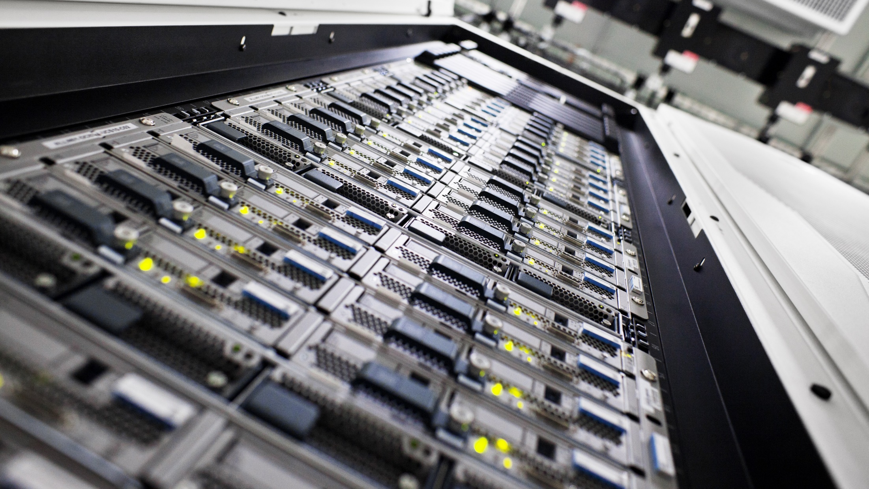
IoT Adoption Challenges
Automation and Management are critical to managing millions of
IoT devices
Exponential
increase in
attack surface
SECURITY
COMPLEXITY
ECOSYSTEM
FRAGMENTATION
DATA RELEVANCE
How to collect data across diverse device types?
How to turn data Into Insight and Action?
Open \ Standards based Eco-system is a requirement for business results

Slide 7

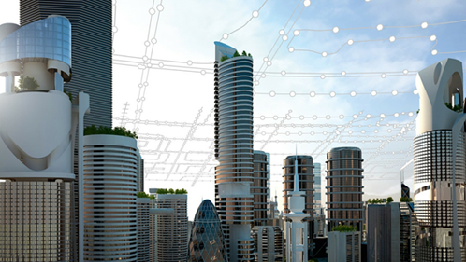







The 3 key things necessary for this Digital Transformation...
New
Experiences & Insights
Empower
Innovations
Transform Processes and Business Models
Buildings Are Central to This Transformation
Notes:
As you know digital transformation is everywhere. So what is this Digital Transformation? Companies everywhere are going digital to gain competitive advantage.
The 3 key things necessary for this digital transformation are creating new CX, transforming business models and empowering workforce innovation
New Customer Experiences: So what does that really mean? In a world of always-on digital services at your fingertips, customer expectations are soaring. Customers are becoming picky today and customer experience is paramount. Before going to a store, the expectation is that it will be stocked with the product they want. These small things matter in today’s world where customers are well informed. At the same time, it is important to gain deep insights into customers’ behavior when they shop, so you can improve services and predict future purchases.
Innovative Business Models: Upcoming new technologies are setting the stage for new ways of doing business and enabling them disruptively transform existing business models. For instance 3D printing has reduced production time frame from several months to a couple of weeks. Now you can prototype things for testing and experimentation before going into full blown production.As more and more devices get connected, companies have the potential to connect to and collect data from every extremity of their value chain. The result is faster time-to-market, leaner operations, and greater agility to respond to market changes.
Empowering Workforce Innovation: The workforce today has become very picky , they want the best environment to work in. How do you make it happen for an employee sitting offshore in an oil plant? How do you make the workforce experience more comfortable so they are more productive and innovative?
Every company is at it!!! And uses technology as a way to Digitally transform themselves. Digital businesses are giving employees the tools to be more connected, engaged, and mobile. A digital workforce requires nonstop connectivity, rich collaboration to support deeper engagement, and security everywhere. With these capabilities in place, organizations can increase productivity and improve their ability to attract and retain the best people.
But where do we start , what is common to all these things? Retail experiences start in the stor, which is a building, Office is a building, products are manufactured in a factory which is again a building.You guys are common to all this…it starts from every desk, every room , every space inside a building..Digital Buildings are central to this transformation. You begin your DT by transforming your buildings.

Slide 8













Digitizing Building Systems is Multi-Faceted…
Base building services
Access &
Improvement
Workspace
Transformation
Analytics for Better Efficiency and Security
Energy and space utilization
Digital signage
Intelligence
Ease of Deployment, Monitoring and Scale
Telemetry info to IoT devices
Flow / stream management
Control
Modern Experiences Through Personalization
Higher collaboration
End-user control
Smart, integrated, and flexible workspaces
Experience
Notes:
Hackers are automating hacking…You need to automate security
The switch makes buildings highly secure. It has robust port and switch security features, and with denial of service attacks now preying on IoT devices, an integrated threat defense across your network is an imperative.
Seamless Security
High-profile security breaches happen almost daily. Proliferation of IoT end points also increases exposure to threats. The switch uses Cisco IOS security with robust port and switch security features. Network as a Sensor (NaaS) identifies compromised devices and provides broad, deep visibility into network traffic patterns and rich threat intelligence information. Network as an Enforcer (NaaE) dynamically enforces role-based security.
To help you maintain the integrity of your entire IT environment, auto-segmentation and device profiling ensures that lighting ports can only be used for lighting—not to access other areas in the network. This is a DNA ready switch with support for APIC-EM with network Plug n Play capability for enterprise-wide network configuration at scale. (Application Policy Infrastructure Controller - Enterprise Module (APIC-EM) is our software-defined networking (SDN) controller for enterprise networks). ISE (Identity Services Engine) integrated with APIC EM defines and segments the network and helps in authentication and profiling
Cisco IoT devices are automatically segmented from other network devices
Profiling→Auto-segmentation→ Authentication

Slide 9




Digital Ceiling Benefits
Lower cost
construction
Converged cable plant – few wires, fewer types
Reduced need for high voltage AC power distribution
Analytics &
Business intelligence
Understand utilization of space & utilities
Adapt control policies to occupant requirements
Dynamic software controls
Flexible zones – light and ventilation where & when it’s needed
Energy reductions with intelligent dimming & demand response
New delivery & consumption models
Control in the cloud – feature velocity
Managed services & subscription pricing
Notes:
Reduced cost of construction
Converged cable plant – commodity network
Fewer AC conduits – PoE displaces high voltage power
Superior business intelligence & analytics
Occupancy and space utilization
Detailed cost accounting of energy & utilities
Software enables intelligent controls
Flexible zones for lighting, HVAC
Energy savings from intelligent occupancy models
New delivery and consumption models
Cloud management, “as a Service” pricing

Slide 10



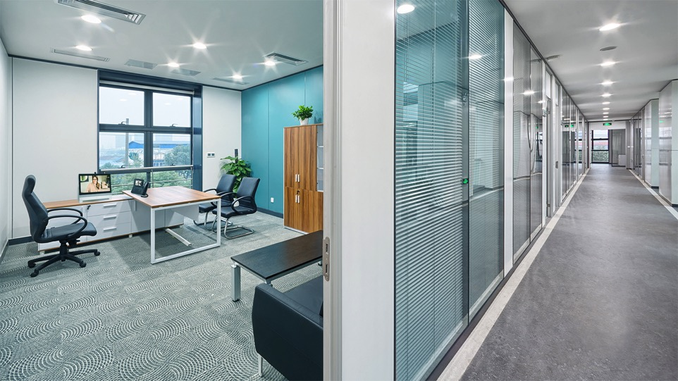


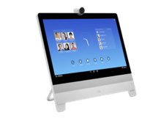





Enhance
User
Experience
  Custom User Experience
Light Intensity and Color
Room Temperature
  Preset Phone & Video Profile
Temperature
Color
Blue
68°
74°
Intensity
High
Adapt Environment to
Personal Preferences
Notes:
In an office building, smart+connected lighting can help improve productivity, because the high color rendering index allows you to closely approximate natural light, which resource has shown improves moods, productivity, health and more.
With network-enabled lights, you can program lights to suit individual desires or task requirements using your laptop, mobile device, or on a tablet mounted to the wall. Another way for settings to follow you would be to scan QR code on wall and settings change.
So building occupants can easily adjust temperature to suit individual preferences at the same time. And turn on preset phone and video profiles. That way, when an employee signs in to a desk, the system will automatically shift to all his or her preferred settings.
Not only that, Network-enabled lighting as part of a converged building network and integrated sensors gives you fixture-level control from anywhere.

Slide 11


Enhance
User
Experience
Network-powered Building Systems Communicate
Sensors Detect More People
Sensors Alert HVAC
to Pipe in More Fresh Air
Automatically Optimize
Environment for Group Comfort

Slide 12


Indoor Location and User Engagement —Wi-Fi & BLE
Use Case
Preferences
Navigation
Proximity Marketing
Analytics
Space Utilization
Technology
Agnostic
© 2016 Cisco and/or its affiliates. All rights reserved. Cisco Confidential
12
Notes:
Today we are announcing the introduction of a BLE-based high accuracy location solution and a Wi-Fi-based high accuracy location. We are the only vendor that can provide this level of accuracy with both technologies. As a result, you don’t have to choose one technology over the other. And, because each technology is optimized for different use cases, you don’t have to compromise on location accuracy because of your desired use case. Cisco can deliver the optimal solution.
Let’s take a look at each of these new Cisco solutions.

Slide 13



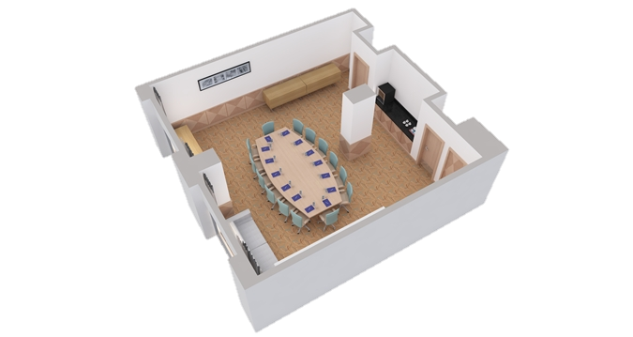
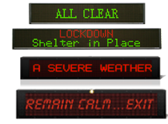

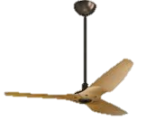


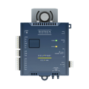













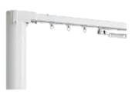

From A/C powered to PoE Digital Building Endpoints...
Ceiling Fans
Cameras
Access Points
Blind Motors
Biometric
Door Locks
Status Signs
Badge
Readers
HVAC VAV’s
Facial
Recognition
Systems
Horns and Sirens
Touchscreen
PC’s
IP Call Stations
Meeting Room
Nameplate
Light Fixtures
Curtain Motors
Temp Sensor
POE Displays
Power
Meter
IP Call Tower
Environmental
Sensor Hubs
Entry Barriers
And Turnstiles

Slide 14
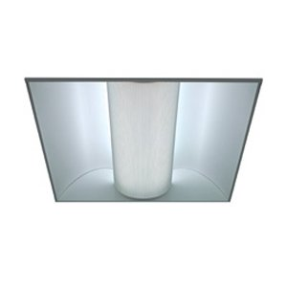

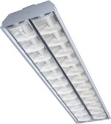



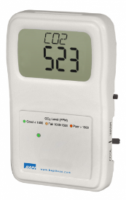

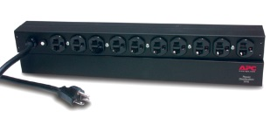
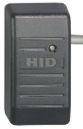
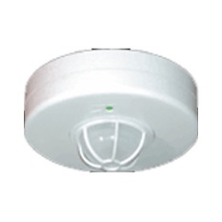
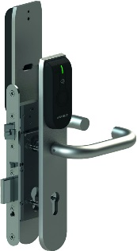
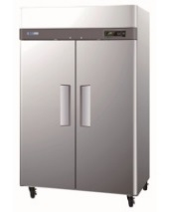
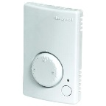
How many potential connected IoT devices?
Consider a 30K sqft bldg
Category | Device Types | Count
Lighting | Light fixtures (Troffers, downlights, decorative) User controls (Wall switches) Sensors (ambient light, motion/occupancy) | 1,600 200 400
HVAC | VAV (air flow valve), Motorized window shades Sensors (Temperature, humidity, CO₂, …) | 200 100
Metering | Plug load electrical Water flow | 800 100
Physical security | Card reader Door sensor | 40
Assumes Greenfield Installation

Slide 15
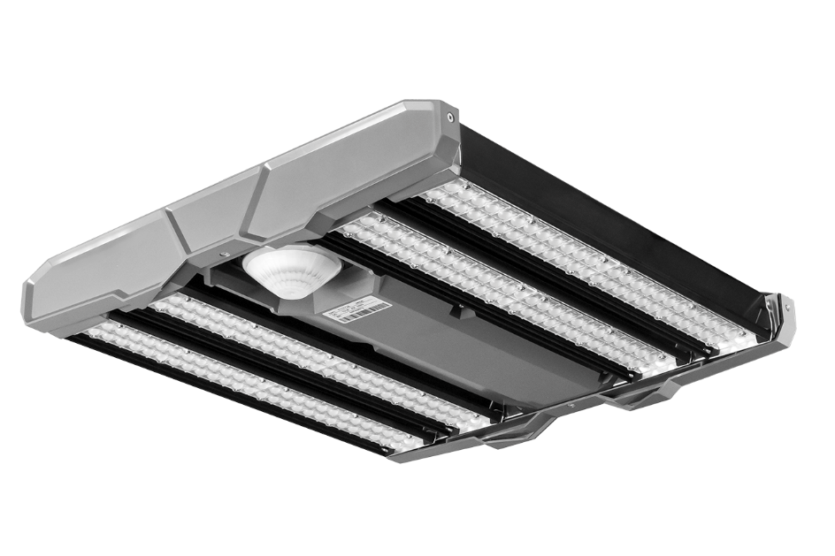
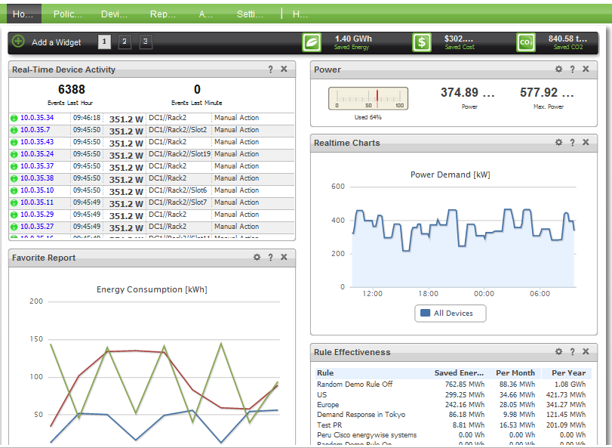
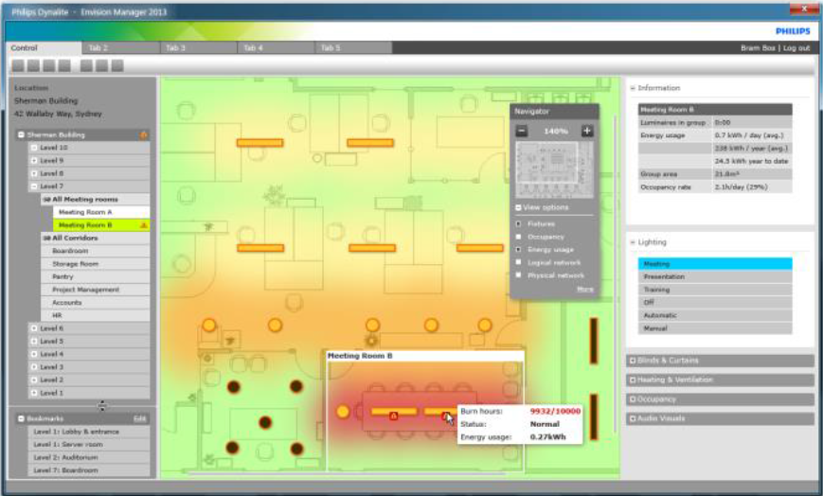
Light fixtures as sensor hubs
Digital ceiling unlocks the power of IoT analytics
Integrated Sensors
Integrated radios
Light
Occupancy / motion
WiFi
LiFi
BLE
Energy
Space / occupancy
Resources
Grouping / interactions
Metering
Analytics

Slide 16


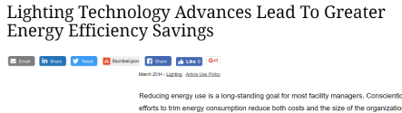



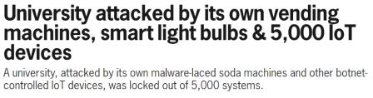


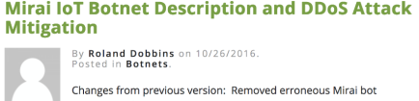


But Building Systems Currently Remain Siloed, Complex, and Insecure
Separate Building
System Networks…
… evolve independently, reinventing the wheel and hindering holistic innovation
Complex
Not cost-optimized
Not scalable
Not secure
Notes:
Converged networks … Lighting, Communications, HVAC, Maintenance, Safety Networks
While some aspects of building systems evolve greatly such as lighting, other aspects esp in IoT remain vulnerable and slow, affecting everyone
In the same way VoIP disrupted the way that Telephony services, Cisco’s Smart+Connected Lighting Platform for Indoor Environments will disrupt how lighting is deployed.
Previously, lighting – as well as every other building network – was its own siloed network. Nothing spoke to each other. And it required complex wiring and conduits configuration.
The Cisco Smart+Connected lighting solution for buildings, on the other hand, runs on Power over Ethernet, or PoE. So there’s no electrical conduit to install. You simply run Cat 5e, 6, or 6a cable to your IP network, using a Cisco PoE switch. You save big money on installation. And because there’s no electrical conduit, you have the flexibility to easily move lights if and when you need to. In fact, in many cases, you can reconfigure the lights using code – with just a software edit. You don’t need to make physical changes at all.
This solution can also help you break down your network and equipment siloes. Smart+Connected indoor lighting is capable of converging disparate networks (including HVAC, Metering, Lighting, CCTV, Physical Security) into one network that provides building intelligence. It uses a high-density light placement model that powered by a resilient, high-bandwidth, and secured wired switch network. This creates a new class of networked LED lighting fixtures capable of hosting a variety of advanced sensors, cameras, speakers, and non-traditional lighting devices. It also leverages advances in LED technology that introduces a variety of new lighting capabilities such as temperature tunable white (aka Kelvin-tuneable) and RGB color.
Cisco Smart+Connected Lighting platform for buildings allows you to deliver new and innovative experiences for building occupants while providing granular energy management, control, analytics, and integration capabilities for building owners and operators.
Hard Wired
Siloed, Multiple Networks
Intelligent, Breaks Silos, Enables Analytics
New User Experiences and Lower Cost
Light Fixture Becomes a Data Source

Slide 17








Common IoT Protocols
IoT Today is fragmented - Too many protocols and data formats (many closed, proprietary)
Need a common language
  Convergence
  Interoperability
  Analytics
  Scalability

Slide 18
Constrained Application Protocol (CoAP)
Modern M2M protocol specially designed for IoT
Web-like protocol based on REST (GET PUT POST)
Designed for constrained environments (low power and memory devices)
Made for billions of nodes
Secure
Open Standard
Open IETF Standard (RFC 7252)
Integration
Maps to HTTP/REST for easy integration
Interoperability in the fragmented industry
Data Model
Lets you choose your data model
Notes:
The COAP protocol is designed for use with constrained devices.
COAP works in the same way on constrained devices as HTTP works on servers in accessing information.
The comparison of COAP and HTTP is shown below:
In the case of a webserver: HTTP is the protocol; TCP is the transport; and HTML is the most common information format transported.
In case of a constrained device: COAP is the protocol; UDP is the transport; and JSON/link-format/CBOR is the popular information format.
COAP provides a means to access and control device using a similar GET /POST metaphor and restful API as in HTTP.
The CoAP Proxy Server runs as a separate process, within IOS, on the access switch.
It would run on the switch and use UDP transport.
It would contain a resource directory of Level-0 endpoints (or other Cisco CoAP Proxy Servers ) that have registered to itself.
A group of Cisco CoAP Proxy Servers can be connected at application level to form a tree of proxy servers. This tree forms a logical Zone of control/aggregation.

Slide 19
Comparison of CoAP and HTTP
HTML/XML
Web Objects
HTTP
CoAP
TLS
DTLS
WEB
IoT
TCP
UDP
IP/IPv6
IP/IPv6/6LowPAN
802.11/802.3
802.11/802.3/802.15.4
Hundreds/Thousands of bytes
Huge Headers
Complex parsing
Devices with abundant memory/power
Tens of bytes
Small Headers
Efficient objects
Devices with low memory/power

Slide 20
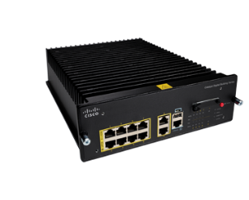
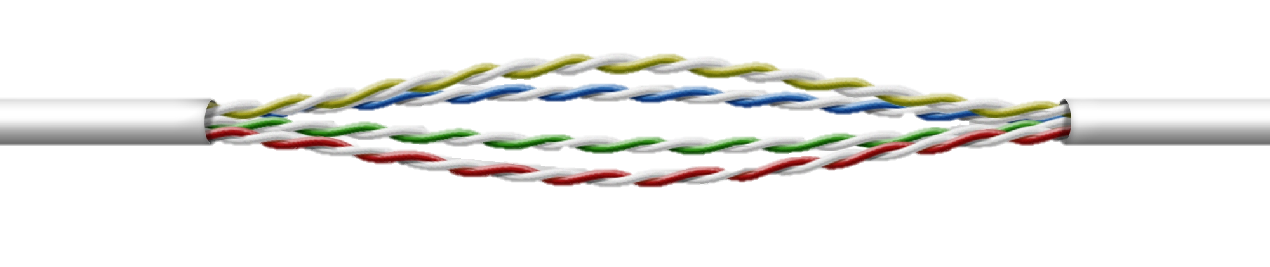
PoE Requirements for Enterprise IoT
Perpetual
UPOE
30W
Cat5e
Digital Building Applications
30W
…
60W total
Commercial LED PoE Fixtures
Dense Sensor Network
(Light, Motion,
CO2/CO, etc.)
IP Video
Surveillance
Camera
Building Mgmt (Connected HVAC)
Wall Switch
Full UPOE
Perpetual UPOE
Fast UPOE
2-Event Classification
Increased PoE
Budget: 480W of
UPOE (8 x 60W)
Fanless, silent
reliable operation with increased MTBF and system life (10 yrs)
Provides non-stop
UPOE power
Switch can continue to provide power during configuration and reboot
  Restores power to powered device within 5 secs of
  power resumption
  Simplified power negotiation without LLDP
  Physical layer negotiation < 1s based on class/type
UPOE supports an Expanding Ecosystem of PoE devices

Slide 21

5x Improvement in Switch Power
Switch
Power
Everything Active
10% Power Saving.
Efficient design, 80-Plus Gold Power Supplies
Low Ethernet Traffic
Power Savings with EEE or Energy Efficient Ethernet
▲
No PoE Draw
Switch Idle Mode with up to 50% savings
No Ethernet Traffic
Switch Hibernate Mode with up to 75% savings
  Integrated with Cisco Energy Manager for total energy visibility and control
Notes:
The Eco-Board’s mission is to:
Impact how we operate as a company
Create efficiencies and innovations in our products
Provide solutions to our customers to address global environmental issues
Inspire our employees to get involved and take action

Slide 22


Automated Security
Robust
Security
Policy-based access
& automation
Identity Services defines &
segments the network
Device profiling: Each port goes through policy-based configuration
Segmentation: Ethernet ports can only be used for own area and not to access other network areas
Network Plug n Play for enterprise-wide network configuration
Segmented from other network devices
With Trustsec on upstream switches
Seamless Security
Authentication: IoT devices, which are automatically segmented from other network devices need role-based access
DNA ready with
support for APIC-EM
Device Profiling Auto-segmentation Authentication
Infrastructure with integrated threat defense across the network
Notes:
Hackers are automating hacking…You need to automate security
The switch makes buildings highly secure. It has robust port and switch security features, and with denial of service attacks now preying on IoT devices, an integrated threat defense across your network is an imperative.
Seamless Security
High-profile security breaches happen almost daily. Proliferation of IoT end points also increases exposure to threats. The switch uses Cisco IOS security with robust port and switch security features. Network as a Sensor (NaaS) identifies compromised devices and provides broad, deep visibility into network traffic patterns and rich threat intelligence information. Network as an Enforcer (NaaE) dynamically enforces role-based security.
To help you maintain the integrity of your entire IT environment, auto-segmentation and device profiling ensures that lighting ports can only be used for lighting—not to access other areas in the network. This is a DNA ready switch with support for APIC-EM with network Plug n Play capability for enterprise-wide network configuration at scale. (Application Policy Infrastructure Controller - Enterprise Module (APIC-EM) is our software-defined networking (SDN) controller for enterprise networks). ISE (Identity Services Engine) integrated with APIC EM defines and segments the network and helps in authentication and profiling
Cisco IoT devices are automatically segmented from other network devices
Profiling→Auto-segmentation→ Authentication

Slide 23


Automation: Network Plug-N-Play Automates Switch
Configuration and integration with IT
Smart
Installs
Network Admin
Installer
Pre Provision Projects/Sites
Policies
Match Rules
Configs/Image
IP Addressing
PnP Server
Network Admin Remotely Monitors Status of Install While in Progress
Booting Devices Call Out to PnP Server, Requesting Instructions
PnP Agent
Smart Install Proxy
PnP Agent
PnP Agent
PnP Agent
Smart Install-Client
Remote Installer
Mount and cable devices
Power-on
UNSKILLED
INSTALLER
CONSISTENT FOR DEVICES AND PIN (CAMPUS/BRANCH)
RMA USE
CASE
GREENFIELD
AND BROWNFIELD
GUI BASED
SECURE

Slide 24
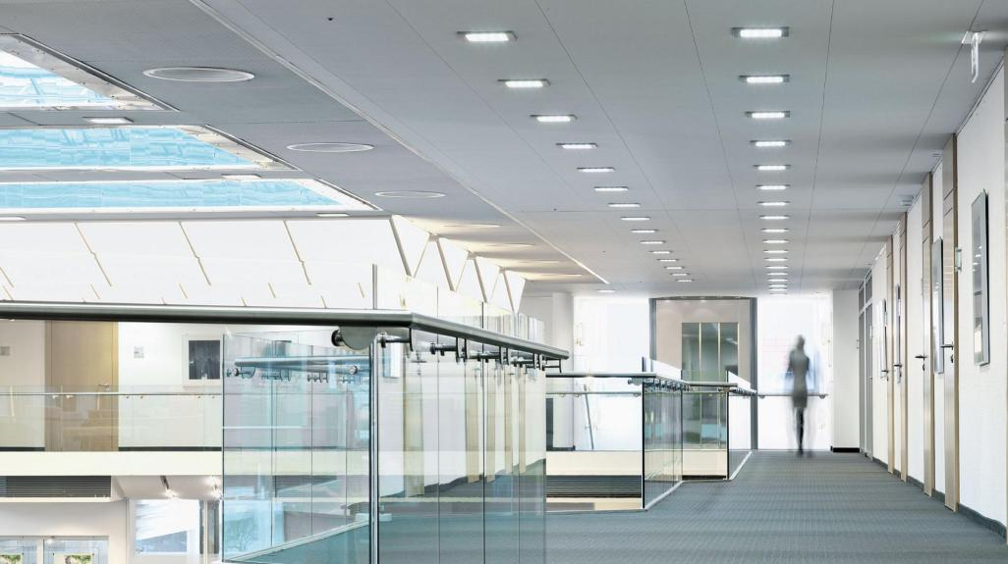

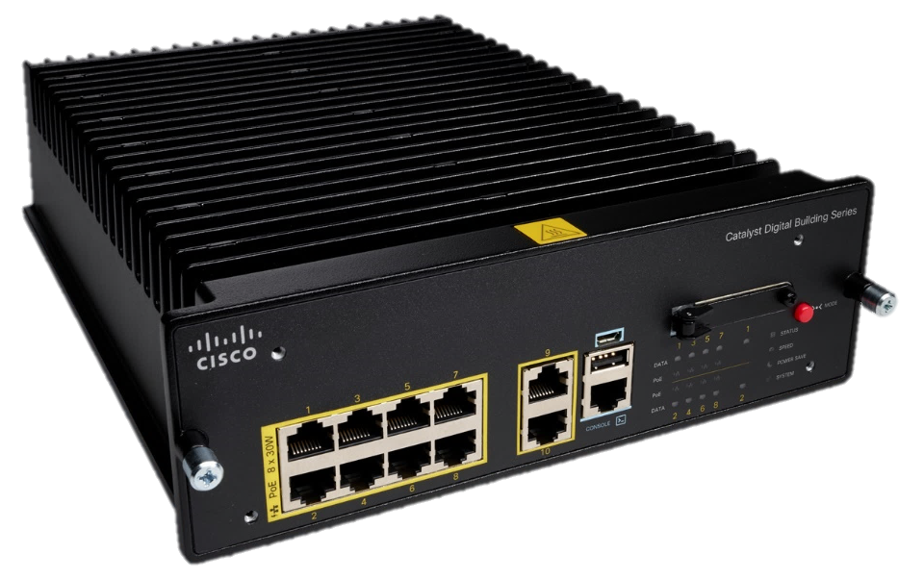
Network Deployment Options
Distributed
“OT/Facilities network”
Centralized
“Converged IT/OT Network”
Dedicated Lighting Network
To IDF
Converged IT/OT Network
Ceiling
Switches
Access Switch in IDF
Long(er) cable Runs
Short(er) PoE Cables
PoE powered luminaires
PoE powered luminaires
Switches in the Ceiling
Energy efficient, shorter cables
Switches in the wiring closet
Higher resiliency due to HA features

Slide 25




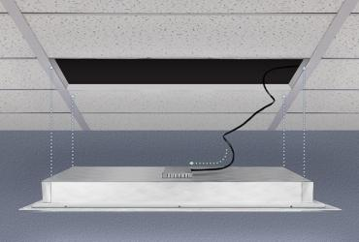




Ceiling based PoE
Smart
Installs
High Voltage A/C
BACnet
Coax
PBX
2005
Late 2000s
2010
2015
Single Cable
1995
Fire, Safety
IP Camera
LED Lights
Variable Air Valve
Badge Reader / Access
Sensors
Flexible Mounting
(Ceiling, rack, cabinet)
Physical Stacking
(multiple stacked mounts)
Flexible Powering
(IEC, Direct Wired)
Flexible Orientation
(Upright, face-down, side)
Simplified Installations with Cable Consolidation Reduces Cost

Slide 26

Digital Building Blueprint - A Converged Ecosystem
Building Applications
(Light & temperature control, video surveillance)
Automation
Policy based Configuration, onboarding & management with APIC-EM
Digital Network Architecture
(Switching, Routing, Security)
Security
Device Profiling, authentication and segmentation of IoT devices with NaaS
Assurance
Security
Automation
Insights
A platform for Real-Time Analytics across enterprise and IoT networks
Building Endpoints
(Sensors, IoT Devices, Luminaires,
VAV, Badging, HVAC)
IP Network Convergence for Full Network Innovation in Digital Buildings
Notes:
Cisco is building an ecosystem of the next generation building architecture..but today we are launching the first step

Slide 27


Software Defined Access (SD – Access)
Policy Based Automation from Edge to Cloud
Fundamental Shift in How We Build and Manage Networks
Secure Fabric
Automation
Assurance
Virtual Networks and
Micro-Segmentation
Made Easy
Simple Policy Definition
and Enforcement Through
APIC-EM and ISE
Monitoring
and Troubleshooting
Through NDP
Decouple Policy from Network Topology
Industry Best-Practices and Policy Compliance
Proactive Issue Identification and Resolution Through Analytics
Notes:
Network Visibility: Netflow... Today but not based on true flows –going forward we will introduce Fabricflow which can be used to coorelate underlay and overlay
Troubleshoot based on who you are & what you are doing... (as opposed to just what you are)
Onboard Users today vs. Onboard user with SDA...

Slide 28

Questions?
http://www.cisco.com/go/digitalbuilding
Notes:
Here is what we should do next

Slide 29
Thank you

