Slide 1
2-6 Writing
Strengthening Your Core
August 2016

Slide 2

Introduction
Cydnee Carter
ELA Specialist (elementary)
WIDA Specialist
cydnee.carter@schools.utah.gov
Kim Rathke
Formative Assessment Specialist
Assessment to Achievement
kim.rathke@schools.utah.gov

Slide 3

Introductions
Name
Grade Level
Years of Experience
If I could learn one thing today, I would most appreciate…

Slide 4
Agenda
SAGE Elementary Sample Essays: Creation and Rangefinding
Recommendations for SAGE Sample Essay Use
Rangefinding
Results and Implications for Instruction
Prompt Analysis
Academic Vocabulary
Transitions
Editing Circles
Challenge Words

Slide 5
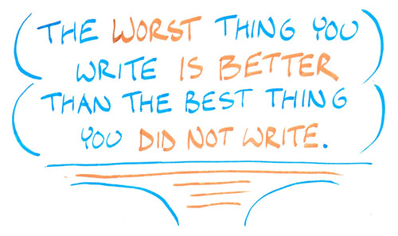
Benefits of Writing
How does writing enhance reading, understanding, academic performance, and life skills?
Notes:
On their note taking guide, have them work in partners to list the benefits of writing.

Slide 6

Table Discussion
How much class time is spent on writing instruction/practice per day?
In the context of what subject matter?
What kinds of student groupings are used?
What programs/materials/lesson frameworks are used for guidance?
Notes:
Have tables discuss these instructional items. Link to previous task in knowing that writing is so critical for so many other areas…does that importance hold true in your school?

Slide 7
Skills in Writing
Lower-level Cognitive Skills
Higher-level Cognitive Demands
Physically forming letters using pencil on paper
Writing left to right.
Using a story structure or expository structure.
Varying sentence structure.
Spacing words on a page.
Sticking to the plan.
Spelling high-frequency irregular words.
Phonetically spelling unknown words.
Using topic sentences in paragraphs.
Notes:
On their note-taking guide have them work with a partner to draw arrows to show whether it is a high level or low level cognitive skill.

Slide 8
Foundational Skills in Writing
Lower-Level Cognitive skills
Higher-Level Cognitive Demands
Writing left to right.
Physically forming the letters using pencil on paper.
Spacing words on the page.
Spelling high-frequency irregular words.
Phonetically spelling unknown words.
Using uppercase letters as appropriate.
Using end punctuation.
Indenting paragraphs.
Using a story structure or expository structure.
Varying sentence structure.
Sticking to the plan.
Using topic sentences in paragraphs.
Keeping the goal of the composition in mind.
Keeping the audience’s need in mind.
Checking for insufficient or unnecessary detail.
Choosing precise vocabulary to express ideas.
Notes:
this will influence students’ abilities to produce quality writing—introductions and conclusions.

Slide 9
Writing Collection Project

Slide 10
Elementary Rangefinding
K-6th grade writing prompts and writing samples
Informative and Opinion writing prompts with stimulus materials
K-2 Handwritten samples
K-2 Rubrics to match standards
3rd-6th Half handwritten samples, half typed samples
SAGE Writing Rubrics
Notes:
http://www.uen.org/core/languagearts/writing-collection/

Slide 11
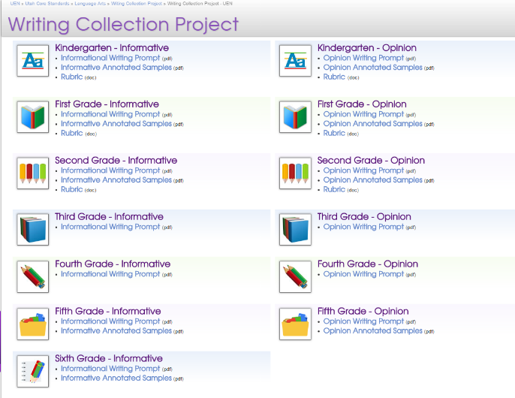
Writing Collection Project
All prompts, rubrics, and annotated samples can be found on UEN
http://www.uen.org/core/languagearts/writing-collection/
Notes:
http://www.uen.org/core/languagearts/writing-collection/

Slide 12
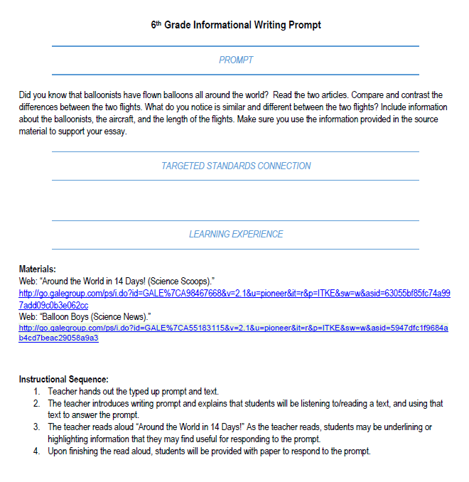
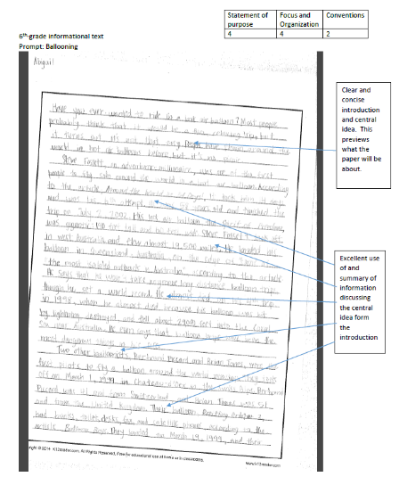
6th Grade Informative Writing

Slide 13

Recommendations for using SAGE Writing Samples
SAGE Writing Samples are not exemplars

Slide 14

Recommendations for using SAGE Writing Samples
These are not an endorsement of any particular approach to essay organization.

Slide 15

Recommendations for using SAGE Writing Samples
Use the writing prompts and passage sets for student compositions.

Slide 16
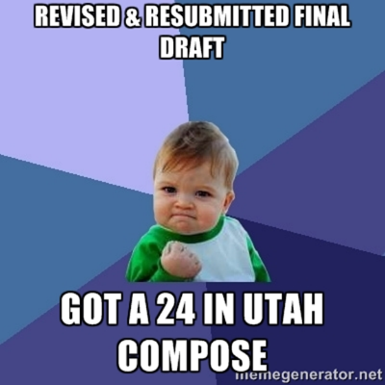
Recommendations for using SAGE Writing Samples
Have students revise and improve the sample essays.
Scaffolding is key:
Modeling
Groups
Sections

Slide 17
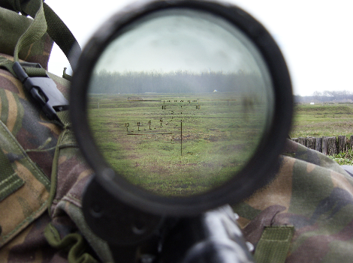
Recommendations for using SAGE Writing Samples
Hold a rangefinding workshop with teachers from your team/school/district.

Slide 18
Record your thoughts!
Current practices
Implications for instruction
Resources available/needed
Support available/needed
Questions
Concerns
Alternate approaches

Slide 19
Rangefinding Results: Grades K-11

Slide 20

Success and Struggle
Students do understand they need to use textual evidence in argumentative essays but are struggling with integrating the evidence in a fluid manner.
Students are incorporating textual evidence but are relying on one source instead of using multiple sources, particularly if source material is a graph or photo.
Students are citing sources but are doing it unevenly.
Organization is improving but too much reliance on 5-paragraph essay format.

Slide 21

Success and Struggle
Students are attempting to address the entire prompts but struggle to stay on topic.
Transitions are evident but too much reliance on simplistic forms (first, second, third, in conclusion).
Academic vocabulary is lacking and students are not addressing the appropriate tone for audience.

Slide 22

Success and Struggle
Elementary Level:
Third grade: All students completed writing by 70 minutes. Writers using technology (iPads or laptops) wrote more and finished earlier than students writing essays by hand
Students consistently wrote more when typing essays, especially at grades 5-6
There was little to no evidence that typing speed affected writing ability
Lots of highlighting of stimulus materials but no evidence of annotation
Graphic organizers were used in classrooms where they were part of instructional process

Slide 23
Writing: Standard 1
Kinder: Use a combination of drawing, dictating, and writing to compose opinion pieces in which they tell a reader the topic or the name of the book they are writing about and state an opinion or preference about the topic or book
1st: Write opinion pieces in which they introduce the topic or name the book they are writing about, state an opinion, supply a reason for the opinion, and provide some sense of closure.
2nd: Write opinion pieces in which they introduce the topic or book they are writing about, state an opinion, supply reasons that support the opinion, use linking words (e.g., because, and, also) to connect opinion and reasons, and provide a concluding statement or section.
3rd: Write opinion pieces on topics or texts, supporting a point of view with reasons. Introduce the topic or text, state an opinion and create an organization structure that lists reasons. Provide reasons that support the opinion, use linking words and phrases to connect opinion and reasons, and provide a concluding statement or section.
4th: Write opinion pieces on topics or texts, supporting a point of view with reasons and information. Introduce the topic or text clearly, state an opinion and create an organization structure in which related ideas are grouped to support the writer’s purpose. Provide reasons that are supported by facts and details, link opinion and reasons using words and phrases, and provide a concluding statement or section.
Notes:
Vertical Alignment of the Standards
The following slides show the progression of the ELA writing standards for opinion and informational/explanatory writing. The red indicates the changes that occur at each grade level. Talk about the nuances at each grade level briefly.

Slide 24
Writing Standard 1
5th: Write opinion pieces on topics or texts, supporting a point of view with reasons and information. Introduce the topic or text clearly, state an opinion and create an organization structure in which related ideas are grouped to support the writer’s purpose. Provide logically ordered reasons that are supported by facts and details, link opinion and reasons using words, phrases, and clauses, and provide a conclusion statement or section.
6th: Write arguments to support claims with clear reasons and relevant evidence. Introduce claim(s) and organize the reasons and evidence clearly. Support claim(s) with clear reasons and relevant evidence, using credible sources and demonstrating an understanding of the topic or text. Use words, phrases, and clauses to clarify the relationships among claim(s) and reasons. Establish and maintain a formal style. Provide a concluding statement or section that follows from the argument presented.
Notes:
Vertical Alignment of the Standards
The following slides show the progression of the ELA writing standards for opinion and informational/explanatory writing. The red indicates the changes that occur at each grade level. Talk about the nuances at each grade level briefly.

Slide 25
Writing: Standard 2
Kinder: Use a combination of drawing, dictating, and writing to compose informative/explanatory texts in which they name what they are writing about and supply some information about the topic.
1st: Write informative/explanatory texts in which they name a topic, supply some facts about the topic, and provide some sense of closure.
2nd: Write informative/explanatory texts in which they introduce a topic, use facts and definitions to develop points, and provide a concluding statement or section.
3rd: Write informative/explanatory texts to examine a topic and convey ideas and information clearly. Introduce a topic and group related information together; include illustrations when useful to aiding comprehension; develop the topic with facts, definitions, and details; use linking words and phrases (e.g., also, another, and, more, but) to connect ideas within categories of information, and provide a concluding statement or section.
Notes:
Grade Level Partner Task: Look at the grade level prior to yours and the grade level after. Look for what is new at your grade level and where students are headed in the next grade level. Highlight the differences.

Slide 26
Writing Standard 2 cont.
4th: Write informative/explanatory texts to examine a topic and convey ideas and information clearly. Introduce a topic clearly and group related information in paragraphs and sections; include formatting (e.g., headings), illustrations, and multimedia when useful to aiding comprehension. Develop the topic with facts, definitions, concrete details, quotations, or other information and examples related to the topic. Link ideas within categories of information using words and phrases (e.g., another, for example, also, because). Use precise language and domain-specific vocabulary to inform about or explain the topic. Provide a concluding statement or section related to the information or explanation presented.
5th: Write informative/explanatory texts to examine a topic and convey ideas and information clearly. Introduce a topic clearly, provide a general observation and focus, and group related information logically; include formatting (e.g., headings), illustrations, and multimedia when useful to aid comprehension. Develop the topic with facts, definitions, concrete details, quotations, or other information and examples related to the topic. Link ideas within and across categories of information using words, phrases and clauses (e.g., in contrast, especially). Use precise language and domain-specific vocabulary to inform about or explain the topic. Provide a concluding statement or section related to the information or explanation presented.
6^{th:} Write informative/explanatory texts to examine a topic and convey ideas, concepts, and information through the selection, organization, and analysis of relevant content. Introduce a topic; organize ideas, concepts, and information, using strategies such as definition, classification, comparison/contrast, and cause/effect; include formatting (e.g., headings), graphics (e.g., charts, tables), and multimedia when useful to aiding comprehension. Develop the topic with relevant facts, definitions, concrete details, quotations, or other information and examples. Use appropriate transitions to clarify the relationships among ideas and concepts. Use precise language and domain-specific vocabulary to inform about or explain the topic. Establish and maintain a formal style. Provide a concluding statement or section that follows from the information or explanation presented.
Notes:
Vertical Alignment of the Standards
The following slides show the progression of the ELA writing standards for opinion and informational/explanatory writing. The red indicates the changes that occur at each grade level. Talk about the nuances at each grade level briefly.

Slide 27
Why is this important?
Look for focus areas found in all grades
Make a list of your grade level expectations
Compare grade below and your list, put a star by new concepts.
Compare following grade, notice extensions on what you are teaching

Slide 28
Why is it important for each grade level to teach their standards?

Slide 29
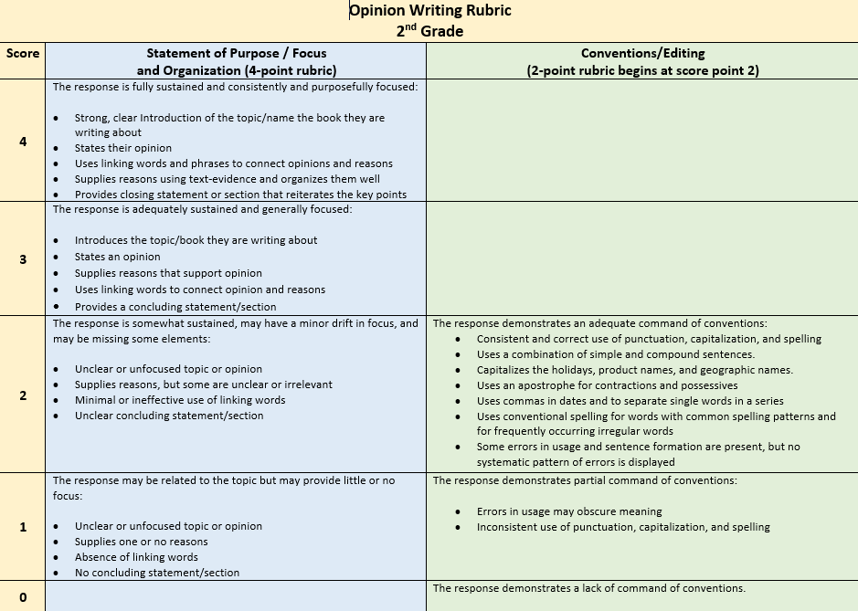
2nd Grade Informative and Opinion Writing Rubrics

Slide 30
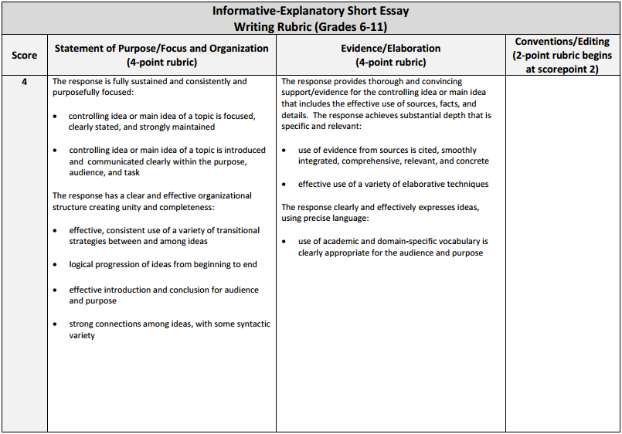
Review Rubrics

Slide 31
Writing Samples

Slide 32
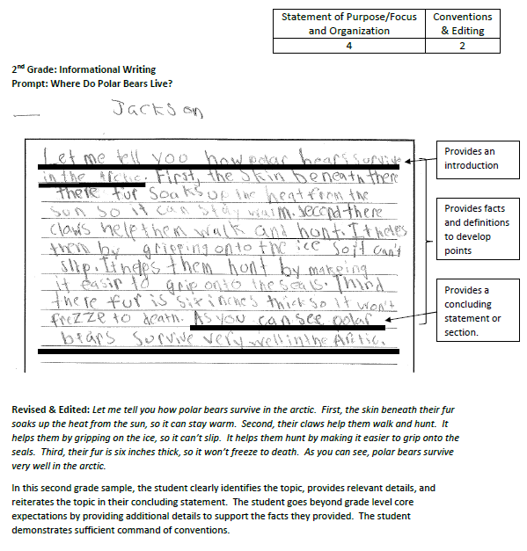
Rangefinding
On your own, review the essay.
Assign a score for each category.
Make notes about why you scored the way you did.
Discuss with your team.

Slide 33
Toys: Amazing Stories Behind Some Great Inventions

Slide 34

Opinion Writing

Slide 35
Prompt Analysis

Slide 36

Informational Prompt (6th Grade)
Through the years new inventions have changed the way we live. Think about one invention that has had an impact on the way you live. Write an essay to your teacher how this invention has changed your life. Use the facts and details you learned about the history of the invention in your response.

Slide 37

How Do I Teach Prompt Analysis?
Develop an instructional process for breaking apart the prompt that allows each task to be addressed separately and coherently

Slide 38

How Do I Teach Prompt Analysis?
Read the prompt aloud
Highlight the verbs or action words
Underline the task you are being asked to do
Circle the question you need to answer

Slide 39

How Do I Teach Prompt Analysis?
Determine the audience
What’s the format?
Use a note-taking strategy to help students include annotated information from stimulus material (where applicable)
Restate
Answer
Cite the source
Explain/Examples

Slide 40

RACE
Notes:
http://www.scholastic.com/teachers/2016/03/responding-text-how-get-great-written-answers#.Vv5_M2PCp1E.email

Slide 41

RACE
R | R stands for "restate the question." We want students to practice “flipping” the question into part of their answer. This avoids students starting with “because” or “yes” and sets them up to actually answer the question given. Often students who don’t or can’t restate the question are going to provide an incomplete or off-base answer
A | A stands for "answer the question." Here is where students give the simple or direct answer. R and A are usually contained in the same sentence.
C | C stands for "cite the source." This is where students find the supporting evidence in the text for their answer.
E | E stands for "explain" or "examples." Often, the evidence cited needs further explanation to tie back to the answer. Other times, just giving another example or extending the answer will suffice.
Notes:
http://www.scholastic.com/teachers/2016/03/responding-text-how-get-great-written-answers#.Vv5_M2PCp1E.email

Slide 42
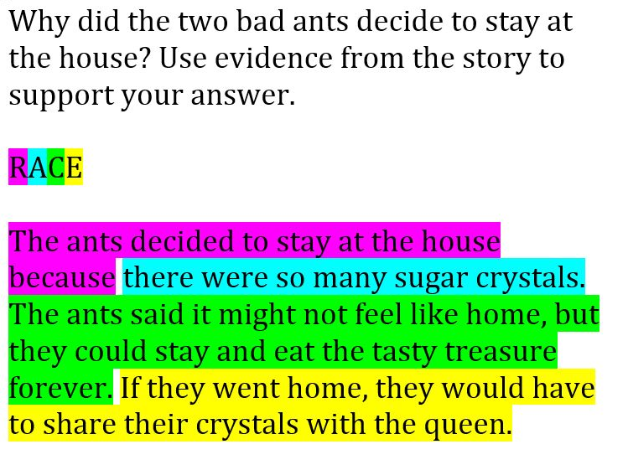
RACE
Notes:
Modeling is essential for this writing process to stick.

Slide 43

How Do I Teach Prompt Analysis?
Use THEMES to help students identify the “big” ideas in a prompt
Time
Health
Education
Money
Environment
Safety

Slide 44
Record your thoughts!
Current practices
Implications for instruction
Resources available/needed
Support available/needed
Questions
Concerns
Alternate approaches

Slide 45
Academic Vocabulary

Slide 46
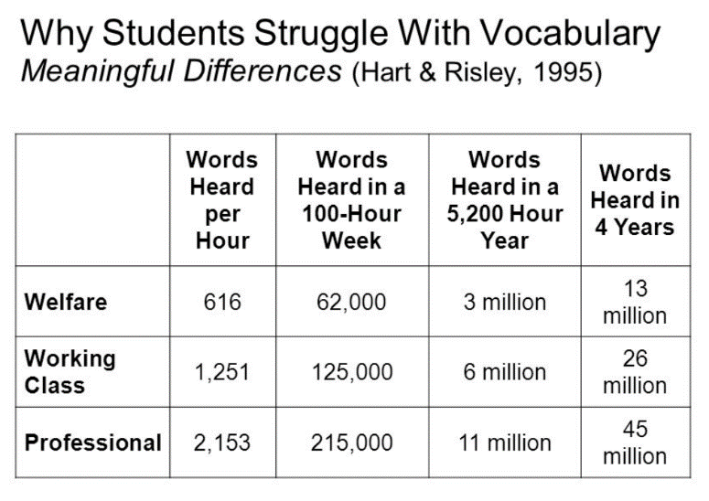
Vocabulary

Slide 50
Definitions
Academic Vocabulary:
Terms that students bring with them to the testing situation
Tier II vocabulary
Domain-Specific Vocabulary:
Terms that students may not already know, but learn and use from the passage set
Tier III vocabulary

Slide 51
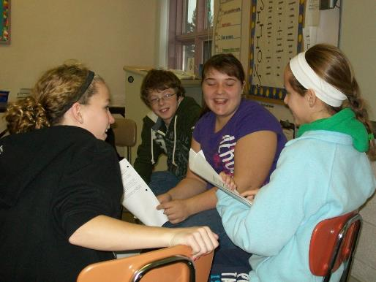
Academic Language
All students are academic language learners:
Academic Vocabulary
Academic Register (Tone and Style)

Slide 52
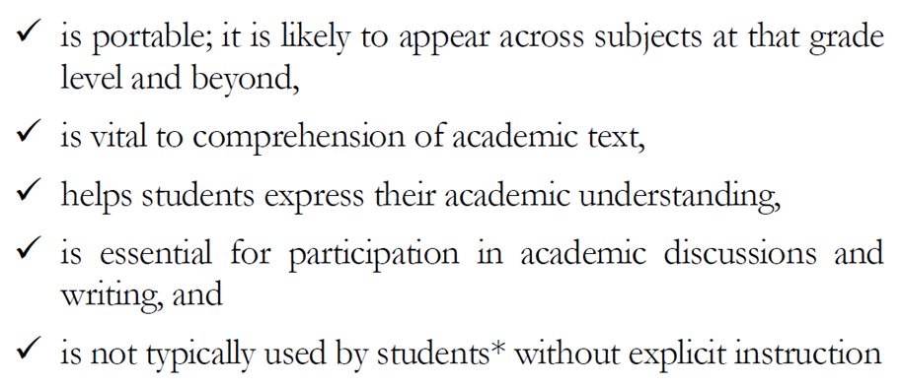
Academic Language

Slide 53
Students must learn 2,000-4,000 words every school year
Direct Instruction
400 words per year K-12 (Beck, McKeown, Kucan, 2002)
“Indirect” Instruction
Instructional read-alouds
Teach word analysis skills: affixes and roots
Link spelling instruction to vocabulary instruction
Teach the use of dictionaries, thesauruses, references
Teach the application of a word learning strategy
Encourage wide reading
Create a keen awareness of language and words
Notes:
Beck, McKeown, and Kucan (2002) recommend teaching about 400 words per year K-12.

Slide 54
Direct Instruction of Vocabulary
Tier I Words
Conversational Speech
House
Girl
Cat
Up
Umbrella

Slide 55
Direct Instruction of Vocabulary
Tier II Words
Academic Vocabulary
Perspective
Generate
Initiate
Intermediate
Solution
Denotation and Connotation
Discrimination

Slide 56
Direct Instruction of Vocabulary
Tier III Words
Domain-Specific Vocabulary
English Language Arts
Onomatopoeia
Denouement
Science
Metamorphic
Igneous
Mathematics
Denominator
Remainder

Slide 57
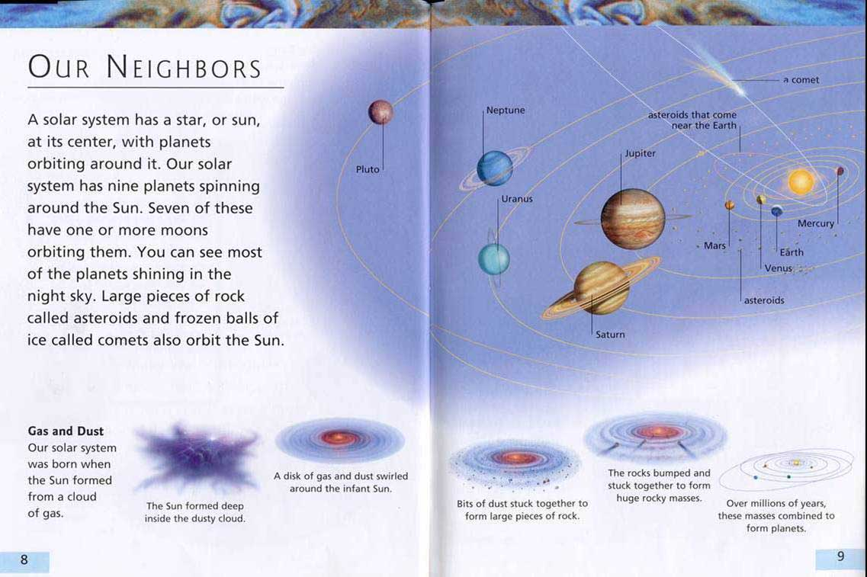
Can You Find a Tier III Word?

Slide 58
Direct Instruction of Vocabulary
Tier IV Words
Rare, esoteric, no longer in use
Majuscule
Xanthodont
Noctuary

Slide 59
Direct Instruction of Vocabulary
Teach Tier II and III Vocabulary
Tier I should not be taught
ELs
Tier IV should not be taught
Morphemes/Structural analysis

Slide 60
Four-Square

Slide 61
Four-Square
Destruction

Slide 62
Four-Square
Destruction: Noun

Slide 63
Four-Square
Destruction: Noun 1 2 3

Slide 64
Four-Square
Destruction: Noun 1 2 3 | Great harm or damage

Slide 65
Four-Square
Destruction: Noun 1 2 3 | Great harm or damage
Destruction caused by a storm might include…

Slide 66
Four-Square
Destruction: Noun 1 2 3 | Great harm or damage
Destruction caused by a storm might include… | Picture

Slide 67
Four-Square
Destruction: Noun Verb 1 2 3 | Great harm or damage
Destruction caused by a storm might include… | Picture

Slide 68
Four-Square
Destruction: Noun Verb Adjective 1 2 3 | Great harm or damage
Destruction caused by a storm might include… | Picture

Slide 69
Four-Square
Destruction: Noun Verb Adjective Adverb 1 2 3 | Great harm or damage
Destruction caused by a storm might include… | Picture

Slide 70
Four-Square
Destruction: Noun Verb Adjective Adverb 1 2 3 | Great harm or damage Synonyms:
Destruction caused by a storm might include… | Picture

Slide 71
Four-Square
Destruction: Noun Verb Adjective Adverb 1 2 3 | Great harm or damage Synonyms: Antonyms:
Destruction caused by a storm might include… | Picture

Slide 72
Record your thoughts!
Current practices
Implications for instruction
Resources available/needed
Support available/needed
Questions
Concerns
Alternate approaches

Slide 73
Transitions

Slide 74
Why Transitions?
“Good transition sentences can connect topics and turn disconnected ideas into a unified whole. Instead of treating different paragraphs as separate ideas, transitions can help the reader understand how the paragraphs work together.”

Slide 75
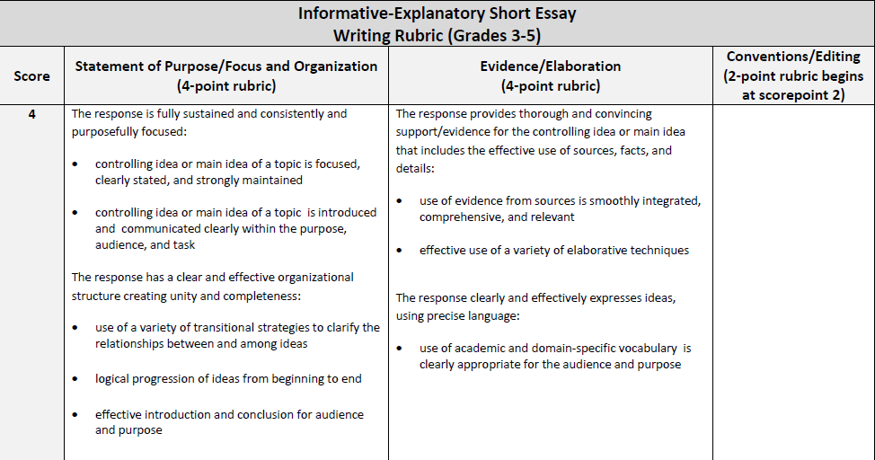
SAGE Writing Rubric Grades 3-5
use a variety of transitional strategies to clarify the relationships between and among ideas

Slide 76
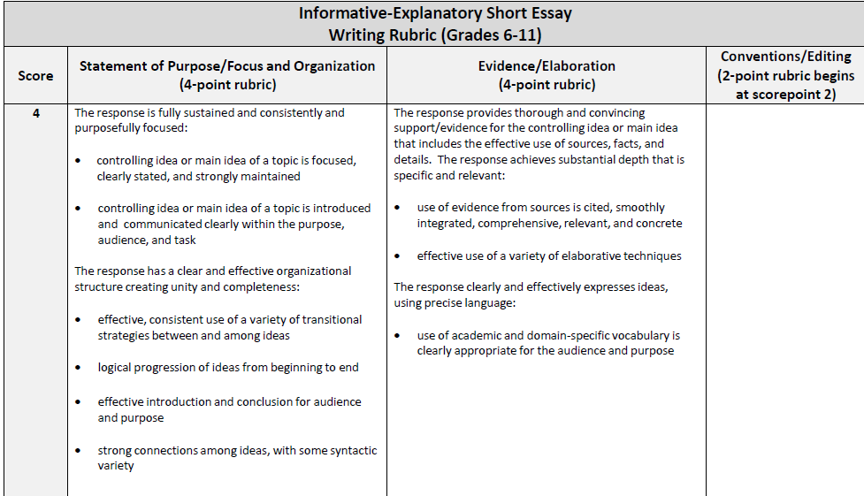
SAGE Writing Rubric Grades 6-11
Effective, consistent use of a variety of transitional strategies between and among ideas

Slide 77
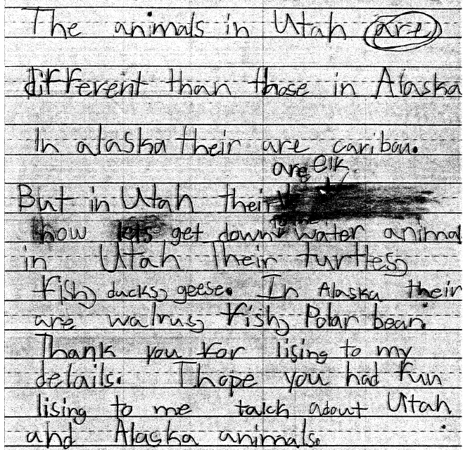
Transitions
2nd Grade

Slide 78
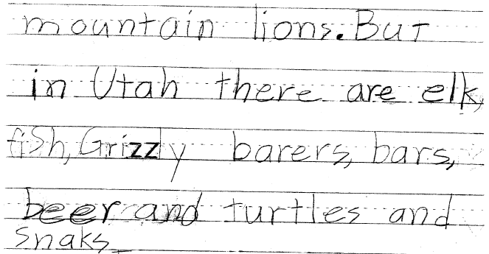
Transitions

Slide 79
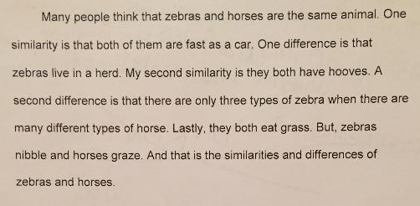
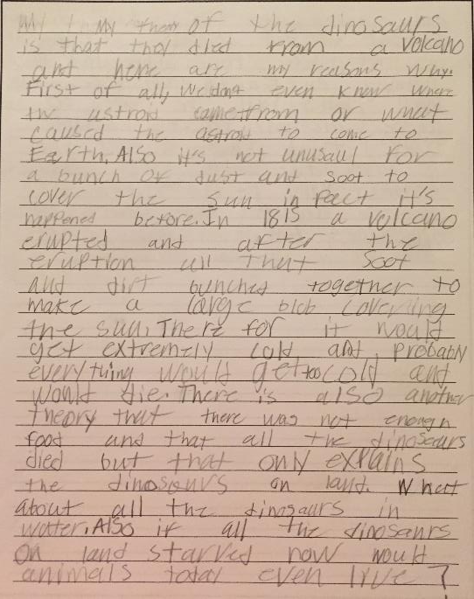
Transitions
3rd Grade
4th Grade

Slide 80
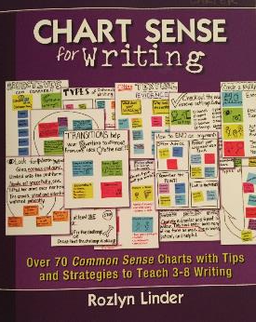
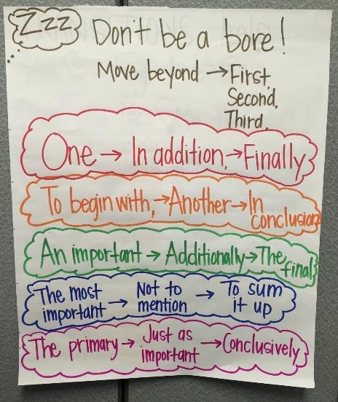
Don’t Be a Bore!
Teach students to move beyond first, next, last
Notes:
Students are regularly taught that writer use transitions to move to different ideas within a piece of writing. Unfortunately, many students think that sequence words, followed by commas, are the only types of transitions that exist. This often results in a very limited use of transitions and an overuse of sequential transitions.

Slide 81
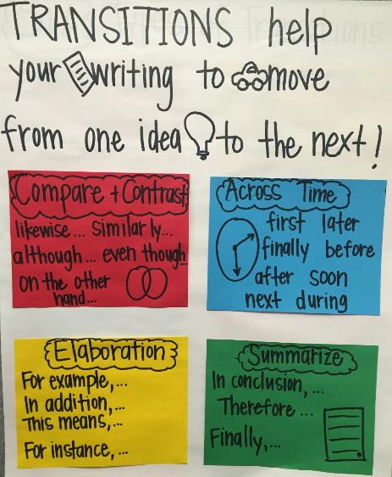
Types of Transitions
Compare and Contrast
Across Time
Elaborations
Summarize
Notes:
Write the title before hand. Then explain each section, and add sentence starters as a whole group. Have students reread older pieces of writing and find at least two places where they can add or revise a transition. Ask volunteers to share their sentence in front of the transition, along with the sentence that follows the transition. Ask the other students to try to name the type of transition used.

Slide 82
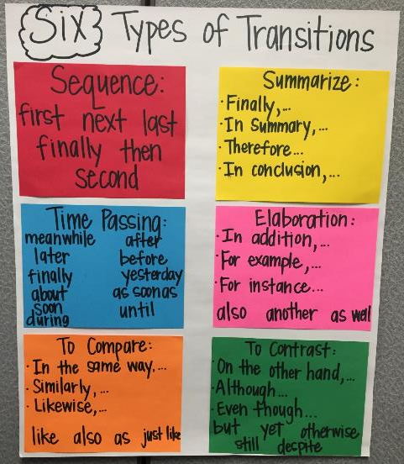
Types of Transitions
Sequence
Summarize
Time Passing
Elaboration
To Compare
To Contrast
Notes:
Students can recreate this chart in their writing notebook, divide page into 6 sections. Create the chart together. Move through each section and have students list examples. Gather print or digital text that uses these transitions to share with students as examplars.
Add transitions over time, build the list as you see new transitions to include in your own writing.

Slide 83
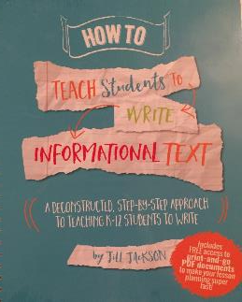
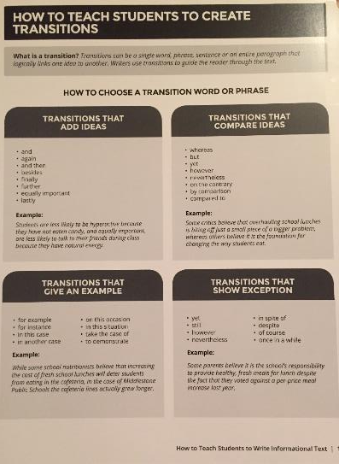
Types of Transitions
Add ideas
Compare ideas
Give an example
Show exception

Slide 84
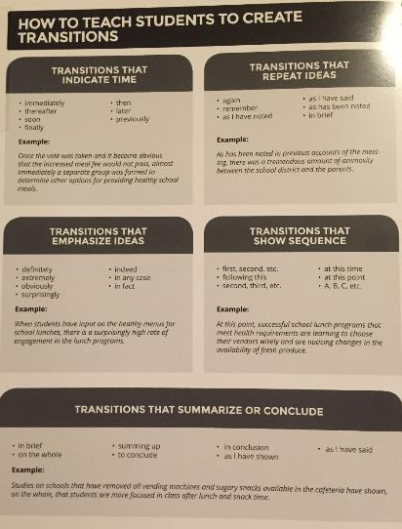
Types of Transitions
Indicate time
Repeat ideas
Emphasize ideas
Show sequence
Summarize or Conclude

Slide 85

How do I teach students to use transitions?
Explain the definition of transitions in writing
Model for students what a paragraph without transitions sounds like
Model for students what the same paragraph sounds like with transitions added
Introduce types of transitions and use mentor texts to model each type
Use previous student work samples to add transitions
REPEAT, REPEAT, REPEAT

Slide 86

What can comedians teach us about transitions?
Transitions thread together several different ideas to create one cohesive piece.
Stand-up comedy is much like an oral essay. The comedian tells jokes, usually in the form of a story, and moves from one segment of material to the next by connecting them with good transition sentences.
Notes:
http://english3840.blogspot.rs/2011/10/what-stand-up-comedy-can-teach-us-about.html
https://www.kibin.com/essay-writing-blog/how-comedians-teach-you-to-write-good-transition-sentences/

Slide 87
Record your thoughts!
Current practices
Implications for instruction
Resources available/needed
Support available/needed
Questions
Concerns
Alternate approaches

Slide 88
Editing Cirlces

Slide 89
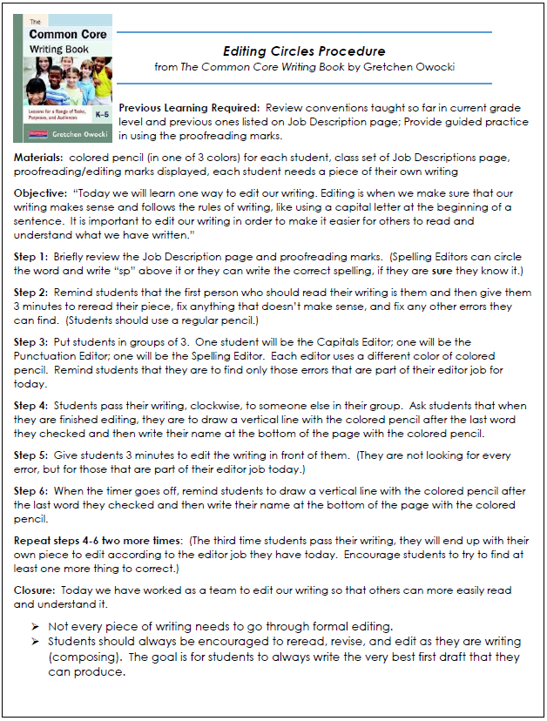
Editing Circles

Slide 90
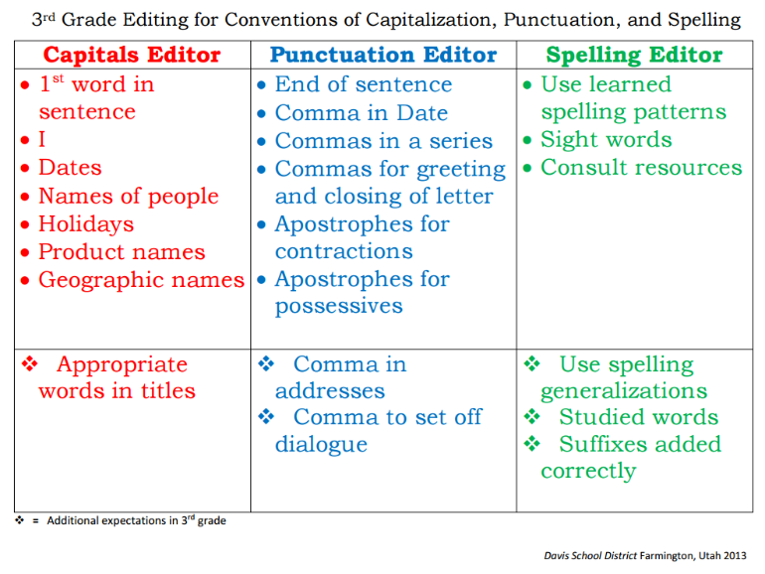
Language Standards

Slide 91
Challenge Spelling Words

Slide 92
Challenge Spelling Words
“Students who struggle mightily with spelling or worry unnecessarily about perfect spelling do not write fluently or easily.”
- Shane Templeton

Slide 93
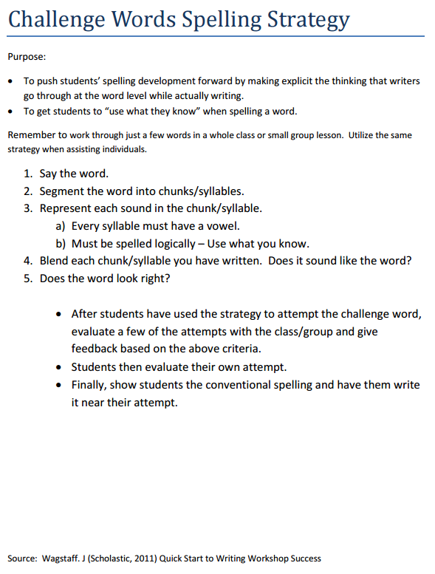
Challenge Spelling Words
Say the word
Segment the word into chunks/syllables
Represent each sound in the chunk/syllable
Every syllable must have a vowel
Must be spelled logically- Use what you know
Blend each chunk/syllable you have written. Does it sound like the word?
Does the word look right?

Slide 94
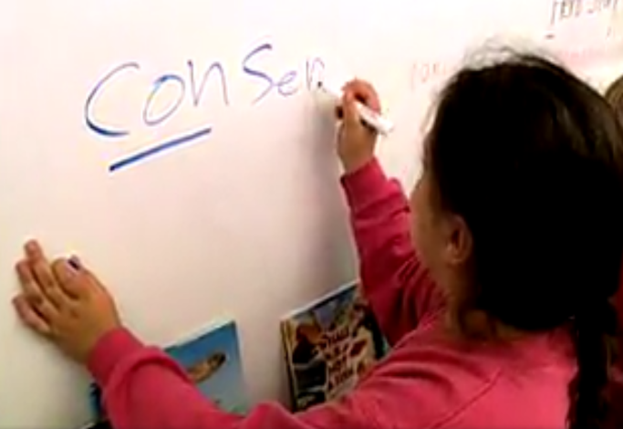
Challenge Spelling Words
Notes:
https://www.facebook.com/literacymattersjw/
Remember quote from Shane Templeton, "Students who struggle mightily with spelling or worry unnecessarily about perfect spelling do not write fluently or easily."

Slide 95


