Slide 1
Improving Integration of
Knowledge and Ideas
Jennifer Throndsen
preK-12 Literacy Coordinator
Utah State Office of Education
Notes:
Snowbird Room from 10:10-11:00
The ELA Core Standards are calling for students to integrate their learned knowledge and ideas across multiple texts. The SAGE results indicate a greater need of support in addressing these standards 7 & 9 (Integration of Knowledge and Ideas). The purpose of this presentation is to provide teachers with concrete examples of what these standards are asking teachers to do to help students be successful.

Slide 2
Reading Anchor Standards 7, 8, & 9
7. Integrate and evaluate content presented in diverse media and formats, including visually and quantitatively, as well as in words.
8. Delineate and evaluate the argument and specific claims in a text, including the validity of the reasoning as well as the relevance and sufficiency of the evidence.
9. Analyze how two or more texts address similar themes or topics in order to build knowledge or to compare the approaches the authors take.

Slide 3
2nd Grade Example: ELA & Science Connection
RI.2.9 Compare and contrast the most important points presented by two texts on the same topic.
Standard 4: Life Science
  Objective 1: Tell how external features affect an animals’ ability to survive in its environment.
    b) Develop, communicate, and justify an explanation as to why a habitat is or is not suitable for a specific organism.

Slide 4


Text Set
RI.2.9 Compare and contrast the most important points presented by two texts on the same topic.
690 L
520L
Notes:
Baby Polar Bears—Epic Books

Slide 5
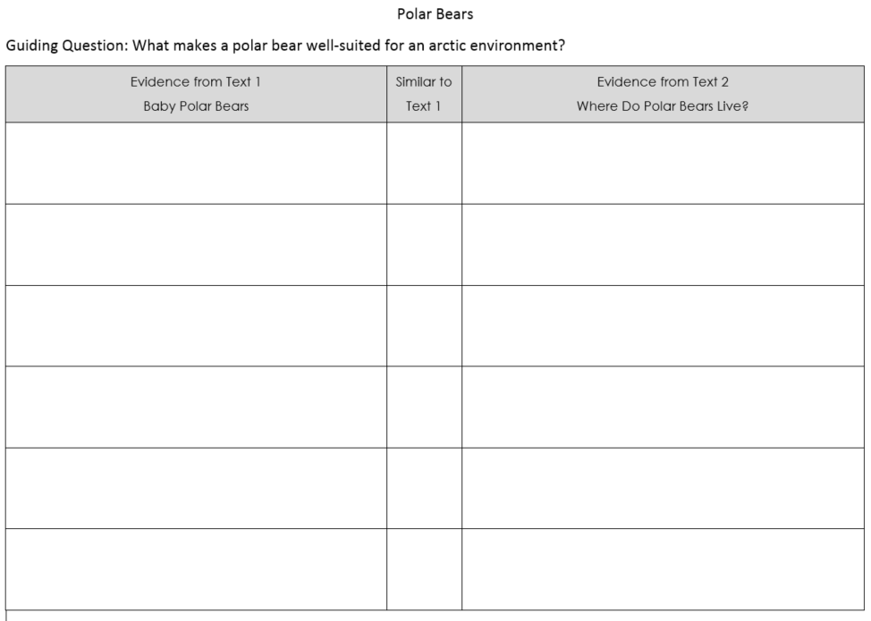
Notes:
Sample note taking device to support standard 9 and to prepare them for the writing task

Slide 6
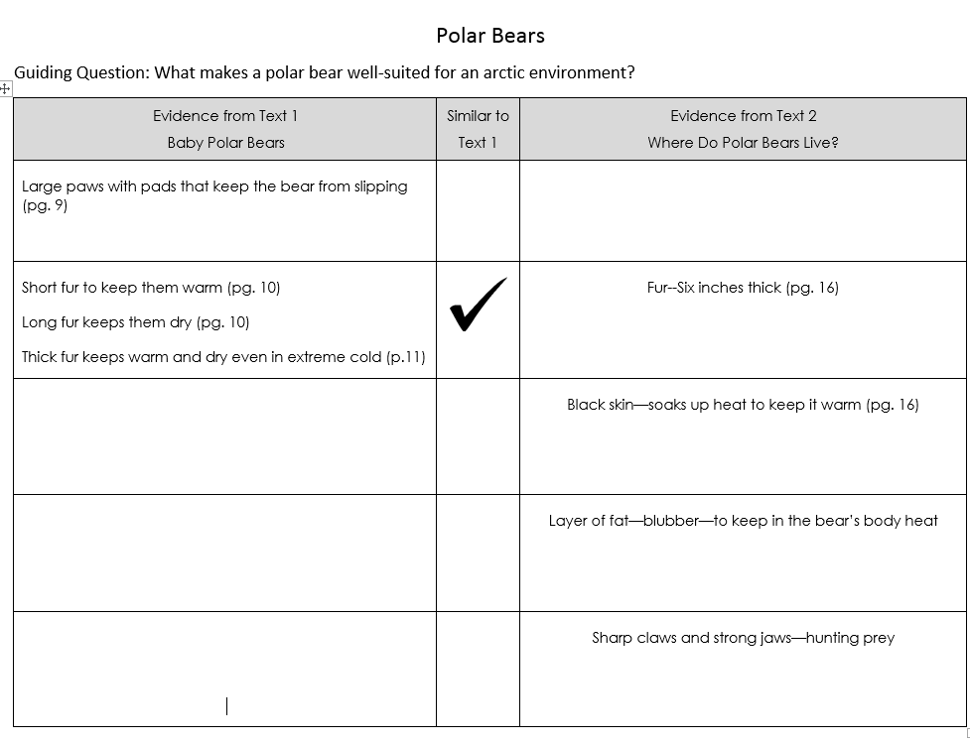

Slide 7
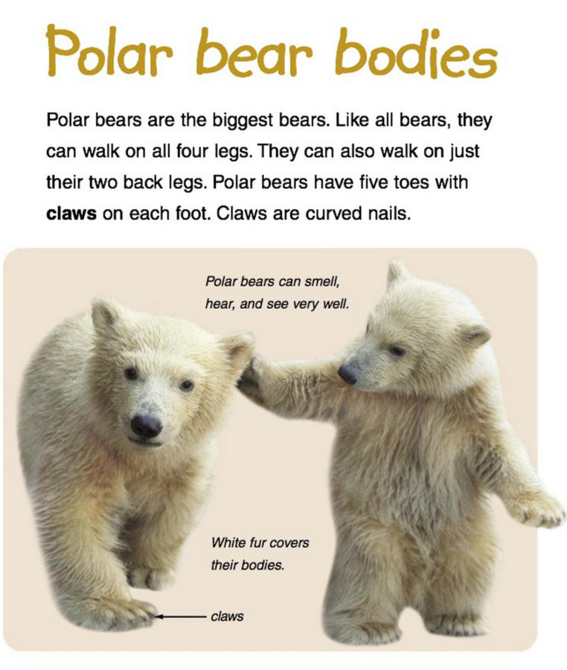
RI.2.7 Explain how specific images (e.g., a diagram showing how a machine works) contribute to and clarify a text.

Slide 8
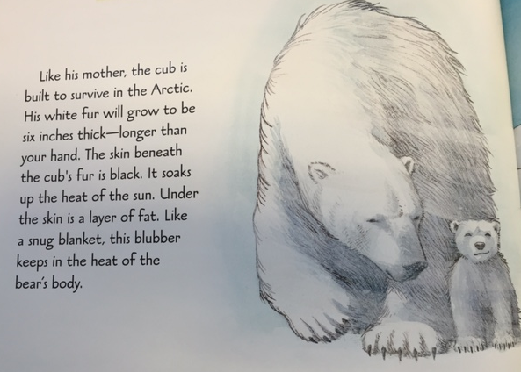
RI.2.8 Describe how reasons support specific points the author makes in a text.
Notes:
The author claims that the polar bear is built to survive in the Arctic. What evidence does the author provide?

Slide 9
Learning Task
To survive in the harsh arctic environment, animals need special adaptations. After reading Baby Polar Bears and Where Do Polar Bears Live?, describe, using facts and definitions, the physical characteristics that allow the polar bear to survive in the Arctic. Be sure to use evidence from the texts to support your ideas.
W.2.2 Write informative/explanatory texts in which they introduce a topic, use facts and definitions to develop points, and provide a concluding statement or section.
W.2.8 Recall information from experiences or gather information from provided sources to answer a question.

Slide 10
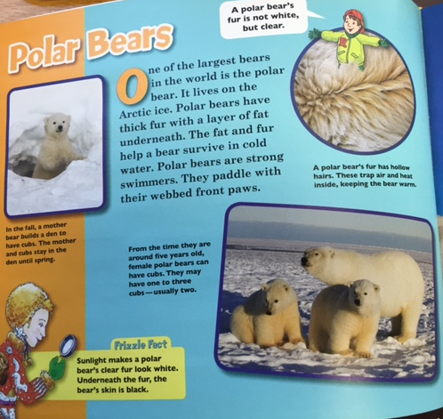
Excerpt from The Magic School Bus: Polar Animals
W.2.2
Write informative/ explanatory texts in which they introduce a topic, use facts and definitions to develop points, and provide a concluding statement or section.
Notes:
The writing piece could even be in a layout like this if they wanted. Oriented in a typical informational text fashion.

Slide 11
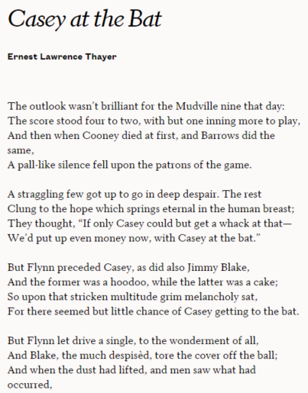
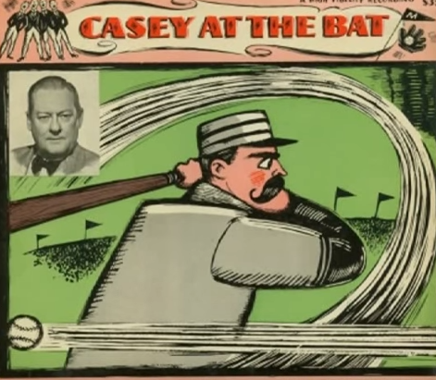
4th Example: Casey at the Bat
RL.4.7 Make connections between the text of a story or drama and a visual or oral presentation of the text, identifying where each version reflects specific descriptions and directions in the text.
900L
Notes:
Handout: Casey at the Bat
http://www.poetryfoundation.org/poem/174665
Read the poem.
Then, listen to a part of the narration to discuss how they might address 5.7 Narration is hyperlinked to image.

Slide 12

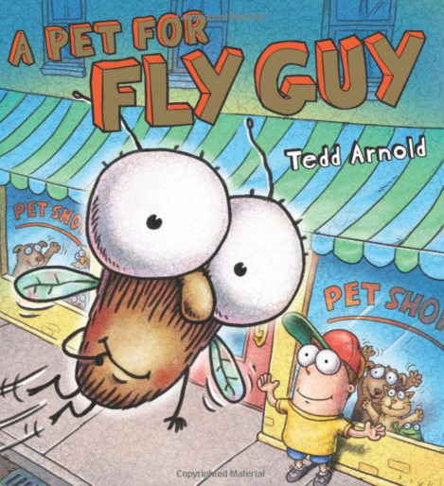
1st Grade Text Set Example: Fly Guy Series
RL.1.9 Compare and contrast the adventures and experiences of characters in stories.

Slide 13
Language Frames for Discussion of the Texts
In Hi! Fly Guy, Buzz believes Fly Guy is a good pet because he…
In A Pet for Fly Guy, a ______ didn’t make a good pet for Fly Guy because…
A good pet for Fly Guy would…

Slide 14
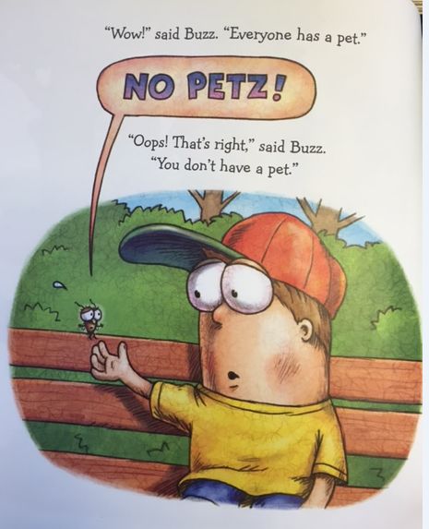
RI.1.7 Use the illustrations and details in a text to describe its key ideas.
RI.1.8 Identify the reasons an author gives to support points in a text.
Notes:
Key Detail—problem in this story—Fly Guy doesn’t have a pet and everybody else does.
1.8—What evidence does the author give to support the statement that “Everyone has a pet.”

Slide 15
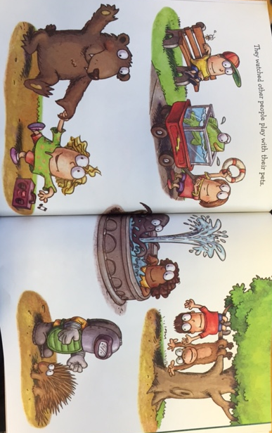
RI.1.8 Identify the reasons an author gives to support points in a text.

Slide 16
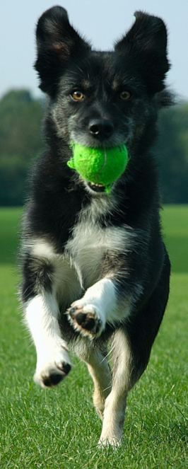


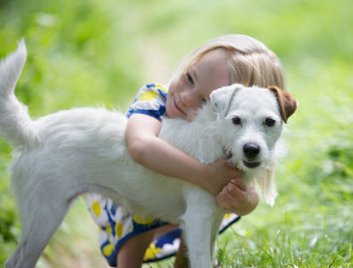
Learning Task:
W.1.1 Write opinion pieces in which they introduce the topic or name the book they are writing about, state an opinion, supply a reason for the opinion, and provide some sense of closure.
After reading Hi! Fly Guy and A Pet for Fly Guy, write about what you think makes a good pet. Be sure to include examples from the text to support your answer.
A good pet likes to play and can do tricks. | A good pet might wrestle with your or play fetch.
Also, it might be able to shake hands. | A good pet is a good friend, too.

Slide 17


3rd Grade: ELA Example
RL.3.9 Compare and contrast the themes, settings, and plots of stories written by the same author about the same or similar characters (e.g., in books from a series)
730L
490L

Slide 18
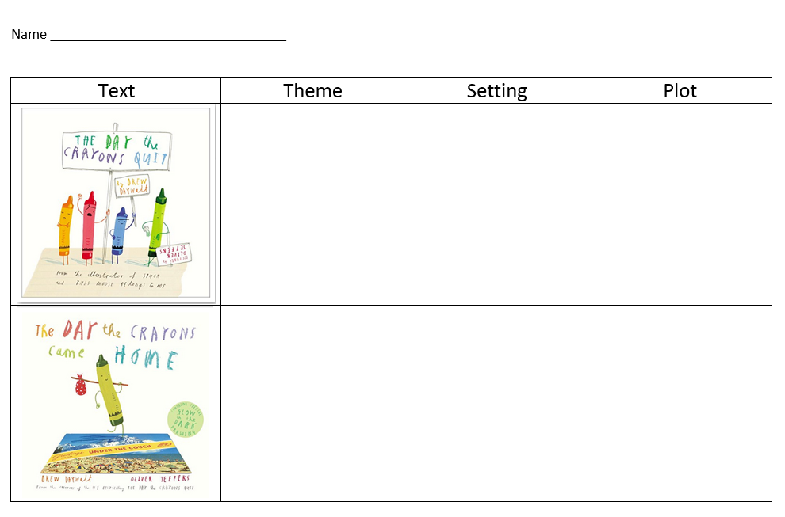
Notes:
Handout: The Crayons Text Set
RL.3.9 Compare and contrast the themes, settings, and plots of stories written by the same author about the same or similar characters (e.g., in books from a series)

Slide 19
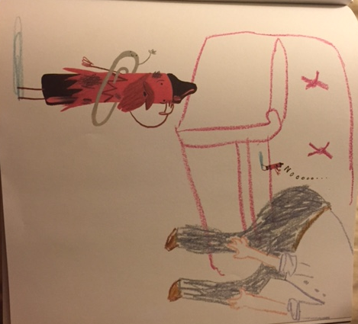
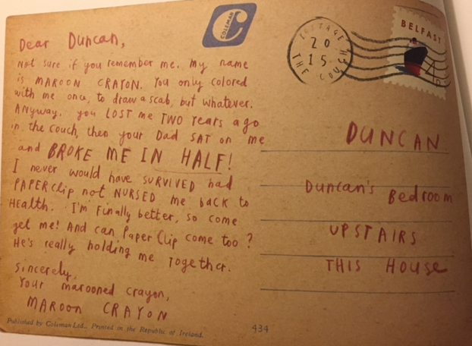
RL.3.7 Explain how specific aspects of a text's illustrations contribute to what is conveyed by the words in a story (e.g., create mood, emphasize aspects of a character or setting)

Slide 20
Learning Task
After reading The Day the Crayons Quit and The Day the Crayons Came Home, write a letter to Duncan from the perspective of one of the crayons about how you feel about Duncan’s response to your letter/postcard.
W.3.3 Write narratives to develop real or imagined experiences or events using effective technique, descriptive details, and clear event sequences.
3.3.B: Use dialogue and descriptions of actions, thoughts, and feelings to develop experiences and events or show the response of characters to situations.

Slide 21


RL.2.7 Use information gained from the illustrations and words in a print or digital text to demonstrate understanding of its characters, setting, or plot.
RL.2.9 Compare and contrast two or more versions of the same story (e.g., Cinderella stories) by different authors or from different cultures.
Notes:
Learning Task for Participants—work with a partner to think about how they would address standards 2.7 & 2.9 with these texts.
Have them share out to close the session (assuming there is time)

Slide 22
Questions or Comments?
Jennifer Throndsen
jennifer.Throndsen@schools.utah.gov
https://drive.google.com/folderview?id=0By89IiEV9jLDeHh4Wkd2NVBYODA&usp=sharing

Slide 23
Writing Anchor Standards 1 & 2
1. Write arguments (opinions) to support claims in an analysis of substantive topics or texts using valid reasoning and relevant and sufficient evidence.
2. Write informative/explanatory texts to examine and convey complex ideas and information clearly and accurately through the effective selection, organization, and analysis of content.

Slide 24
Standard 7 in isolation
RL.K.7 With prompting and support, describe the relationship between illustrations and the story in which they appear (e.g., what moment in a story an illustration depicts).
RL.1.7 Use illustrations and details in a story to describe its characters, setting, or events.
RI.K.7 With prompting and support, describe the relationship between illustrations and the text in which they appear (e.g., what person, place, thing, or idea in the text an illustration depicts).
RI.1.7 Use the illustrations and details in a text to describe its key ideas.

Slide 25
Standard 7 in isolation
RL.2.7 Use information gained from the illustrations and words in a print or digital text to demonstrate understanding of its characters, setting, or plot.
RL.3.7 Explain how specific aspects of a text's illustrations contribute to what is conveyed by the words in a story (e.g., create mood, emphasize aspects of a character or setting)
RI.2.7 Explain how specific images (e.g., a diagram showing how a machine works) contribute to and clarify a text.
RI.3.7 Use information gained from illustrations (e.g., maps, photographs) and the words in a text to demonstrate understanding of the text (e.g., where, when, why, and how key events occur).

Slide 26
Standard 7 in Isolation
RL.4.7 Make connections between the text of a story or drama and a visual or oral presentation of the text, identifying where each version reflects specific descriptions and directions in the text.
RL.5.7 Analyze how visual and multimedia elements contribute to the meaning, tone, or beauty of a text (e.g., graphic novel, multimedia presentation of fiction, folktale, myth, poem).
RI.4.7 Interpret information presented visually, orally, or quantitatively (e.g., in charts, graphs, diagrams, time lines, animations, or interactive elements on Web pages) and explain how the information contributes to an understanding of the text in which it appears.
RI.5.7 Draw on information from multiple print or digital sources, demonstrating the ability to locate an answer to a question quickly or to solve a problem efficiently.

Slide 27
Standard 8 in Isolation
RI.K.8 With prompting and support, identify the reasons an author gives to support points in a text.
RI.1.8 Identify the reasons an author gives to support points in a text.
RI.2.8 Describe how reasons support specific points the author makes in a text.
RI.3.8 Describe the logical connection between particular sentences and paragraphs in a text (e.g., comparison, cause/effect, first/second/third in a sequence).
RI.4.8 Explain how an author uses reasons and evidence to support particular points in a text.
RI.5.8 Explain how an author uses reasons and evidence to support particular points in a text, identifying which reasons and evidence support which point(s).

Slide 28
Standard 9 in isolation
RL.K.9 With prompting and support, compare and contrast the adventures and experiences of characters in familiar stories.
RL.1.9 Compare and contrast the adventures and experiences of characters in stories.
RL.2.9 Compare and contrast two or more versions of the same story (e.g., Cinderella stories) by different authors or from different cultures.
RI.K.9 With prompting and support, identify basic similarities in and differences between two texts on the same topic (e.g., in illustrations, descriptions, or procedures).
RI.1.9 Identify basic similarities in and differences between two texts on the same topic (e.g., in illustrations, descriptions, or procedures).
RI.2.9 Compare and contrast the most important points presented by two texts on the same topic.

Slide 29
Standard 9 in Isolation
RL.3.9 Compare and contrast the themes, settings, and plots of stories written by the same author about the same or similar characters (e.g., in books from a series)
RL.4.9 Compare and contrast the treatment of similar themes and topics (e.g., opposition of good and evil) and patterns of events (e.g., the quest) in stories, myths, and traditional literature from different cultures.
RL.5.9 Compare and contrast stories in the same genre (e.g., mysteries and adventure stories) on their approaches to similar themes and topics.
RI.3.9 Compare and contrast the most important points and key details presented in two texts on the same topic.
RI.4.9 Integrate information from two texts on the same topic in order to write or speak about the subject knowledgeably.
RI.5.9 Integrate information from several texts on the same topic in order to write or speak about the subject knowledgeably.

