Slide 1
K-1 Writing
Strengthening Your Core
August 2016

Slide 2

Introduction
Cydnee Carter
Utah State Board of Education (USBE)
ELA Specialist (elementary)
WIDA Specialist
cydnee.carter@schools.utah.gov

Slide 3

Introductions
Name
Grade Level
Years of Experience
If I could learn one thing today, I would most appreciate…

Slide 4
Agenda
Stages of Writing and Spelling Development
Letter Formation and Handwriting
Vocabulary
Writing Collection Project
Mentor Text
Quick Bursts of Writing

Slide 5
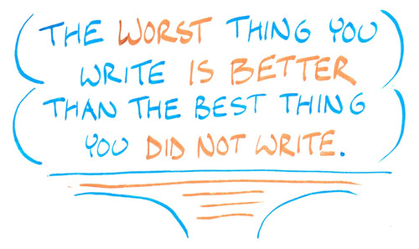
Benefits of Writing
How does writing enhance reading, understanding, academic performance, and life skills?
Notes:
On their note taking guide, have them work in partners to list the benefits of writing.

Slide 6

Table Discussion
How much class time is spent on writing instruction/practice per day?
In the context of what subject matter?
What kinds of student groupings are used?
What programs/materials/lesson frameworks are used for guidance?
Notes:
Have tables discuss these instructional items. Link to previous task in knowing that writing is so critical for so many other areas…does that importance hold true in your school?

Slide 7
Skills in Writing
Lower-level Cognitive Skills
Higher-level Cognitive Demands
Physically forming letters using pencil on paper
Writing left to right.
Using a story structure or expository structure.
Varying sentence structure.
Spacing words on a page.
Sticking to the plan.
Spelling high-frequency irregular words.
Phonetically spelling unknown words.
Using topic sentences in paragraphs.
Notes:
On their note-taking guide have them work with a partner to draw arrows to show whether it is a high level or low level cognitive skill.

Slide 8
Foundational Skills in Writing
Lower-Level Cognitive skills
Higher-Level Cognitive Demands
Writing left to right.
Physically forming the letters using pencil on paper.
Spacing words on the page.
Spelling high-frequency irregular words.
Phonetically spelling unknown words.
Using uppercase letters as appropriate.
Using end punctuation.
Indenting paragraphs.
Using a story structure or expository structure.
Varying sentence structure.
Sticking to the plan.
Using topic sentences in paragraphs.
Keeping the goal of the composition in mind.
Keeping the audience’s need in mind.
Checking for insufficient or unnecessary detail.
Choosing precise vocabulary to express ideas.
Notes:
this will influence students’ abilities to produce quality writing—introductions and conclusions.

Slide 9
Stages of Writing

Slide 10
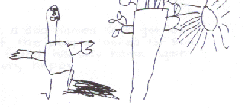
Drawing
Notes:
Children begin by using pictures to tell stories about their thinking. Eventually students will differentiate between drawing and writing, but at this point drawing is accepted as a form of writing.

Slide 11
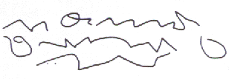
Scribbling
Notes:
Children use scribbles to imitate handwriting and are able to tell what they wanted their writing to say.

Slide 12

Random strings of letters
Notes:
Children use their knowledge of letters to write random letter strings to express their thinking.

Slide 13
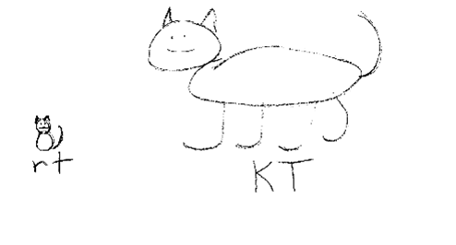
Beginning and ending consonant sounds
Notes:
Children use their segmenting skill to label or write at least the first and last sounds in words.

Slide 14
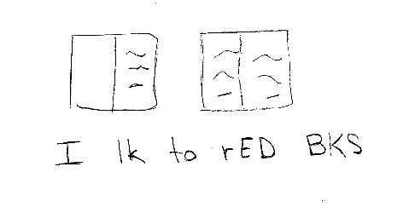
Vowels, high frequency words, and sentence structure
Notes:
Children now hear and represent more sounds in words. They begin to use known sight words in their writing. Writing begins to look more like sentences including spaces between words.

Slide 15

Most sounds represented within sentences
Notes:
Children write multiple sentences with most sounds in words represented. Students are developing the stamina to get down many of their ideas.

Slide 16

Conventional writing
Notes:
Children integrate all of their skills, knowledge and thinking to write in a conventional manner. (sight words, segmentation for unknown words, sentence structure, beginning with a capital letter and experimenting with ending punctuation)
Students are able to write easily and fluently to express multiple thoughts about a topic in one sitting as well as across multiple days.

Slide 17
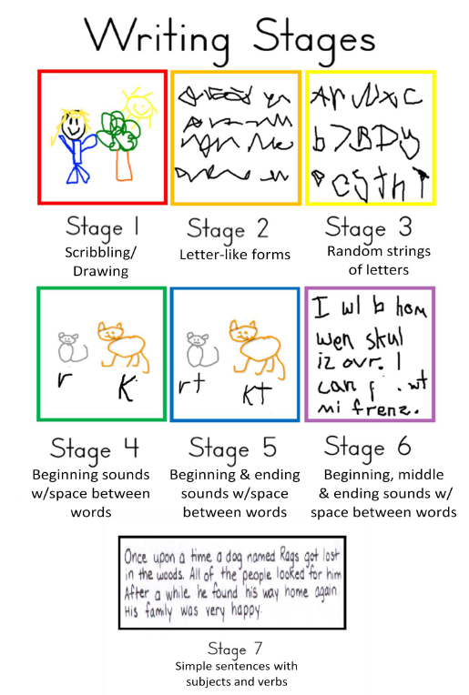
Writing Stages

Slide 18

Discussion
How does your knowledge of the writing stages help to guide your instruction to improve student writing?

Slide 19
Invented Spelling
Notes:
Invented spelling refers to a child applying what he or she knows about sounds or visual patterns when attempting to write an unknown word. For example, a child who spells the word cake as kak. It is simply a phonetic approach to writing.
The value of invented spelling is allowing young children to express their thoughts in writing.

Slide 20
Stages of Spelling Development
Precommunicative Stage
Semiphonetic Stage
Phonetic Stage
Transitional Stage
Correct Stage

Slide 21
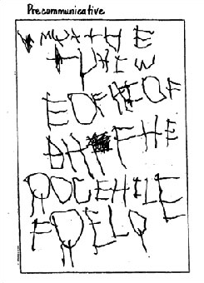
Precommunicative Stage
Uses letters but no knowledge of letter-sound correspondences
Lack knowledge of:
Enitre alphabet
Distinction between upper and lower case letters
Left-to-right direction
Notes:
The child uses letters from the alphabet but shows no knowledge of letter-sound correspondences. The child may also lack knowledge of the entire alphabet, the distinction between upper- and lower-case letters, and the left-to-right direction of English orthography. (e.g. The letter M used for the word Jessica)

Slide 22
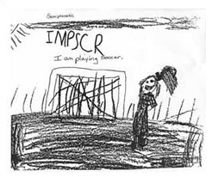
Semiphonetic Stage
Beginning to understand letter-sound correspondence
Rudimentary logic- using single letters to represent words, sounds, and syllables, e.g. U for you
Notes:
The child begins to understand letter-sound correspondence--that sounds are assigned to letters. At this stage, the child often employs rudimentary logic, using single letters, for example, to represent words, sounds, and syllables (e.g., U for you).

Slide 23
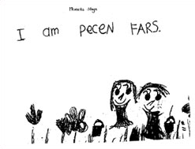
Phonetic Stage
Uses letter or groups of letters to represent every speech sound heard
May not conform to conventional English spelling, but systematic and easily understood e.g. tak for take or en for in
Notes:
Use a letter or group of letters to represent every speech sound that they hear in a word. Although some of their choices do not conform to conventional English spelling, they are systematic and easily understood. (e.g. The letters TAK fortake and EN for in.)

Slide 24
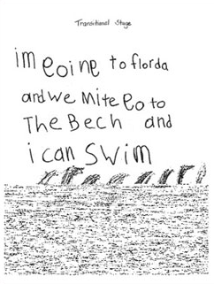
Transitional Stage
Begins to use conventional alternative for representing sounds
Moving from dependence on phonology to reliance on visual structure of words, e.g. egul for eagle or higheked for hiked
Notes:
The speller begins to assimilate the conventional alternative for representing sounds, moving from a dependence on phonology (sound) for representing words to a reliance on visual representation and an understanding of the structure of words. Some examples are EGUL foreagle and HIGHEKED for hiked.

Slide 25
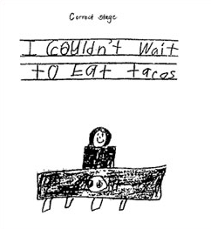
Correct Stage
Knows the basic rules
Understands prefixes and suffixes, silent consonants, alternative spellings, irregular spellings
Large number of learned words
Generalizations about spelling and knowledge of exceptions are usually correct
Notes:
The speller knows the basic rules. The correct speller understands how to deal with such things as prefixes and suffixes, silent consonants, alternative spellings, and irregular spellings. A large number of learned words are accumulated, and the speller recognizes incorrect forms. The child's generalizations about spelling and knowledge of exceptions are usually correct.
It is important to note that the progression through each stage is a gradual one and that examples from more than one stage may exist in samples of writing taken from students. Instruction in spelling shapes the progression through each of the stages.

Slide 26
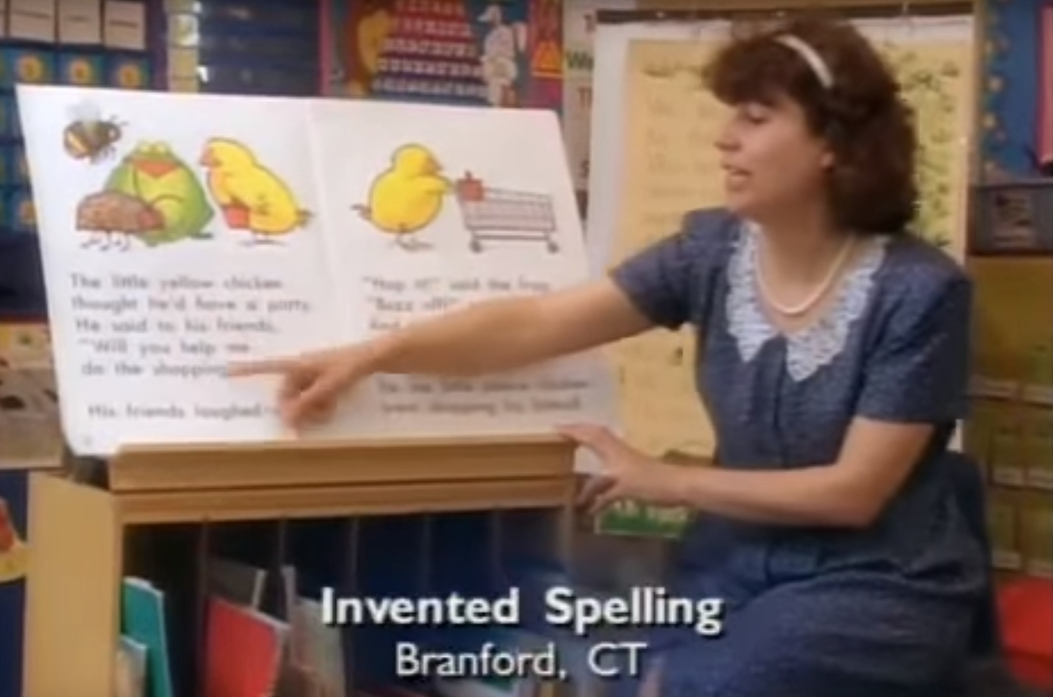
Invented Spelling
Notes:
http://www.readingrockets.org/teachers/firstyear/fyt_program/modules/spelling/spelling-depth

Slide 27
3000 Words

Slide 29
Letter Formation and Handwriting

Slide 30
Why teach Handwriting?
Handwriting (both manuscript and cursive) is an important skill for students to learn. Teaching and practicing writing allows students to write letters correctly and efficiently. Fluent writers are able to focus on generating idea, producing grammatically correct text, and considering audience. Even when a student moves to a computer or other device, that writing fluency is important to the composing process.
– Utah State Board of Education
Notes:
Direct, systematic, explicit teaching of handwriting improves students’ overall written composition for many years. Students who are automatic with correct letter formation, including reasonable legibility and fluency, can cognitively attend to the higher-level skills associated with written tasks. Attention to higher-level skills is compromised when students have to focus their cognitive energy on letter formation. Best practices support the integration of handwriting instruction within other written tasks. Research indicates that early handwriting instruction improves students’ written work, not just its legibility, but its quantity and quality as well (Graham, 2010; Moats, 2008).

Slide 31
Effective and Efficient Handwriting instruction
Step 1: Provide 2-5 minutes of direct, explicit instruction during the Language Block.
Instruction includes:
Providing visual models around the room
• Using lined paper with labels for top/middle/bottom
• Connecting sound/spelling card, name and sound of letter (K-3)
• Using language to describe the strokes
• Writing letters in the air using whole arm and pointing with index and middle fingers to trace the letter
• Monitoring student posture and grip as necessary
• Focusing on accuracy, then fluency
Step 2: Embed additional practice in spelling/word study, writing, or conventions instruction
Step 3: Practice Stations can be used for additional, brief practice opportunities

Slide 32
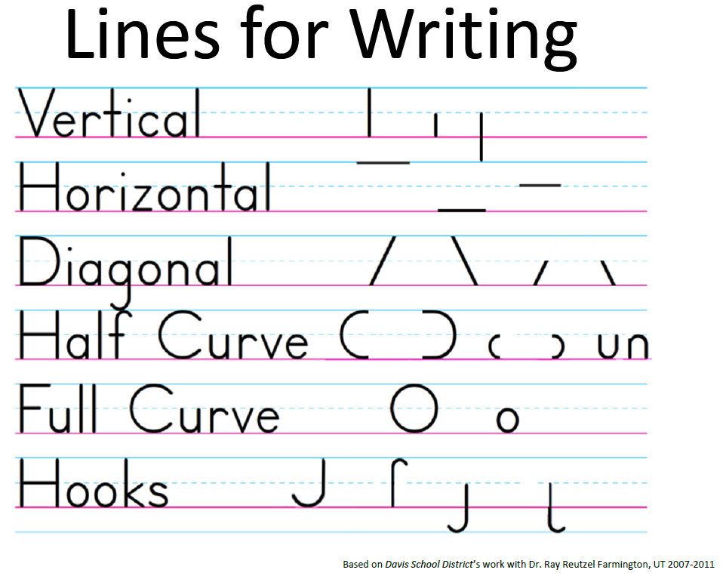
Provide Visual Models

Slide 33

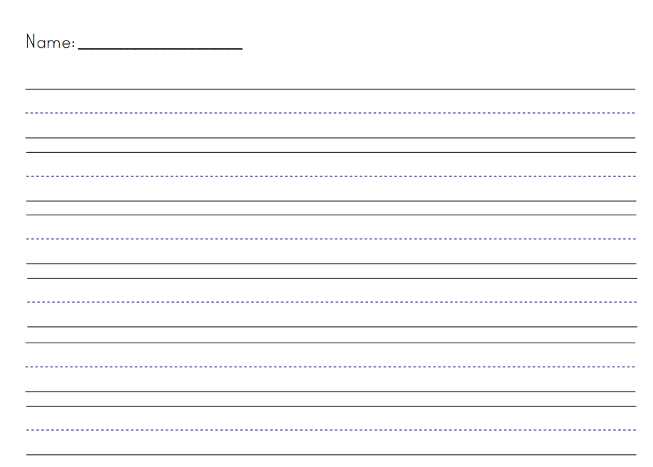
Lined Paper

Slide 34
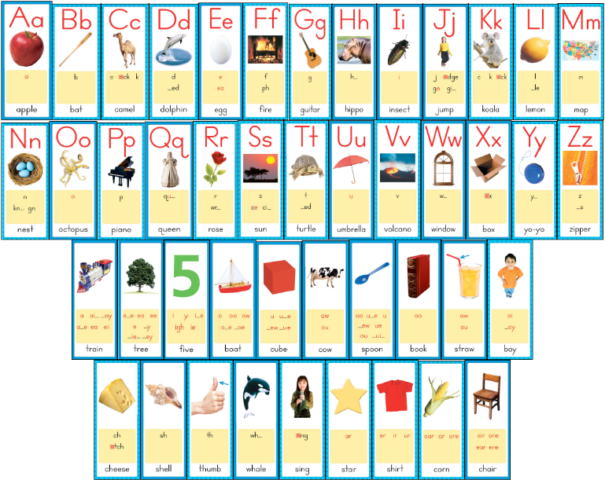
Sound/Spelling Card, Name & Sound

Slide 35
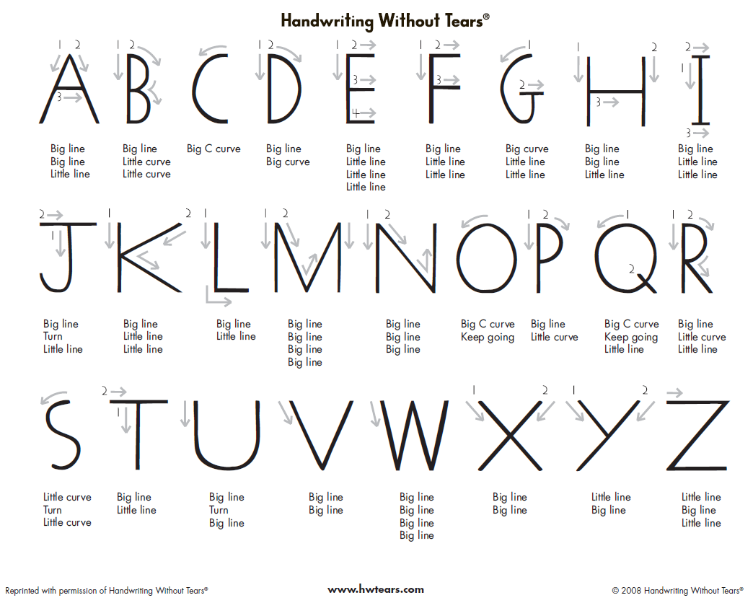
Using Language to Describe Strokes

Slide 36
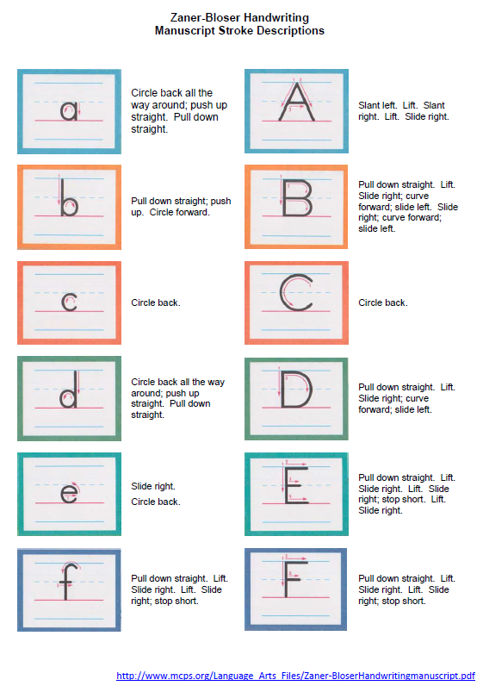
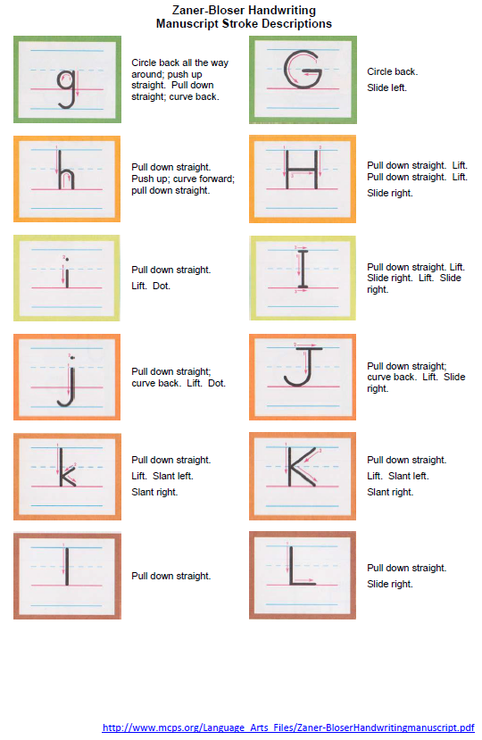
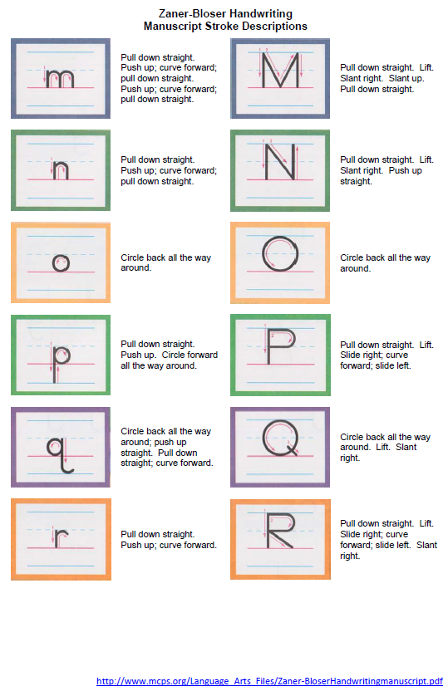
Using Language to Describe Strokes

Slide 37

Building Transcription Fluency
5-10 minute warm-up
Forming a few letters, using numbered arrow cues, tracing, verbalizing, or writing from memory, then evaluating accuracy.
Producing the alphabet, in sequence, one or two times per session, until fluency is achieved.
Writing graphemes for dictated phonemes (vowels and consonants), including letter combinations such as vowel teams and digraphs.
Combining onsets and rimes to write whole syllables.
Writing high-frequency words to dictation—a few at a time, singly, or in sentences—saying the letters while writing each word.
Notes:
In K-2, it is essential to provide short, daily practice in letter formation and writing high-frequency words

Slide 38
Vocabulary

Slide 39
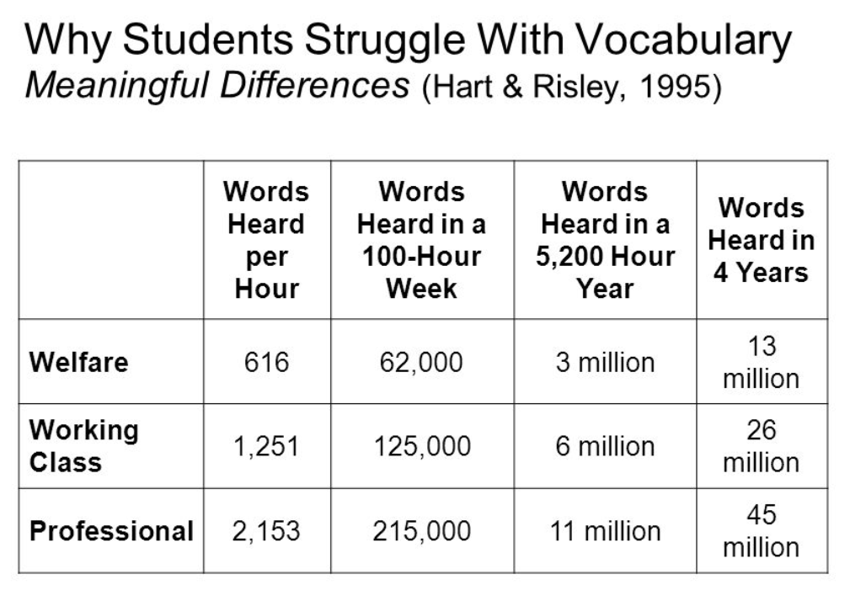
Vocabulary

Slide 40
Definitions
Academic Vocabulary:
Terms that students bring with them
Tier II vocabulary
Domain-Specific Vocabulary:
Terms that students may not already know, but learn and use from the text
Tier III vocabulary

Slide 41
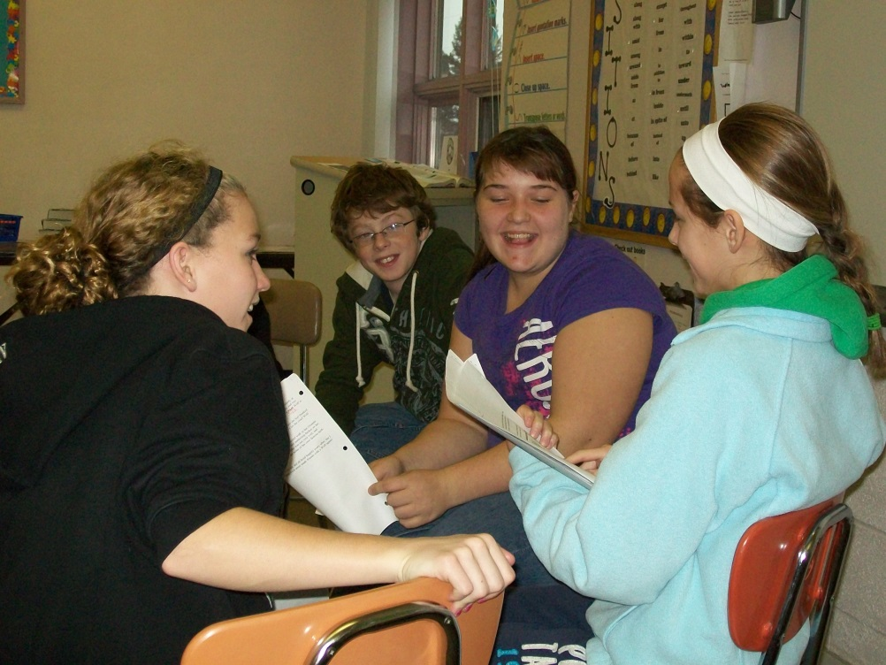
Academic Language
All students are academic language learners:
Academic Vocabulary
Academic Register (Tone and Style)

Slide 42
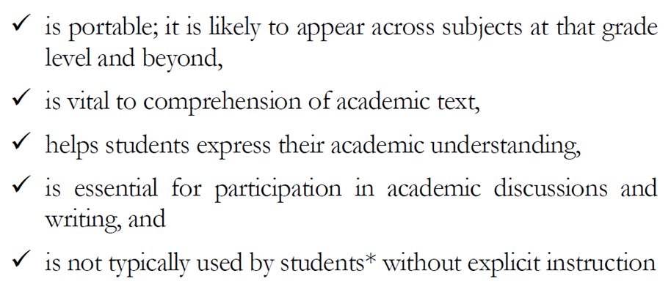
Academic Language

Slide 43
Students must learn 2,000-4,000 words every school year
Direct Instruction
400 words per year K-12 (Beck, McKeown, Kucan, 2002)
“Indirect” Instruction
Instructional read-alouds
Teach word analysis skills: affixes and roots
Link spelling instruction to vocabulary instruction
Teach the use of dictionaries, thesauruses, references
Teach the application of a word learning strategy
Encourage wide reading
Create a keen awareness of language and words
Notes:
Beck, McKeown, and Kucan (2002) recommend teaching about 400 words per year K-12.

Slide 44
Direct Instruction of Vocabulary
Tier I Words
Conversational Speech
House
Girl
Cat
Up
Umbrella

Slide 45
Direct Instruction of Vocabulary
Tier II Words
Academic Vocabulary
Similarities
Connections
Appear
Community
Spotted
Solution
Denotation and Connotation
Compose

Slide 46
Direct Instruction of Vocabulary
Tier III Words
Domain-Specific Vocabulary
English Language Arts
Illustrations
Glossary
Science
Properties
Components
Mathematics
Cylinder
Sequence

Slide 47
Writing Collection Project

Slide 48
Elementary Rangefinding
K-6th grade writing prompts and writing samples
Informative and Opinion writing prompts with stimulus materials
K-2 Handwritten samples
K-2 Rubrics to match standards
3rd-6th Half handwritten samples, half typed samples
SAGE Writing Rubrics
Notes:
http://www.uen.org/core/languagearts/writing-collection/

Slide 49
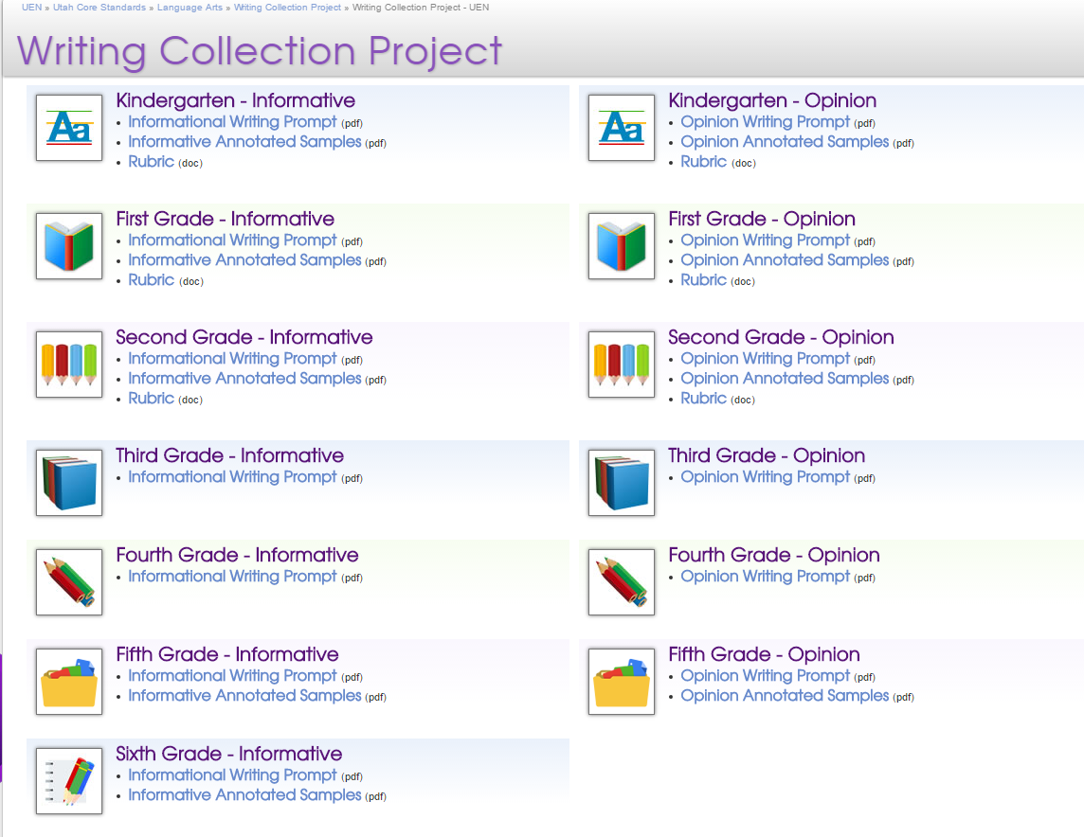
Writing Collection Project
All prompts, rubrics, and annotated samples can be found on UEN
http://www.uen.org/core/languagearts/writing-collection/
Notes:
http://www.uen.org/core/languagearts/writing-collection/

Slide 50
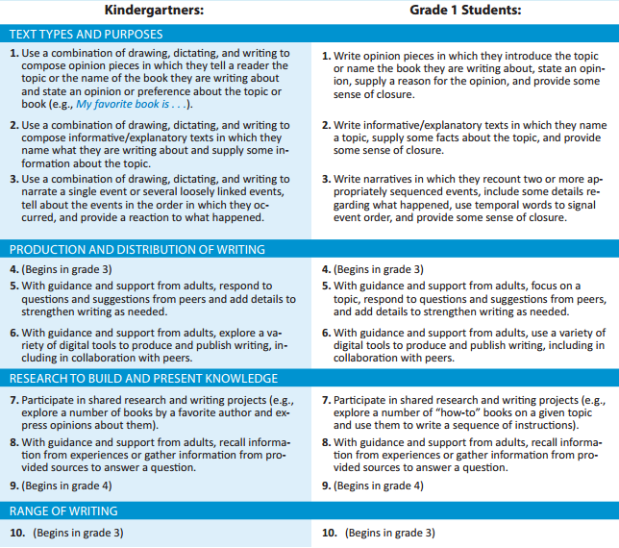

Slide 51
Opinion Writing Standards
Use a combination of drawing, dictating, and writing to compose opinion pieces in which they tell a reader the topic or the name of the book they are writing about and state an opinion or preference about the topic or book (e.g. My favorite book is…
Write opinion pieces in which they introduce the topic or name the book they are writing about, state an opinion, supply a reason for the opinion, and provide some sense of closure.

Slide 52
Informative Writing Standards
Use a combination of drawing, dictating, and writing to compose informative/explanatory texts in which they name what they are writing about and supply some information about the topic.
Write informative/explanatory texts in which they name a topic, supply some facts about the topic, and provide some sense of closure.

Slide 53
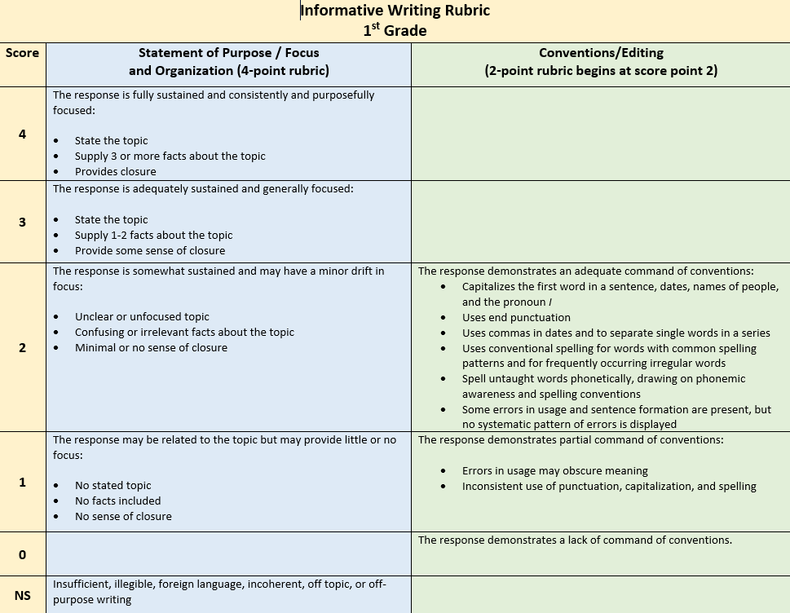
K-1 Informative and Opinion Writing Rubrics

Slide 54
The Day the Crayons QUit

Slide 55
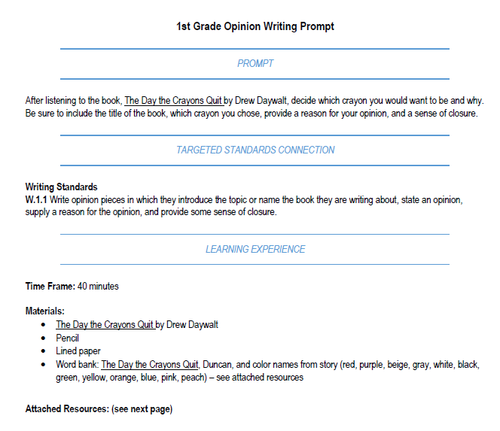

1st Grade Opinion Writing

Slide 56
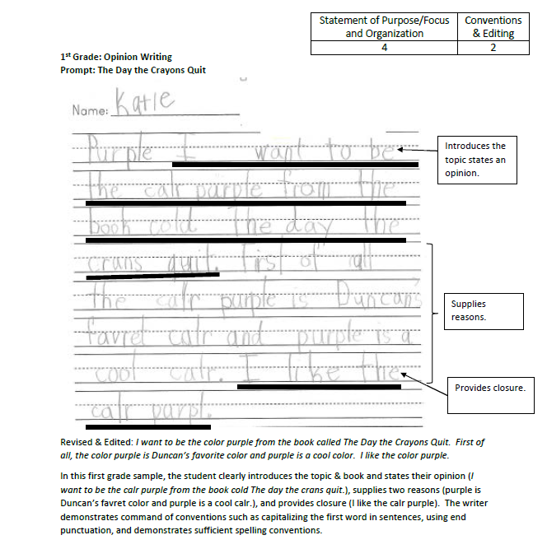
1st Grade Opinion Writing

Slide 57
Writing Samples

Slide 58
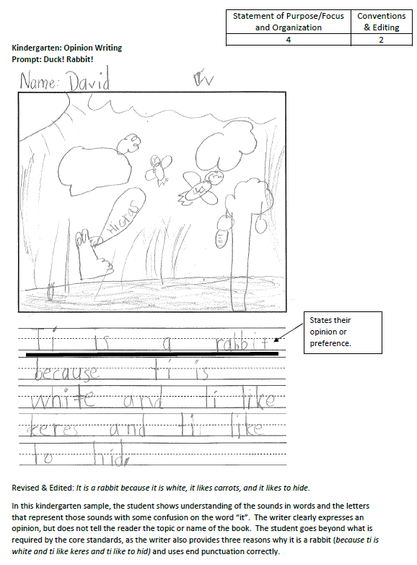
Rangefinding
On your own, review the essay.
Assign a score for each category.
Make notes about why you scored the way you did.
Discuss with your team.

Slide 59
Mentor Text

Slide 60
Successfully Teaching Informative Writing
Students need to first build knowledge about a topic before they are asked to produce formal informative writing pieces.
Remember to use the Stop, Think, and Write Strategies:
Thinking Boxes
Quick Jot
Quick Try
Quick Write
Notes:
Review the points on the slide.

Slide 61

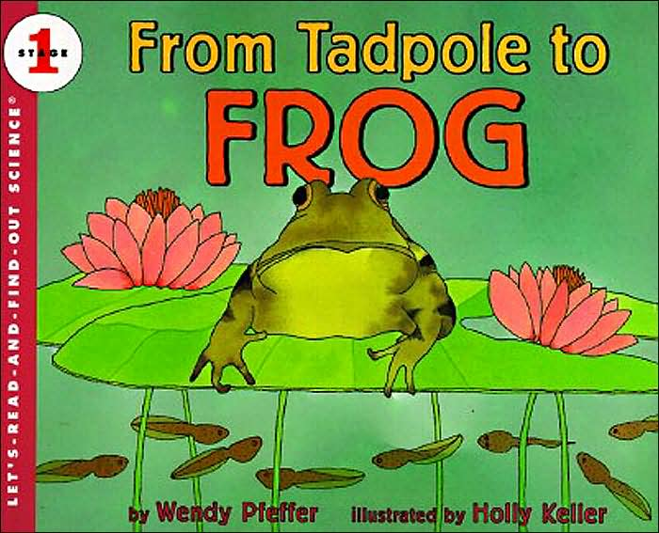
Successfully Teaching Informative Writing
Thinking Box 1 | Thinking Box 2
Thinking Box 3 | Thinking Box 4
Notes:
As students learn about a topic through shared research they can record the knowledge they’re building – and better remember what they’ve learned – with stop, think, and write strategies such as Thinking Boxes. See student samples.
Our goal with a group of first graders was to have them write about how tadpoles become frogs. We read from two texts (see slide) and used Thinking Boxes to write about we were learning.
Show Thinking Box samples and walk through the steps of the lesson.

Slide 62
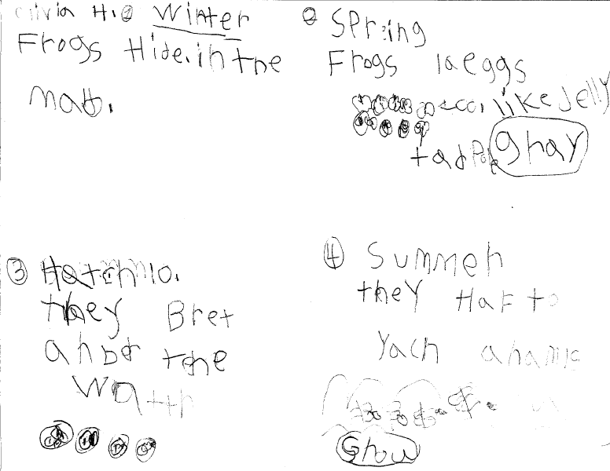
Successfully Teaching Informative Writing

Slide 63
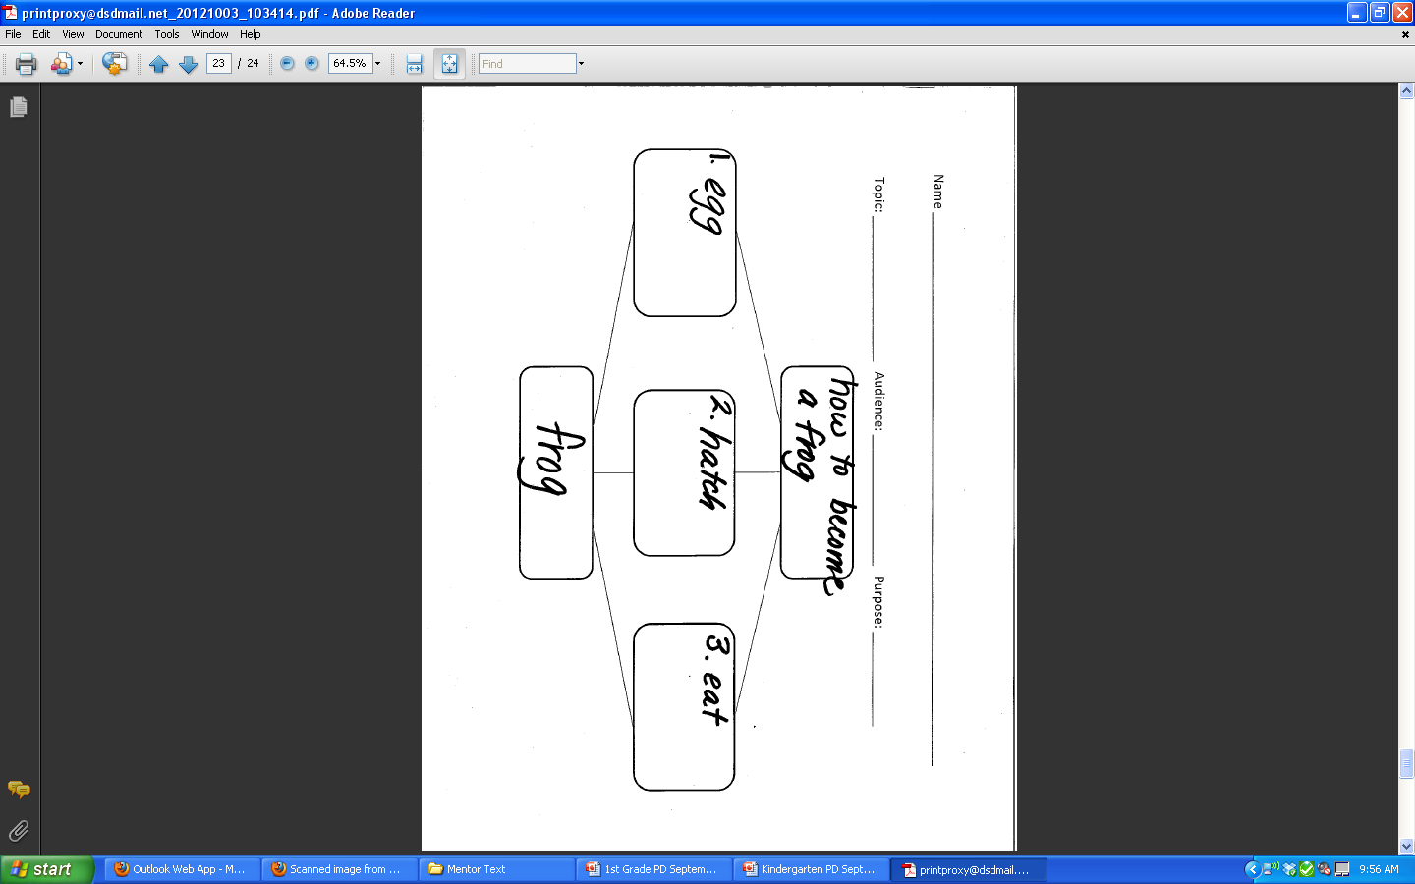
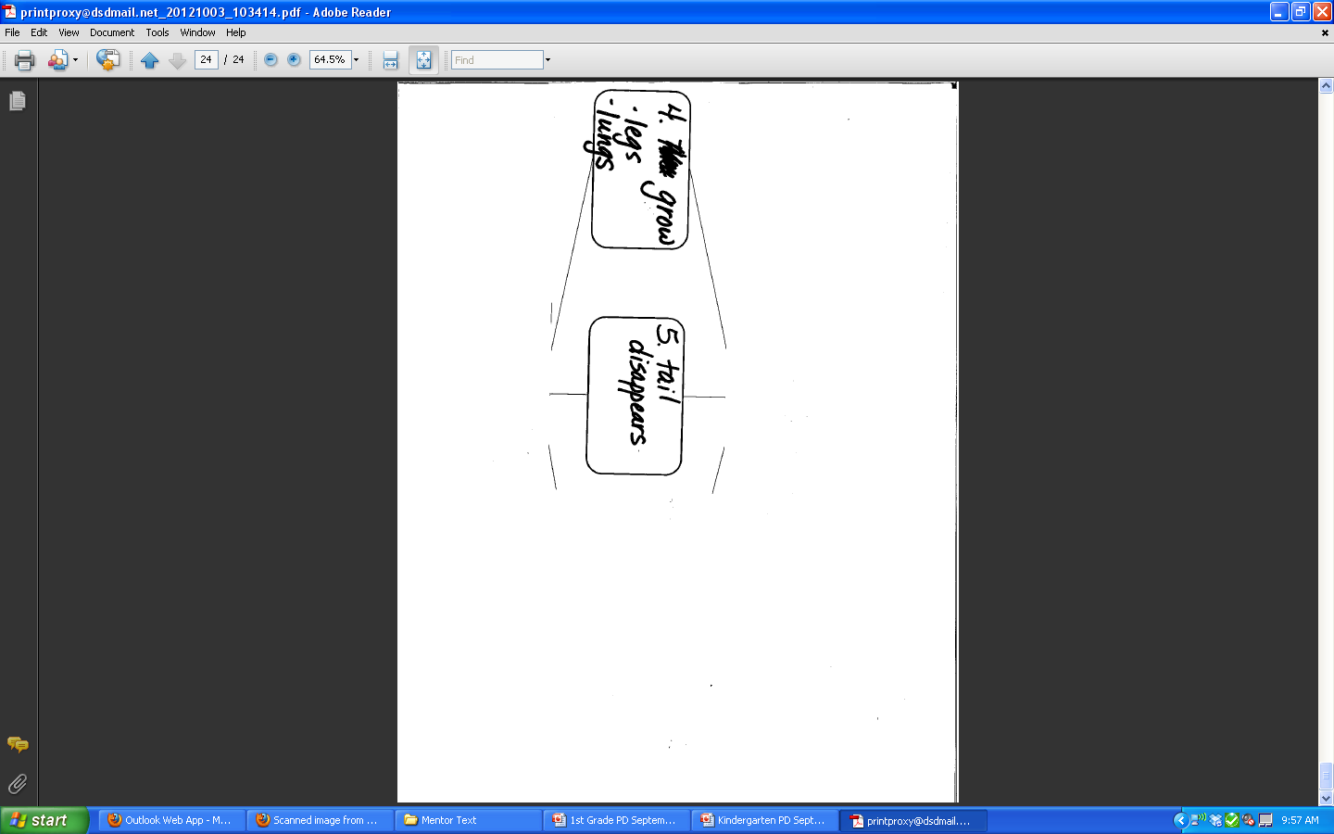
Successfully Teaching Informative Writing
Introduction
Main Idea
Main Idea
Main Idea
Main Idea
Main Idea
Conclusion
Notes:
After building knowledge, students are now prepared to write about their topic. They can use graphic organizer to organize their writing.
The graphic organizer on this slide represents the informative writing expectations for 1st grade students:
State the topic.
Supply some facts about the topic.
Provide a sense of closure.
We can see how students could organize their information about tadpoles growing into frogs in this graphic organizer …
However, we want to share a Mentor Text Routine with you that supports using this organizer, but also guides students as they write in the informative genre and elevates their writing.

Slide 64
Successfully Teaching Informative Writing
The purpose of this routine is to show students a model of quality writing. Students and teacher analyze the writing of skilled writers to see how experts successfully write in a particular genre or use language in masterful ways.
This routine is important to you because students have an “expert by their side” guiding them in their own writing attempts. Students grow as writers through multiple opportunities to explore the writing techniques and styles of many authors.
Notes:
Introduce the Mentor Text Routine.
Review the points on the slide.

Slide 65
Successfully Teaching Informative Writing
We organized the order of the steps with a writing structure. The whole class worked together, and the teacher was the scribe. The students used the graphic organizer to order their ideas and the mentor text map to guide their writing.
Notes:
Discuss points on slide.

Slide 66

Successfully Teaching Informative Writing
Notes:
The Mentor Text Routine is a great strategy for modeling how good writers successfully and proficiently write in the genres of the standards: informative, opinion, and narrative as well as how good writers use language to communicate effectively in their writing.
Review the steps of the routine.

Slide 67
Use Mentor Texts to Teach the Components of Informative Writing
Create a map.
Notes:
Share the book.
You will notice this is an example of an informational “how to” book.
Create a map with participants.
Highlight the connection between the map and the informative writing structure – Topic, Main Ideas w/details, Conclusion

Slide 68
Follow the Map
How to Become a Frog
If you want to ________, follow these simple instructions.
1. _________(Give a direction.)
(Add details)
2. _________(Give a direction.)
(Add details)
3. _________(Give a direction.)
(Add details)
If you follow these instructions, you will have
______ and you will have no _________.
Notes:
Here is the map we created from the mentor text. We used the map and the graphic organizer to write our own “How to” books.
Show “How to Become a Frog” student writing samples.

Slide 69
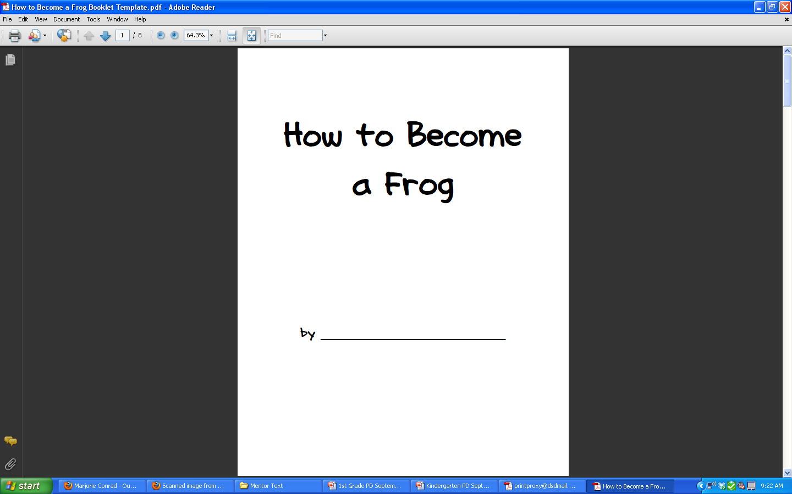
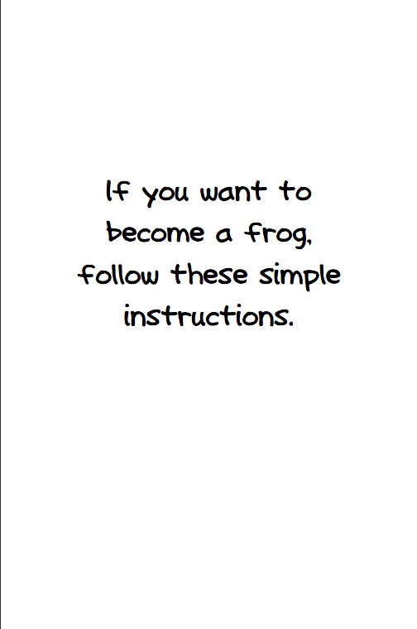
Successfully Teaching Informative Writing
Notes:
All students began with the following pages.

Slide 70
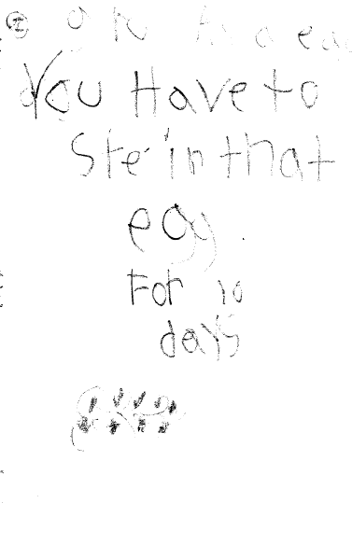
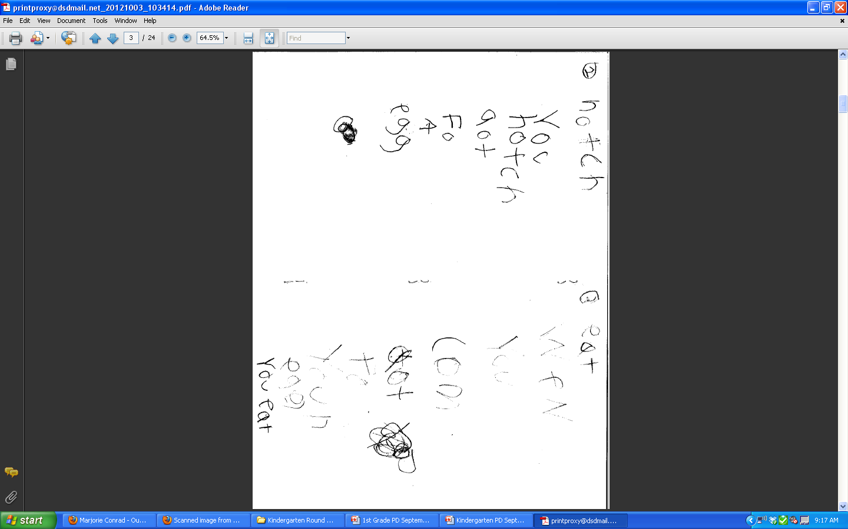
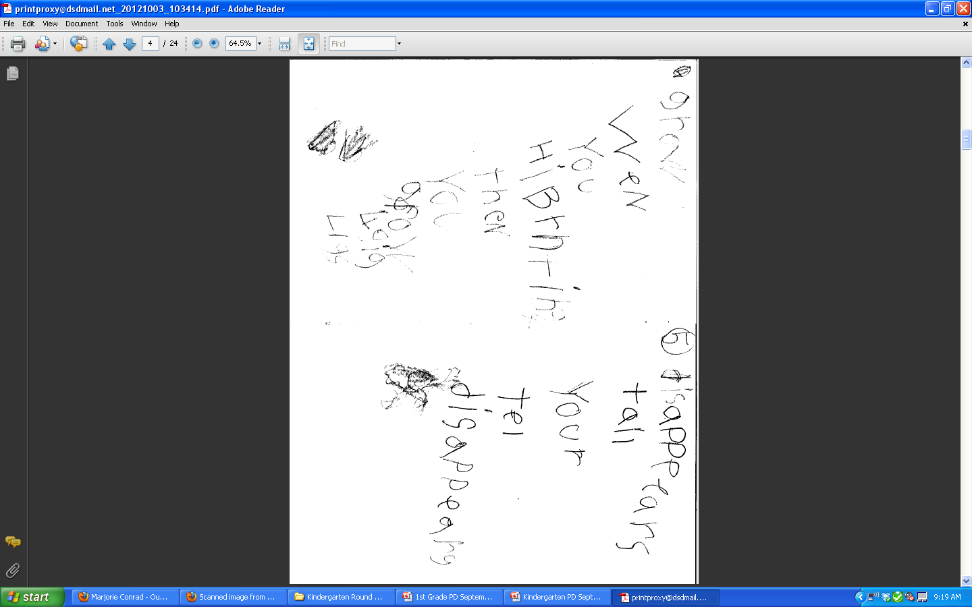
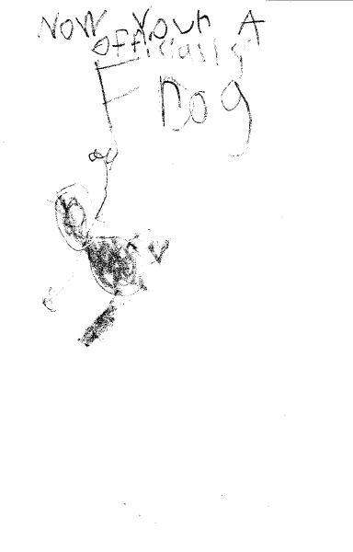
Successfully Teaching Informative Writing
1. Grow as a egg
You have to stay in
that egg for 10 days
2. Hatch
You hatch out of a
egg
3. Eat
When you come out
of your egg you eat
4. Grow
When you (are
done) hibernating,
then you grow long
legs
5. Tail disappears
Your tail disappears
Now you’re
officially a frog
Notes:
One student’s booklet …

Slide 71

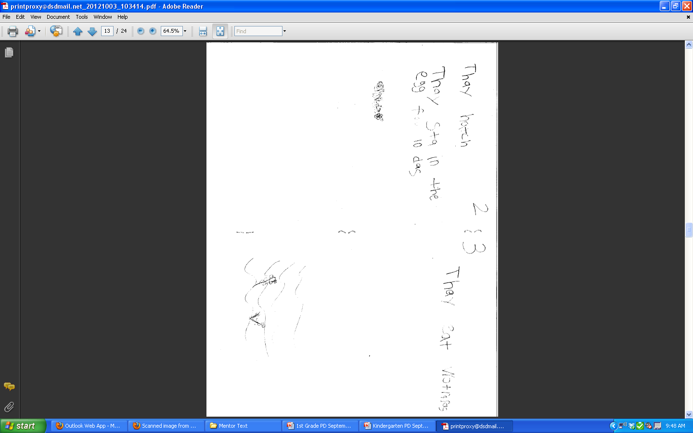
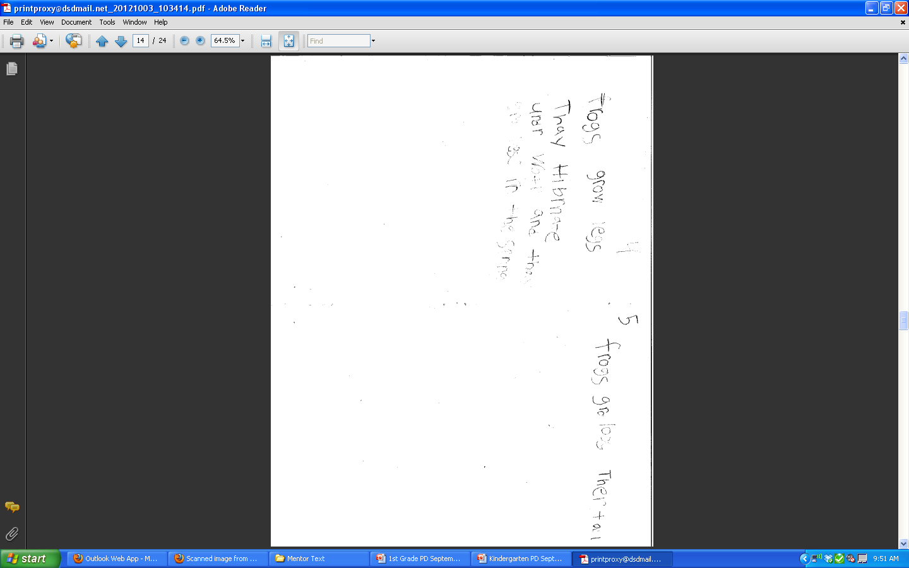

Successfully Teaching Informative Writing
1. They grow inside
the egg.
2. They hatch
They stay in the egg
for 10 days
3. They eat water
plants
4. Frogs grow legs
They hibernate
under water and
they grow legs in
the spring
5. Frogs grow
Lose their tail
Now you’re
a frog
Notes:
Another student’s booklet …

Slide 72
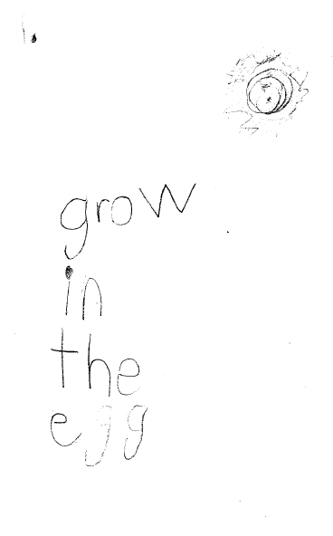
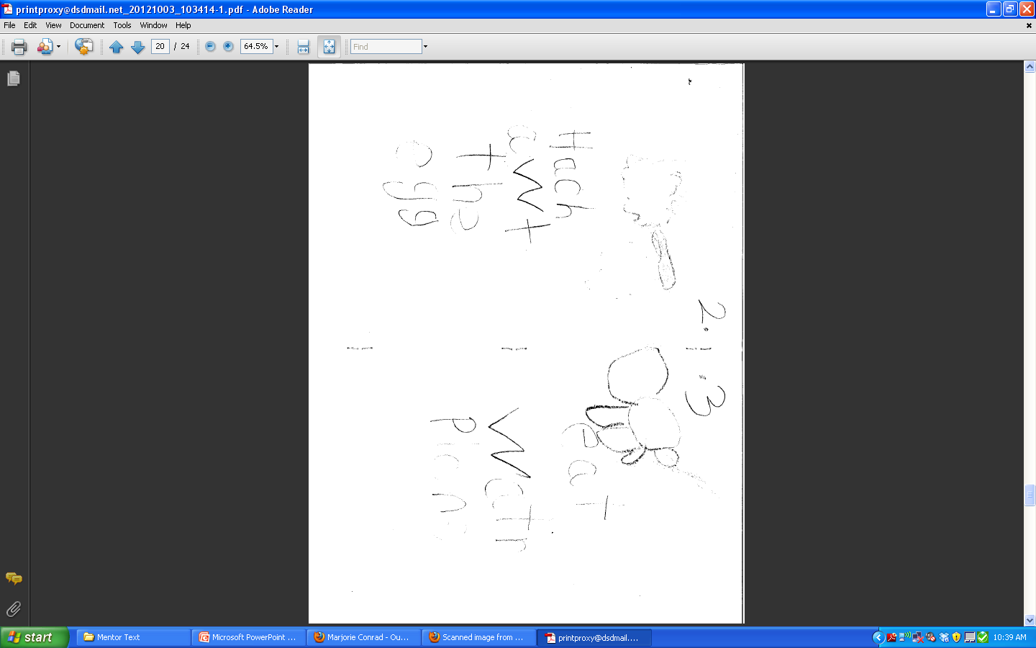
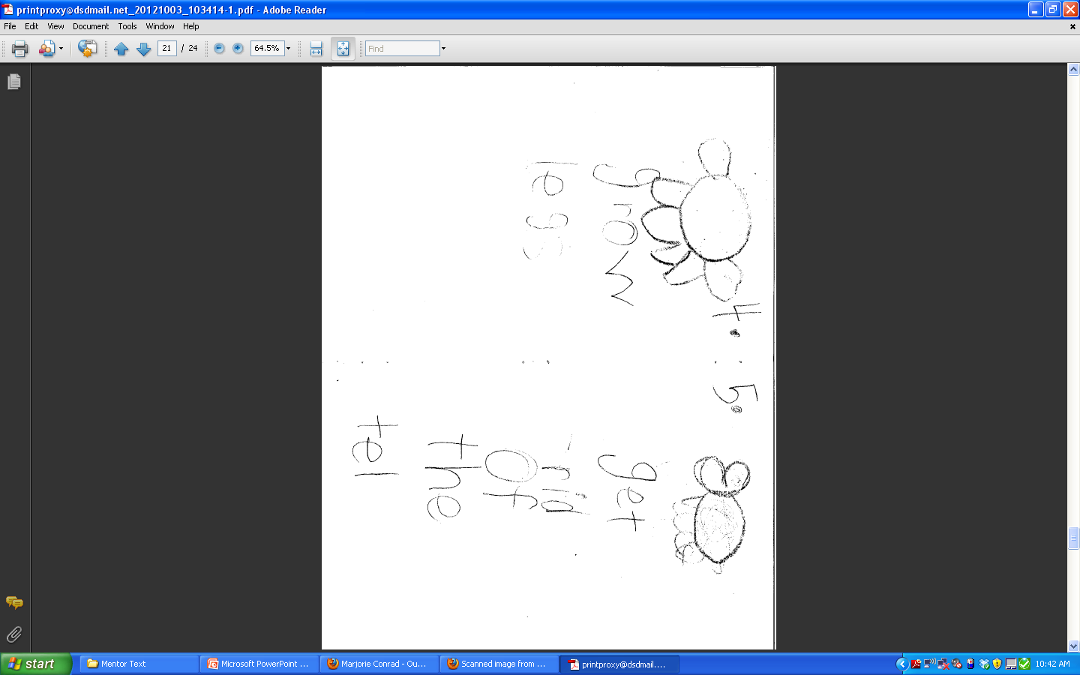
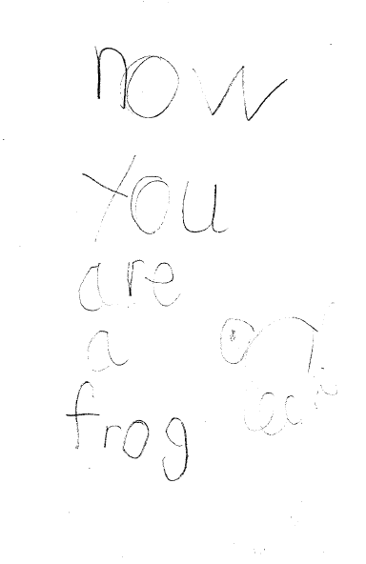
Successfully Teaching Informative Writing
1. Grow in the egg
2. Hatch out the egg
3. Eat water
plants
4. Grow legs
5. Get rid of the tail
Now you are a frog
Notes:
Another booklet …

Slide 73
Mentor Text Routine: Review of Key Points
Select a Standard.
Use a text that is an excellent model of that standard. (Group related information together, introduce a topic, …)
Read and understand the text together.
Analyze the text together. Create a map for the whole class to use.
The teacher models writing with the map before the students write. (This gives students a second model.)
Students follow the map to produce their own writing.
Notes:
Review the points on the slide.

Slide 74
Challenge Spelling Words

Slide 75
Challenge Spelling Words
“Students who struggle mightily with spelling or worry unnecessarily about perfect spelling do not write fluently or easily.”
- Shane Templeton

Slide 76
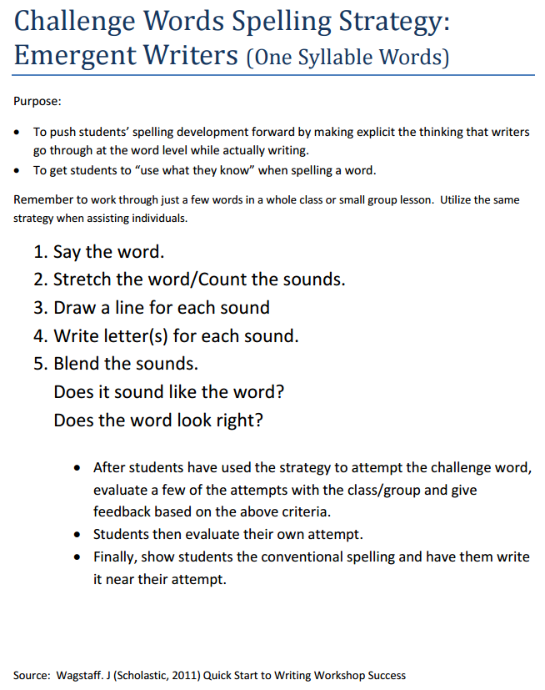
Challenge Spelling Words
Say the word
Stretch the word/Count the sounds
Draw a line for each sound
Write letter(s) for each sound
Blend the sounds
Does it sound like the word?
Does the word look right?

Slide 77
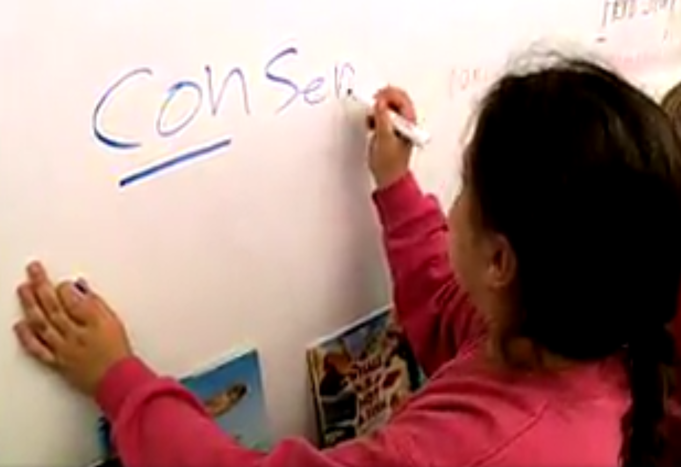
Challenge Spelling Words
Notes:
https://www.facebook.com/literacymattersjw/
Remember quote from Shane Templeton, "Students who struggle mightily with spelling or worry unnecessarily about perfect spelling do not write fluently or easily."

Slide 78
Modeled and Shared Writing

Slide 79
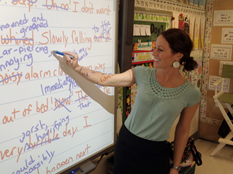
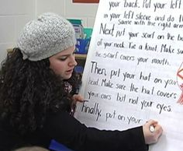
MODEL: shared writing
Young or inexperienced writers need to both observe knowledgeable writers at work and participate in writing events in authentic and well-supported ways. Shared writing lessons will allow you to both model and actively engage students in the writing processes that they most need in order to improve their writing.
ILA/NCTE 2016

Slide 80
Quick Bursts of Writing

Slide 81

Stop, Think, and Write Strategies
Quick Jots
Quick Tries
Quick Writes
Thinking Boxes

Slide 82
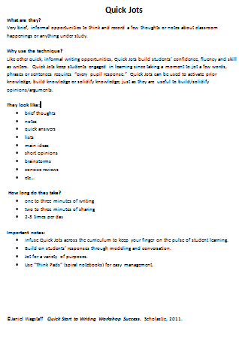
Quick Jot
Activate prior knowledge, build or solidify knowledge
1-3 min. writing
2-3 min. sharing
2-3 times per day
Notes, lists, quick answers, short opinions, brainstorms, etc.
Notes:
Review and discuss the document, then look at the following two slides. What are the benefits of incorporating Quick Jots into your daily curriculum? What adjustments do you need to make to incorporate Quick Jots?
http://www.davis.k12.ut.us/Page/51191

Slide 83
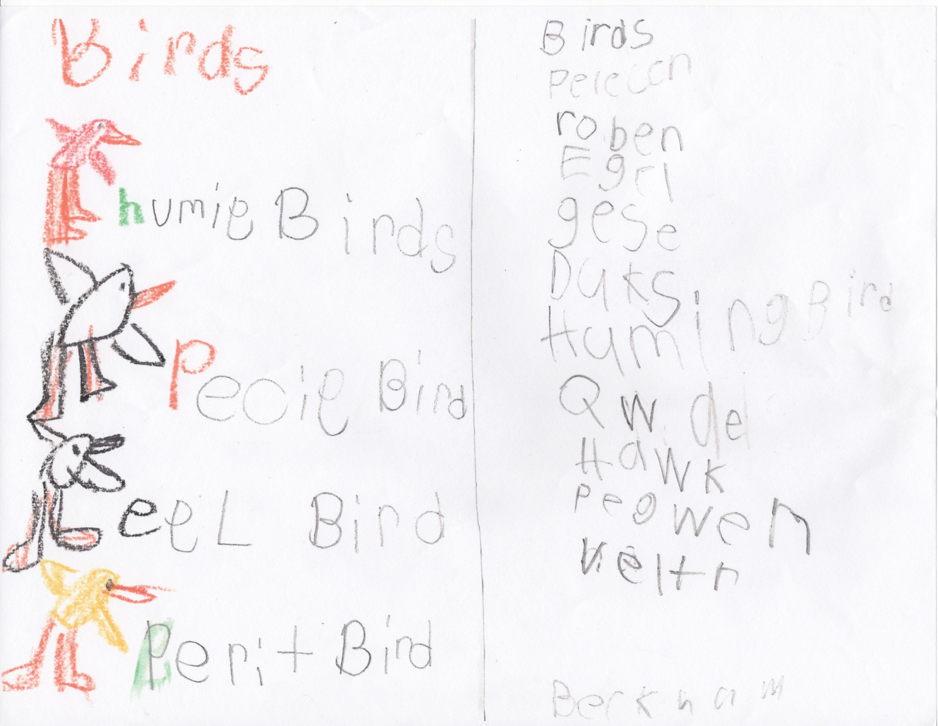
Quick Jot
Notes:
This is a Quick Jot done with a group of Kindergarten students. The students were getting ready to learn about birds. They were asked to compile a list of ‘birds you know’.

Slide 84

Quick Jot
Notes:
This was a 3rd grade Quick Jot given during a unit on Force and Motion. The students were to list ways you could move play dough. This student came up with things like roll it, flick it, chuck it, smash it, etc.

Slide 85

Quick Try
Alternative to worksheet, a form of practice, try it out
1-3 min. of writing
3-4 min. of sharing
2-3 times a day
Jotting and sketching to solve a math problem,
Notes:
Review and discuss the document, then look at the following two slides. What are the benefits of incorporating Quick Tries into your daily curriculum? How are Quick Tries different from Quick Jots? What adjustments do you need to make to incorporate Quick Tries?
http://www.davis.k12.ut.us/Page/51191

Slide 86

Quick Try
Notes:
Here is a Kindergarten Quick Try which combines science and math: What does our weather graph show?

Slide 87

Quick Try
Notes:
Here’s a Second Grade Quick Try in Math. Students were given manipulatives and asked to show how they solved a problem through writing and sketching.

Slide 88

Quick Write
Open-ended responses, provide reasons, evidence, examples to support thoughts
7-10 min. writing
5-10 min. sharing
1-3 times per week
Builds comfort and stamina with “on demand” writing
Notes:
Review and discuss the documents, then look at the following two slides. What are the benefits of incorporating Quick Writes into your curriculum? How are Quick Writes different from the other informal Quick Burst strategies covered so far? What adjustments do you need to make to incorporate Quick Writes?
http://www.davis.k12.ut.us/Page/51191

Slide 89

Quick Write
Notes:
Here’s a First Grade Quick Write about plants.

Slide 90

Quick Write
Notes:
Here’s a Second Grade Quick Write. The teacher gave students ten minutes to write about life cycles as a culmination to their unit of study in science.

Slide 91

Thinking Boxes
Brief episodes of thinking, jotting, and sketching while working through material
1-3 min. writing per box
2-3 min. sharing per box
Once or twice per week
Connecting, summarizing, processing, questioning, etc.
Notes:
Review and discuss the document, then look at the following two slides. What are the benefits of incorporating Thinking Boxes into your curriculum? How are Thinking Boxes different from the other informal techniques? What adjustments do you need to make to incorporate Thinking Boxes?
http://www.davis.k12.ut.us/Page/51191

Slide 92

Thinking Boxes
took notes on facts explicitly stated; 2) synthesize info and draw conclusion;
3) connect to personal experience and schema; 4) make an inference from quote
Notes:
Here is a teacher-model of Thinking Boxes done with fourth graders as the class read a USOE article on the water cycle.
Important note about Thinking Boxes: This is meant to be an interactive strategy; not simply boxes to be filled in on a worksheet. When students share as they complete boxes, they build and clarify knowledge together and the teacher’s immediate feedback plays an important role. This doesn’t happen if students are working independently on worksheets. Consider how this is true for all of the Stop, Think, and Write strategies.

Slide 93

Thinking Boxes
Notes:
Here: Kindergarten (in April) Thinking Boxes based on a read aloud of a book on spring. In Box 1 students jotted the topic, in Box 2 they noted and added sketches in response to the question: “What are changes you SEE in the spring?”, in Box 3 they responded to, “What changes do you FEEL in the spring?” and in Box 4 they noted their favorite SPRING activity.

Slide 94
Quick Write
Have you used any of these strategies? How might this work in your classroom? What Quick Burst Writing Strategy might you use?

