Slide 1
Strengthening Your Core: Phonemic Awareness
Sara Wiebke
K-3 Literacy Specialist
USBE
sara.wiebke@schools.utah.gov

Slide 2
Phonological Awareness Is Research-Based
The National Reading Panel concluded that
“ . . . teaching children to manipulate phonemes in words was highly effective under a variety of teaching conditions with a variety of learners across a range of grade and age levels and that teaching phoneme awareness (PA) to children significantly improves their reading more than instruction that lacks any attention to PA.”
52 studies were found to support these findings!
Notes:
The amount of evidence in support of this conclusion (52 studies meeting standards for scientific investigation) is overwhelming and has been accumulating for more than 30 years.
Studies that compare instruction with PA to instruction without PA have consistently shown that, with PA instruction, regular-class children learn to read better and faster, spell better, and are less likely to fall behind academically.

Slide 3
The National Institute of Child Health and Human Development (NICHD)found that of the students who struggle to learn to read during the elementary school years, 86% of those students need instruction in PA and phonics.
-Tim Shanahan
Notes:
National Institute of Child Health and Human Development (NICHD)
Example: group of 25 struggling students, 22 of those students need PA & phonics instruction

Slide 4
Two Domains and Five Essential Components of Reading
PRINTED WORD RECOGNITION
LANGUAGE COMPREHENSION
x
Fluency
Phonemic Awareness
Phonics
Vocabulary
Reading Comprehension
Notes:
LETRS

Slide 5
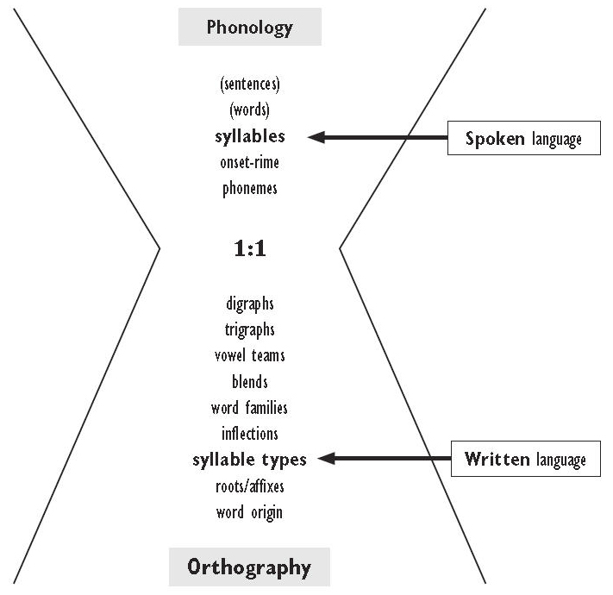
Phonological Awareness vs. Phonemic Awareness
Phonological Awareness
Phonological awareness is an umbrella term that includes the awareness of the larger parts of spoken language, such as words, syllables, and onsets and rimes – as well as the smaller parts, phonemes.
Phonemic awareness is the ability to detect, identify, and manipulate phonemes in spoken words.
Phonological Awareness
Phonemic Awareness
Connect letters and sounds
Phonics
Orthography

Slide 6
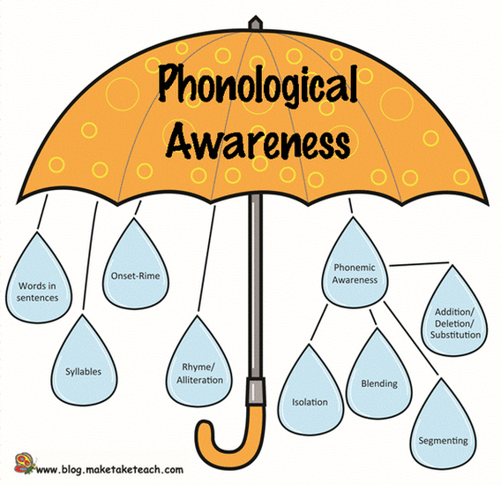
Phonological Awareness

Slide 7
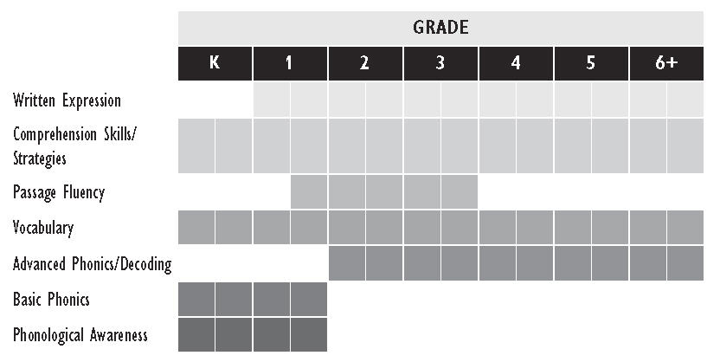
Reading Instruction Components Typically Emphasized at Each Grade Level
Notes:
LETRS

Slide 8

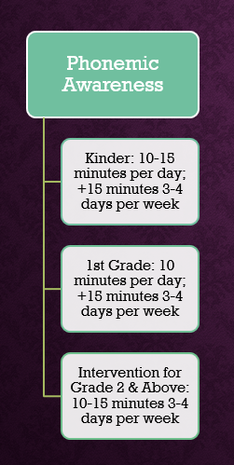
Suggested Instructional Minutes
Phonemic Awareness

Slide 9
Phonological Awareness in the Standards
Grade 1: Phonological Awareness:
Kindergarten: Phonological Awareness:
CCSS.ELA-LITERACY.RF.K.2 Demonstrate understanding of spoken words, syllables, and sounds (phonemes).
CCSS.ELA-LITERACY.RF.K.2.A Recognize and produce rhyming words.
CCSS.ELA-LITERACY.RF.K.2.B Count, pronounce, blend, and segment syllables in spoken words.
CCSS.ELA-LITERACY.RF.K.2.C Blend and segment onsets and rimes of single-syllable spoken words.
CCSS.ELA-LITERACY.RF.K.2.D Isolate and pronounce the initial, medial vowel, and final sounds (phonemes) in three-phoneme (consonant-vowel-consonant, or CVC) words.¹ (This does not include CVCs ending with /l/, /r/, or /x/.)
CCSS.ELA-LITERACY.RF.K.2.E Add or substitute individual sounds (phonemes) in simple, one-syllable words to make new words.
CCSS.ELA-LITERACY.RF.1.2 Demonstrate understanding of spoken words, syllables, and sounds (phonemes).
CCSS.ELA-LITERACY.RF.1.2.A Distinguish long from short vowel sounds in spoken single-syllable words.
CCSS.ELA-LITERACY.RF.1.2.B Orally produce single-syllable words by blending sounds (phonemes), including consonant blends.
CCSS.ELA-LITERACY.RF.1.2.C Isolate and pronounce initial, medial vowel, and final sounds (phonemes) in spoken single-syllable words.
CCSS.ELA-LITERACY.RF.1.2.D Segment spoken single-syllable words into their complete sequence of individual sounds (phonemes).
Notes:
Write PA next to these standards

Slide 10

Word Awareness
Rhyme and Alliteration
Syllables
Onset and Rime
Phoneme Identity
Phoneme Categorization
Phoneme Isolation
Phoneme Blending
Phoneme Segmenting
Phoneme Deletion
Phoneme Addition
Phoneme Substitution
Phoneme Reversal
Phonological Awareness
Phonemic Awareness

Slide 11

Why Phonemic Awareness is important
PA is necessary for learning and using the alphabetic code.
PA predicts later outcomes in reading and spelling.
The majority of poor readers have relative difficulty with phonemic awareness and other phonological skills.
Instruction in PA is beneficial for novice readers and spellers.
PA interacts with and facilitates the development of vocabulary and word consciousness.
Students do not automatically or instinctively acquire phonemic awareness.
Notes:
p. 19

Slide 12

Phonological Awareness (PreK-1)
Word awareness (How many words are in the following sentence?)
Let’s go outside to play. – 5 words
Rhyme recognition & alliteration (Do the following words rhyme?)
Split/splat – no, pound/sound - yes
*Don’t get stuck on rhyming!
Syllables (How many syllables are there in the following words?)
Amazing – 3 syllables
Onset (consonant sound(s) found at the beginning of a syllable in a one syllable word) and rime (from the vowel on) manipulation (plants: onset /pl/, rime /ants/)
Phonemes (phonemic awareness)
The categories above should be mastered* before moving onto phonemic awareness.*

Slide 13
Phonemic Awareness Skills (K-2)
Phoneme Identity (What is the first/last speech sound in the following words?)
First – phone, fall, phenomenal - /f/
Last – have, pave, prove - /v/
Phoneme Categorization (what word does not belong here?)
Flower, voice, phone - voice
Phoneme Isolation (What is the first/last/second speech sound in the following words?)
First – quiet - /k/ * many will say /kw/, first sound is /k/
Last – kissed - /t/
Second – exit - /k/ * x=2 sounds /ks/
Phoneme Blending (Blend the following sounds to make a word: provide these sounds slowly)
/sh/ /ar/ /k/ - shark
Phoneme Segmenting (What are the individual speech sounds/phonemes in the following words?)
Think - /th/ /ĭ/ /ng/ k/

Slide 14
Phonemic Awareness Skills (K-2) continued
Phoneme Deletion
Say spark. Now say spark without /s/. - park
Phoneme Addition
What word would you have if you added /z/ to the end of the word frog? - frogs
Phoneme Substitution
Say splat. Change /t/ to /sh/. What word would you get? - splash
Phoneme Reversal
Say flesh. Now say the sounds of the word flesh backward. - shelf

Slide 15

Guideline for Teaching Phonemic Awareness
General Principles
Follow the order of phonological skills development
Focus on speech sounds before letters
Encourage mouth awareness – use mirrors
Include all English phonemes in instruction
Think multisensory – involve hands, eyes, bodies, and mouths if possible
Brief instruction – 10 -15 minutes, 12 - 20 weeks (most students)
Explicit instruction (I do, we do, you do)
When ready, use letters to represent sounds
Use the same instructional tools and strategies during intervention for cohesion

Slide 16

Guideline for Teaching Phonemic Awareness
Grouping for Instruction
Teach phonemic awareness in small groups – research indicates that this is most effective for helping students acquire phonemic awareness skills
Students benefit from listening to peers and having more opportunities to participate
Model proper pronunciation - critical
Ask students to repeat new words, checking for proper pronunciation
Listen to students speak, provide immediate, corrective feedback when necessary

Slide 17
Guideline for Teaching Phonemic Awareness
Explicit and Systematic Instruction
Focus instruction on types on phonemic awareness most closely associated with beginning reading and spelling achievement by linking phoneme to print
Explicitly teach phonemic awareness and regularly schedule instruction
During a lesson, target only one type of phonemic awareness, such as blending phonemes or segmenting words into phonemes
Follow scope and sequence (easier- more difficult). Example: find the picture that start with /m/ is easier than a production task “What sounds do you hear in moon?”
Use words that students know and that are easy to manipulate during phonemic awareness activities
Consider the number of sounds in a word (2, 3, 4…)
Phoneme position (initial, final, medial)
Phonological properties of words (prolonged sounds are easier /m/ vs. /t/) – clip schwas
Model each activity when it is first introduced (explicitly)
As soon as possible, help students make the connection between letters and sounds to read and to spell words

Slide 18

Guideline for Teaching Phonemic Awareness
Ongoing Practice
Provide opportunities to practice phonemic awareness with teacher support
In first grade, begin with phoneme blending, segmenting, and manipulating
Some activities, like songs, games, and stories, are simply oral. Others use concrete objects and manipulatives, such as fingers/arms, blocks, counters/chips, puppets, and pictures.
Link sounds to print
When students practice sounds along with the letters of the alphabet, they learn to blend sounds to read words and to segment sounds to spell words

Slide 19

Phonological/phonemic awareness activities can be done in the dark.

Slide 20

Assessing for PA
Screener
Diagnostic
DIBELS Measures:
First Sound Fluency
Phoneme Segmentation Fluency
Quick Phonological Awareness Screening (QPAS)
CORE Phonological Segmentation Test (K-1)
CORE Phoneme Deletion Test (K-3)
CORE Phoneme Segmentation Test (2-12)
Progress monitoring
Regularly monitor each student’s phonemic awareness progress (WBB-weekly, BB – 2-4 weeks, BM – 4-6 weeks
Data used to identify progress or necessity of additional instruction of skills not yet acquired

Slide 21
PHONOLOGICAL AWARENESS
Phonological awareness is an umbrella term that includes the awareness of the larger parts of spoken language, such as words, syllables, and onsets and rimes – as well as the smaller parts, phonemes.

Slide 22
Awareness Activities by Language Units
Word Awareness | Sample Activity
A word has a consistent pronunciation and a consistent referent , or meaning and has a place within sentence structure. | Orally say each word in a sentence while touching a chip/block that represents each word.
Unit of Language | Sample Activity
Syllable A unit of speech that is organized around a vowel sound. dis-or-gan-i-za-tion man-eu-ver | Tap your arm as you say each syllable. cer-e-al muf-fin choc-o-late
Onset and Rime Two parts of any syllable. The onset is the sound(s) that come before the vowel; the rime is the vowel plus the consonant(s) that follow. f-ish fr-esh squ-ish spl-ash | Orally blend the two pieces of a syllable together. cl + ean = clean h + am = ham Note that rhyming involves the manipulation of rimes.
Phoneme The smallest segment of sound that differentiates words in a language system. chose = /ch/ /ō/ /z/ those = /th/ /ō/ /z/ (one sound change) These = /th/ /ē/ /z/ (one sound change) Threes = /th/ /r/ /ē/ /z/ (two sound changes) | Say all the sounds in these syllables as you raise a finger for each sound. each = /ē/ /ch/ know = /n/ /ō/ house = /h/ /ou/ /s/
Our | cat | runs | fast.
Notes:
Module 2 – pg. 12

Slide 23
Phonological Skills in Order
Phonological Skill | Description
Word awareness | Tracking the words in a sentence.
Responsiveness to rhyme and alliteration during word play | Enjoying the reciting learned rhyming words or alliterative phrases in familiar storybooks or nursery rhymes.
Syllable awareness | Counting, tapping, blending, or segmenting a word into syllables. (arm tap)
Onset and rime manipulation | The ability to produce a rhyming word depends on understanding that rhyming words have the same rime. Recognizing a rhyme is easier than producing a rhyme.
Phonemic Awareness | Identify and match the initial sounds in words, then final, then middle sounds. Segment and produce the initial sound, then final, then middle sounds. Blend sounds into words. Segment the phonemes in two- or three-sound words, moving to four- or five-sound words. Manipulate phonemes by removing, adding, or substituting sounds.

Slide 24
Exercise: Identify whether the items are segmented into words (W), syllables (S), onset-rime (OR), and phonemes (P)
Item | Unit of Segmentation | Item | Unit of Segmentation
un-re-con-struct-ed |  | str-ing
Good morning, America! |  | side-walk
st-age |  | t-r-ee
s-p-l-a-t |  | pl-ate
fr-iend |  | po-ta-to
happ-y birth-day |  | th-u-mb
f-l-oa-t-s |  | sh-oe
Notes:
CLOSE EYES and LISTEN…
Identify how are these units segmented - Words (W), syllables (S), onset-rime (OR), and phonemes (P)
p.18

Slide 25
Exercise: Identify the Unit of Language
Item | Unit of Segmentation | Item | Unit of Segmentation
un-re-con-struct-ed | syllables | str-ing | onset-rimes
Good morning, America! | words | side-walk | words, syllables
st-age | onset-rimes | t-r-ee | phonemes
s-p-l-a-t | phonemes | pl-ate | onset-rimes
fr-iend | onset-rimes | po-ta-to | syllables
happ-y birth-day | syllables | th-u-mb | phonemes
f-l-oa-t-s | phonemes | sh-oe | phonemes, onset-rimes

Slide 26
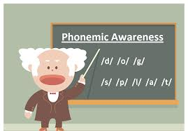
PHONEMIC AWARENESS
Phonemic awareness is the ability to detect, identify, and manipulate phonemes in spoken words.

Slide 27
PHONEMIC AWARENESS
Under the phonological awareness umbrella
Must be done orally; student must be able to hear the sounds
Students need solid phonemic awareness instruction for phonics instruction to be effective.
Approximately 20-40% of students have difficulty with phonemic awareness
Focusing on 1-2 skills at a time is more effective than multiple skills (e.g. segmenting and blending phonemes)

Slide 28
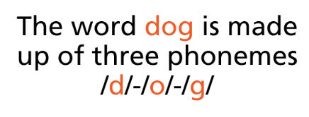
Why Learn the Phonemes?
Phonemes are coarticulated in spoken words, and therefore, difficult to separate.
Adults pay attention to spelling more than to speech sounds, once they have learned to spell.
Adults (especially teachers) have learned different ways to classify sounds.
We have never studied the inventory of sounds.
Notes:
p. 25

Slide 29

What is a phoneme?
The smallest segment of speech in a language system that can determine word meaning, or that can be combined with other speech sounds to make a new word.
English has about ____ phonemes.
Notes:
p.26

Slide 30
What is a phoneme?
The smallest segment of speech in a language system that can determine word meaning, or that can be combined with other speech sounds to make a new word.
English has about 44 phonemes.
Notes:
p.26
Even professional linguists do not agree on how many phonemes there are or how they are classified.

Slide 31
Exercise: Count Phonemes
string _____
joyless _____
dodge _____
mixed _____
heard _____
hippo _____
although _____
chew _____
house _____
few_____

Slide 32
Exercise: Count Phonemes
s/t/r/i/ng 5
j/oy/l/e/ss 5
d/o/dge 3
m/i/k/s/ed(t) 5
h/ear/d 3
h/i/pp/o 4
a/l/th/ough 4
ch/ew 2
h/ou/se 3
f/ew (/y/ /oo/) 3
Notes:
p. 25

Slide 33
English Consonant Phonemes by Place and Manner of Articulation
 | Lips Together | Teeth on Lip | Tongue Between Teeth | Tongue on Ridge Behind Teeth | Tongue Pulled Back on Roof of Mouth | Back of Throat | Glottis
Stops: Unvoiced Voiced | /p/ /b/ |  |  | /t/ /d/ |  | /k/ /g/
Nasals | /m/ |  |  | /n/ |  | /ng/
Fricatives: Unvoiced Voiced |  | /f/ /v/ | /th/ /th/ | /s/ /z/ | /sh/ /zh/
Affricatives: Unvoiced Voiced |  |  |  |  | /ch/ /j/
Glides: Unvoiced Voiced |  |  |  |  | /y/ | /wh/ /w/ | /h/
Liquids |  |  |  | /l/ | /r/
Notes:
p. 34

Slide 34
Stops, Nasals, Fricatives, Affricatives, Glides, and Liquids
Stops | made with one burst of sound
Nasals | made by sending the air stream through the nose
Fricatives | are hissy sounds created when air is forced through small spaces in the mouth during articulation
Affricatives | stop air before releasing it
Glides | consonants that are always followed by a vowel phoneme and that literally glides right into the vowel
Liquids | seem to float in the mouth; influence the vowels that come before them

Slide 35
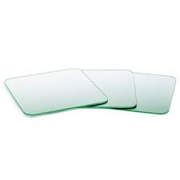
Practice sounds with mirrors
Stops
Nasals
Fricatives
Affricatives
Glides
Liquids

Slide 36
Stops
Made with one burst of sound
Unvoiced (vocal cords turned off) - /p/, /t/, /k/
Voiced (vocal cords engaged) - /b/, /d/, /g/
Place your hands over your ears to hear the difference between voice and unvoiced
With mirror - /p/ & /b/ - lips together
With mirror - /t/ & /d/ - tongue on ridge behind teeth
With mirror - /k/ & /g/ - back of throat
What kind of confusion is happening if a student writes pasment for basement or sbidr for spider?

Slide 37
Nasals
Made by sending the air stream through the nose
/m/,/n/, /ng/
If you hold your nose and try to say these sounds, what happens?
With mirror /m/ - lips together
With mirror - /n/ - tongue on ridge behind teeth
With mirror - /ng/ - back of throat
Say the following consonants in sequence, noticing the similarity of place of articulation:
Student commonly confuse these phonemes when they occur at the ends of words such as sack, sag, and sang or back, bag, and bang. Students who write sig for sing may be substituting one sound for another that is made in the same part of the mouth.
/p/, /b/, /m/ | /t/, /d/, /n/ | /k/, /g/, /ng/

Slide 38
Fricatives
Are hissy sounds created when air is forced through small spaces in the mouth during articulation
All eight are continuants – we can say them until we run out of breath.
Unvoiced (vocal cords turned off) - /f/, /th/, /s/, /sh/
Voiced (vocal cords engaged) - /v/, /th/, /z/, /zh/
With mirror - /f/ & /v/ - top teeth on bottom lip, put your hand on your throat to feel the difference between unvoiced and voiced
With mirror - /th/ (thin, thick, death) & /th/ - (this, that, bathe) – tongue between teeth
Subtle distinction, spelled with same digraph (breath, breathe)
With mirror - /s/ & /z/ - tongue on ridge behind teeth
Tricky to hear, especially when the letter s is used for the sound /z/ (hogs, wings, rose)
With mirror - /sh/ & /zh/ (genre, treasure, garage) - tongue pulled back on roof of mouth

Slide 39
Affricatives
Stop air before releasing it (combination of stop and fricative)
Unvoiced - /ch/
Voiced - /j/
With mirror - /ch/ & /j/ - tongue pulled back on roof of mouth, lips puckered (cherry, Jerry, rich, ridge)
What kind of confusion is represented by the spelling jili for chile and jokalet for chocolate?

Slide 40
Glides
Consonants that are always followed by a vowel phoneme and that literally glides right into the vowel
Unvoiced – /wh/, /h/
Voiced - /y/, /w/
Try this with the mirrors: say yell and well, help and whelp, wile and while. Did you say the first sounds of any of these words the same way?
America vs. Britain - /w/ and /wh/ are a difficult distinction in America – weather & whether
The glide /y/ is often placed in front of the vowel /ū/. Usual and unicorn begin with /y/, just like you and Yule. Words such as cute and funeral have the hidden glide /y/ before /ū/. This gets tricky during spelling.
Say ooze and use. Which one begins with /y/?
Which words have /y/ + /ū/? duke, educate, moon, immune, coup, cute, lampoon, puny, tune

Slide 41
Glides continued
Which words have /y/ + /ū/? duke, educate, moon, immune, coup, cute, lampoon, puny, tune
The glottal sound for /h/ is formed with the throat open and no other obstruction of air stream and it always followed by a vowel.
With mirror - /h/ - say “Harry ran home”

Slide 42
Liquids
Seem to float in the mouth; influence the vowels that come before them
/l/ - (league, whole) tip on tongue lifted to touch the top of the mouth
/r/ - (rouge, there, motorcycle) both sides of the tongue touching the top of the mouth, and the tongue retracted
When liquids follow vowels, they change the vowels. Try these: scored, scold, scour, scowl. The vowels are shaped by the mouth to blend with the /r/ or /l/.

Slide 43
English Consonant Phonemes by Place and Manner of Articulation
 | Lips Together | Teeth on Lip | Tongue Between Teeth | Tongue on Ridge Behind Teeth | Tongue Pulled Back on Roof of Mouth | Back of Throat | Glottis
Stops: Unvoiced Voiced | /p/ /b/ |  |  | /t/ /d/ |  | /k/ /g/
Nasals | /m/ |  |  | /n/ |  | /ng/
Fricatives: Unvoiced Voiced |  | /f/ /v/ | /th/ /th/ | /s/ /z/ | /sh/ /zh/
Affricatives: Unvoiced Voiced |  |  |  |  | /ch/ /j/
Glides: Unvoiced Voiced |  |  |  |  | /y/ | /wh/ /w/ | /h/
Liquids |  |  |  | /l/ | /r/
Notes:
p. 34

Slide 44
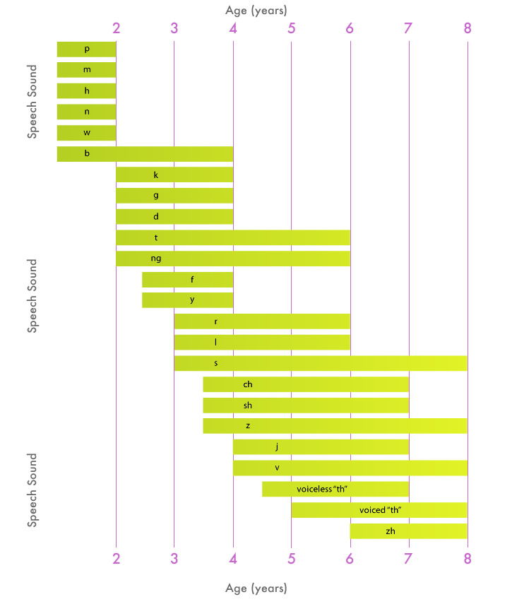
Development of Consonant Articulation
based on Sander, 1972

Slide 45
Exercise: Identify Beginning and Ending Sounds
Words | Beginning Sound | Ending Sound
come
seethe
crave
cage
rhyme
white
one
gnat
hymn
queen
league
whole
rose
south
Words | Beginning Sound | Ending Sound
bridge
knob
young
cache
wrinkle
phone
united
thresh
psychic
rouge
giant
wage
there
Notes:
p. 36
Identify, say, and write the symbol for the beginning and ending consonant sounds for each word.
Difficult for readers – they think of spelling (letter) not sound

Slide 46
Exercise: Identify Beginning and Ending Sounds
Words | Beginning Sound | Ending Sound
come | /k/ | /m/
seethe | /s/ | /th/
crave | /k/ | /v/
cage | /k/ | /j/
rhyme | /r/ | /m/
white | /wh/ or /w/ | /t/
one | /w/ | /n/
gnat | /n/ | /t/
hymn | /h/ | /m/
queen | /k/ | /n/
league | /l/ | /g/
whole | /h/ | /l/
rose | /r/ | /z/
south | /s/ | /th/
Words | Beginning Sound | Ending Sound
bridge | /b/ | /j/
knob | /n/ | /b/
young | /y/ | /ng/
cache | /k/ | /sh/
wrinkle | /r/ | /l/
phone | /f/ | /n/
united | /y/ | /d/
thresh | /th/ | /sh/
psychic | /s/ | /k/
rouge | /r/ | /zh/
giant | /j/ | /t/
wage | /w/ | /j/
there | /th/ | /r/
Notes:
p. 36
Identify, say, and write the symbol for the beginning and ending consonant sounds for each word.

Slide 47
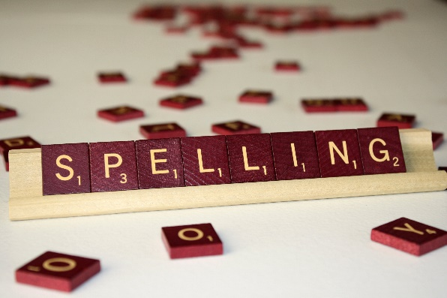
Exercise: Analyze Spelling Errors
Target Word | Misspelling | Reason
fan | van | voiced for voiceless consonant
sharp | charp
brag | brak
bed | md
this | vis
grade | grat
items | inems
Consonant confusions may occur because consonants share features and students may not fully differentiate the phonemes in spoken words. A student’s spelling can give you insight as to his/her understanding of the sounds in language.
Notes:
p. 37
Identify the reason for these misspellings (voiced/unvoiced/ location of mouth)

Slide 48
English Consonant Phonemes by Place and Manner of Articulation
 | Lips Together | Teeth on Lip | Tongue Between Teeth | Tongue on Ridge Behind Teeth | Tongue Pulled Back on Roof of Mouth | Back of Throat | Glottis
Stops: Unvoiced Voiced | /p/ /b/ |  |  | /t/ /d/ |  | /k/ /g/
Nasals | /m/ |  |  | /n/ |  | /ng/
Fricatives: Unvoiced Voiced |  | /f/ /v/ | /th/ /th/ | /s/ /z/ | /sh/ /zh/
Affricatives: Unvoiced Voiced |  |  |  |  | /ch/ /j/
Glides: Unvoiced Voiced |  |  |  |  | /y/ | /wh/ /w/ | /h/
Liquids |  |  |  | /l/ | /r/
Notes:
p. 34

Slide 49
Exercise: Analyze Spelling Errors
Target Word | Misspelling | Reason
fan | van | voiced for voiceless consonant
sharp | charp | fricative/affricative confusion
brag | brak | voiceless for voiced consonants
bed | md | both /b/ and /m/ are made with the lips together
this | vis | /th/ and /v/ are voiced fricatives
grade | grat | /d/ and /t/ differ in voicing
items | inems | Nasal/stop confusion
Consonant confusions may occur because consonants share features and students may not fully differentiate the phonemes in spoken words. A student’s spelling can give you insight as to his/her understanding of the sounds in language.
Notes:
p. 37
Identify the reason for these misspellings (voiced/unvoiced/ location of mouth)

Slide 50

Vowel Phonemes
How many vowel phonemes in the English language?

Slide 51
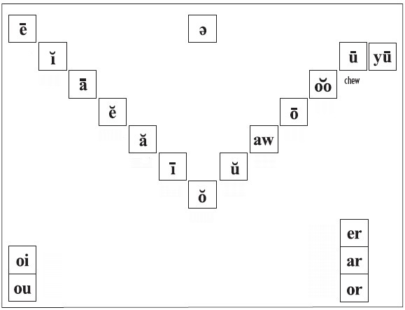
18 Vowel Phonemes
beet
schwa
bit
chew
you
bate
book
bet
boat
mouth gradually opening
mouth gradually closing
bat
bought
bite
but
r-controlled
bot(tle)
diphthongs
Bert
boy
Bart
bout
(a)bort
Notes:
Vowels are open sounds distinguished by tongue position, height, and lip shape.
Hand under chin while saying in order
Dialect, regional differences
p. 39
Don’t teach e & i together, separate confusing phonemes when teaching – example a & i are very different and could be taught near each other

Slide 52
Use mirrors with hand under chin
beet
schwa
bit
chew
you
bate
book
bet
boat
mouth gradually opening
mouth gradually closing
bat
bought
bite
but
r-controlled
bot(tle)
diphthongs
Bert
boy
Bart
bout
(a)bort
Notes:
Vowels are open sounds distinguished by tongue position, height, and lip shape.
Hand under chin while saying in order
Dialect, regional differences
p. 39
Don’t teach e & i together, separate confusing phonemes when teaching – example a & i are very different and could be taught near each other

Slide 53
ĕ and ĭ confusion
Just remember, only a fingernail could fit between the line and dot of an i.
i only a fingernail
e - mouth is open about a finger space
Use mirrors with students
pit pet

Slide 54
Long & Short Vowels
Long | Short
/ē/ beet | /ĭ/ bit
/ā/ bait | /ĕ/ bet
/ō/ boat | /ă/ bat
/ū/ boot | /ŏ/ pot
/yū/ beauty* | /ŭ/ but
(/ī/ bite) | /aw/ bought
 | /o͝o/ book
mācron
brēve
*long u is often preceded by the glide /y/, as in use, cute, feud.
Notes:
(/ī/ bite) sometimes considered a diphthong
Macron (may kron)
Breve (breeve)

Slide 55

Schwa
Indistinct, neutral vowel sound that occurs only in unaccented syllables
Like a /ŭ/, but is not accented
At times, sounds more like a / ĭ/, as in definition and surface
Schwa is spelled in many ways: wagon, effect, compare, aware, circuit
One way to recognize a schwa is that it cannot easily be sounded out for spelling

Slide 56


Diphthongs not dipthongs
Vowels that do not fit in the step-by-step sequence /oi/ and /ou/
Single vowel phonemes that glide in the middle
Mouth position shifts during production
say /oi/ (spoil) & /ou/ (sow) slowly – mouth shifts

Slide 57
Importance of True Vowel Sounds
Notes:
Be sure picture matches the true sound

Slide 58
Exercise: Match Words to Vowels on Your Vowel Phonemes Chart
moose | heard | staff | vein | ride | cute
heart | chief | out | calm | dove | scald
dread | choice | hymn | could | pour | most

Slide 59
Exercise: Match Words to Vowels on Your Vowel Phonemes Chart
moose /ū/ | heard /er/ | staff /ă/ | vein /ā/ | ride /ī/ | cute /yū/
heart /ar/ | chief /ē/ | out /ou/ | calm /ŏ/ | dove /ŭ/ | scald /aw/
dread /ĕ/ | choice /oi/ | hymn /ĭ/ | could /o͝o/ | pour /or/ | most /ō/

Slide 60
PA is especially important for…
Students who aren’t scoring well on FSF and PSF on DIBELS
Students who do not carefully attend to the sounds of language
Students who cannot break words apart into sound segments
Students who cannot hear or produce rhymes*
Students who have limited experience with text
EL students
Students with chronic ear infections, tubes, or difficulty hearing
Students who have a parent or other relative who experiences difficulty learning to read or spell OR a parent or relative who is speech impaired
Students who mispronounce or confuse similar sounding words (Pacific and specific)

Slide 61
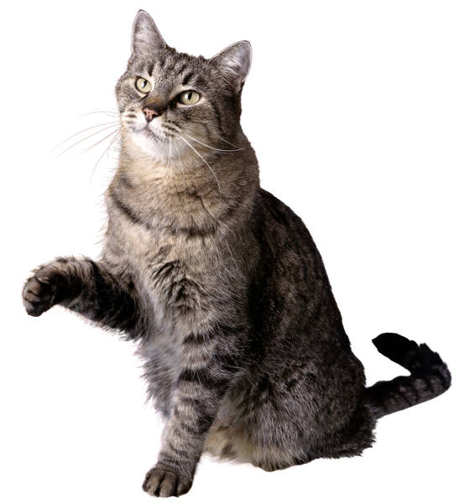
Phonological Awareness & Phonics
Make phonological awareness instruction explicit. Use concrete objects to assist with mental manipulation of sounds – use a marker while saying the phoneme and with students who know their letters use letters in manipulation tasks.
Show me the sounds in cat…
Show me the letters you hear in cat…
c
a
t

Slide 62

Phonemic Awareness Activities
Phoneme Isolation
Say kick (kick). Say kick (kick). What’s the first* sound in kick? /k/
Say kid (kid). Say kid (kid). What’s the last* sound in kid? /d/
Say cap (cap). Say cap (cap). What’s the middle sound of cap? /ă/
*this could be a vocabulary issue, especially for EL students
Use arm and hand

Slide 63
Phonemic Awareness Activities
Phoneme Segmentation and Counting (spelling the sounds)
Say sick (sick). Say sick (sick). Say the sounds in sick? /s/ /ĭ/ /k/
Say big (big). Say big (big). Say the sounds in big? /b//ĭ/ /g/
*this could be a vocabulary issue, especially for EL students
Use arm and hand

Slide 64
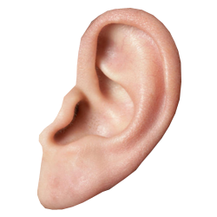
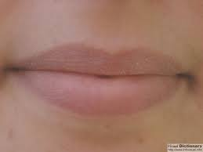
Phonemic Awareness Activities
Phoneme Blending
(Touch ear) Listen and (touch mouth) repeat. /b/ /a/ /k/ Repeat phoneme series 3 times. /b/ /a/ /k/, /b/ /a/ /k/, /b/ /a/ /k/ - bak
(Touch ear) Listen and (touch mouth) repeat. /t/ /a/ /p/ Repeat phoneme series 3 times. /t/ /a/ /p/, /t/ /a/ /p/, /t/ /a/ /p/ - tap

Slide 65
Phonemic Awareness Activities
Phoneme Deletion
Say sick. (Repeat sick). Say sick. (Repeat sick). Say sick without the /s/? /ik/
Say sit. (Repeat sit). Say sit. (Repeat sit). Say sit without the /t/? /si/
Use arm and hand

Slide 66
Phonemic Awareness Activities
Phoneme Substitution
Say kick. (Repeat kick). Say kick. (Repeat kick). Now change the first sound in kick to /t/. /tick/
Say dim. (Repeat dim). Say dim. (Repeat dim). Now change the last sound in dim to /g/. /dig/
Say sick. (Repeat sick). Say sick. (Repeat sick). Now change the middle sound in sick to /a/. /sack/
Use arm and hand

Slide 67
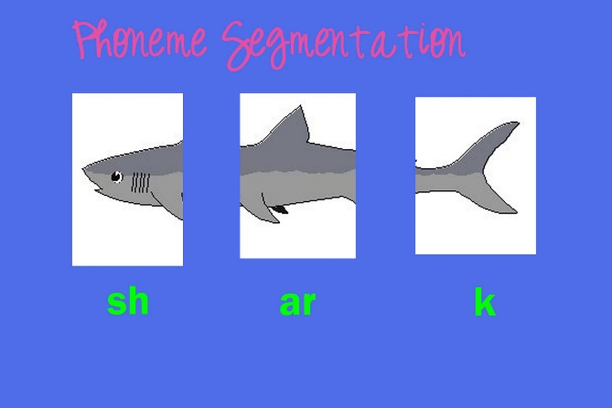
Classroom Activities to Support PA
Start with 2 phoneme words first, then move to 3 phoneme words
Finger Stretching
Slinkies
Elkonin/sound boxes
Say it and move it card
Tracking mat and sound chaining
Say it, tap it, map it, graph it

Slide 68
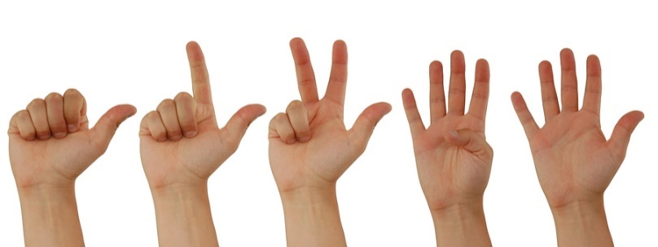
Finger-Stretching
Direction is key!
Hold a fist in front of your body
Say a word with three phonemes, such as moon
Beginning with the thumb, put up one digit as you say each sound in the word. For example, moon, the thumb would represent /m/, the forefinger would represent /ū/, and the middle finger would represent /n/
Blend the sounds together as your close your fist, pulling it toward your body. For students who struggle with left-to-right orientation , move the arm across the body left to right when pulling together the sounds.

Slide 69
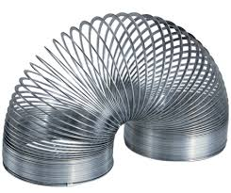
Slinkies
pull out to segment each phoneme
push together when blending

Slide 70
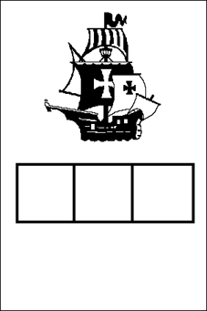
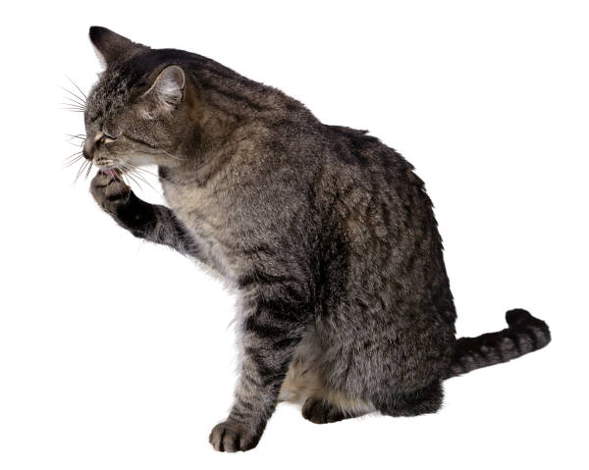
Use Elkonin or Sound Boxes

Slide 71
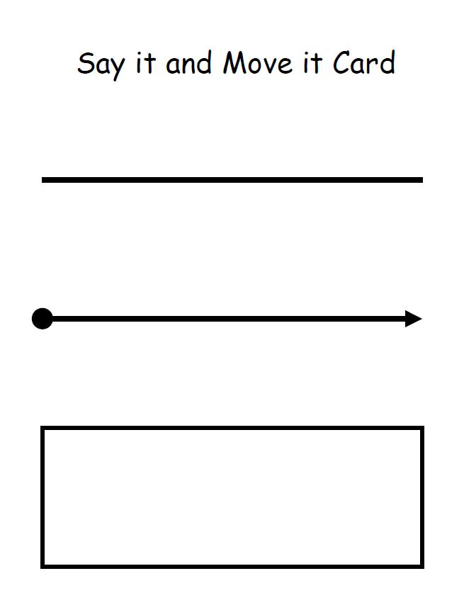
Say it and Move It Card
go
ape
each
in
*tip – make chips the same color

Slide 72
Say it and Move It Card
go
ape
each
in

Slide 73
Say it and Move It Card
go
ape
each
in

Slide 74
Say it and Move It Card
Slide finger under while saying sounds and word
go
ape
each
in
*top line – picture card and eventually write the word
*can use wand and magnetic chips
Notes:
Eventually writing the word on top line

Slide 75
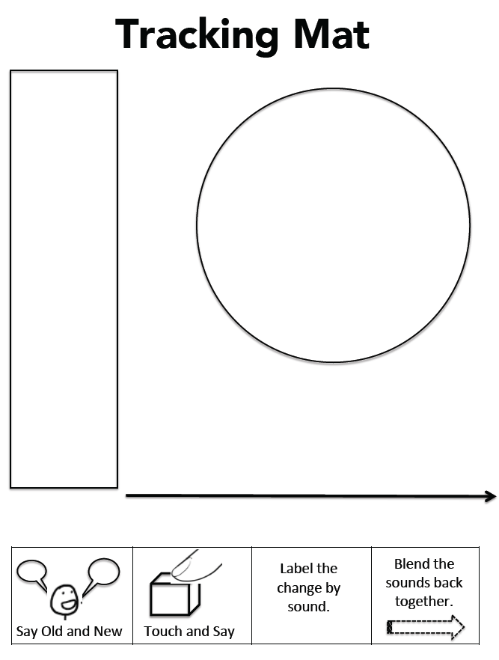
Tracking Mat With Sound Chaining
*tile colors in order, start from bottom
*moving from easier to more difficult (VC-a/t, CVC-s/i/p, CCVC-g/r/ow/l, CCVCC-f/l/a/sh/ed (/t/), CCCVCC-s/t/r/i/pp/ed (/t/))
simple | complex
ap | stod
op | stid
top | slid
tap | slish
pat | plish
pet | plash
set | plach
sel | flach
Show me the sounds in __________.
If this says ______, show me ______.
Say the old word.
Say the new word.
Point to each tile and say each sound in old word.
Point to each tile and say each sound in new word.
Change the tile that corresponds to the changed sound.
Repeat.

Slide 76
Tracking Mat
fan – man
Say the old word.
Say the new word.
Point to each tile and say each sound in old word.
Point to each tile and say each sound in new word.

Slide 77
Tracking Mat
fan – man
Say the old word.
Say the new word.
Point to each tile and say each sound in old word.
Point to each tile and say each sound in new word.
Change the tile that corresponds to the changed sound.

Slide 78
Tracking Mat
*change fan – man
Change the tile that corresponds to the changed sound.

Slide 79
Tracking Mat
fan – man
*tile colors in order, start from bottom

Slide 80
Tracking Mat
mast – mat
*tile colors in order, start from bottom
Say the old word.
Say the new word.
Point to each tile and say each sound in old word.
Point to each tile and say each sound in new word.

Slide 81
Tracking Mat
*change mast – mat
5. Change the tile that corresponds to the changed sound.

Slide 82
Tracking Mat
mast – mat
*tile colors in order, start from bottom

Slide 83
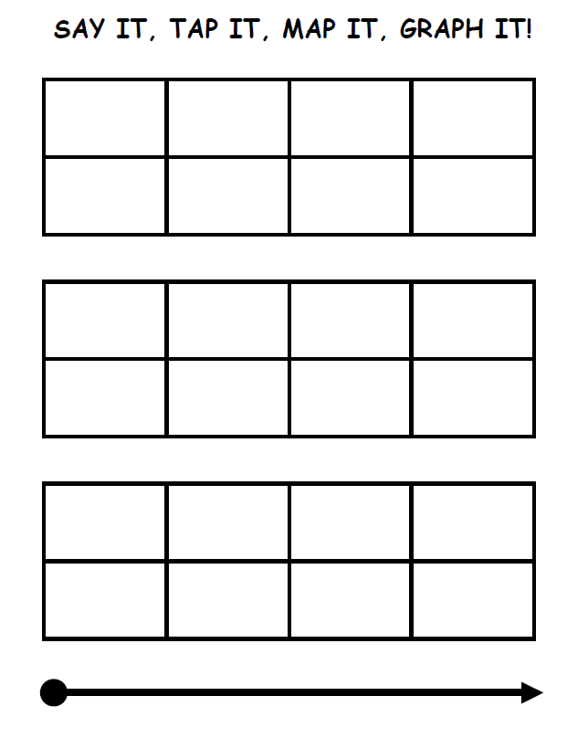
Say It, Tap it, Map It, Graph It
SAY IT– /m/ /a/ /t/

Slide 84
Say It, Tap it, Map It, Graph It
TAP IT with fingers in boxes (second row) – /m/ /a/ /t/

Slide 85
Say It, Tap it, Map It, Graph It
Map It – /m/ /a/ /t/

Slide 86
Say It, Tap it, Map It, Graph It
Map It – /m/ /a/ /t/

Slide 87
Say It, Tap it, Map It, Graph It
Map It – /m/ /a/ /t/

Slide 88
Say It, Tap it, Map It, Graph It
m
Graph It – /m/ /a/ /t/

Slide 89
Say It, Tap it, Map It, Graph It
m
a
Graph It – /m/ /a/ /t/

Slide 90
Say It, Tap it, Map It, Graph It
m
a
t
Graph It – /m/ /a/ /t/

Slide 91
PA Phonics
PA and phonics in action
Model thinking and routinize strategies so students can eventually do it on their own, without support
Sound by sound blending example (shape):
Step 1 - PA say /sh/, phonics write sh
Step 2 – PA say /ā/, phonics write a_e
Step 3 – PA say /p/, phonics write p
After sounds, blend /sh/ /ā/ /p/, while writing shape
Phonics – writing letters that connect to those phonemes

Slide 92
Phoneme-Grapheme Correspondences
Phoneme | Word Examples | Common spellings
/p/ | pit, spider, stop | p
/b/ | bit, brat, bubble | b
/m/ | mitt, comb, hymn | m, mb, mn
/t/ | tickle mitt, sipped | t, tt, ed
/d/ | die, loved | d, ed
/n/ | nice, knight, gnat | n, kn, gn
/k/ | cup, kite, duck, chorus, folk, quiet | k, c, ck, ch, lk, q
/g/ | girl, Pittsburgh | g, gh
/ng/ | sing, bank | ng, n
/f/ | fluff, sphere, tough, calf | f, ff, ph, lf
/v/ | van, dove | v, ve
/s/ | sit, pass, science, psychic | s, ss, sc, ps

Slide 93
Phoneme-Grapheme Correspondence
Phoneme | Word Examples | Common spellings
/z/ | zoo, jazz, nose, as, xylophone | z, zz, se, s, x
/th/ | thin, breath, ether | th
/th/ | this, breathe, either | th
/sh/ | shoe, mission, sure, charade, precious, notion, mission, special | sh, ss, s, ch, sc, ti, si, ci
/zh/ | measure, azure | s, z
/ch/ | cheap, future, etch | ch, tch
/j/ | judge, wage | j, dge, ge
/l/ | lamb, call, single | l, ll, le
/r/ | reach, wrap, her, fur, stir | r, wr, er/ur/ir
/y/ | you, use, feud, onion | y (u, eu), i
/w/ | witch, queen | w, (q)u
/wh/ | where | wh
/h/ | house, whole | h, wh

Slide 94
Phoneme-Grapheme Correspondence
Phoneme | Word Examples | Common spellings
/ē/ | see, these me, eat, key, happy, chief, either | ee, e__e, -e, ea, ey, -y, ie, ei
/ĭ/ | sit, gym | i, y
/ā/ | make, rain, play, great, baby, eight, vein, they | a__e, ai, ay, ea, -y, eigh, ei, ey
/ě/ | bed, breath | e, ea
/ă/ | cat | a
/ī/ | time, pie, cry, right, rifle | i__e, ie, -y, igh, -i
/ŏ/ | fox, swap, palm | o, wa, al
/ŭ/ | cup, cover, flood, tough | u, o, oo, ou
/aw/ | saw, pause, call, water, brought | aw, au, all, w, ough
/ō/ | vote, boat, toe, snow, open | o_e. oa, oe, ow, o-
/ŏŏ/ | took, put, could | oo, u, ou
/ū/ [ōō] | moo, tube, blue, chew, suit, soup | oo, u_e, ue, ew, ui, ou

Slide 95
Phoneme-Grapheme Correspondence
Phoneme | Word Examples | Common spellings
/y/ /ū/ | use, few, cute | u, ew, u_e
/oi/ | boil, boy | oi, oy
/ow/ | out, cow | ou, ow
/er/ | her, fur, sir | er, ur, ir
/ar/ | cart | ar
/or/ | sport | or

Slide 96
-http://www.fcrr.org/for-educators/sca.asp -Phonemic Awareness in Young Children by Adams, Foorman, Lundberg, Beeler -Road to the Code by Blachman, Ball, Black, and Tangel -Teaching Reading Sourcebook (2nd edition) by Honig, Diamond, and Gutlohn
Resources

