Slide 1
Scaffolded Reading (Jennifer)
Different scaffolds for difficulty and aspects of the text
I do, we do, you do (not enough practice)
Active reading strategies
Different scaffolds for difficulty and aspects of the text
Scaffolded reading article by Fisher & Frey vs. Guided Reading
Toys: Amazing Stories (paperback version) for Cori and Cyd’s sessions
The Kid Who Invented the Popsicle: And Other Surprising Stories about Inventions

Slide 2
Copies
Active Reading Strategies Poster—Card Stock—11 x 14
Handout 1 Note Taking Guide
Handout 2 Alaska Adventure text
Handout 3 Scaffolding Strategy Guide
Handout 4 Scaffolding Planning Template
Handout 5 Should We Teach Students at Their Reading Levels?
Handout 6 Range of Reading and Text Complexity
Handout 7 The Challenge of Challenging Text

Slide 3
Materials
Sticky Chart Paper (for me)
Markers (for me)
Blank copy paper…color for four square

Slide 4
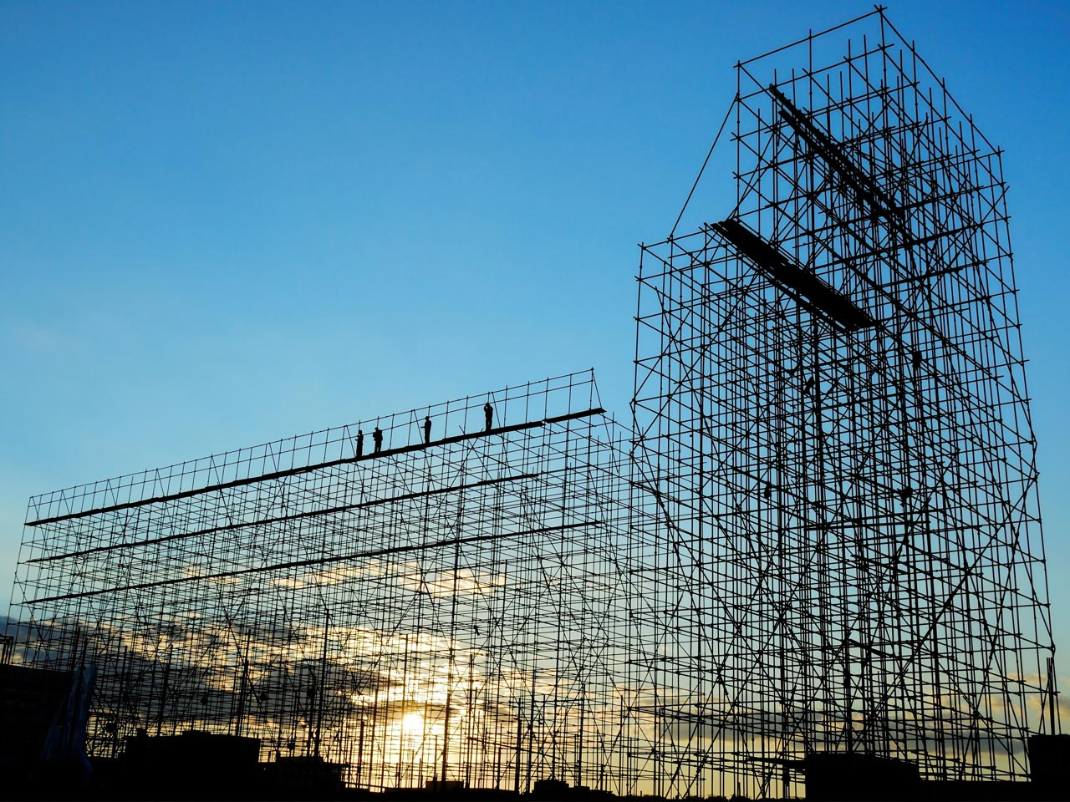
Scaffolded Reading
Jennifer Throndsen
PreK-12 Literacy and Library Media Coordinator
Utah State Board of Education

Slide 5

That’s Me
Notes:
That’s me—ask questions like 2nd grade teacher, 3rd grade…less than 5 years experience, more than 5 etc.

Slide 6
Learning Targets
Learning Intentions
Success Criteria
Participants will explore instructional strategies and practices to scaffold reading instruction in both whole group and small group settings.
I can identify specific elements that make a text challenging and strategies to scaffold.
I can describe the difference between guided reading and scaffolded reading.

Slide 7

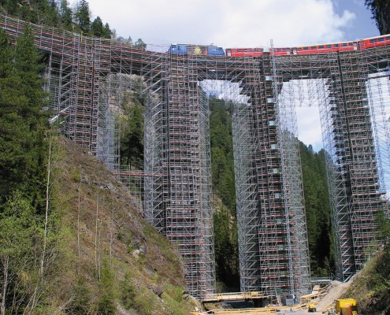
Define Scaffolding
In the literacy classroom,
What does scaffolding look like?
What does scaffolding sound like?
Notes:
Note taking guide
Ask participants to define what scaffolding means to them—pre
Step 1: Written reflection first
Step 2: Share with colleagues at table; add to your own definition as appropriate
Step 3: Pick 2-3 keywords/phrases to share out with the group that represent the big ideas
Step 4: Call on each table and have them share out—record on chart paper

Slide 8
Scaffolding Defined
A process that enables a child or novice to solve a problem, carry out a task or achieve a goal which would be beyond his unassisted efforts (Wood, Bruner, & Ross, 1976)
Supported situations in which children can extend current skills and knowledge to a higher level of competence (Rogoff, 1990)
What teachers say and do to enable children to complete complex mental tasks they could not complete without assistance (Pearson and Fielding, 1991)
A temporary supportive structure that teachers create to assist a student or a group of students to accomplish a task that they could not complete alone (Graves, Watts, & Graves, 1994)
Notes:
Have them read these scaffolding definitions…adjust their definitions as desired.
Purpose—build a common language and understanding of what scaffolding is.

Slide 9
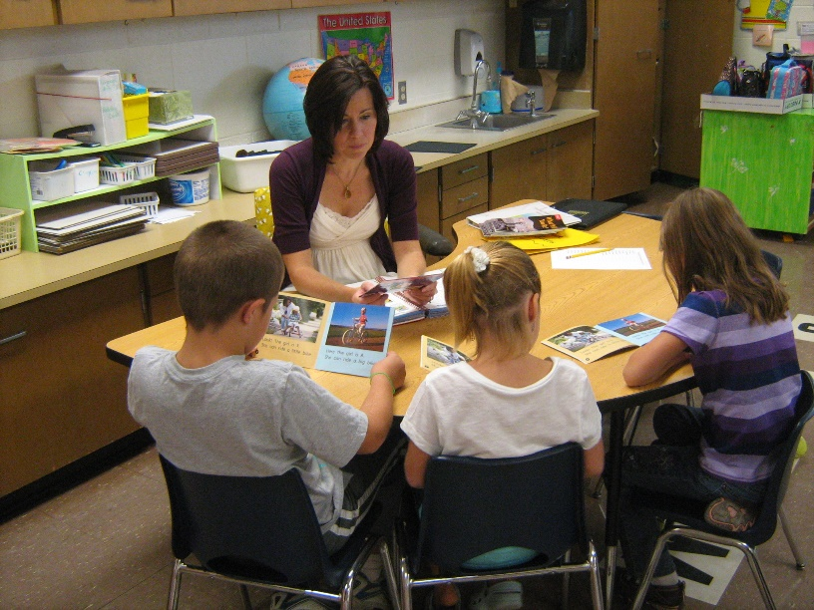
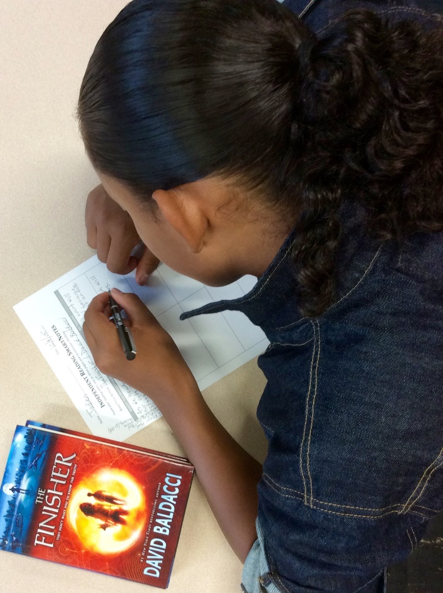
Types of Scaffolding in Reading
Whole group vs. small group
Before, during, and after reading

Slide 10
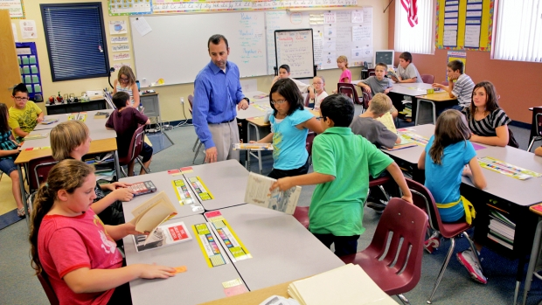
Whole Group Strategies

Slide 11
Instructional Routine #1: Building Fluency
A fluent reader reads with…
  accuracy: pronounces words correctly
  rate: an appropriate pace, not too slow or fast, pausing at meaningful intervals
  expression: emotion, emphasizing key words in phrases
  punctuation: interprets punctuation such as commas and question marks

Slide 12
Goals of Instructional Routine #1 Building Fluency
Build fluency: for challenging level text before partner reading or silent independent reading
Structure engagement: ensure students are reading, not just passively listening to you read

Slide 13
Instructional Routine #1: Building Fluency
What is it? Reading with appropriate rate, accuracy, pronunciation, and expression/prosody.
Preparation:
  Chunk text into manageable segments.
  Direct students to number the text segments in pencil.
  Select 3-5 words per segment to omit as you read aloud. Select words you have pre-taught, strong words that carry familiar meaning, and words that come at the end of phrases.
Notes:
Ideas
Use the video in which Kate models this
Then, do it with them with a simple text
Then, have them do a segment on their own and identify the key words they would leave out.

Slide 14
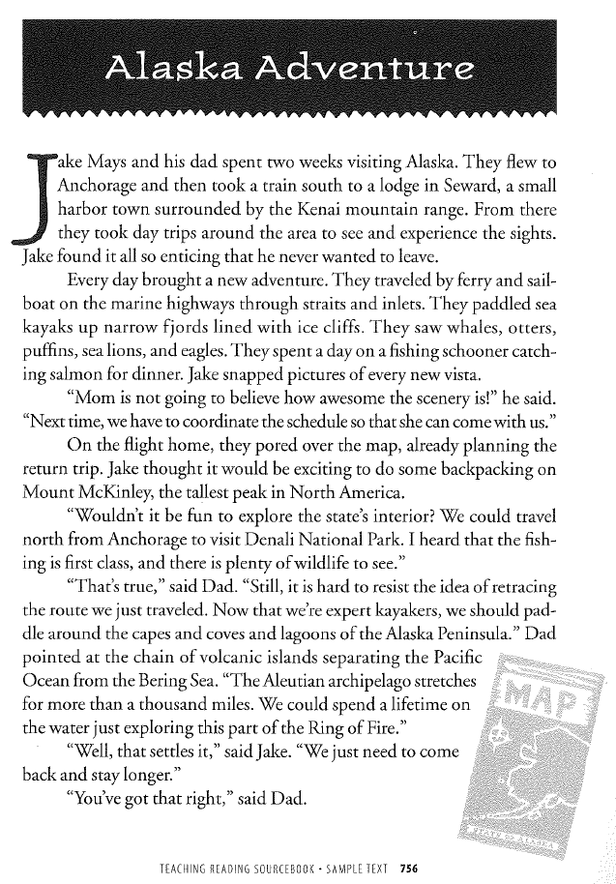
Building Fluency: Practice Task
Notes:
Handout: Alaska Adventure

Slide 15
Notes:
Handout: Alaska Adventure

Slide 16
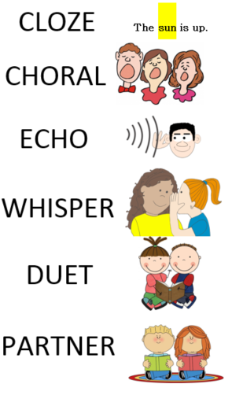
Building Fluency: Other Active Reading Strategies
Choral
Echo
Whisper
Strategic Partners
  Duet (stronger student with weaker student)
  Partner (stronger student reads first;
  weaker reader rereads next)
Notes:
Model these strategies with the other paragraphs in the Alaska Adventure text
Handout: Active Reading Strategies poster

Slide 17

The Challenge of Challenging Text
Vocabulary
Sentence Structure
Coherence
Organization
Background Knowledge
Notes:
Jigsaw this text: Assign each of them one of the components that may need scaffolding.
Then, have them teach one another about their topic and suggestions for
Four square—need color paper

Slide 18
Vocabulary
Higher-order thinking in reading heavily depends on knowledge of word meanings
Often instruction emphasizes domain-specific words (e.g., erosion, rhombus, metaphor)
Need to provide instruction on the essential but more general academic terms
“Students’ ability to comprehend a piece of text depends on the number of unfamiliar domain-specific words and new general academic terms they encounter.”
Notes:
Quickly review these to ensure participants have the key ideas

Slide 19
Sentence Structure
Determines how words operate together
“The stork was walking in the beautiful cornfield”
  More than just being able to define individual words
  How the words fit together (Which stork? Where was the stork? What was it doing?)
Length: short vs. long

Slide 20

Coherence
How particular words, ideas, and sentences in text connect with one another
  John and Mary went to space camp. They liked it there. Of course, boys often like rockets, but Mary, too, enjoyed it.

Slide 21
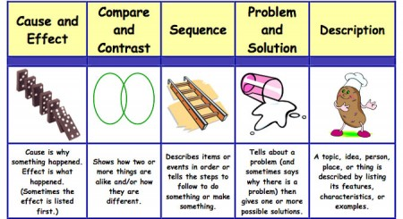
Organization
Sequence (e.g., time, flashbacks)
Compare and Contrast (e.g., alligators and crocodiles)
Problem-Solution (e.g., causes of water pollution)
Text features

Slide 22

Background Knowledge
Reader’s prior knowledge
Developmental
Experiential
Cognitive Factors

Slide 23
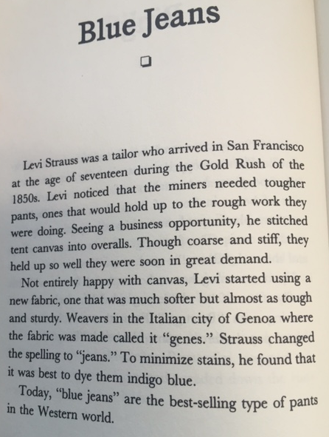
Application – I Do
The Kid Who Invented the Popsicle
p. 14 Blue Jeans
Evaluate
  Vocabulary
  Sentence Structure
  Coherence
  Organization
  Background Knowledge
Notes:
Using page 14 in The Kid Who Invented the Popsicle, Model for participants how to evaluate the text on the 5 elements of challenge: vocabulary, sentence structure, coherence, organization, background knowledge.

Slide 24

Application – We Do
The Kid Who Invented the Popsicle
p. 22 Chewing Gum
Evaluate
  Vocabulary
  Sentence Structure
  Coherence
  Organization
  Background Knowledge
Notes:
Using p. 22 Chewing Gum, have participants apply the same routine just modeled with Blue Jeans to the Chewing Gum text. Ask participants to evaluate the text on the 5 elements of challenge: vocabulary, sentence structure, coherence, organization, background knowledge….they can record their observations on the back of the four square

Slide 25

Notes:
10-15 minute break—when we come back we will look at instructional strategies you can use to overcome these 5 challenges

Slide 26
Scaffolding Strategies
Preview the text
Preteach vocabulary
Teacher reads aloud the text
Active reading strategies
Chunking text
Peer and small group discussion
Text-dependent questioning
Building connections
Partially completed or structured graphic organizer
Provide sentence frames for discussion
Provide sentence or paragraph frames for writing about what they read

Slide 27

Preview the Text
Notes:
-Set or clarify purpose for reading
-How is the text organized?
-Previewing the headers, subheadings, introductory material
-Skimming to get an overview of the content and organization of the text

Slide 28
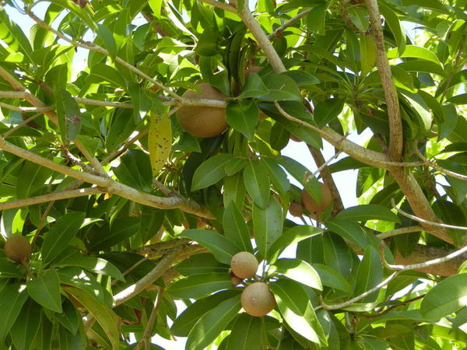
Preteach Vocabulary
Chicle
Hardened sap from a Sapodilla Tree
Notes:
Before doing an activity, teaching content, or reading a story in class, pre-teaching vocabulary is always helpful, especially for ELLs. This gives students a the chance to identify words and then be able to place them in context and remember them.
Strategies
Role playing or pantomiming
Using gestures
Showing real objects
Pointing to pictures
Doing quick drawings on the board

Slide 29

Teacher reads the text aloud
Notes:
model fluent reading
Exposes them to the text so that they will know what is about when they attempt to read it
Helps students learn new words==if they follow the teacher with their finger as they are read to

Slide 30
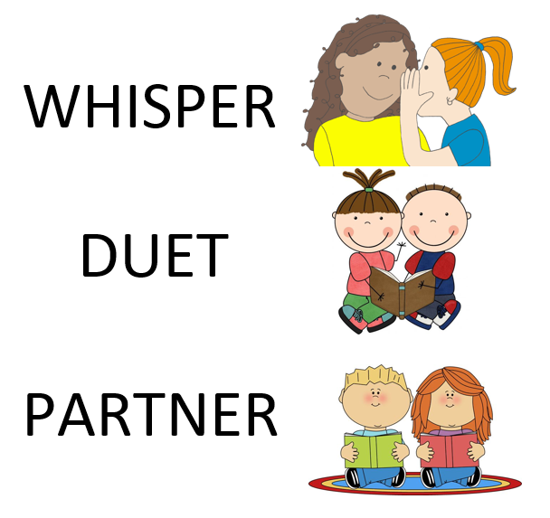
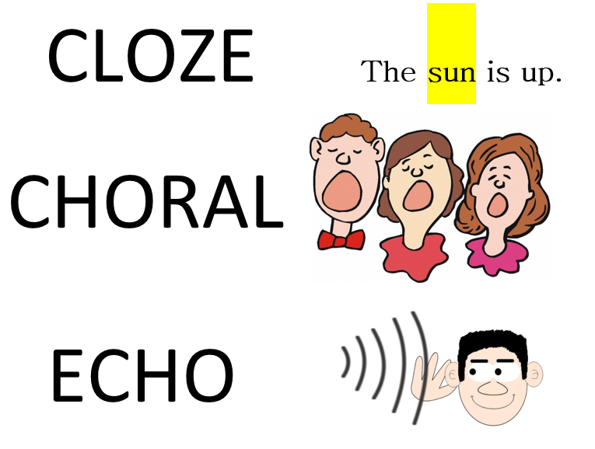
Active Reading Strategies

Slide 31
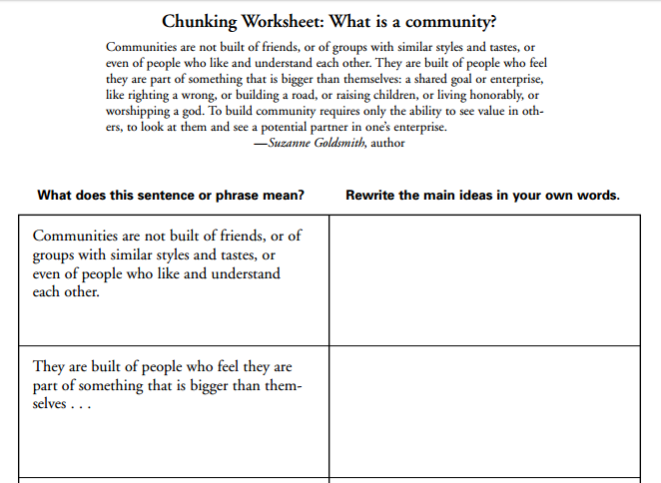
Chunking Text
Notes:
Breaking long passages into shorter sections or even paragraphs into sentences or phrases
chunk the text and read and discuss as you go
Chunking is an example of a strategy that helps students breakdown difficult text into more manageable pieces. Dividing content into smaller parts helps students identify key words and ideas, develops students’ ability to paraphrase, and makes it easier for students to organize and synthesize information.

Slide 32
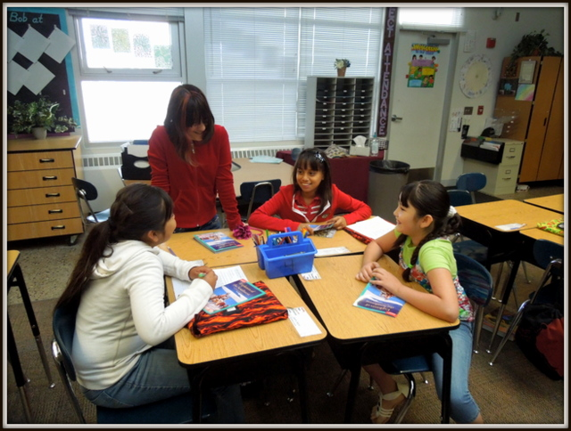
Peer or small group discussion prior to whole group discussion
Notes:
Allows students to process their thinking prior to the whole group discussion
Can provide students who aren’t sure with a better understanding from listening to their peers
Allows the teacher to monitor students’ understanding—can hear more students in the small group discussion than might be able to do during a whole group discussion

Slide 33
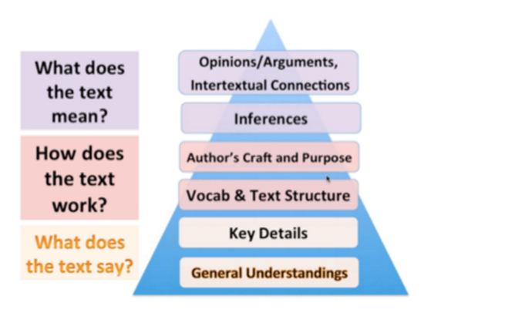
Text-Dependent Questioning
Notes:
Text-dependent questioning frame the extended discussion of a text and invite children to co-construct knowledge in the company of their teacher. These types of questions advance students through a process of more deeply understanding a text.

Slide 34

Building Connections
Notes:
Point out connections between the text at hand and something else they’ve studied in your class.
Questions can encourage students to make connections to their previous reading or class discussion, evaluate arguments, or apply the concepts they read about to other scenarios.

Slide 35
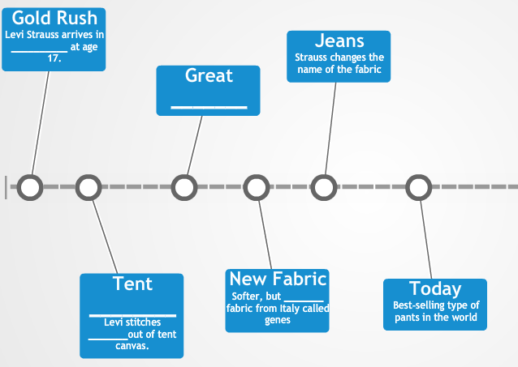
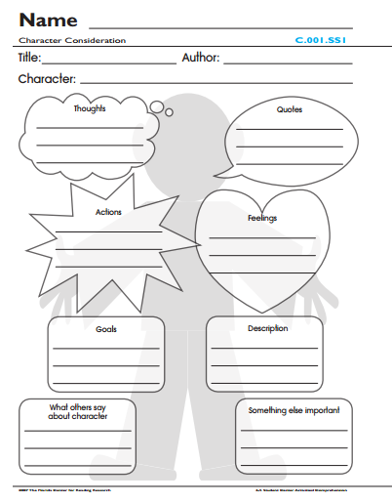
Partially completed or structured graphic organizer
Notes:
To go along with the Blue Jeans text, this partially completed graphic organizer is one example of how to accomplish this scaffolding support.

Slide 36
Provide sentence frames for discussion
Weather patterns affect humans by _______________________.
While trying to make ____________, Adams was successful in __________________.

Slide 37
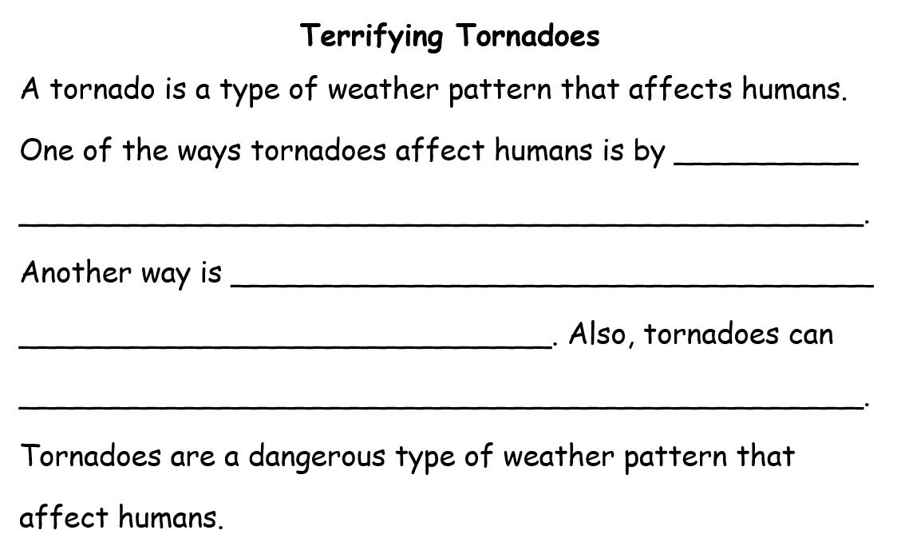
Provide sentence of paragraph frames for writing about what they read

Slide 38
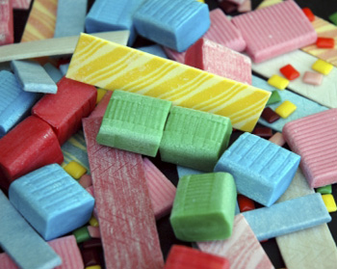
Scaffolding Strategies: Application
Choose a before, during, and after strategy and describe how you would incorporate them if you were to use the chewing gum or the blue jeans text.
Notes:
Scaffolding Planning Template
Note there are more strategies on this template than those that I covered…some should be self-explanatory

Slide 39
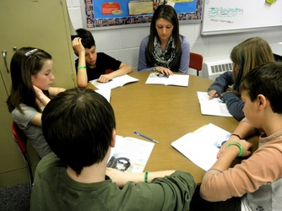
Small Group Strategies

Slide 40

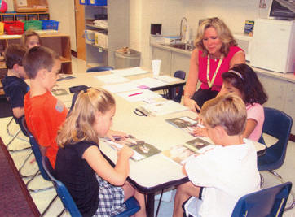
Guided Reading or Scaffolded Reading?

Slide 41
Guided Reading
Scaffolded Reading
What are the characteristics of guided reading?
Notes:
After they have completed filling in their chart…have them read “Should we teach students at their reading levels?”

Slide 42
Guided Reading
Scaffolded Reading
Purpose is to allow students to integrate newly acquired skills and knowledge while reading text for meaning
Largely focused on comprehension skill and strategy development
Allows for teacher to monitor student application of skills
Notes:
After they have completed filling in their chart…have them read “Should we teach students at their reading levels?”

Slide 43

Read and Respond
3, 2, 1
3 Key Ideas
2 Questions
1 Thing to Remember
Notes:
In blank space on note taking guide have participants record 3 key ideas and 2 questions. After, have participants get up and find someone with the same shoe color to pair with. Have them share their 3 key ideas—add to their list as needed—and their 2 questions. Colleagues can try to answer their questions. Bring the group back together and ask what questions do you still need answers to? Brief Q&A time for about 5 minutes.
After Q & A, have participants record 1 thing they want to remember about the text and conversation.

Slide 44
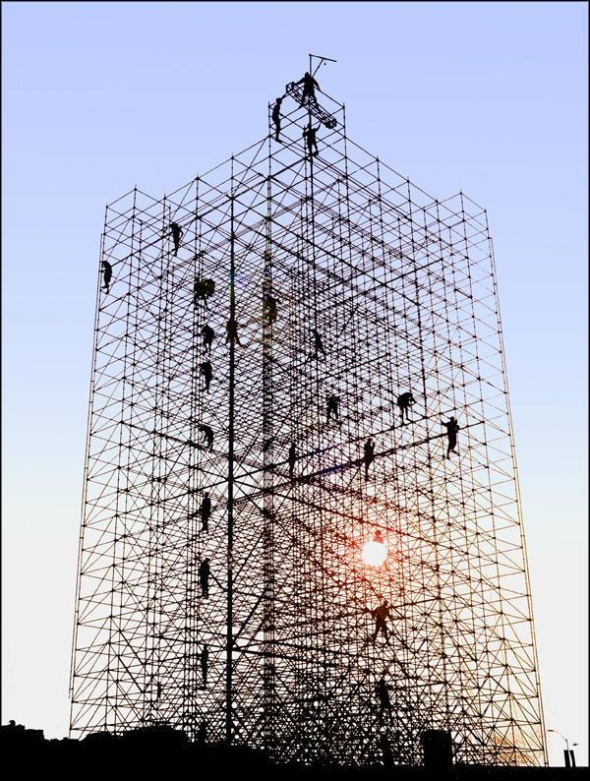
Points to Ponder
Instructional level is not a placement. It is something you take on through scaffolding.
-Dr. Tim Shanahan
Shouldn’t the teacher, rather than the text, serve as the primary source of scaffolds?
-Fisher & Frey

Slide 45
R.L. 10: Read and comprehend complex literary and informational texts independently and proficiently
2nd Grade: By the end of the year, read and comprehend literature, including stories and poetry, in the grades 2-3 text complexity band proficiently, with scaffolding as needed at the high end of the range.
3rd Grade: By the end of the year, read and comprehend literature, including stories, dramas, and poetry, at the high end of the grades 2-3 text complexity band independently and proficiently.
4th Grade: By the end of the year, read and comprehend literature, including stories, dramas, and poetry, in the grades 4-5 text complexity band proficiently, with scaffolding as needed at the high end of the range.
5th Grade: By the end of the year, read and comprehend literature, including stories, dramas, and poetry, at the high end of the grades 4-5 text complexity band independently and proficiently.
Notes:
Handout—Range of Reading and Text Complexity

Slide 46
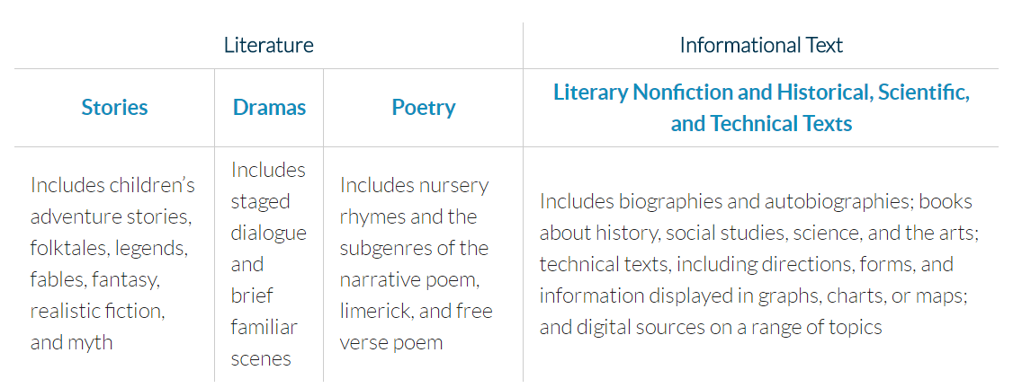
Range of Reading

Slide 47
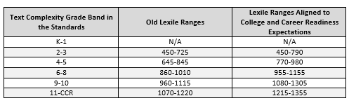
Expected Lexile Levels

Slide 48
Guided Reading
Scaffolded Reading
Opportunity to grapple with text that is more difficult than they can access on their own
Provides students and the teacher with the opportunity to talk at length about the learning
Pose questions, engage in speculation, support and challenge claims, draw conclusions
Notes:
Ideas in scaffolded reading instruction in the content areas article by fisher and frey

Slide 49
Guided Reading
Scaffolded Reading
Three purposes:
Extension of close reading
Preparation for close reading or collaborative reading tasks
Address the assessed needs of specific students
Notes:
Ideas in scaffolded reading instruction in the content areas article by fisher and frey
P.350 gives examples of the three purposes

Slide 50
Learning Targets
Learning Intentions
Success Criteria
Participants will explore instructional strategies and practices to scaffold reading instruction in both whole group and small group settings.
I can identify specific elements that make a text challenging and strategies to scaffold.
I can describe the difference between guided reading and scaffolded reading.

Slide 51

Questions?
Jennifer Throndsen
Utah State Board of Education
PreK-12 Literacy and Library Media Coordinator
jennifer.throndsen@schools.utah.gov

Slide 52
Schedule
 | Day 1 AM | Day 1 PM | Day 2 AM | Day 2 PM
Blue | Struggling Reader | Scaffolded Reading | Complex Text | Writing
Red | Scaffolded Reading | Complex Text | Writing | Struggling Reader
Yellow | Complex Text | Writing | Struggling Reader | Scaffolded Reading
Green | Writing | Struggling Reader | Scaffolded Reading | Complex Text

