Slide 1
Strengthening Your Core: Struggling Readers – Grades 2-6
Sara Wiebke
K-3 Literacy Specialist
USBE
sara.wiebke@schools.utah.gov
Lisa Brown
Educator Preparation Program Approval Specialist
USBE
lisa.brown@schools.utah.gov
Notes:
Update Lisa’s contact info. (email)

Slide 2

“The National Institute of Child Health and Human Development (NICHD) found that of the students who struggle to learn to read during the elementary school years, 86% of those students need instruction in phonemic awareness and phonics.”
-Tim Shanahan
Notes:
National Institute of Child Health and Human Development (NICHD)
Example: group of 25 struggling students, 22 of those students need PA & phonics instruction

Slide 3

The Big Picture
Early assessment is one of the most effective ways to prevent the downward spiral of reading failure. It identifies students who need extra help in reading before they experience serious failure (Torgesen 1998).
The sooner the intervention occurs, the more likely students will regain ground (Torgesen, 1998, 2004).
There is often a decline in motivation and interest in reading in students who at first had difficulty in learning to read (Eccles et al. 1993; McKenna, Kear, and Ellsworth 1995).
Notes:
Students who have lost motivation and interest are affected in two ways - they will spend less time reading and are less interested in fully understanding what they read.

Slide 4

How to Motivate
Tasks and activities are relevant to their lives
Access to a wide range of reading materials
Ample opportunities to engage in sustained reading
Opportunities to make choices about what they read
Opportunities to socially interact with others about the text
Opportunities to succeed in challenging text
Classroom incentives reflect the value and importance of reading

Slide 5
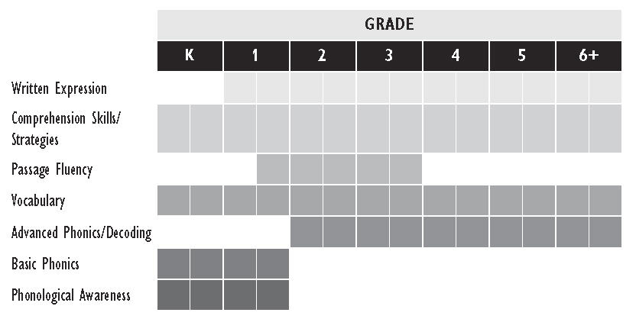
Reading Instruction Components Typically Emphasized at Each Grade Level
Notes:
Building blocks

Slide 6
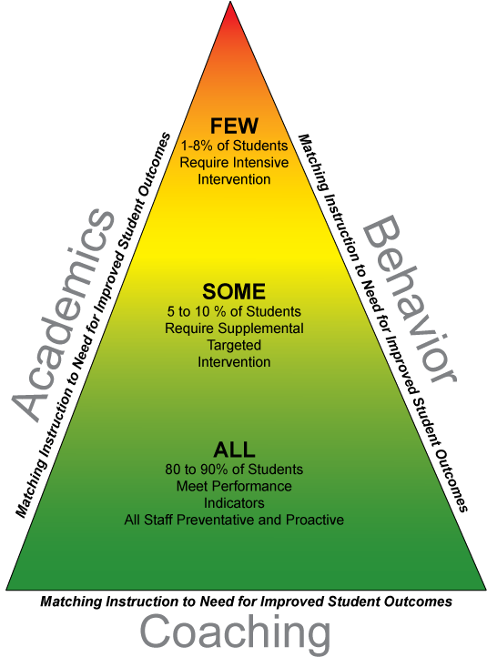
MTSS/RTI - Ranked 3rd out of 150 influences on student achievement with an effect size of 1.07.
Anything over 1.0 = advancing student achievement by 2-3 years.
Visible Learning for Literacy Fisher, Frey, and Hattie
Notes:
RTI has an effect size of 1.07 and is ranked third (out of 150 influences) in Visible Learning for Literacy (Fisher, Frey, & Hattie). Anything over 1.0 is considered to advance student achievement by 2-3 years.
Activity after – groups of 3 , describe each of the tiers.

Slide 7
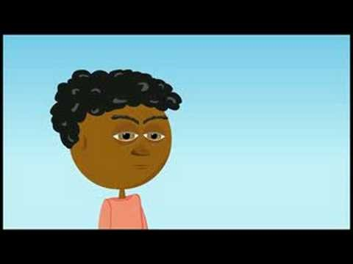
Notes:
https://youtu.be/nkK1bT8ls0M
Activity after – groups of 3 , describe each of the tiers.

Slide 8
Tier I: Core Instruction
Who: All students
Instructional Content: District/School curriculum and instructional practices that are evidence-based, aligned with state standards and incorporate differentiated instruction (small group)
Setting: General education classroom
Assessments: Screening, continuous progress monitoring, and classroom outcome measures
  Effective core instruction will result in at least 80% of students achieving proficiency
  When in place, there is a decreased need for the intensive instruction provided in Tier II & III
  “You can’t intervene your way out of a Tier I problem.” – Dave Tilly (80%)
Notes:
Activity after – groups of 3 , describe each of the tiers.

Slide 9

Tier I Instruction
Be mindful of your time, intensity, content, and strategies
Explicit
  I do (model & teach), we do (guided practice with scaffolding), you do (independent practice)
Systematic
  Scope & sequence – separate confusion, easy to hard
120 -180 minutes of literacy instruction, including writing instruction (content areas)
Differentiated instruction based on student needs (small groups)
Progress monitor every 4-6 weeks
Examples: Journeys, Reading Wonders, Reading Street
Notes:
Give explicit feedback and praise
Death by Diagnostic
-”we do” may happen many more times than once

Slide 10
Tier II: Supplemental, Targeted Intervention
Who: Students identified through screening as at risk for poor learning outcomes
  Look at all sub-measures, not just composite score
Instructional Content: Targeted, supplemental instruction delivered to small groups, in addition to Tier I core instruction
  Small group of students who all need to learn the same skill
  Provided by the classroom teacher and/or interventionist
Setting: General education classroom or other location within the school
Assessments: Progress monitoring and diagnostic assessments
Myths: Slower and louder, STAR tutoring is an intervention
Notes:
Prevent/remediate deficits

Slide 11

Tier II Instruction
Research-based interventions
20-30 minutes, 4-5 days per week
Targeted, supplemental instruction
Small group setting: 5-6 students
Skill deficits identified through diagnostic assessment
Progress monitor every 2-4 weeks
Examples: 95% Group, EIR, Early, Next, and Higher Steps, PALS, REWARDS, SpellRead

Slide 12
Tier III: Intensive Instruction
Who: Students who have not responded to Tier I/II or have significant needs. Students with intensive needs may access Tier III supports without first receiving Tier II instruction.
Instructional Content: Intensive, supplemental instruction delivered to small groups or individually, in addition to Tier I core instruction
  Smaller group size
  Increased intensity: more explicit, focused
  Setting: General education classroom or other location within the school
Assessment: Diagnostic assessments and weekly progress monitoring
Myth: Tier III is Special Ed.
Notes:
Tier III may or may not equate to special education services.

Slide 13

Tier III Instruction
Research-based interventions
High-risk students
45-60 minutes daily
Intensive, individually-responsive instruction
Adapted strategies, increase of frequency, intensity, or time
Conducted in small group setting (2-4) or one-on-one
Identified through diagnostic assessment that assesses discrete skills
Progress monitor weekly (survey level) and monthly on grade level
Examples: LANGUAGE!, LiPS, My Sidewalks, Reading Mastery, S.P.I.R.E., Wilson

Slide 14

Tier II & III
Federal and state law requires students to receive immediate intervention instruction when it is first noticed that they are not achieving as expected.
There is no magic program/intervention that works for every single child.
Low-performing students receive targeted, skill-based instruction.
The most severe students need intervention in the morning, before brain overload sets in.
Has time been set aside for Tier II & III instruction in your school/classroom?
Questions about MTSS?
Notes:
Intervention toolkit is needed

Slide 15

Activity
Get into groups of three. Each person will describe one tier.

Slide 16
Decision-Making Process
1st
Review Benchmark Data
Sort Students Into the Four Quadrants
2nd
Look at students in each quadrant and determine further diagnostic needs—see flowcharts
3rd
Identify which intervention material or tool to use
Administer intervention and progress monitor student response
Administer appropriate diagnostic(s)

Slide 17


Data-Based Decision Making
  Vital signs – blood pressure/temperature
  Answers the question: who is at risk for academic failure
  Use data to identify and sort all students
Benchmark Assessment

Slide 18

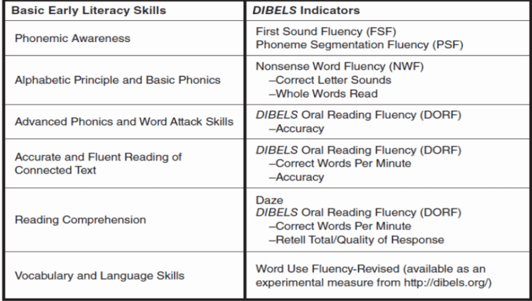
DIBELS Next
Alignment of DIBELS Next Measures With Basic Early Literacy Skills
-Universal Screener of the most predictive skills for reading achievement
-Lowest level of “ok”

Slide 19
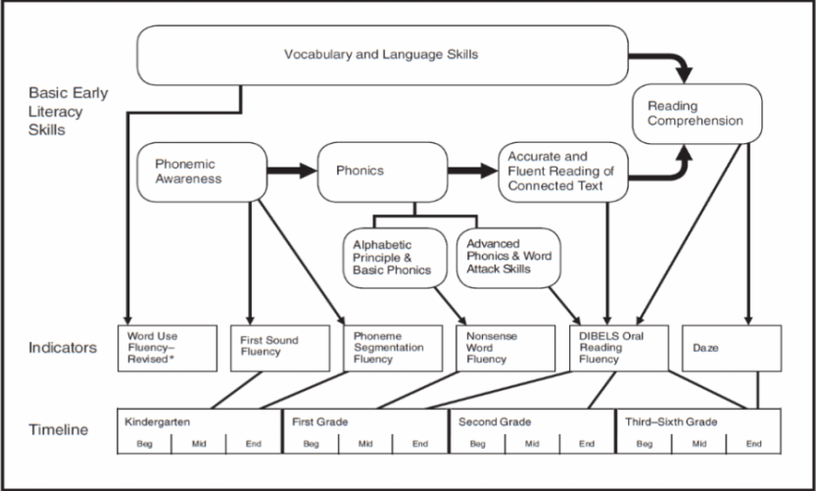
DIBELS Next
Basic Early Literacy Skills, Indicators, and Timeline
*Note – how do we ensure proficiency was met if that component is no longer tested?
Notes:
If student wasn’t proficient on FSF (first sound fluency) in kindergarten, how do we know in first grade that they got it?

Slide 20
Benchmark Data
1st
Sorting Students
Quadrant 1 Accurate and At/Above Benchmark Rate on ORF | Quadrant 2 Accurate and Below Benchmark Rate on ORF
Quadrant 3 Inaccurate and Below Benchmark Rate on ORF | Quadrant 4 Inaccurate and At/Above Benchmark Rate on ORF

Slide 21
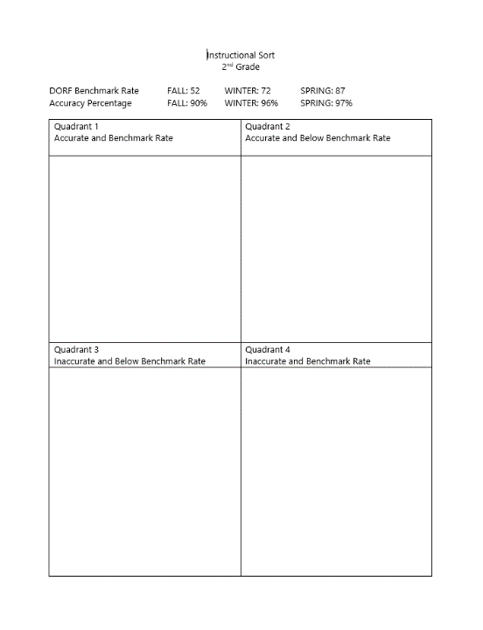
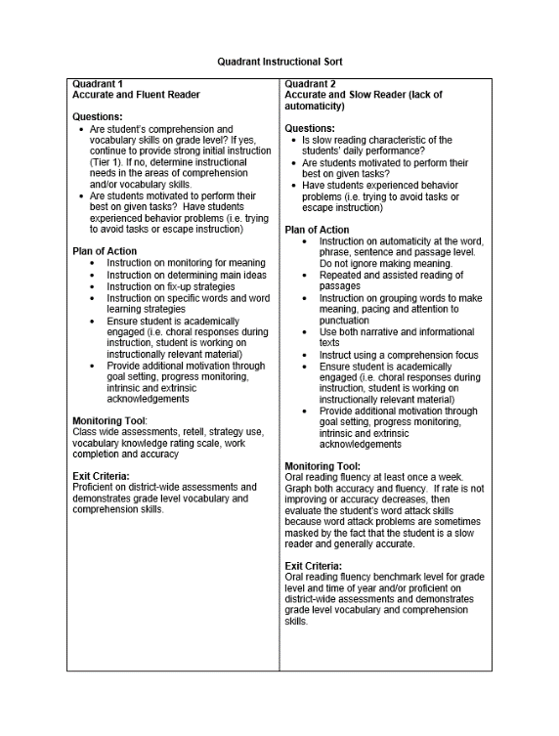
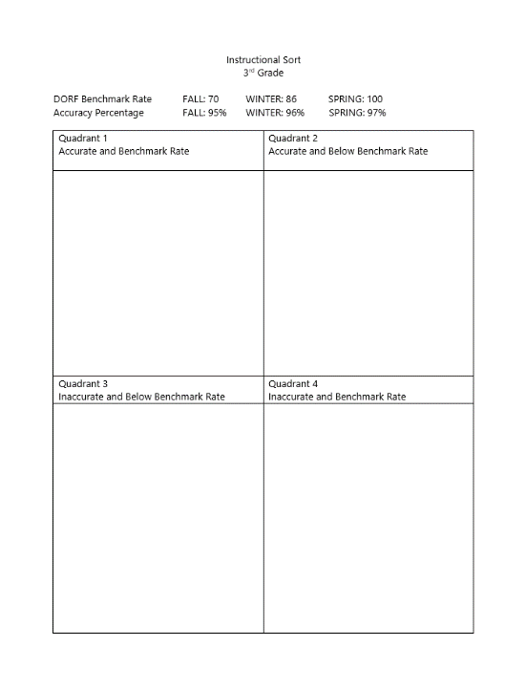
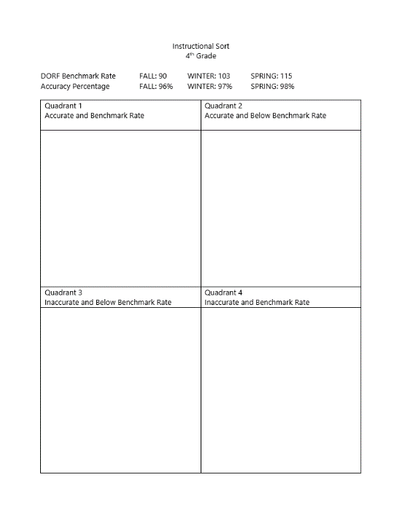

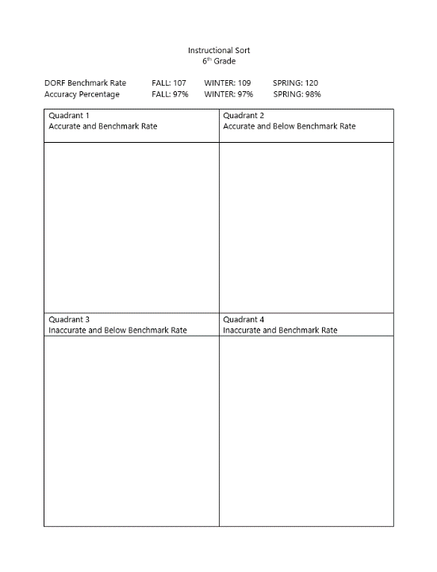
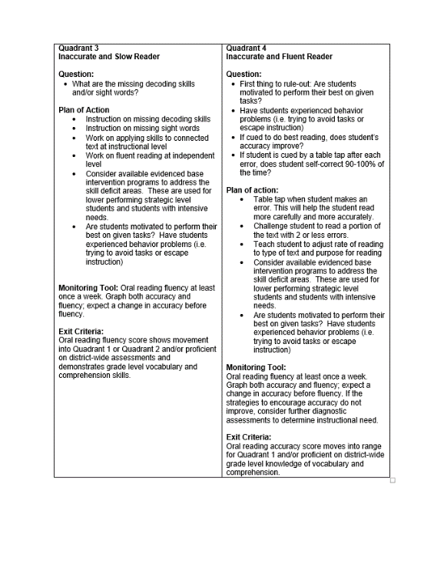
Instructional Sorts – Grades 2-6

Slide 22

Description: accurate & fluent
Plan of Action: core skills - extension opportunities in comprehension, vocabulary, and writing
Monitoring Tools: classroom assessments and progress monitoring every 4-6 weeks
Diagnostic needed: no

Slide 23
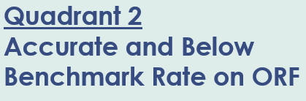
Description: accurate, but slow
Plan of Action: repeated reading or phrase-cued reading
Monitoring Tools: progress monitoring on DORF every 2-4 weeks
Diagnostic needed: likely
Note: this cannot be ignored, these students will have issues in middle school if ignored

Slide 24
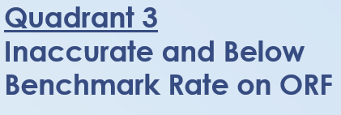
Description: inaccurate and slow
Plan of Action: phonics, sight words, phonemic awareness
Monitoring Tools: progress monitoring (survey level) weekly, grade level – monthly
Diagnostic needed: yes, possibly more than one
Note – the best phonics programs include connected text so students can apply their skills. Students do not automatically transfer this skills on their own.

Slide 25
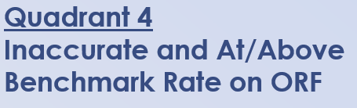
Description: inaccurate and fluent
Plan of Action: table tap/pencil tap (2-4 weeks), graph errors
Monitoring Tools: progress monitoring on DORF (accuracy first)
Diagnostic needed: possibly (see below)
Note: if the student cannot self correct, check phonics

Slide 26
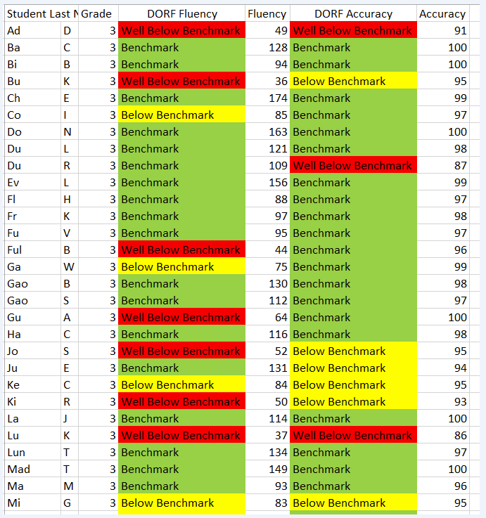
Activity
Sort this 3rd grade class into the 4 quadrants.
*Note – this data represents 3rd grade MOY
Notes:
3rd grade goals for MOY are 86 correct words per minute and 96% accuracy.

Slide 27
Ba
Bi
Ch
Do
Du L.
Ev
Fl
Fr
Fu
Gao B.
Gao S.
Ha
La
Lun
Mad
Ma
Co
Ful
Ga
Gu

Slide 28
Ad
Bu
Jo
Ke
Ki
Lu
Mi
Du R.
Ju

Slide 29
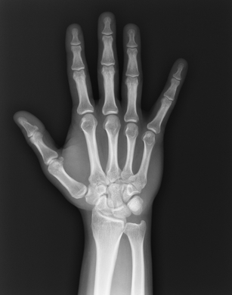
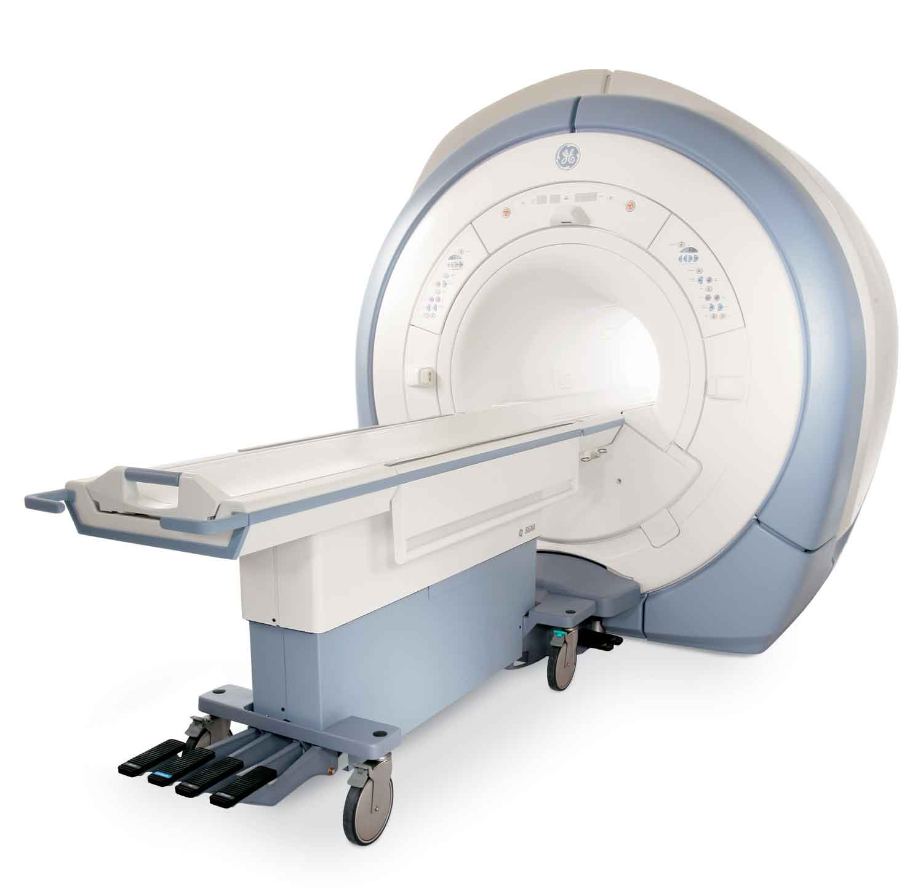
Data-Based Decision Making
    X-ray, MRI, CAT scan
  Answers the question: what are the underlying student needs
  Use data to identify skill gaps of students below level
Diagnostic Assessment
Notes:
“death by diagnostic” – not every student needs a diagnostic assessment

Slide 30
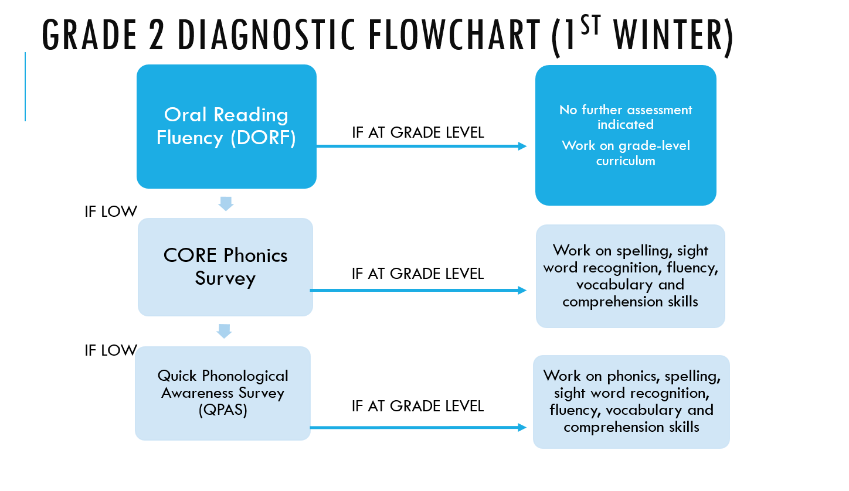
Grade 2
Notes:
I provided all K-6 handouts, but primarily you will only need 2-6. Handout 4

Slide 31
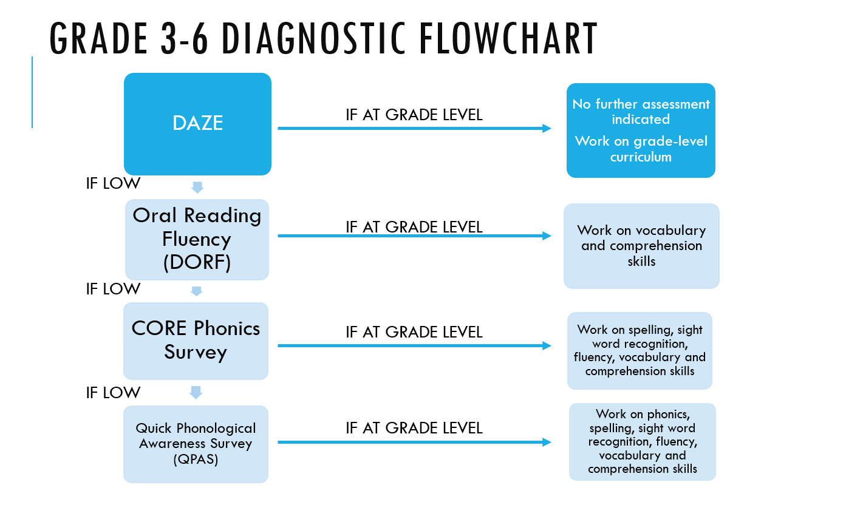
Grades 3-6
Notes:
Handout 5

Slide 32
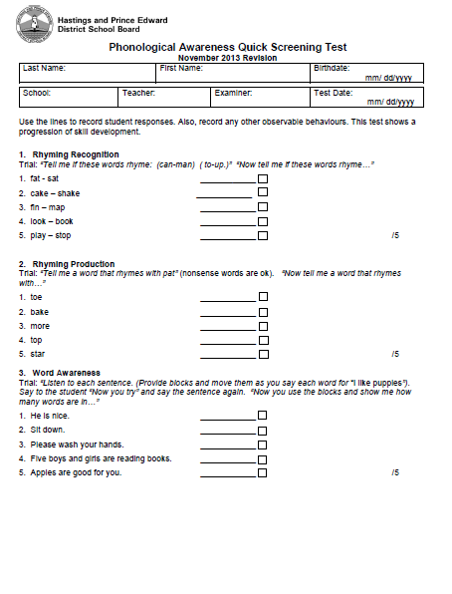
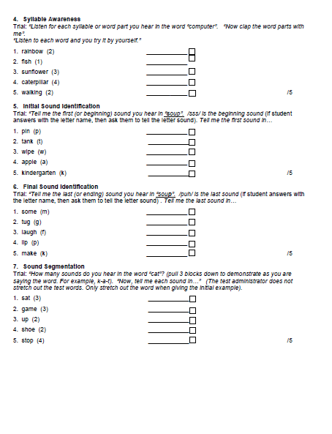
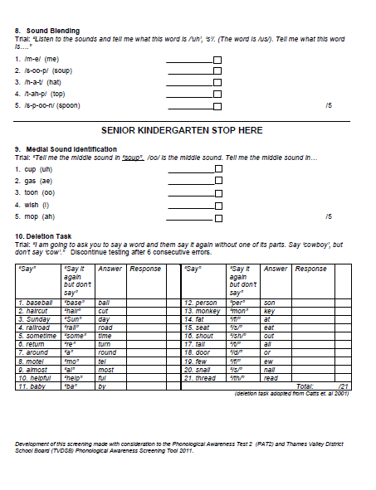
Quick Phonological Awareness Screening (QPAS)
Notes:
Handout 6

Slide 33
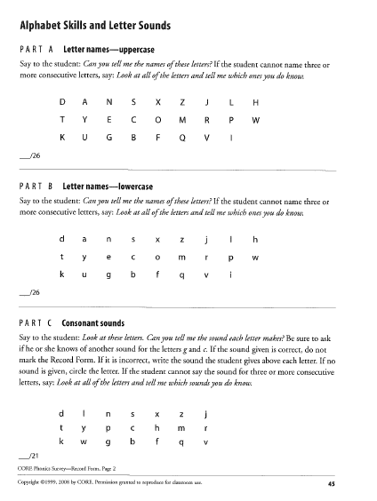
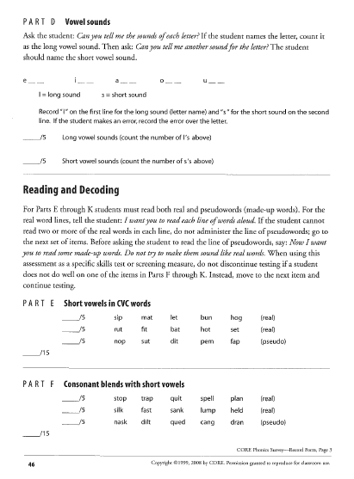
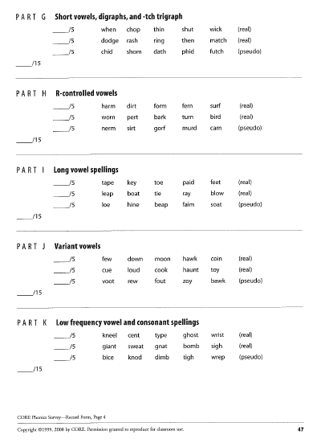
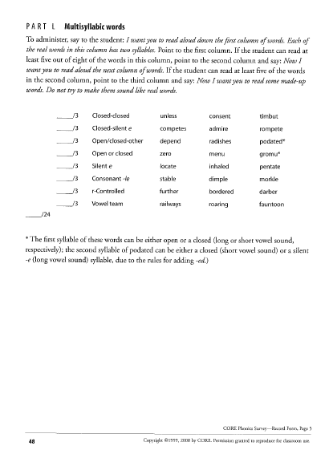
CORE Phonics Survey
Notes:
Handout 7

Slide 34

Data-Based Decision Making
  Prescription/procedure
  Focused, targeted, explicit instruction
  Who - interventionist/teacher/specialist
  What - intervention
  Where - classroom/other area of school
  When - frequency and duration
  How - small group/ one-on-one
Intervention
Notes:
Getting students from the known to the unknown.

Slide 35

Data-Based Decision Making
  Follow up appointment
  Answers the question: is the intervention working?
  Effect size of 0.90 (Hattie)
  Informs instruction, using the moving median of 3
  Used in conjunction with Pathways of Progress
  The frequency of progress monitoring should match the level of concern about the student’s skill development and need for support
    Recommended frequency:
      well below benchmark – 1-2 weeks
      below benchmark - 2-4 weeks
      benchmark - 4-6 weeks
  Note: Three passages are given for DORF during benchmark testing, but only ONE passage is used for progress monitoring. There are 20 PM forms for each measure. Be sure to use a different form each week.
Progress Monitoring
Notes:
First Sound Fluency (FSF)
Phoneme Segmentation Fluency (PSF)
Nonsense Word Fluency (NWF)
DIBELS Oral Reading Fluency (DORF) levels 1-6
DAZE levels 3-6
DAZE – once a month
3rd largest effect size out of 138 influences on student achievement
Perspective – 1.0 is equivalent of 2-3 years progress

Slide 36
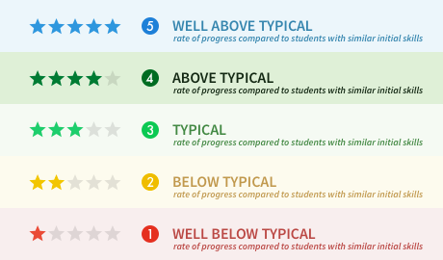
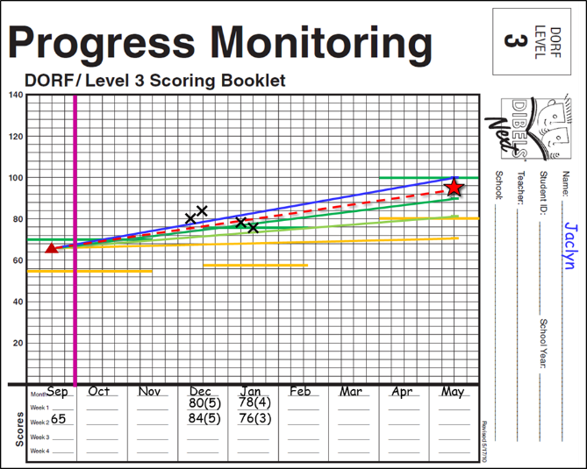
Data-Based Decision Making
  Research-based goal setting tool
  Meaningful, ambitious, and attainable goals
  Evaluate individual student progress and rate of growth, compared to other students with the same level of initial skills
  Evaluate the effectiveness of support at the classroom, school, or district level
  Not available with survey level progress monitoring
Pathways of Progress

Slide 37
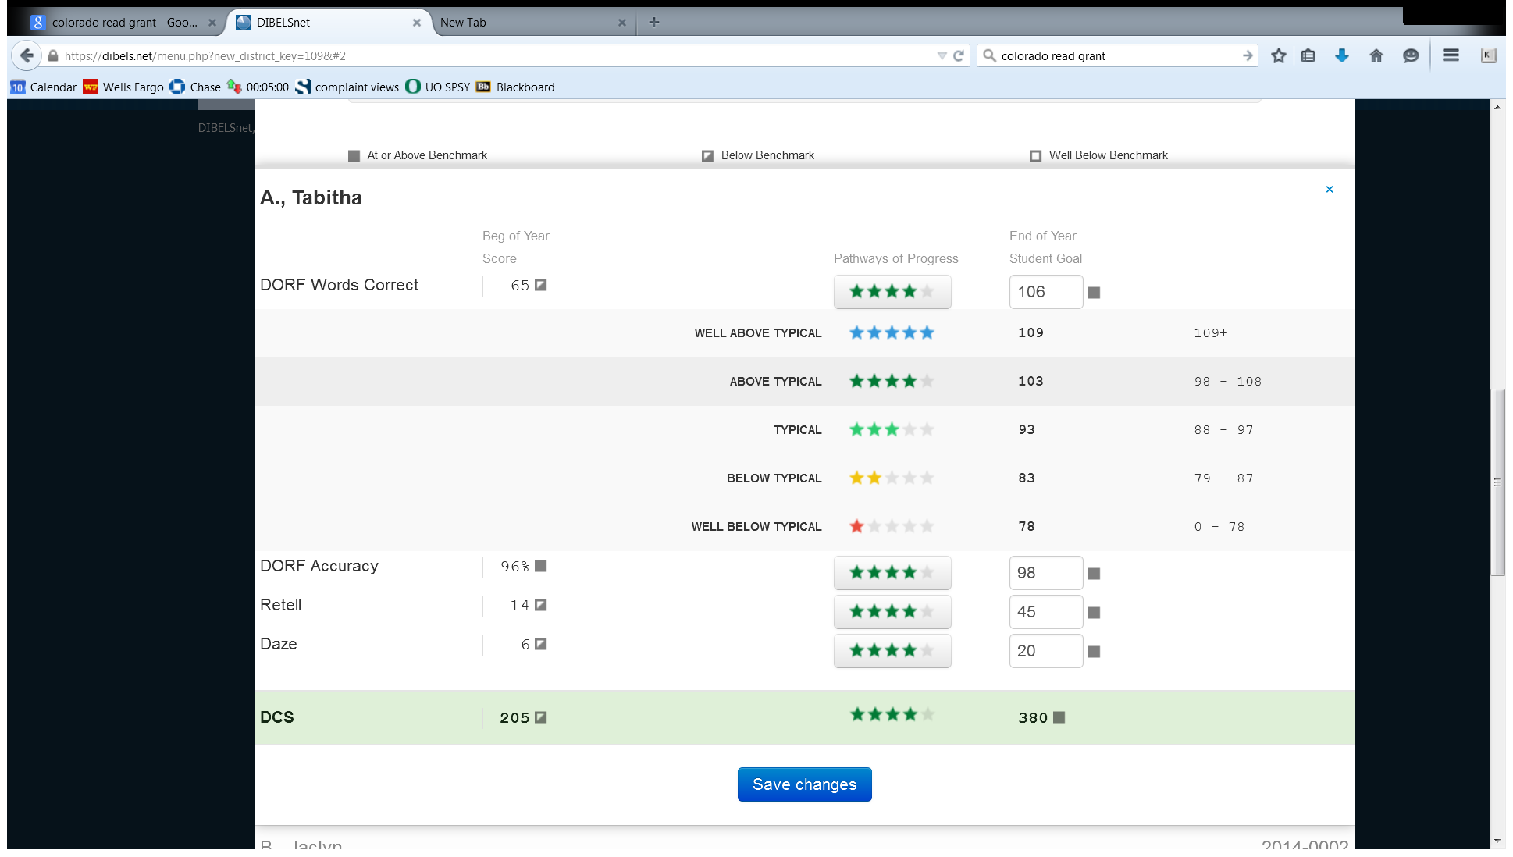
DIBELSnet® Pathways of ProgressTM
Goal Setting Utility

Slide 38
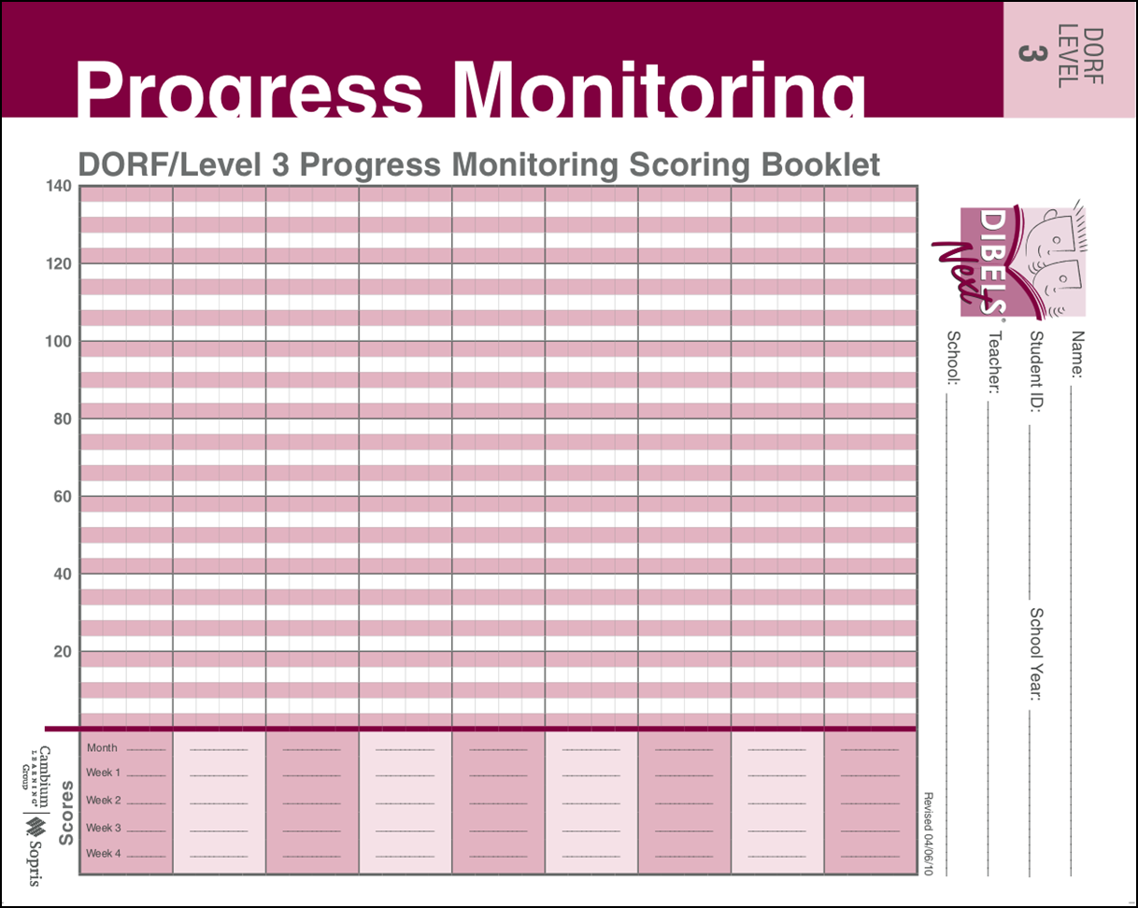




Periodic checkups on progress using grade level material.
Alistair
Well Above Typical
Above Typical
Typical
Below Typical
Well Below Typical
Sep
Oct
Nov
Dec
Jan
Feb
Mar
Apr
May
12

Slide 39
Moving Median of the 3 most recent Progress Monitoring Points:
DORF = 81, Pathway of Progress = 4.
DORF = 88, Pathway of Progress = 5.
DORF = 84, Pathway of Progress = 4.
Median Pathway of Progress = 4.
Well Above Typical
Above Typical
Typical
Below Typical
Well Below Typical
Tabitha
Moving Median of the 3 most recent Progress Monitoring Points provides a good balance of timeliness, confidence, and resources for instructional decisions. It also enable decisions about progress based on how the student is doing now.
Sep
Oct
Nov
Dec
Jan
Feb
Mar
Apr
May
71
88
65
68
84
72
74
81

Slide 40
Sometimes it’s not about reading skills; it’s about conditions or some other factor. If student performance is all over the map, it is probably not appropriate to make any statement about reading progress.
Well Above Typical
Above Typical
Typical
Below Typical
Well Below Typical
Jeremy
Sep
Oct
Nov
Dec
Jan
Feb
Mar
Apr
May
109
66
75
83
92
65
40
100
57
48
Notes:
Scatter plot PM = underlying issue (motivation, behavior, attendance)
That issue must be dealt with, instructional decisions cannot be made with scatter plot PM data

Slide 41

Changes in Intervention
If the student is not responding, ask questions:
  Was intervention implemented with fidelity?
  Was intervention evidence-based?
  Does intervention match the student’s academic skill deficit?
  Duration/frequency?
  Group size?
  Motivation?
  Attendance of interventionist/student?
  Interventionist?

Slide 42
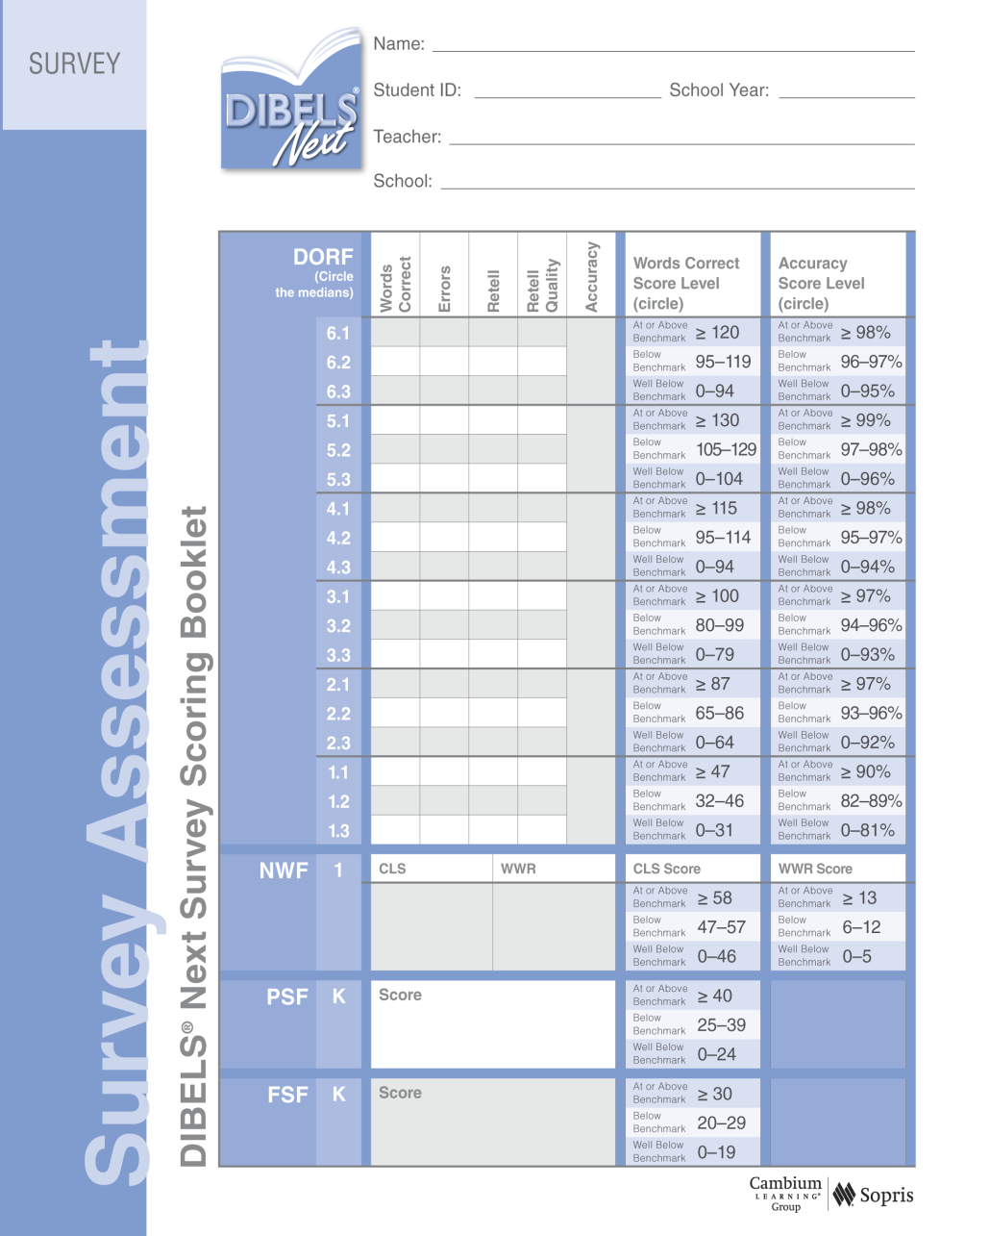
DIBELS Survey® for Alistair
Alistair – 3rd grade
24212
Ms. Harvey
Bright Elementary
Suggested Out of Level Progress Monitoring using NWF CLS and WWR
Testing began at Level 3
8
10
0
9
1
15
0
63%
10
1
18
3
1
23
3
8
1
20
5
74%
27
8
1
2
10
1
35
25
6
2
37
33
80%
41
3
3
35
3
2
Well Below Benchmark on NWF CLS and WWR
38
2
42
At or Above Benchmark on PSF

Slide 43
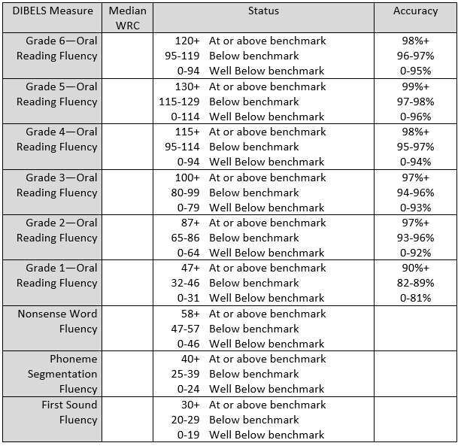
DIBELS Next Survey (off-level progress monitoring)
Notes:
Handout 8

Slide 44
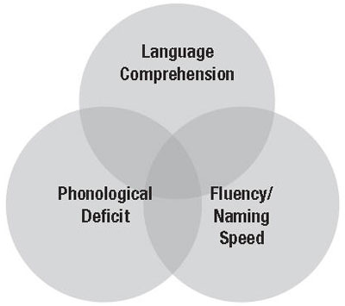
Diagram of Subtypes of Reading Disability
Decode words better than they can comprehend the meaning of passages. Reads words accurately and quickly and can spell. Weak at inferencing, working memory, and comprehension monitoring. “word callers”
Accurate but slow in word recognition and text reading. Specific weaknesses with speed of word recognition and automatic recall of word spellings, although, do relatively well on tests of phoneme awareness and other phonological skills. Difficulty developing automatic recognition of words by sight and tend to spell phonetically, but not accurately.
Difficulties with accurate and fluent word recognition that originates with weakness in phonological processing, often in combination with fluency and comprehension problems. Struggle learning sound-symbol correspondence, sounding out words, and spelling.
10% - 15%
70% - 80%
10% - 15%
Notes:
Reminder – 86% of struggling readers likely need phonics and phonemic awareness instruction

Slide 45
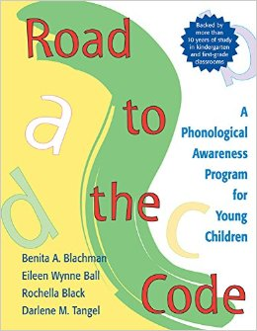
Phonemic Awareness Resources
FCRR - http://www.fcrr.org/for-educators/sca.asp
PA Curriculum - Road to the Code by Blachman, Ball, Black, and Tangel
PA Curriculum - Phonemic Awareness in Young Children by Adams, Foorman, Lundberg, Beeler
Teaching Reading Sourcebook (2nd edition) by Honig, Diamond, and Gutlohn
KPALS - http://kc.vanderbilt.edu/pals/reading-kindergarten.html
Notes:
Open links and show resources

Slide 46

Phonics Resources
FCRR - http://www.fcrr.org/for-educators/sca.asp
Explicit Phonics Lessons - http://sped.rale.k12.wv.us/Pages/phonics.html
Instructional Routine, Texts, & Game Sheets - http://csdelak5.wikispaces.com/CSD+Decodable+Database
KPALS - http://kc.vanderbilt.edu/pals/reading-kindergarten.html
PALS - http://kc.vanderbilt.edu/pals/reading.html
Great Leaps - http://www.greatleaps.com/index.php?main_page=index&cPath=1&page=Reading%20Intervention&zenid=tijbc1r67sltad27r5pgiq4tq1
ERI (Early Reading Intervention) - http://www.pearsonschool.com/index.cfm?locator=PSZu68&PMDbProgramID=13301
Teaching Reading Sourcebook (2nd edition) by Honig, Diamond, and Gutlohn

Slide 47

Fluency Resources
Achieve the Core Fluency Packets - http://achievethecore.org/category/411/ela-literacy-lessons?filter_cat=1153&sort=name
FCRR - http://www.fcrr.org/for-educators/sca.asp
Intervention Programs: Great Leaps, Six-Minute Solution, Read Naturally
Teaching Reading Sourcebook (2nd edition) by Honig, Diamond, and Gutlohn
Repeated Reading - uses repeated guided oral reading practice and immediate error correction to improve reading rate, accuracy, and comprehension. Students read short passages several times until a level of fluency that is satisfactory is reached.
Phrase-Cued Reading – teacher and students mark a passage to denote pauses and intonation demands. http://www.interventioncentral.org/academic-interventions/reading-comprehension/phrase-cued-text-lessons
Choral Reading – teacher and students read orally aloud as a group.
Echo Reading – students “echo” back what the teacher reads by mimicking pacing and inflection.
The Crazy Professor Reading Game - https://www.youtube.com/watch?v=8xFcUPQ_z_8
Peer-Assisted Learning Strategies (PALS) – pairing a strong reading and weak reader who take turns reading, re-reading, and retelling
Audiobooks with Text – high-interest, difficult text, student listens to audio while following along in book (try storyline online)
Notes:
Crazy Prof Video @ 1:20

Slide 48
Fluency Facts

Slide 49
What is Fluency?
The ability to read text quickly, accurately, and with proper expression. (The National Reading Panel, 2000)
Rapid, efficient, accurate word recognition skills that permit the reader to read with expression and construct meaning. (Pikulski & Chard, 2003)

Slide 50
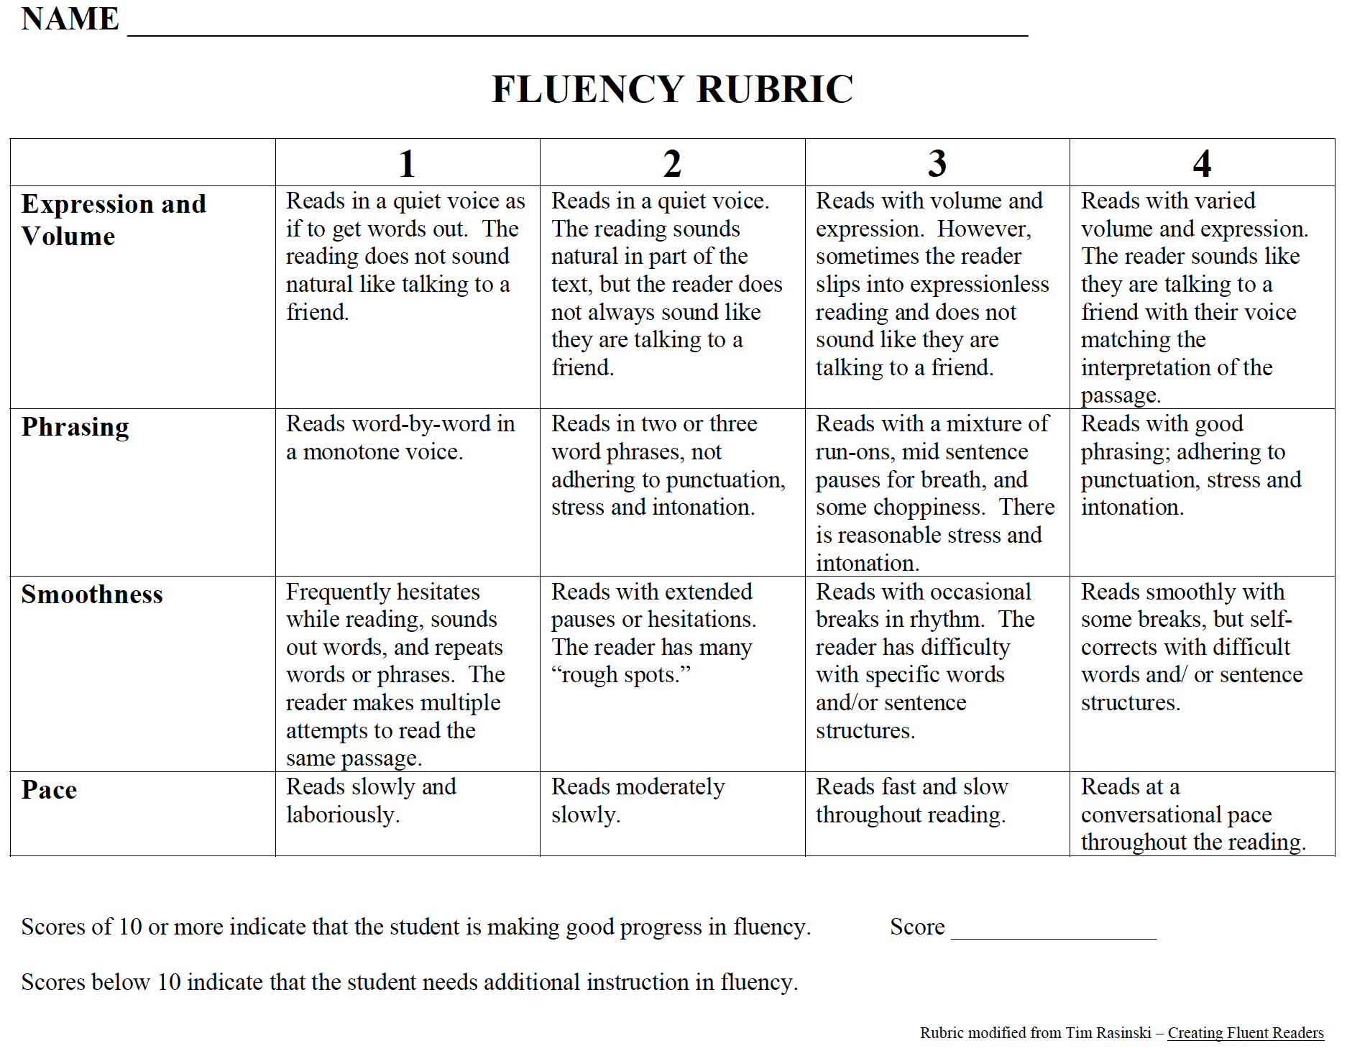
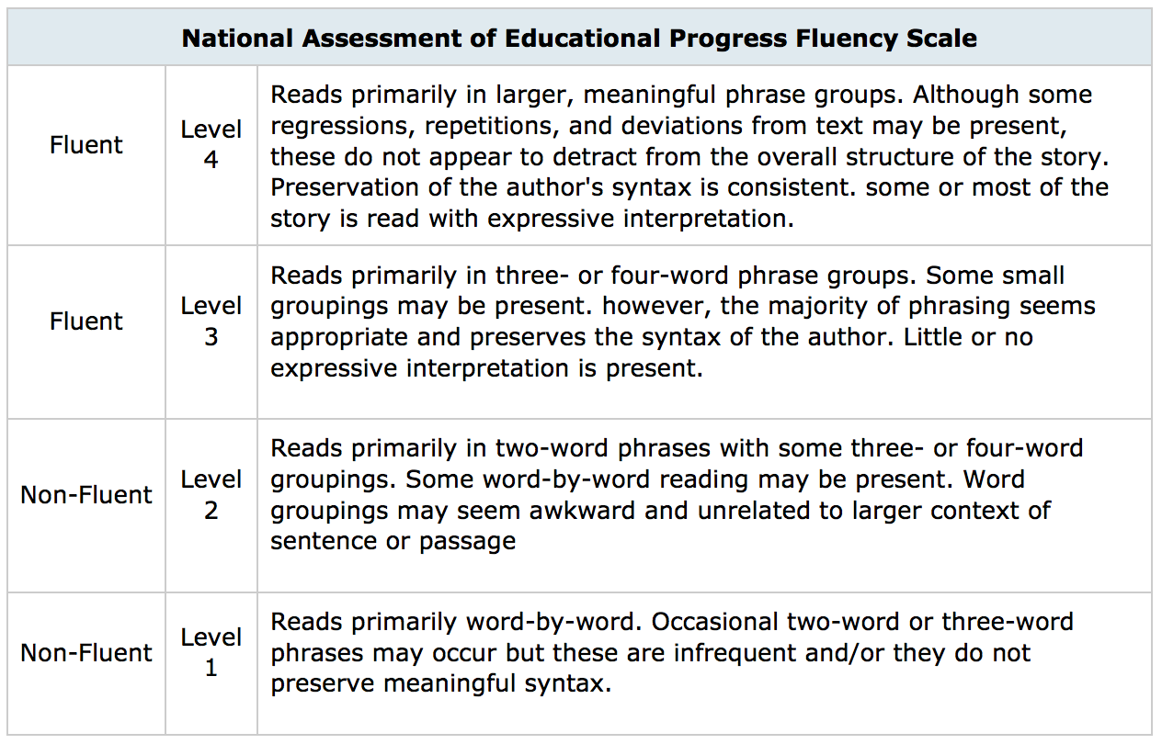
Fluency is more than accuracy and rate:

Slide 51
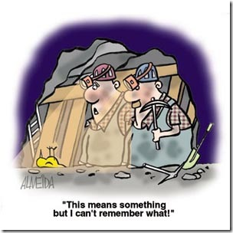
1-Minute Timed Fluency Assessments
What do they tell us?
  How are they useful?
  What do we do next?

Slide 52
Deeper Approaches to Fluency
“Through understanding that readers struggle and why they struggle, we can design appropriate instruction to support students’ developing fluency” (Denney, 2010).

Slide 53
Improving Reading Fluency
(Pikulski & Chard, 2003; Honig, Diamond & Gutlohn, 2014)
“Any instruction that focuses primarily on speed with minimal regard for meaning is wrong” (Rasinski, 2012).
Read, read, read, and read some more…WITH varied approaches, an authentic focus on comprehension, and expert teacher guidance:
  Modeled reading
  Repeated oral reading
  Wide independent reading
  Assisted reading of appropriately selected materials.

Slide 54


Slide 55
References:
Deeney, T. (2010). One-minute fluency measures: Mixed messages in assessment and instruction. The Reading Teacher, 63(6), 440-450.
Honig, B., Diamond, L., &Gutlohn, L. (2008). Teaching reading sourcebook, 2nd edition. Novato, CA: Arena Press.
National Institute of Child and Human Development (2000). Report of the National Reading Panel: Teaching Children to Read. Arlington, VA: Educational Research Service.
Pikulski, J., & Chard, D. (2005). Fluency: bridge between decoding and reading comprehension. The Reading Teacher, 58(6), 510-519.
Rasinski, T. V. (2012). Why reading fluency should be hot!. The Reading Teacher 65(8), 516-522.
Zutell, J., & Rasinski, T. V. (1991). Training teachers to attend to their students’ oral reading fluency. Theory Into Practice 30(3), 211-217.

Slide 56
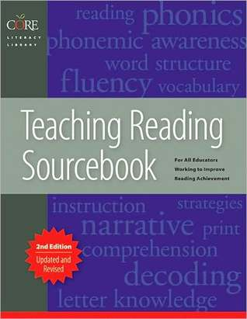
Vocabulary Resources
FCRR - http://www.fcrr.org/for-educators/sca.asp
Vocabulary Exercises - http://achievethecore.org/page/974/vocabulary-and-the-common-core
Academic Word Finder - produces a list of words that are not too common and not too rare - http://achievethecore.org/academic-word-finder/
Semantic Maps – maps or webs of words, visually display the meaning-based connections between a word and a set of related words or concepts.
Three Tiers of Vocabulary - tier one (basic vocabulary), tier two (academic vocabulary), tier three (domain-specific words)
Use Dictionary Resources
Teaching Reading Sourcebook (2nd edition) by Honig, Diamond, and Gutlohn

Slide 57

Comprehension Resources
ReadWorks.org (K-12th grade paired texts) - http://www.readworks.org/rw/k-12th-grade-paired-texts?utm_source=Email&utm_medium=Email&utm_campaign=1.13.16%20paired%20text
FCRR - http://www.fcrr.org/for-educators/sca.asp
Annotating Text
Close Reading
Repeated Reading
Questioning
Graphic organizers
Teaching Reading Sourcebook (2nd edition) by Honig, Diamond, and Gutlohn
Notes:
Don’t teach comp in silos – teach one strategy then add another, don’t wait 4-6 weeks and never say it again

Slide 58
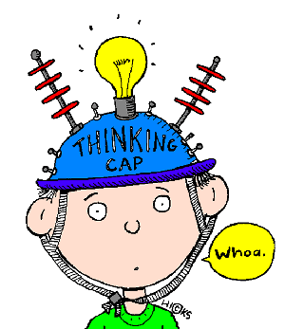
Comprehension is not a single skill
While many tend to blame comprehension issues on comprehension difficulties, most poor readers have underlying difficulties with word reading, or decoding, that negatively impacts their ability to understand what is read.
Researchers have not found a big subgroup of students who are good at decoding and poor at comprehension, except in populations of ELs.

Slide 59
ELs
ELs need more work in oral language development, vocabulary, and text comprehension than native English speakers
Recommendations:
  Build decoding skills through early, explicit, and intensive instruction in phonological awareness and phonics. *don’t get stuck on rhyming
  Offer additional opportunities for the development of in-depth vocabulary knowledge.
  Provide the strategies and knowledge necessary to comprehend challenging literary and informational texts.
  Focus instruction in reading fluency on vocabulary and increased exposure to print.
  Supply significant opportunities for students to engage in structured, academic talk.
  Ensure that independent reading in structured and purposeful, with good reader-text match.

Slide 60
-Visible Learning for Literacy by Fisher, Frey, and Hattie
-Assessing Reading: Multiple Measures (2nd Edition) by Diamond & Thorsnes
-Explicit Instruction by Archer and Hughes
Resources

Slide 61
Paired Oral Reading Using Difficult Text
A whole-class intervention for struggling readers
Lisa Trottier Brown, Utah State University
Kathleen A. J. Mohr, Utah State University
Bradley R. Wilcox, Brigham Young University
Notes:
I am excited to share a research project with you that I have led during this past school yea. This research was conducted with the third grade students in the school where I have been teaching. We have found some exciting results with Paired Oral Reading using Difficult Text.

Slide 62
What is Paired Oral Reading?
Paired oral reading is cooperative peer-assisted reading, a lead reader and an assisted reader sit side by side and read aloud from a shared text in unison.
The power of this method is in providing supported access to difficult text for struggling readers in a whole-class setting.

Slide 63
Background:
Common Core State Standards: “To build a foundation for college and career readiness, students must read widely and deeply from among a broad range of high-quality, increasingly challenging literary and informational texts” (CCSS, 2012, ELA Anchor Standards).
National Assessment of Educational Progress (NAEP) Scores:
    36% Proficient in reading in 4th grade.
    34% Proficient in reading in 8th grade.
    Approximately 25% of students assessed as below-basic proficiency. (The Nation’s Report Card, 2015)
Notes:
With the Common Core requirement of the use of increasingly complex and difficult text in the classroom to help students reach college and career readiness
along with the evidence from NAEP scores that our students are not currently meeting proficiency standards, researchers have called for investigation into the supported use of more difficult texts in the classroom. It is hoped that through using more challenging texts, our students will increase their reading performance and we will be able to raise students to the appropriate levels of proficiency.
I first became interested in this research when I attended the UCIRA conference in fall of 2014. Tim Shanahan discussed the need for research into the scaffolded use of frustration-level text in achieving greater reading growth. In his presentation, Dr. Shanahan quoted from a BYU study conducted by Morgan, Wilcox, and Eldredge using Dyad Reading with difficult text with second-grade struggling readers. Using many of the procedures from this study, we adjusted some of the assessments and included tests for additional elements. We included interim adjustments to text difficulty levels, which I will describe later, and created methods for answering additional questions through the study.

Slide 64
Challenging Text and Reading Achievement:
“Just as it’s impossible to build muscle without weight or resistance, it’s impossible to build robust reading skills without reading challenging text” (Shanahan, 2005, p. 58).
Notes:
In addition, the use of difficulty text holds promise for increasing students’ reading achievement as they work in the zone of proximal development with support from teachers, tutors, and peers (read quote).

Slide 65
Paired Oral Reading:
Paired oral reading provides a multidimensional sensory experience for struggling readers as they hear, see, and say the words in the text, improving sight recognition of words over time.
        (Eldredge, 1988, Heckelman, 1969; Stahl, 2012)
Notes:
Using paired oral reading, struggling readers are provided with a multi-sensory reading experience wherein they see the words, say the words, and hear the words. In this process, struggling readers improve their sight recognition of words that frequently appear in text and are exposed to greater amounts of exposure to these words.

Slide 66
Paired oral reading provides struggling readers:
Supported access to greater quantities of challenging reading materials.
Focus on prosody and meaning rather than decoding.
Facilitates comprehension in a collaborative context.
Positive experiences with challenging text.
(Eldredge, 1988; Fisher, Frey, & Lapp, 2008; Heckelman, 1969; Stahl, 2012)
Notes:
Several studies have examined the use of paired oral reading practice to expose struggling readers to more difficult text and scaffolding this more difficult reading in order to facilitate the development of prosody and comprehension.

Slide 67
The History of Paired Oral Reading:
  The Neurological Impress Method (NIM) was originally a clinical intervention – a child with an adult reader.
  Eldredge (1988) introduced the use of student pairs to enable the intervention to be used in a whole-class setting.
Notes:
NIM was introduced as an intervention of reading disabled students in special education settings. Lloyd Eldredge, from BYU, was the first to use this procedure with typically developing students. He adjusted the procedure to be done with student pairs in a classroom setting.

Slide 68
The History of Paired Oral Reading:
“The Neurological Impress Method (NIM), arguably one of the easiest and most cost-effective methods of developing children’s fluency, is making a comeback after a hiatus of fifteen years. Research on the effectiveness of NIM was a staple of the research literature on fluency during the 1960s through 1980s, but it inexplicably disappeared from the literature during the past decade” (Flood, Lapp, & Fisher, 2005, p. 147).
Notes:
Paired reading has a long history of research and application beginning in the 1960’s (read quote)

Slide 69
Study Purpose:
To investigate the effect of various text difficulty levels on the reading achievement of third-grade students using paired reading.
To evaluate the effect that serving as a lead reader has on reading achievement.
Notes:
The study we conducted was designed to … (Read)

Slide 70
Study Participants:
142 Third-Grade Students in Davis County, Utah
    Treatment Group: 116 students (5 classrooms)
    Control group: 26 students (1 classroom)
68 Females, 74 Males
Between 8 and 9 years old
Notes:
(read)

Slide 71
Instruments:
Scholastic Reading Inventory (SRI) Lexile score
DIBELS-DORF Beginning and mid-year assessments
DIBELS-DAZE Beginning and mid-year assessments
Multidimensional Fluency Scale (Zutell & Rasinski, 1991)
Notes:
The SRI is a research-based, computer-adaptive reading assessment for Grades K-12 that measures a student’s level of reading comprehension. SRI uses authentic passages of children’s literature and non-fictions texts for reading selections. Questions are posed in a multiple choice context and include understanding of main idea, inference, drawing conclusions, and generalization.

Slide 72
Paired Reading Setup: Strategic Partnering
Participants were assessed using the Scholastic Reading Inventory (SRI).
Students were ranked from high to low.
The classroom lists were separated at the median score.
The high scoring student was matched with the student at the top of the lower half of the list.
The higher scoring student in the pair served as the lead reader, the lower scoring student was the assisted reader.
Notes:
At the beginning of the study we assessed….

Slide 73
Difficulty Level Assignments:
Each student pair was randomly placed in one of three treatment groups.
Group A read from texts 2 grade levels above the assisted reader’s SRI Lexile.
Group B read from texts 3 grade levels above the assisted reader’s SRI Lexile.
Group C read from texts 4 grade levels above the assisted reader’s SRI Lexile.
Control Group – No paired reading.
Notes:
(Read)

Slide 74

Materials:
Classroom library, leveled using Lexile.com
Supplemental reading materials from McGraw-Hill Reading Wonders
Resource Leveled library
Notes:
(Read)

Slide 75
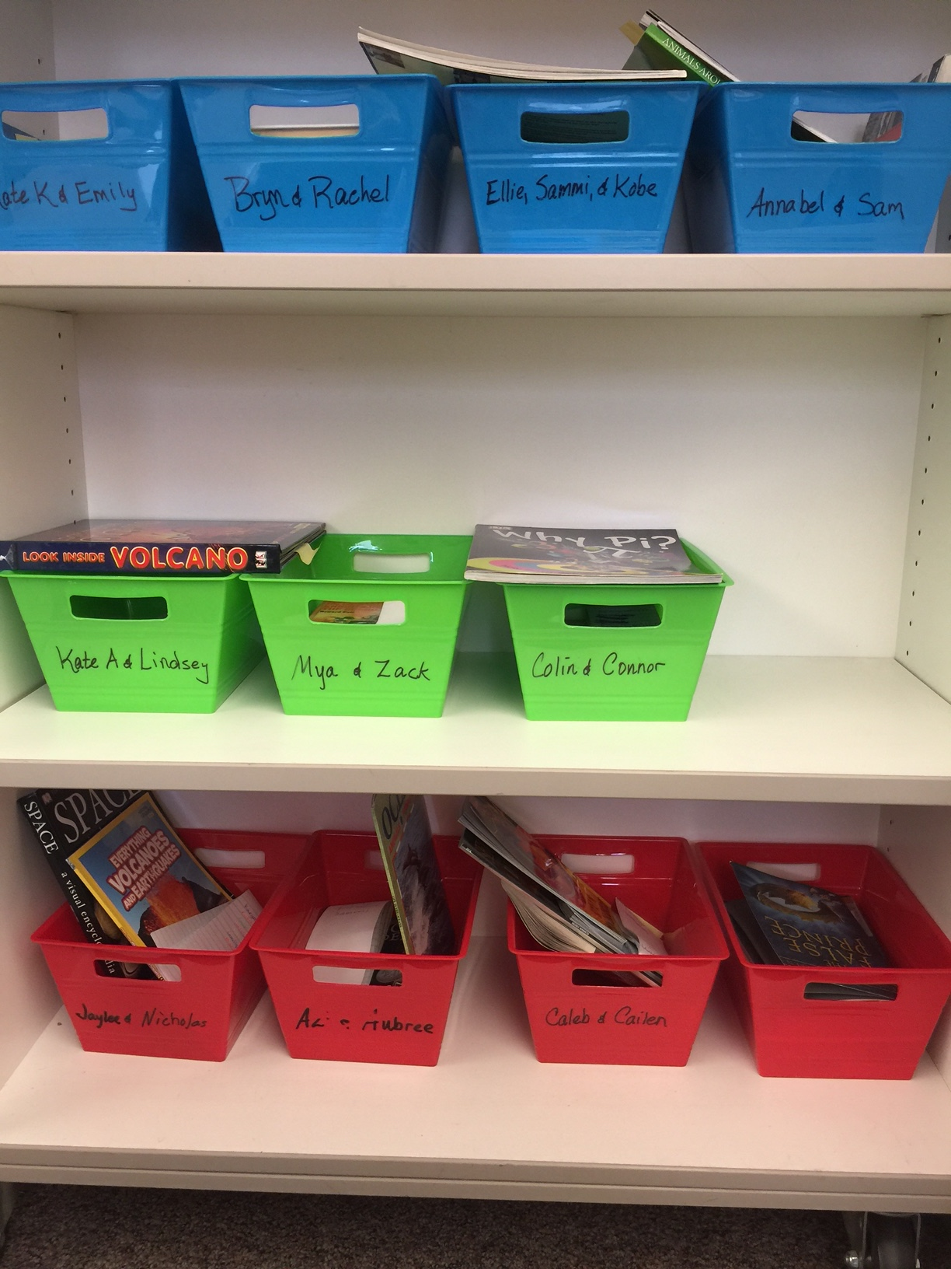
Materials:
Student pairs had their own book bins containing:
At least 3 books for students to select from.
Both fiction and nonfiction books.
A note pad to record unfamiliar words.
Notes:
(Read)

Slide 76
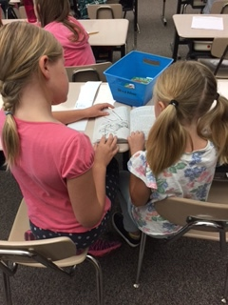
Methods:
Participants sat side-by-side using one book.
Both participants read aloud simultaneously.
The lead reader used a finger to track the words.
Pairs read 15 minutes per day for 95 sessions (Morgan, Wilcox, Eldredge, 2000).
Notes:
In dyad reading…(read)

Slide 77
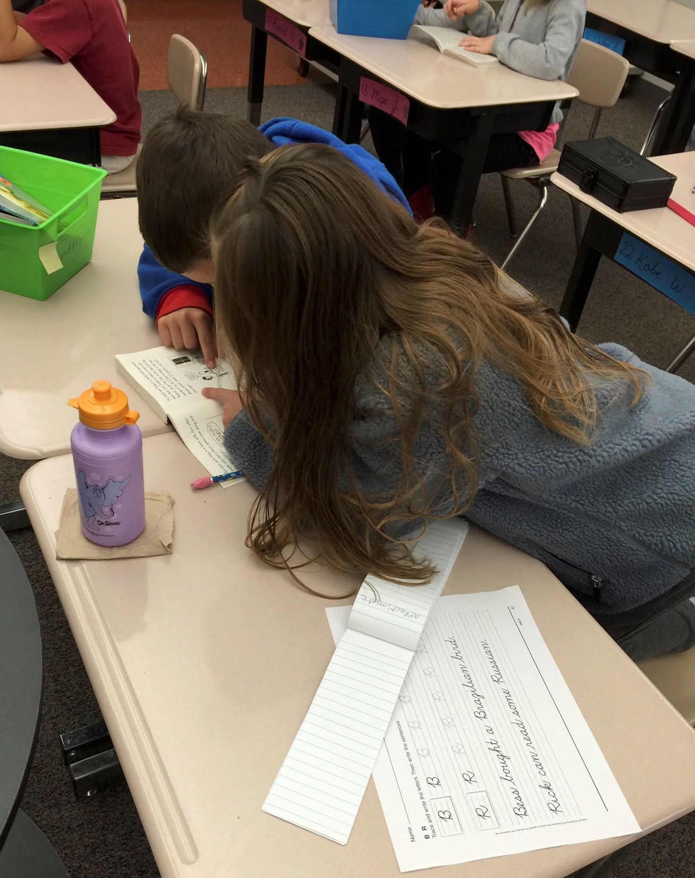
Vocabulary:
Students recorded “crazy words” encountered during reading.
After reading, students wrote their “crazy words” on the board.
The teacher modeled decoding of the words, identified roots, affixes, word families, compound words, and discussed word meanings.
Notes:
To support vocabulary…(read)

Slide 78
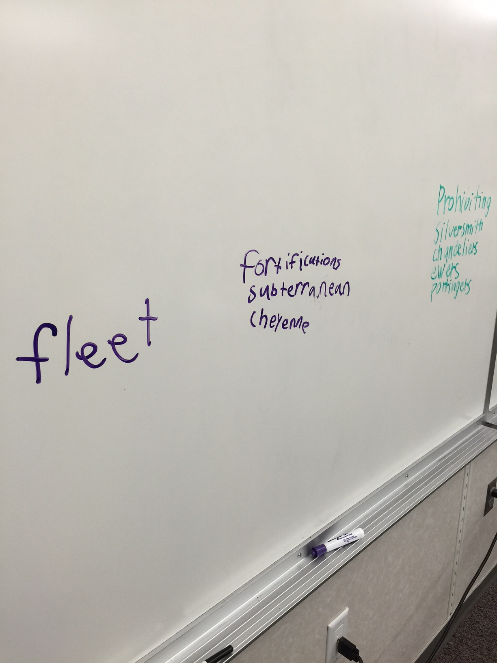
Vocabulary
  Direct, explicit vocabulary instruction has a positive impact on both immediate word learning and long-term reading comprehension
  (Baker, Simmons & Kame-enui, 1995; Beck, McKeown, & Kucan, 2002; Biemiller, 2003).
  Systematic vocabulary instruction is an essential element in closing the achievement gap for students at risk (Marzano, 2004).

Slide 79
Keeping the students challenged:
Interim assessments using the SRI were conducted at the end of each term (approximately 40 days and 80 days).
Based on the results of interim SRI Lexile scores:
  Text difficulty was adjusted to maintain the assigned text difficulty level for the assisted reader.
  Reading partners were changed.
Notes:
(read)

Slide 80
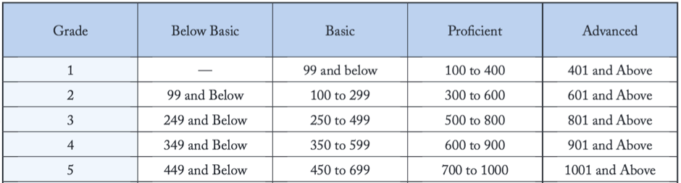
SRI Growth Expectations:
For 3rd Grade students, the average expected yearly growth is 107 Lexile points.
Notes:
For 3rd Grade students, the average expected yearly growth is 107 Lexile points.

Slide 81
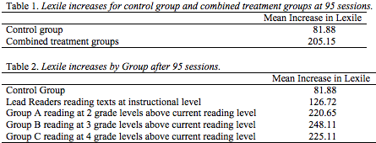
SRI Assessment – 95 Sessions:
Notes:
The 95-session assessment was approximately 3 weeks beyond the mid year point. The anticipated growth level for mid-year is 54 Lexile pionts. As you can see the combined treatment groups average increase in Lexile points was 2 ½ times greater than the control group. Looking at the individual treatment groups, Group B, reading at 3 grade levels above their current reading level experienced more than 3 times the growth as the control group. Reading texts three grade levels above a student’s current reading level produced the greatest achievement. Student reading at 4 grade levels above current level were close behind.

Slide 82
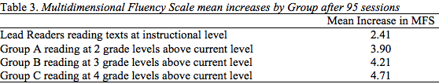
Multidimensional Fluency Scale
Notes:
Prosody, or reading with expression, showed patterns based on the level of text difficulty. The MFS is a 16 point scale. This table shows the mean increases in score for each treatment group.

Slide 83


DIBELS DORF & DAZE Assessments
Notes:
DIBELS- DORF and DAZE scores did not show patterns based on text difficulty, however, the treatment groups combined average increases were significantly greater for the combined treatment groups than for the control group.

Slide 84
Results:
Treatment groups strongly outperformed the control group on all measures.
  SRI – Struggling readers at 3 grade levels above their current level made 3 times the progress of the control group.
  MDFS - Prosody showed distinct patterns of increase based on increased difficulty of text.
  DIBELS-DORF – The treatment groups made significantly greater progress than the control group.
  DIBELS-DAZE – The treatment group made almost double the progress of the control group.
Notes:
In this study…(Read)

Slide 85
Importance of the Findings:
Daily oral reading practice appears to be effective in improving reading achievement for both lead and assisted readers.
Using difficult texts, with support through student pairing for oral reading practice, increased reading performance on all measures.
Using materials at 3 grade levels above a struggling reader’s current reading level appears to facilitate the greatest growth.
Notes:
(read)

Slide 86
Classroom Application:
Provides intervention for struggling readers in a whole-class setting.
Requires only 15 to 20 minutes per day.
Limited expense:
    Uses existing classroom materials.
    Does not require additional staff.
Paired reading has been found to be effective for English Learners. (Almaguer, 2005)
Paired reading has been found to be effective for low income students. (Klvacek, Monroe, in-process)
Notes:
(read)

Slide 87
Classroom Application:
“What a child can do in cooperation today he can do alone tomorrow. Therefore the only good kind of instruction is that which marches ahead of development and leads it” (Vygotsky, 1962, p. 104).
Notes:
(read)

Slide 88
Talk Time
Take 2 minutes to talk with a partner to summarize the partner reading with difficult text.
How might you use it in your classroom?
Note any questions that you have.

Slide 89
Selected References:
Eldredge, J. L. (1988). Improving the reading comprehension of poor readers, Reading Horizons, 29 (1), 35-42.
Fisher, D., Frey, N., & Lapp, D. (2008). Shared readings: Modeling comprehension, vocabulary, text structures, and text features for older readers. The Reading Teacher, 61(7), 548-556.
Heckelman, R. G. (1969). A neurological-impress method of remedial-reading instruction. Academic Therapy.
Morgan, A., Wilcox, B. R., Eldredge, J.L., (2000), Effect of difficulty levels on second-grade delayed readers using dyad reading, The Journal of Educational Research, 94 (2), 113-119.
Scholastic Inc. (2011). Scholastic Reading Inventory. Scholastic Inc.
Scholastic Inc. (2007). Scholastic Reading Inventory Technical Guide. New York, Scholastic Inc. Retrieved from http:// teacher.scholastic.com/ products/ sri_reading_assessmentpdfs/SRI_TechGuide.pdf
Shanahan, T. (2005). The National Reading Panel Report. Practical Advice for Teachers. Learning Point Associates/North Central Regional Educational Laboratory (NCREL).
Shanahan, T., Fisher, D., & Frey, N. (2012). The challenge of challenging text. Educational Leadership.
Stahl, K. A. D. (2012). Complex text or frustration-level text: Using shared reading to bridge the difference. The Reading Teacher, 66(1), 47–51.
Vygotsky, L. S. (1962). Thought and language. Cambridge: M.I.T. Press, Massachusetts Institute of Technology, p. 104.
Zutell, J., & Rasinski, T. V. (1991). Training teachers to attend to their students’ oral reading fluency. Theory Into Practice, 30(3), 211-217

