Slide 1
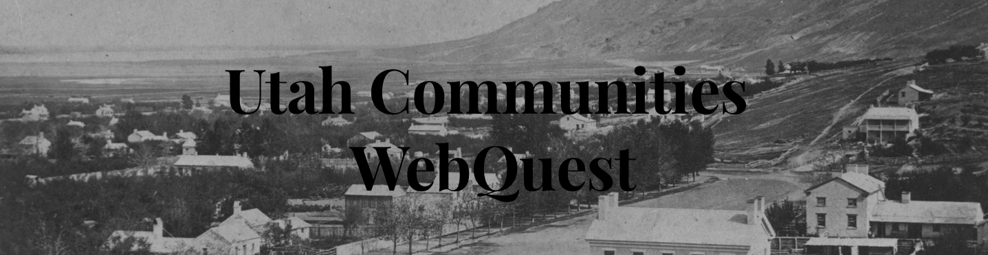

Slide 2
What is a Community?
A community may be big or small. It is a group of people living in the same place that often have something in common. A community may center around a town or an industry. Others are created around ethnicity or religion. Your family, school, neighborhood, town, and even your state are different types of communities.

Slide 3
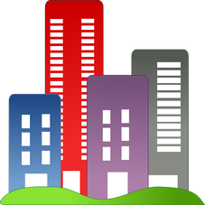

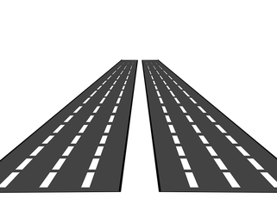

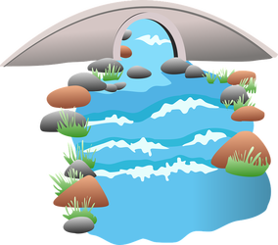
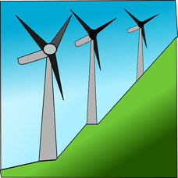
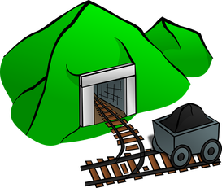
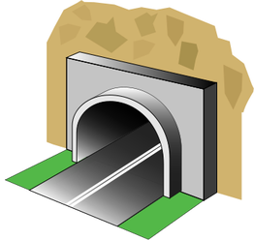
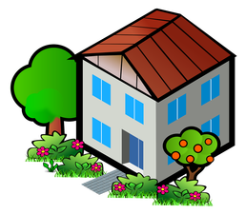
What is a Modification?
A modification is changing something about the environment to fit your needs.
Cutting down trees
Mining
Constructing Buildings
Building Tunnels
Planting Crops
Installing Windmills
Building Bridges
Building Roads
Building a House

Slide 4
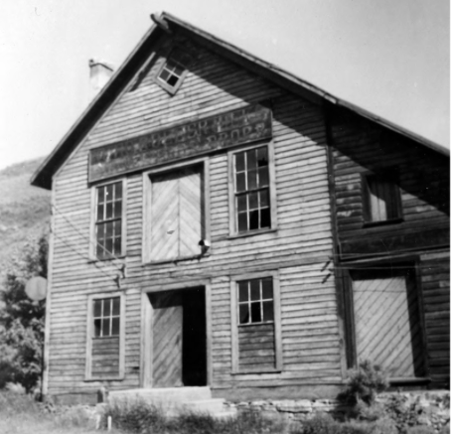
Echo, UT
Echo is a small settlement near the Weber river. It got its name because it is located at the mouth of Echo Canyon. It was settled in 1854 by James Bromley, who ran the Weber Stage Station for the Pony Express. In 1868 it became an important railroad community. It was in the perfect location because it was right between Ogden, UT and Evanston, WY. The grade was so steep between these two towns that eastbound trains would have to stop and refuel in Echo City. A coal tower and a water tower were built first and the rest of the town grew around them. The railroad supplied the jobs in town and most of the houses were owned by the Union Pacific. Kids grew up around the tracks and often played games such as basketball and marbles on the cinders. Although they played on and around the tracks, the children understood how dangerous the trains could be: moving trains would crush anything on the track; stopped trains belched out burning steam and cinders. No one was ever injured on a railroad track in Echo City. In the spring of 1960 Echo City refueled its last Union Pacific train.

Slide 5
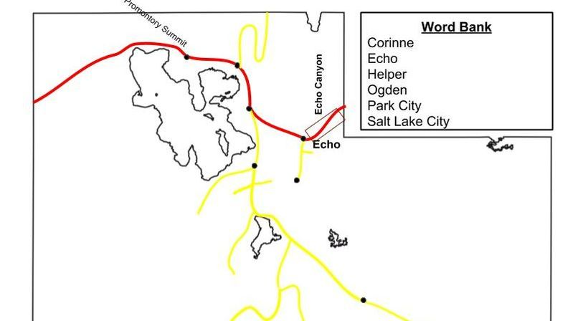

Slide 6
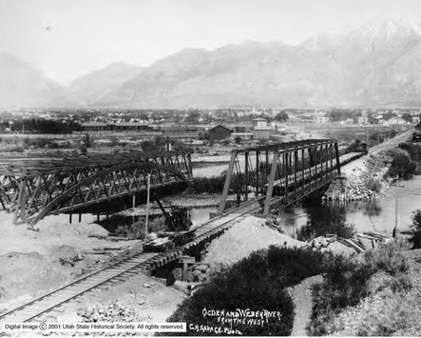
Ogden, UT
Ogden was settled in 1845 when Miles Goodyear, a mountain man, built a small picket fort. In 1847, he sold the fort and his land to a group of Mormon settlers. In 1851, the settlement was named Ogden in honor of Peter Skene Ogden, a trapper for the Hudson's Bay company.
After the transcontinental railroad was routed through Ogden, the community grew dramatically. It became a railroad town, where trains heading in all directions would stop. Ogden received the nickname "Junction City." Due to the access that the railroads provided, many industries came to the area. These included livestock yards, canneries, flour mills, breweries, iron works, banks, woolen mills, hotels, railroads, telephone, telegraph, and power companies. These jobs brought many new immigrants to the area. It also made Ogden the perfect place to build military bases that employ thousands of people. Today, Ogden is the center for the aerospace industry and is the most diverse of Utah's cities.

Slide 7
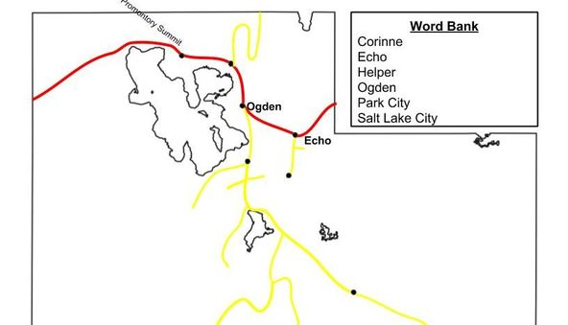

Slide 8
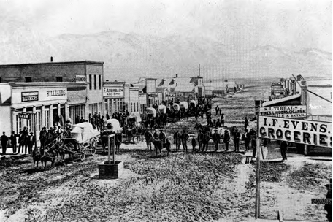
Corinne, UT
In February 1869, just a few months before the transcontinental railroad was completed at Promontory Summit, UT, the Union Pacific Railroad Company laid out the town of Corinne. In just two weeks there were 500 frame and tent buildings. Soon many businesses were up and running such as blacksmith shops, livery stables, boarding houses, hotels, an opera house, newspapers, banks, warehouses, cigar factory, saw mill, and gambling halls. Chinese railroad workers settled there and started businesses such as laundries and restaurants. In 1870, Corinne was an important place of trade. It laid at the connection of the Bear River and the railroad line. Wagons from Corinne carried goods and ore between mines in Montana and the transcontinental railroad. The founders hoped the city might become the state capital. However in 1904 the railroad company built a short cut across the Great Salt Lake, bypassing Corinne and ending the town's profitable shipping business.

Slide 9
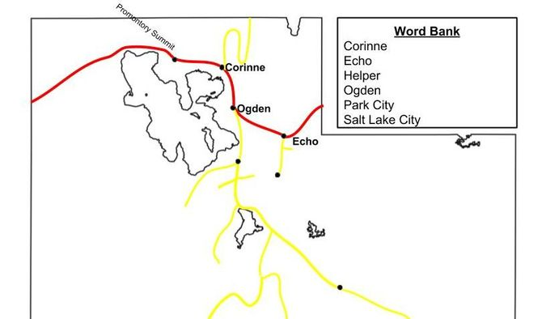

Slide 10
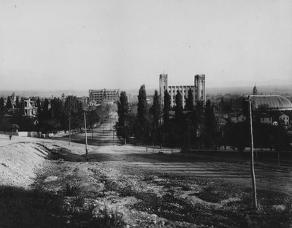
Salt Lake City, UT
Salt Lake City was settled on July 24, 1847 by Mormon settlers led by Brigham Young. They had come in search for a place where they could have the freedom to practice their religion. On the day they arrived they began to plant crops and shortly afterwards they named the town Salt Lake after the salty lake to the west.
In 1869, the transcontinental railroad was completed about 80 miles northwest of Salt Lake City. Now Utah was connected to the East and West. Within eight months after the transcontinental railroad was completed, rails connected Ogden and Salt Lake City. Salt Lake attracted tradespeople and new businesses. Many people traveled by rail to see the "City of the Saints."
Salt Lake is now a large, thriving city and the capital of Utah.

Slide 11
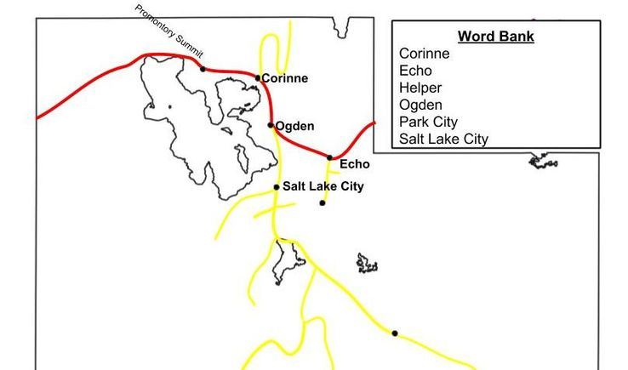

Slide 12
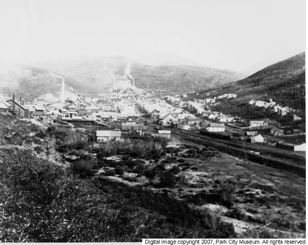
Park City, UT
Park City was founded in 1868 when soldiers from Salt Lake City went through Big Cottonwood Canyon in search of silver. They discovered silver ore there, and when the transcontinental railroad was completed, miners came to Utah in hopes of becoming rich. In 1880 the first rail line was completed in Park City, to serve the Ontario Silver Mine. By 1951 most people had left Park City because many of the mines had been shut down. Park City almost became a ghost town. However, with government assistance a ski resort was opened. The last of the ore was mined in 1982 and Park City is now known for skiing.

Slide 13
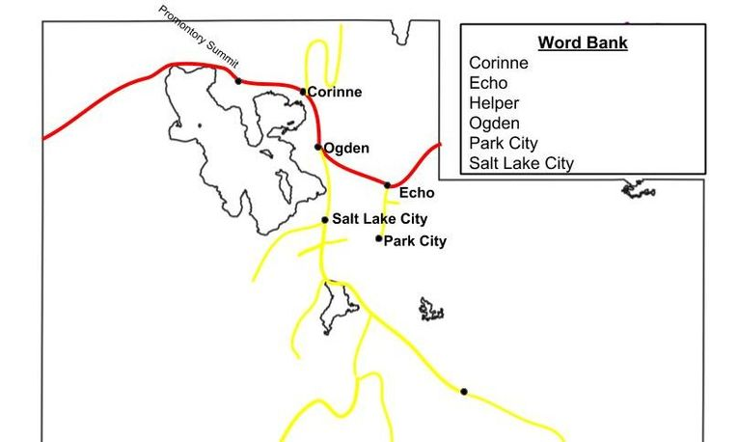

Slide 14
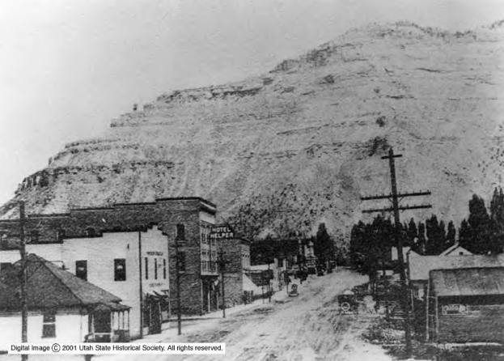
Helper, UT
In 1883, the Denver & Rio Grande Western Railroad completed its line between Salt Lake City, UT and Denver, CO. A town was created near Price where "helper" engines were available to assist heavy freight trains going up Soldier Summit in the Wasatch Mountains. These "helper" trains gave the town its name. Coal mining and railroading brought many immigrants to Helper. The present day depot replaced the original train depot in 1940. In addition to a passenger waiting room, the depot also includes Union Pacific offices.

Slide 15
