Slide 1
Blast Through the Past
Transportation
& Movement in Utah

Slide 2
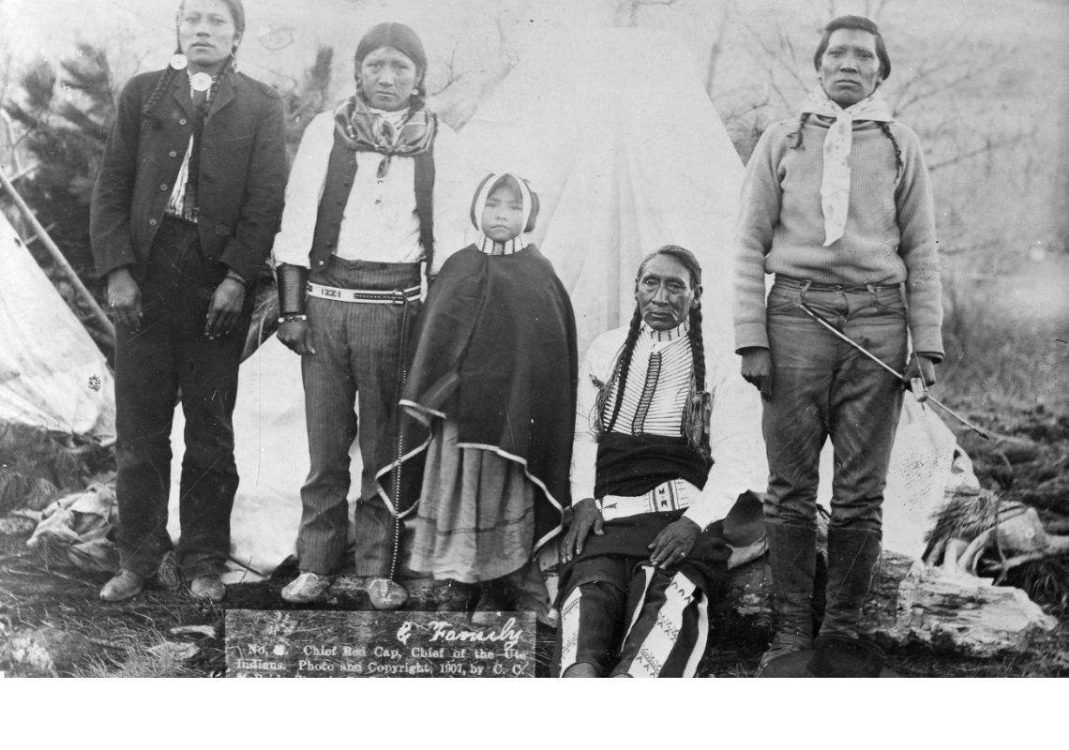
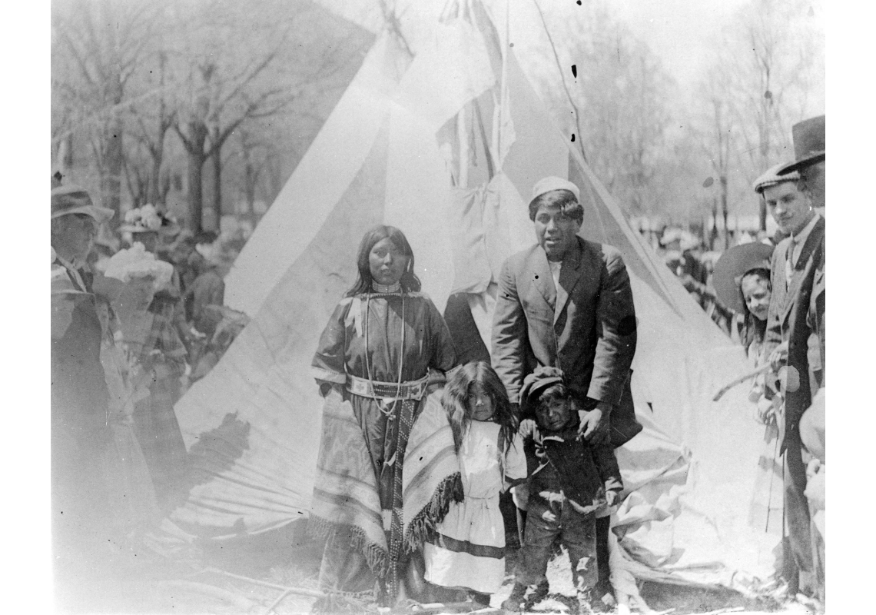
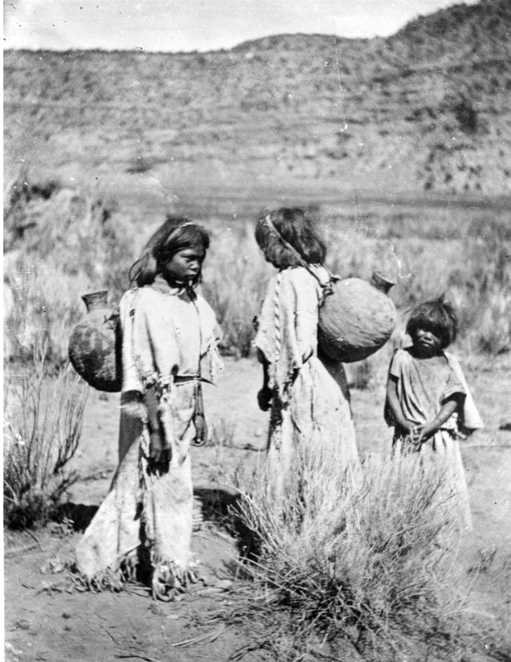
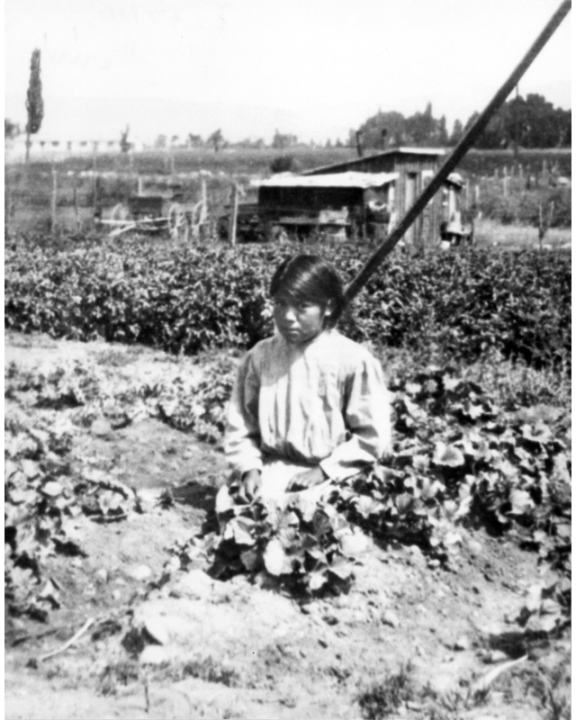
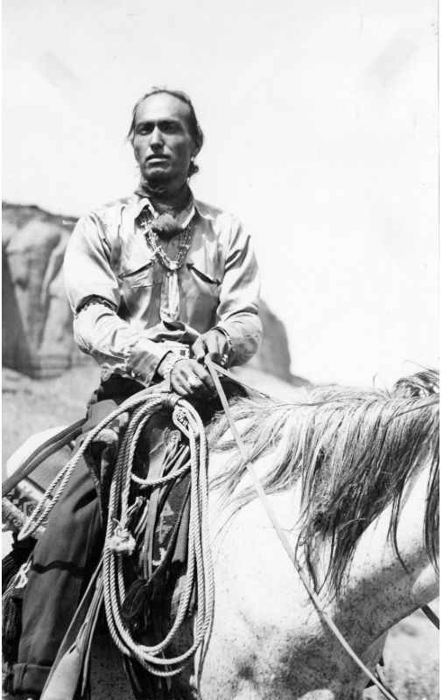
Utah’s Indigenous People
`

Slide 3
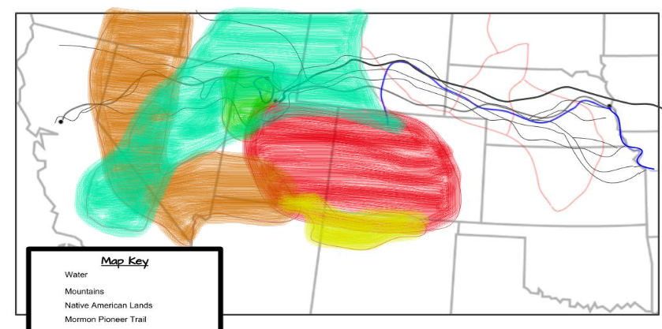
Blast Through the Past
Map Key
Ute
Paiute
Goshute
Shoshone
Navajo

Slide 4
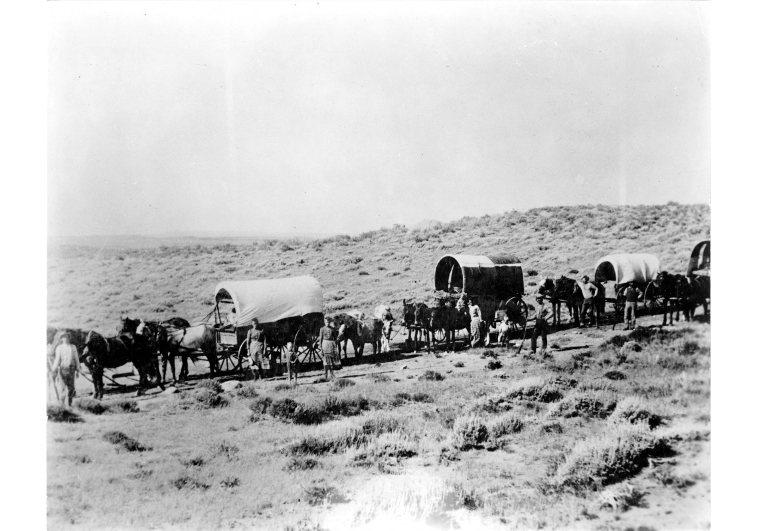
European Settlers

Slide 5
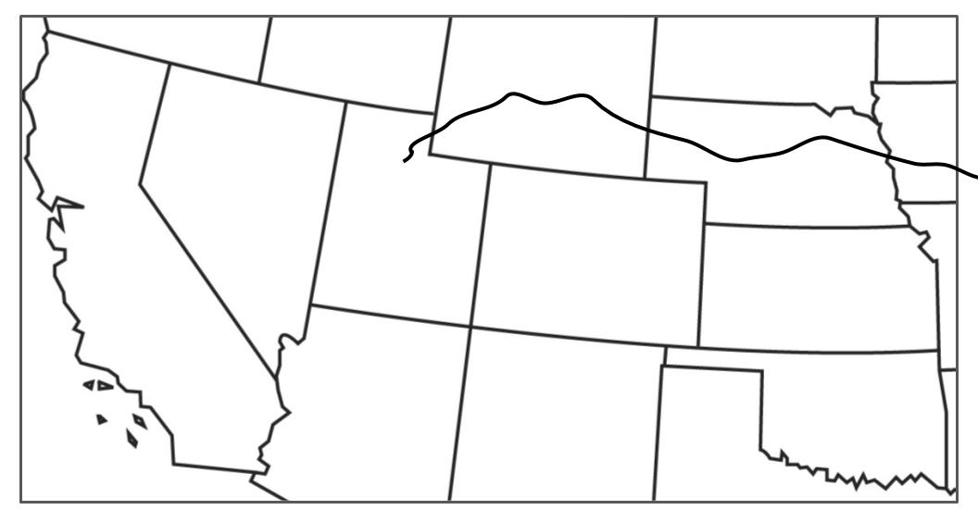
Blast Through the Past
Map Key
Water
Mountains
Mormon Pioneer Trail
Transcontinental Railroad

Slide 6
Blast Through the Past
Great Salt Lake
Platte River
Great Salt Lake
Map Key
Water
Mountains
Mormon Pioneer Trail
Transcontinental Railroad
Platte River

Slide 7
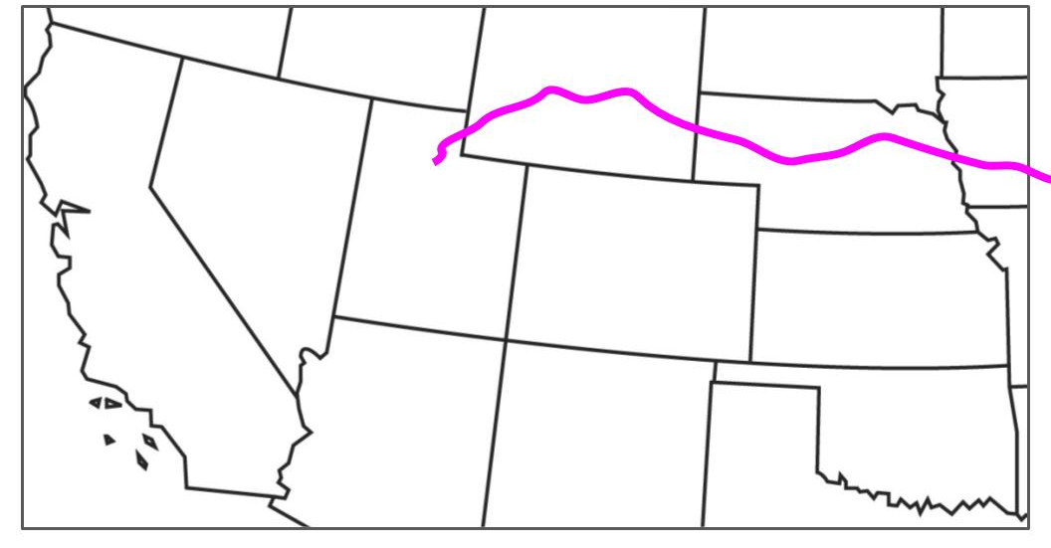

Blast Through the Past
Great Salt Lake
SLC, UT
Sierra Nevadas
Platte River
Rocky Mtns
Map Key
Water
Mountains
Mormon Pioneer Trail
Transcontinental Railroad
Mountains

Slide 8
Blast Through the Past
SLC, UT
Platte River
Rocky Mtns
Map Key
Water
Mountains
Mormon Pioneer Trail
Transcontinental Railroad
SLC, UT

Slide 9
Blast Through the Past
Great Salt Lake
SLC, UT
Omaha, NE
Platte River
Rocky Mtns
Map Key
Water
Mountains
Mormon Pioneer Trail
Transcontinental Railroad Red = Union Pacific
Omaha, NE
Union Pacific Railroad

Slide 10
Blast Through the Past
Great Salt Lake
SLC, UT
Sacramento, CA
Omaha, NE
Platte River
Rocky Mtns
Map Key
Water
Mountains
Mormon Pioneer Trail
Transcontinental Railroad Green = Central Pacific,
Red = Union Pacific
Sacramento, CA
Central Pacific Railroad

Slide 11
Blast Through the Past
Promontory, UT
Great Salt Lake
SLC, UT
Sacramento, CA
Omaha, NE
Sierra Nevadas
Platte River
Rocky Mtns
Map Key
Water
Mountains
Mormon Pioneer Trail
Transcontinental Railroad
Promontory, UT

Slide 12
Eggs for Sale!
To Chicago →
SLC
Draper
Omaha, NE
San Francisco, CA
Denver, CO
Map Key
Water
Mountains
Mormon Pioneer Trail
Transcontinental Railroad

