Slide 1
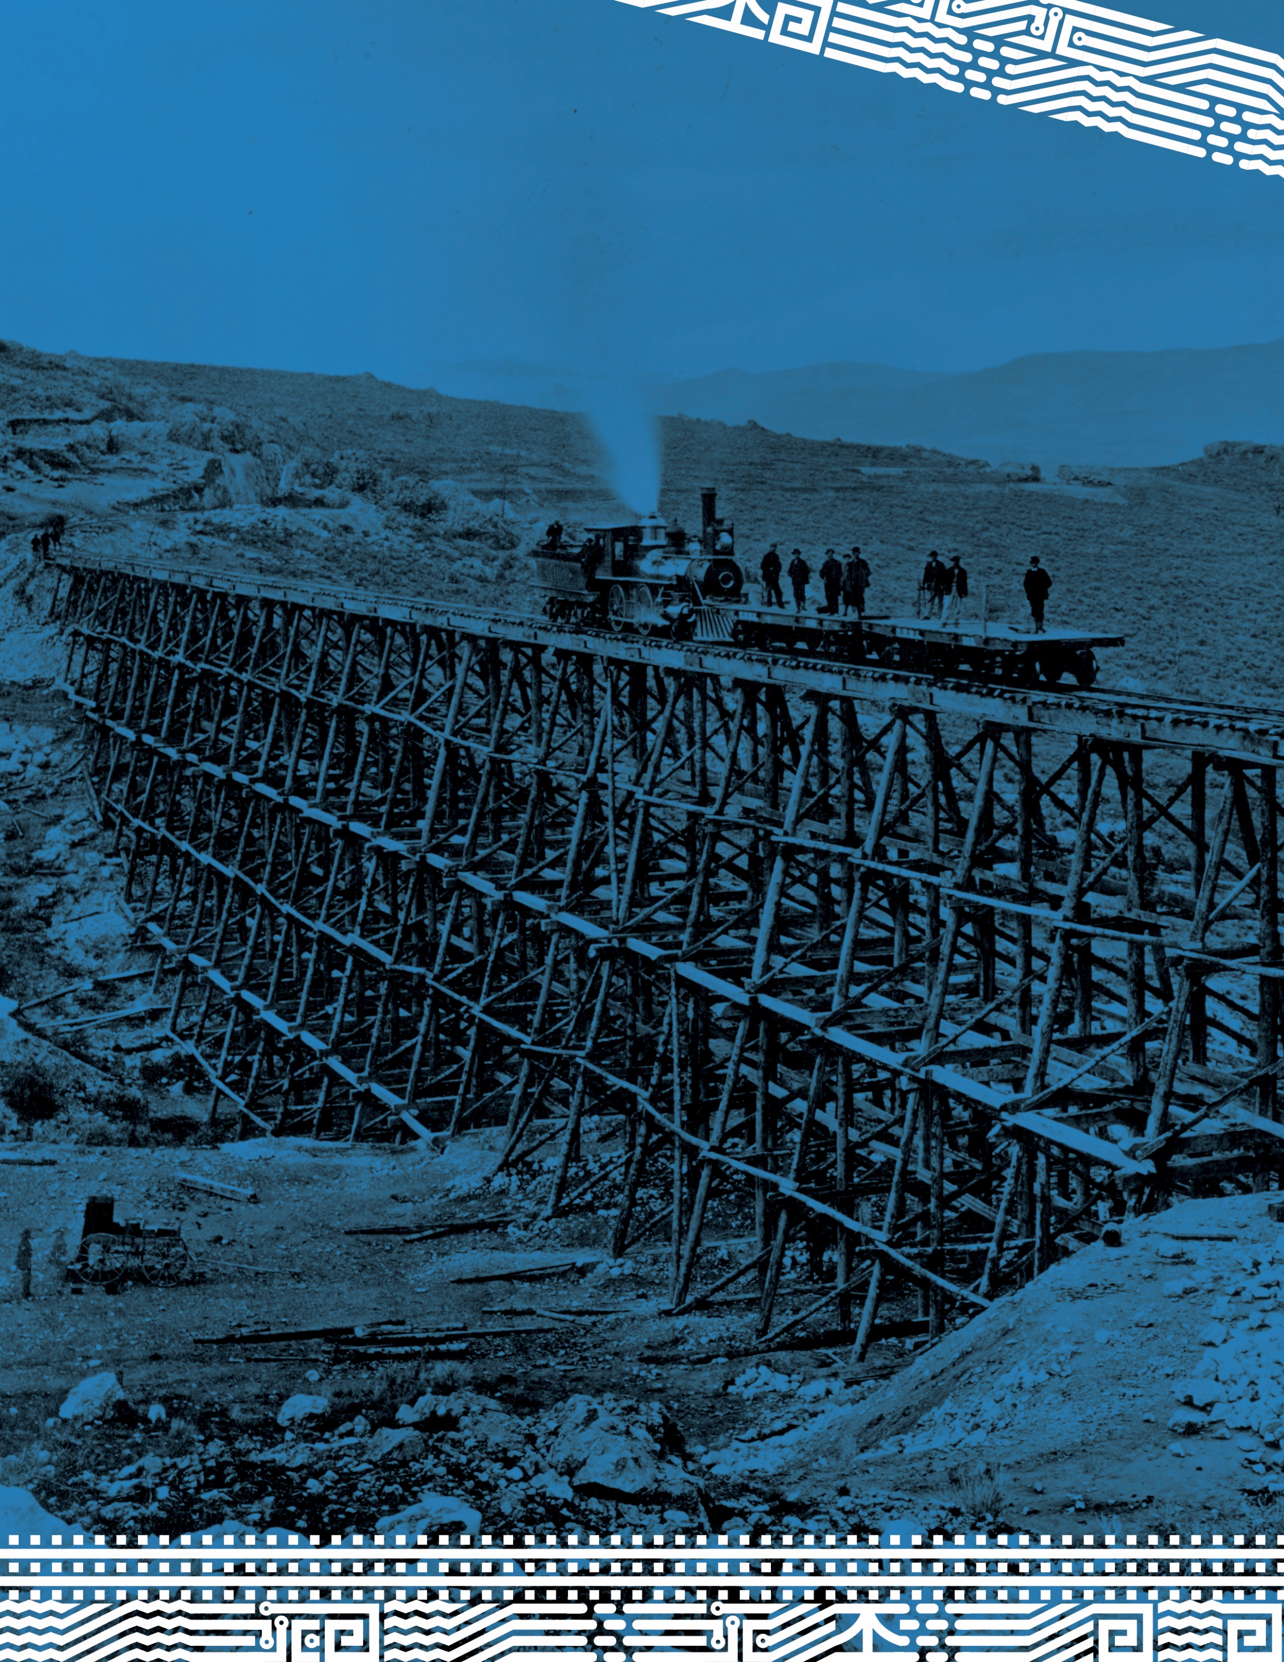
Chinese Workers on the Transcontinental Railroad
Historic Photographs
& Artifacts

Slide 2
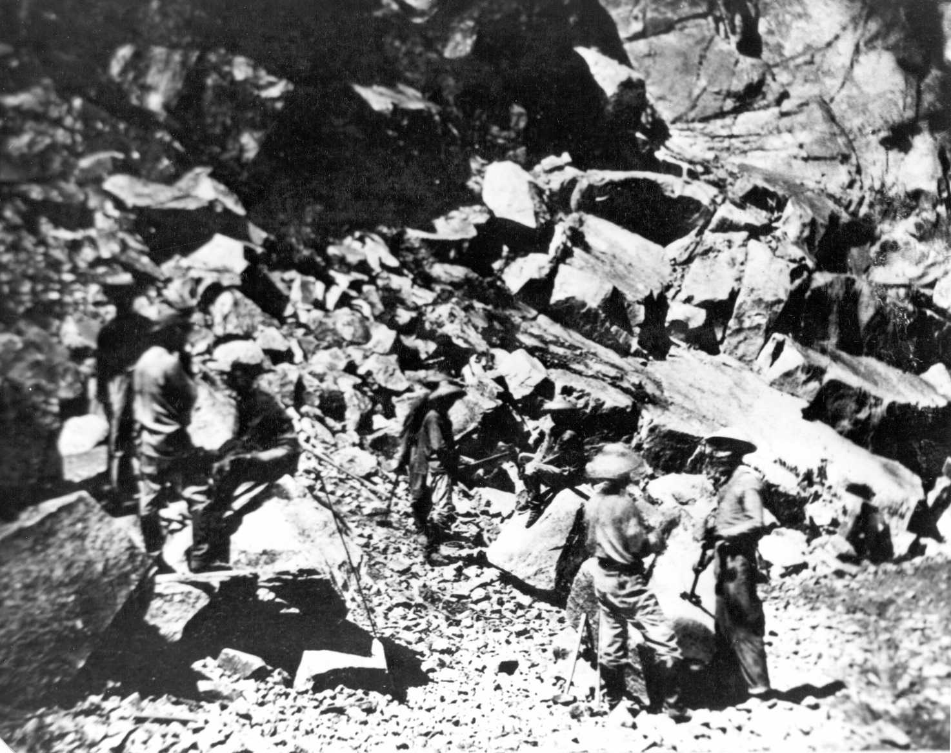
Chinese workers / laborers working near the entrance to the Summit Tunnel, Sierra Nevada Mountains, in 1867. This was 105 1/4 miles from Sacramento. Photograph taken by official Central Pacific photographer Alfred A. Hart of Sacramento. Southern Pacific Photo X109. Gift of: Southern Pacific Railroad Company. Courtesy Utah State Historical Society. https://collections.lib.utah.edu/ark:/87278/s6ft8jvp

Slide 3
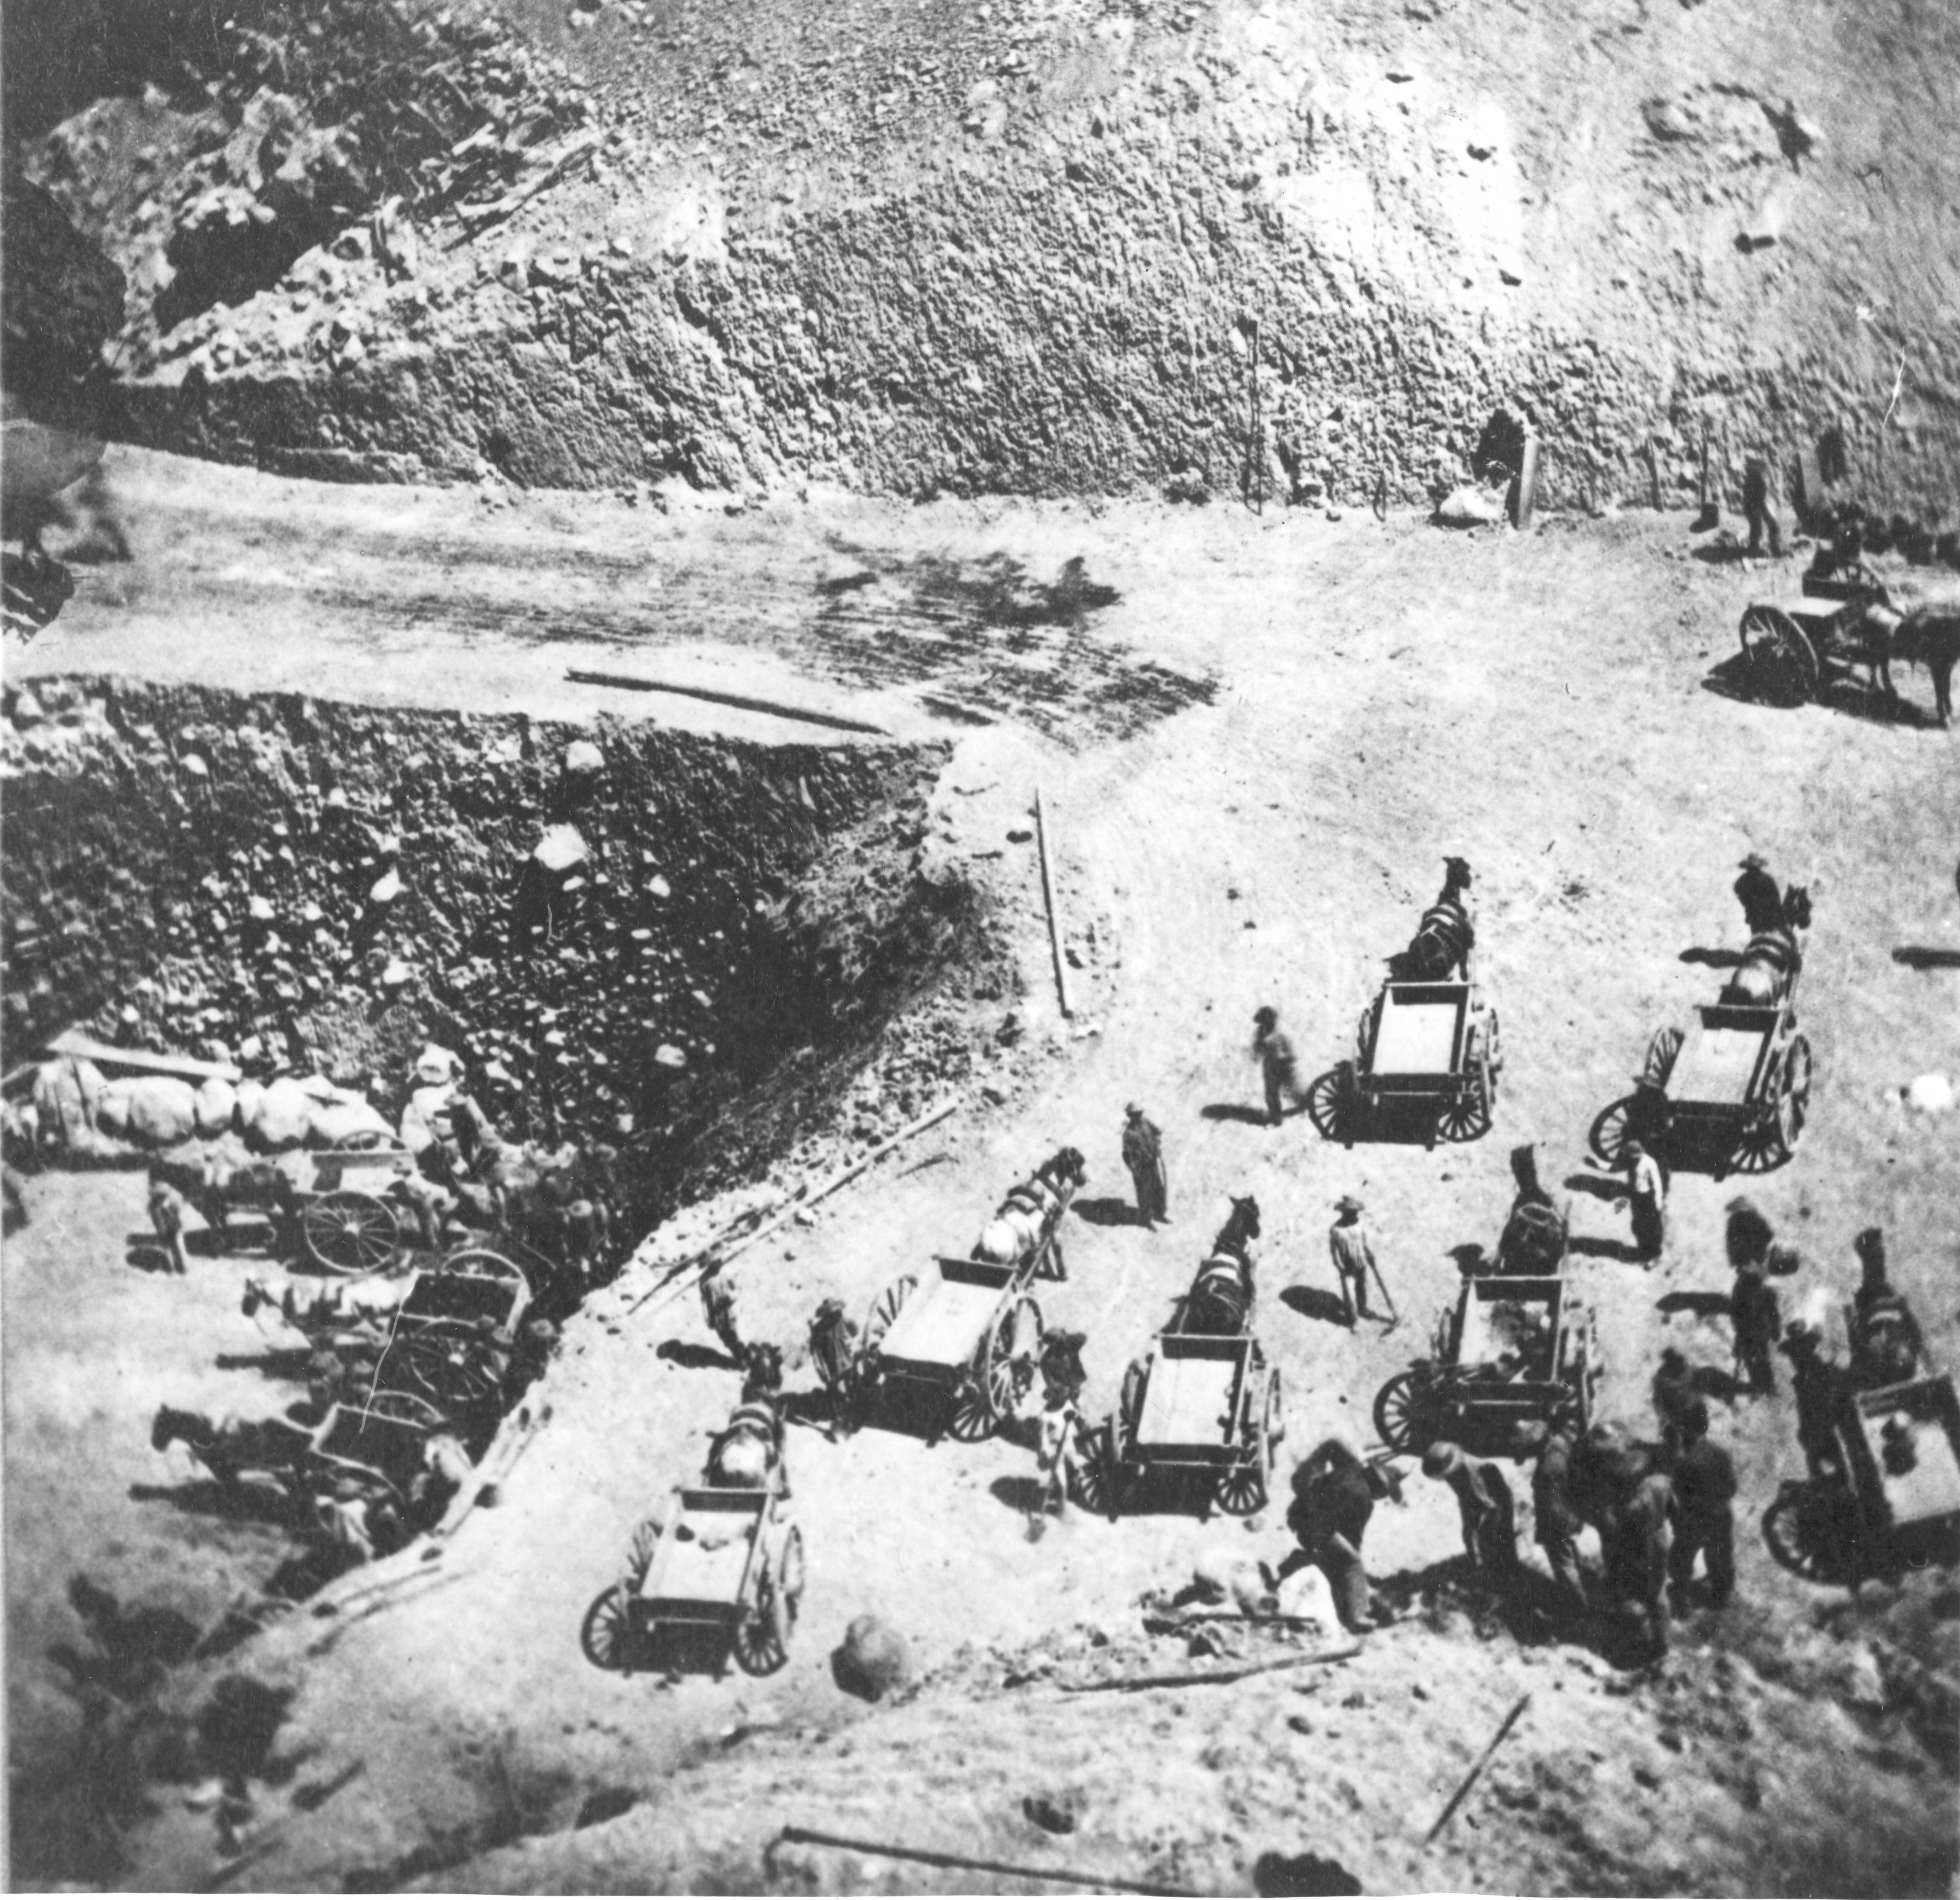
Chinese laborers / workers with one-horse dump carts building a grade for the Central Pacific at Prospect Hill Cut, 75 miles from Sacramento, where construction started. Photograph taken by official Central Pacific photographer: Alfred A. Hart of Sacramento. Southern Pacific Photo X167. Courtesy Utah State Historical Society. https://collections.lib.utah.edu/ark:/87278/s64n0md4

Slide 4
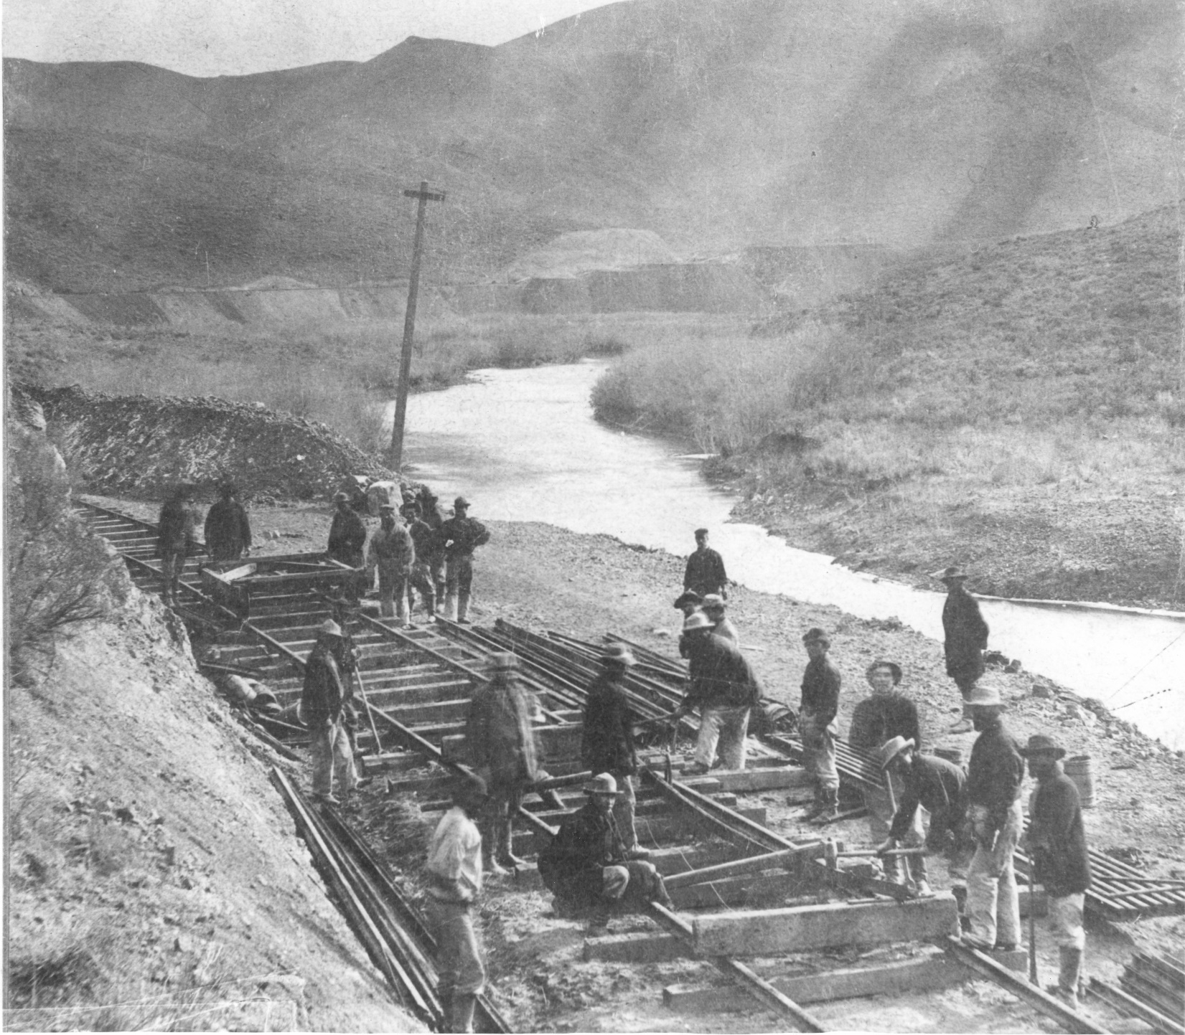
A Chinese gang curving iron rail in 12-mile Canyon (also known as Palisade Canyon), Nevada, during construction of the Central Pacific Railroad (now Southern Pacific Railroad) in 1868. To curve rail, two rails were placed on the track about 25 feet apart. A rail was laid on its side and six men stood on it. A man with a heavy hammer would start at one end of the rail. As each of the men stepped off in succession, he would strike the hammer, moving gradually down to the other end. The weight of the men gave spring to the rail in this curving method. After the rail was bent, it was placed on its base and curvature tested with chord. It was hammered, as necessary, to even the curve. For curves of four degrees or less, no attempt was made to curve the rail before laying, as sufficient curvature could be induced in lining up the track. 435 miles from Sacramento. Photograph taken by official Central Pacific photographer: Alfred A. Hart of Sacramento. Southern Pacific Photo X156. Courtesy Utah State Historical Society. https://collections.lib.utah.edu/ark:/87278/s6qg08m7

Slide 5
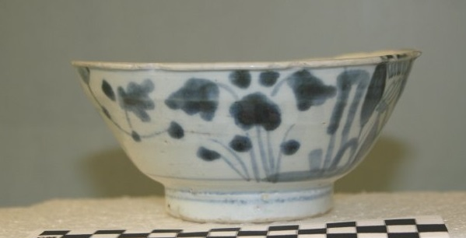
Artifact A. “Bamboo” Style Bowl
Notes:
This was the worker’s most common style bowl during the construction of the railroad as it was both durable and cheap. The bowl is made from a thick porcelain, and was decorated by a blue hand-painted pattern that reflects shoots and flowers of Bamboo. The worker would have used this bowl as their main eating dish for breakfast, lunch and dinner. Some even had the workers’ initials scratched into the bottom.

Slide 6
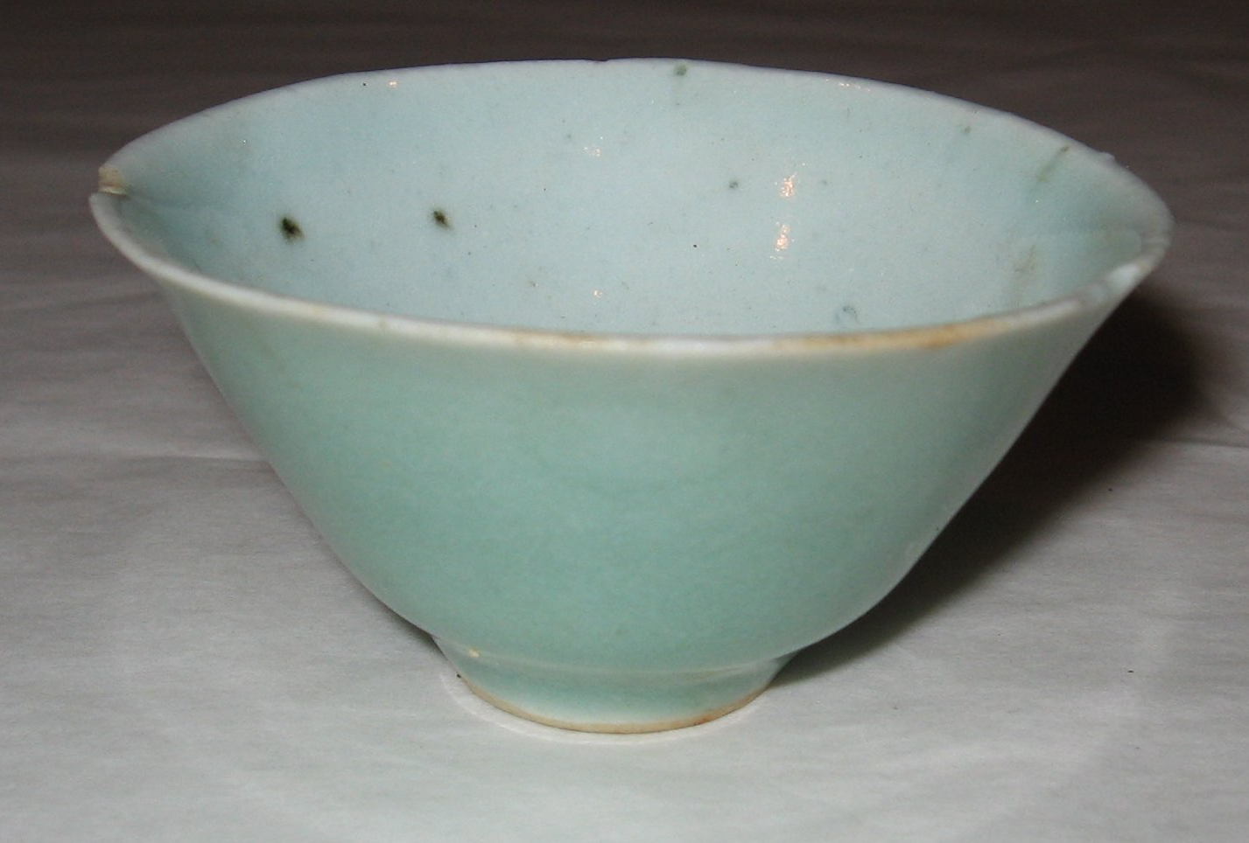
Artifact B. “Celadon” or “Wintergreen” Style Bowl
Notes:
This common style is named for the greenish blue glaze on the outside of the objects. Celadon style is made to look like the types of objects that the Emperor would have had in their palace, but was cheaper and made for the common person to own. Unlike the “bamboo” style bowl, celadon appears as many different types of objects such as bowls, cups, saucers, and even spoons. This ceramic was nicer and more expensive than the bamboo pattern, but was still common on railroad worker sites.

Slide 7
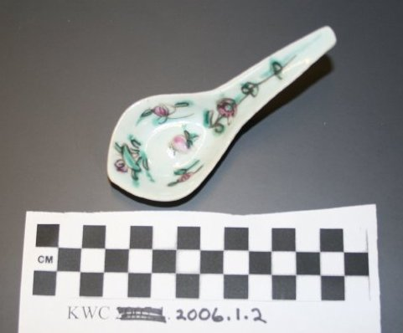
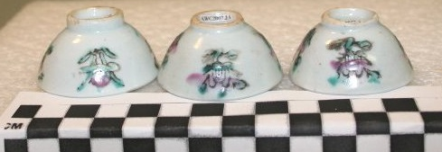
Artifact C. “Four Flowers” or “Four Seasons” Style Spoon and Bowls
Notes:
This style is the most decorative and colorful of the ceramics that Chinese railroad workers owned. Similar to the “celadon” vessel, this pattern came in a variety of forms such as spoons, tea cups, plates, bowls, and others. Each of the four different flowers represent different seasons. These flowers are Plum Blossom (Winter), Orchid (Spring), Bamboo (Summer), and Chrysanthemums (Fall).

Slide 8
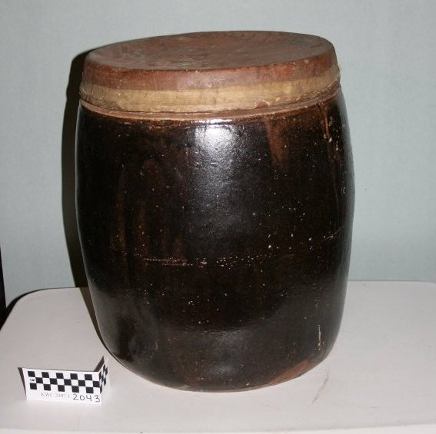
Artifact D. Brown-Glazed Stoneware Barrel Jar
Notes:
Chinese storage jars are generally a brown-glazed stoneware that can come in a variety of shapes and sizes depending on what the vessel originally held. Like most immigrants, Chinese railroad workers in the U.S. continued to eat the foods they were accustomed to. To do this they imported many types of foods and spices directly from China. This large jar was about the size of a 5-gallon bucket. It likely held pickled vegetables or eggs, dried foods, rice, or sugar.

Slide 9
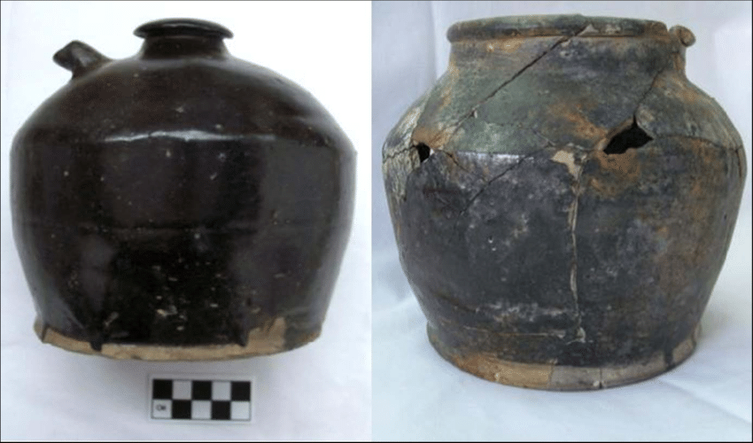
Artifact E. Spouted Jar
Notes:
While this small jar looks like a teapot, it is actually a container for soy sauce, vinegar, or vegetable oil. These three condiments are important in Chinese cooking, just like cooking oil and ketchup are for many American families. The top of the jar was sealed with a cork and a clay stopper to prevent it from leaking. Oftentimes Chinese workers would re-use this jar after it was emptied to hold water, oil, or even as a tea pot.

Slide 10
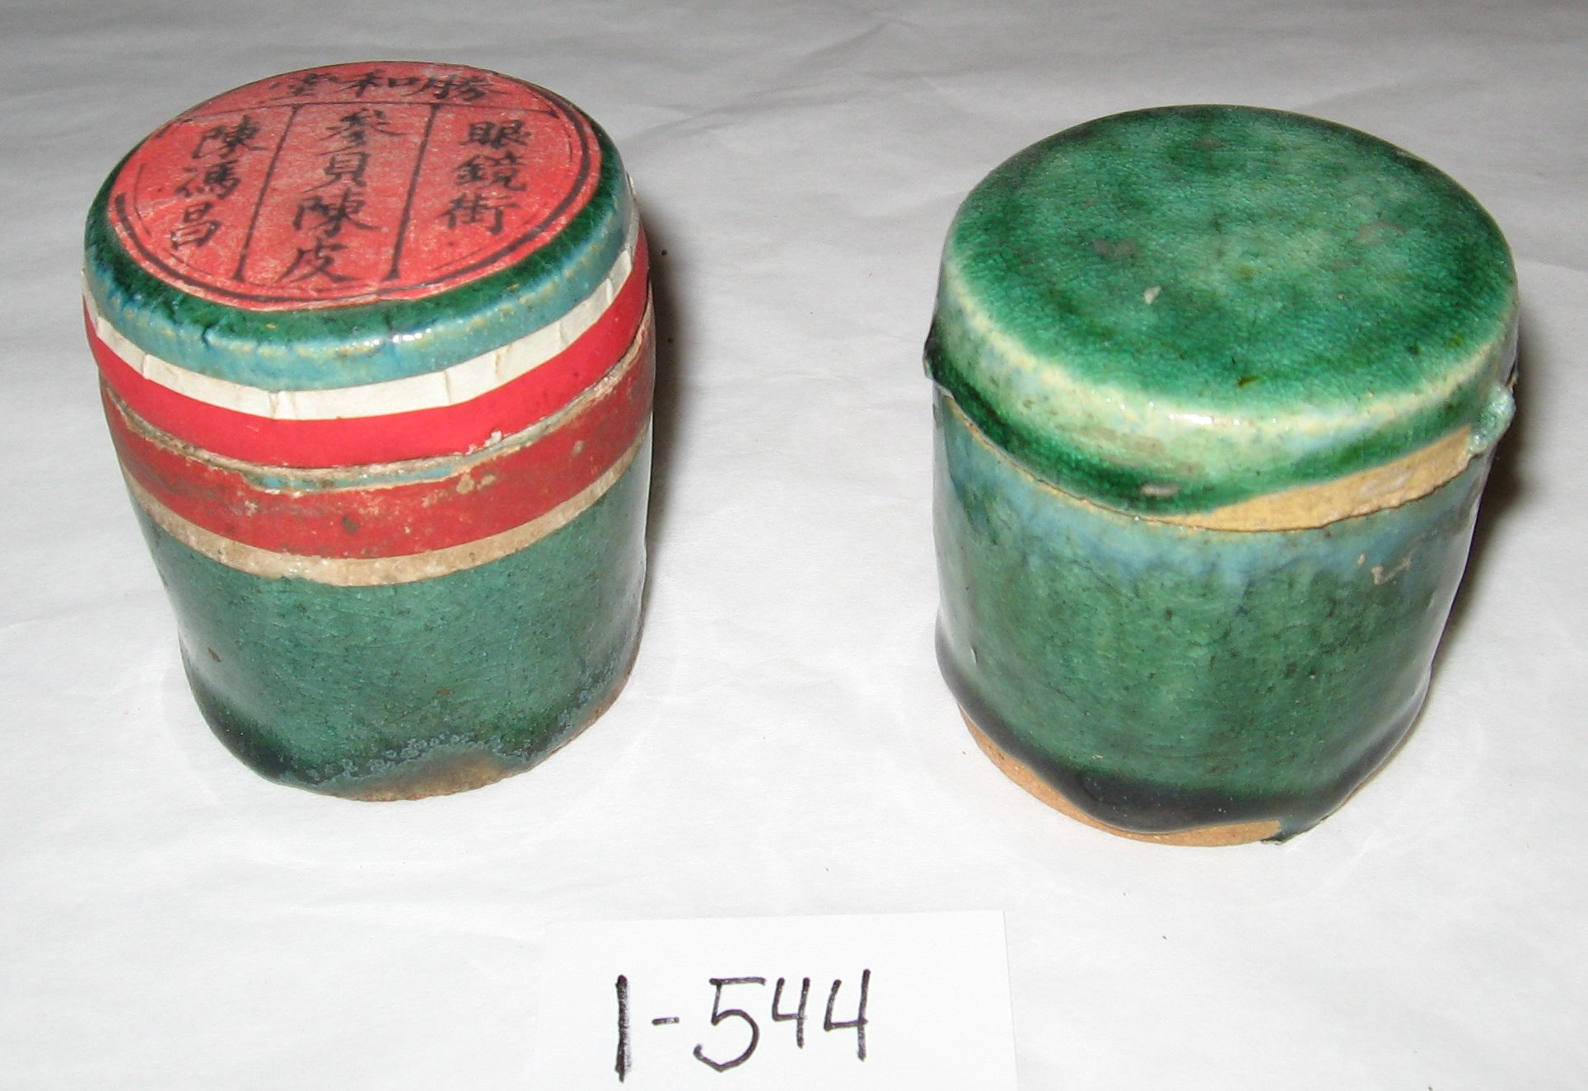
Artifact F. Spice Jars
Notes:
This stoneware jar and lid, covered in a rich green glaze, held dried, candied, or powdered spices, such as citrus or ginger root. Ginger root is a main flavoring in many Chinese dishes, and is an important part of Chinese cooking. Ginger is also used as a treatment for stomachache. The red label reads “dried orange peel.”

Slide 11
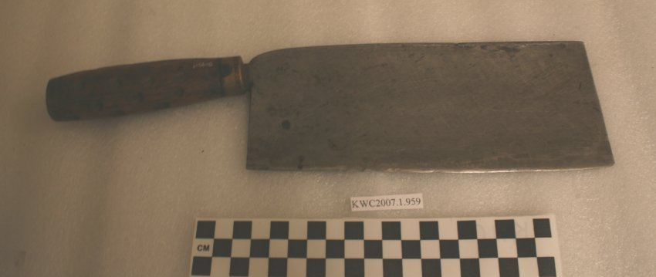
Artifact G. Cleaver
Notes:
Chinese railroad workers used tools similar to those of their non-Chinese neighbors. At many Chinese worker camps pieces of knives are found near trash dumps and cookhouses. This cleaver (da dao) was used for slicing, dicing, and light-duty chopping. Cooks cut ingredients into bite-sized pieces according to the style of foodways from southern China. The Chinese cleaver has a long, square shaped steel blade and short wooden handle, where American styles have a shorter and more curved blade.

Slide 12
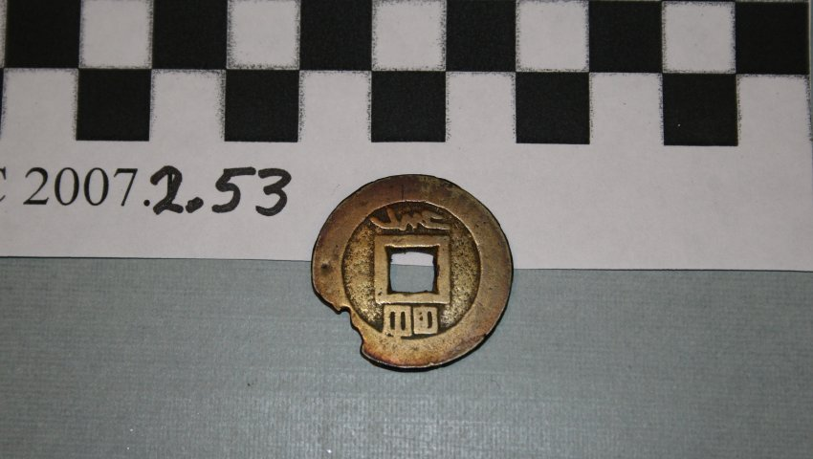
Artifact H. Chinese Coin
Notes:
Brass and copper coins have been made in China for nearly 3,000 years, and many of these came to the United States and Utah with the Chinese railroad workers. These coins were not used as money (to buy things), but were used in games, as good luck charms, and during special events and rituals such as funerals. These coins usually show the name of the Emperor who was in power at the time it was made on one side, which helps date the artifacts. The square holes allowed the coins to be held together on a string. The Chinese also believed that evil spirits would be caught in the square hole, protecting the coin’s owner.

Slide 13
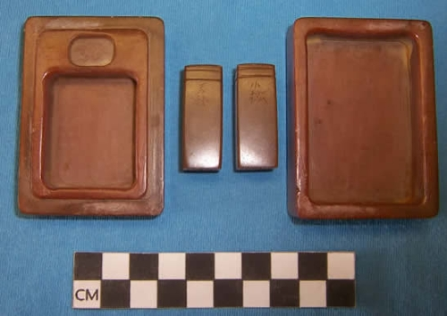
Artifact I. Ink Stone and Ink Stick
Notes:
To make the elaborate and beautiful characters of the Chinese written language, they would grind dry ink sticks in a stone tray like these, then mix with water to make ink for writing and art. Chinese writers used calligraphy brushes, which look very much like small, pointed paint brushes. While some of the workers arriving in the United States for the railroad could not write, many of them had years of education and could write letters home to the families they left behind. Non-Chinese writers of the same time used liquid ink from bottles and special types of pens.

Slide 14
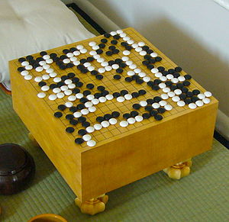
Artifact J. “Wei-Chi” Pieces
Notes:
The game of Wei-Chi (or Go, as it is known in Japan), is thought to be the oldest board game in the world, dating back more than two thousand years to early China. Chinese workers brought this traditional game with them to the United States. To play the game you would need white and black glass or ceramic pieces and a wooden game board divided into a grid. The point of the game is for two players to alternate turns, each attempting to capture territory on the game board. It is similar to the American game Othello. Chinese railroad workers would have played this game in the evenings or on their days off to pass the time and to relax.

Slide 15
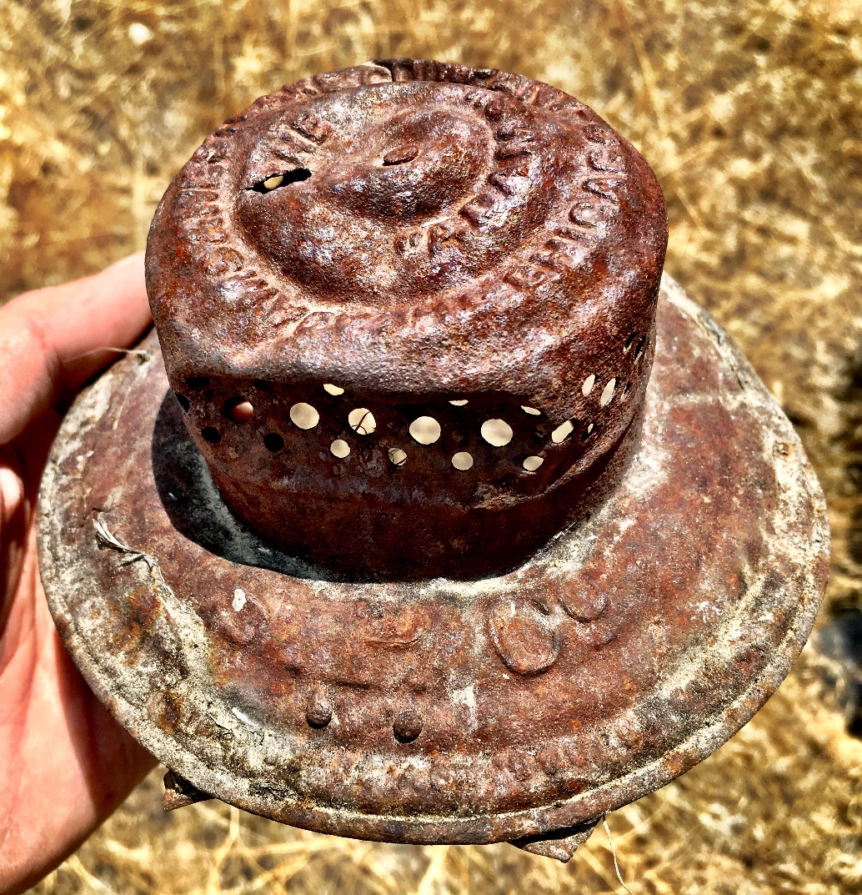
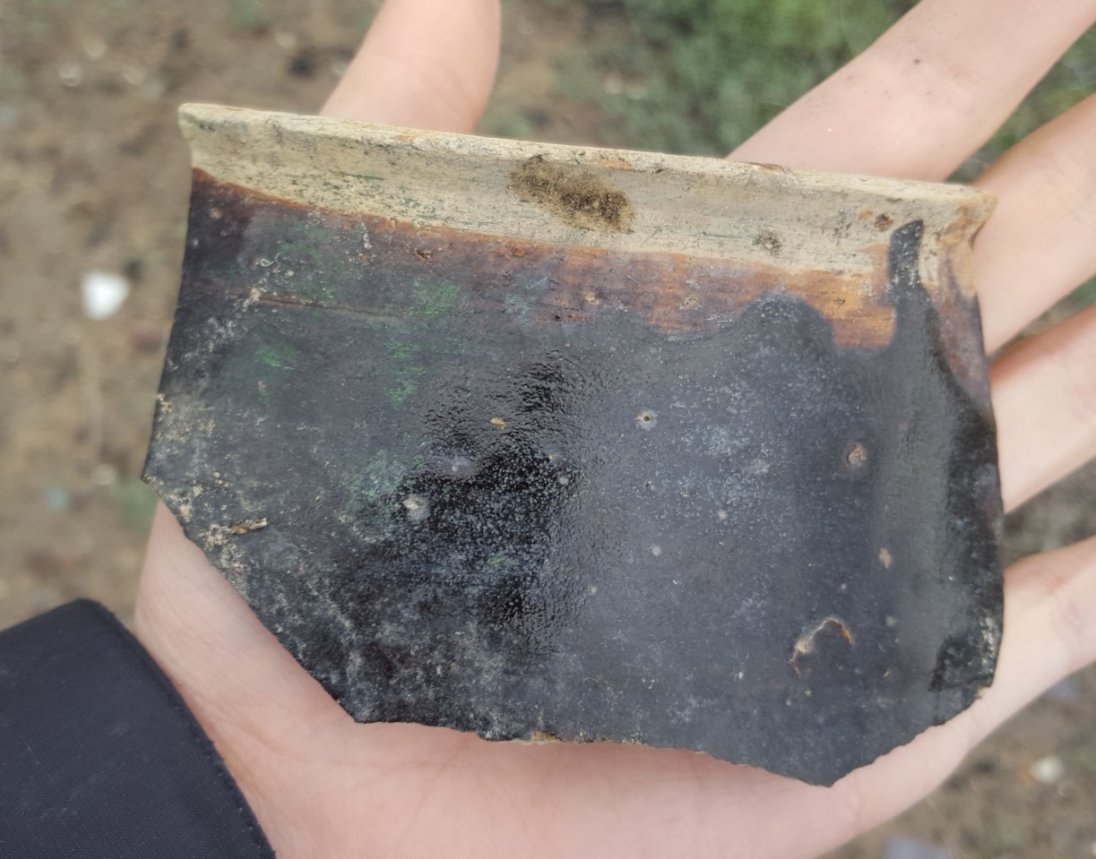
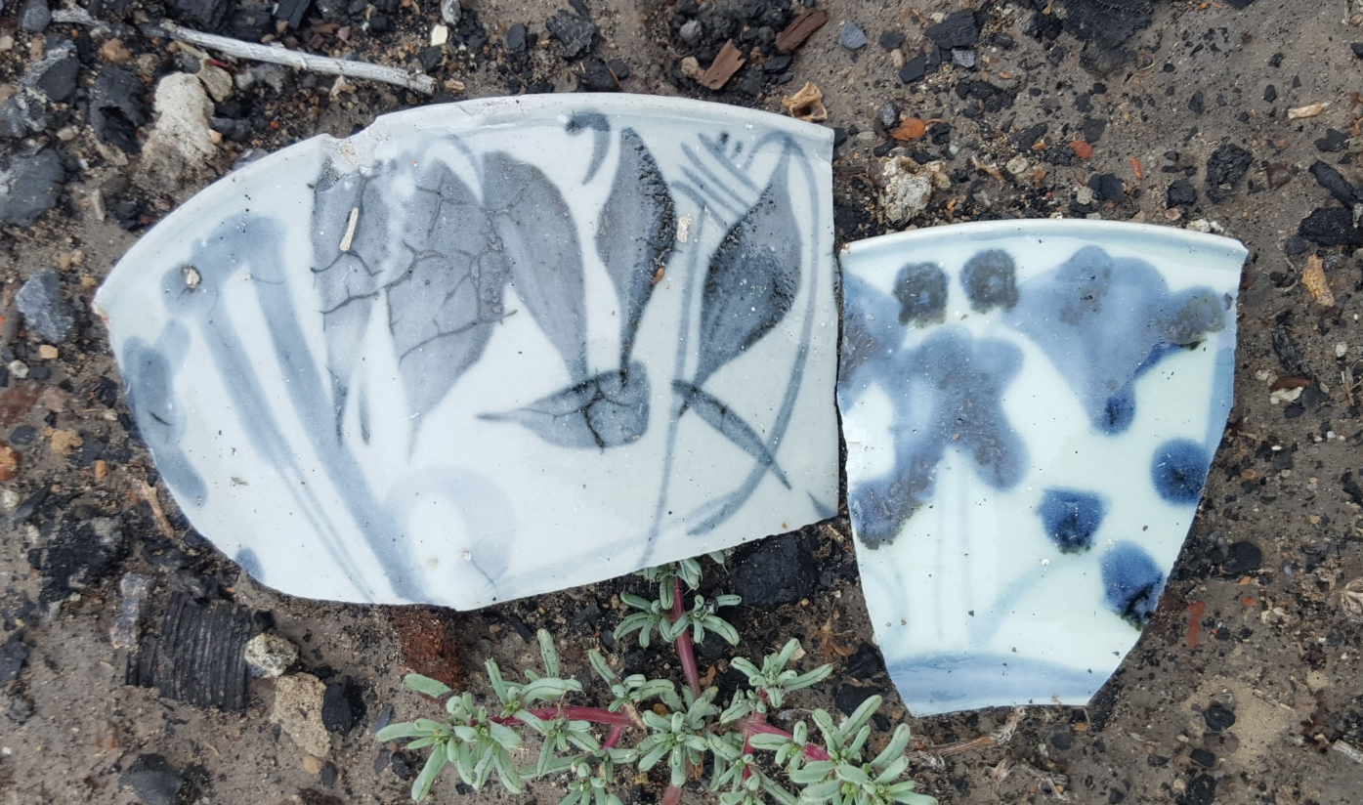
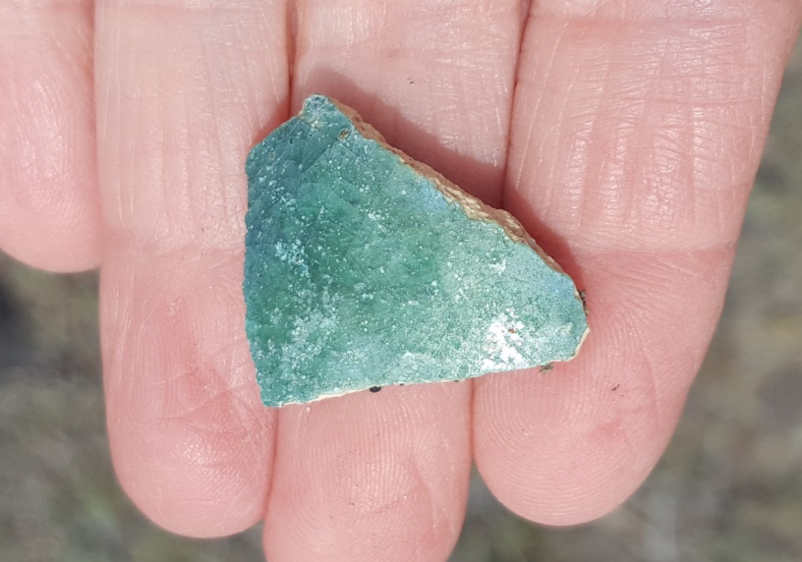
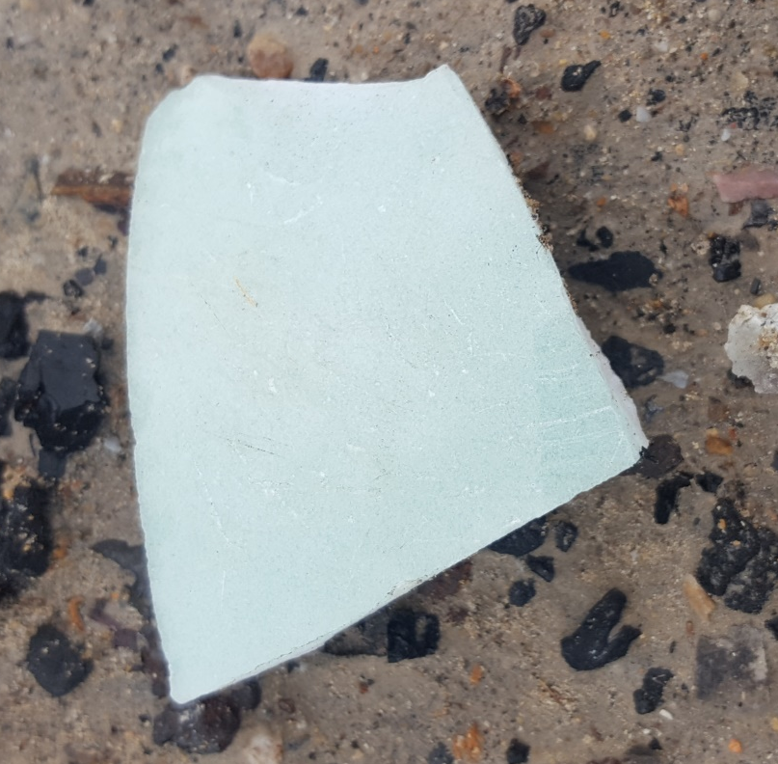
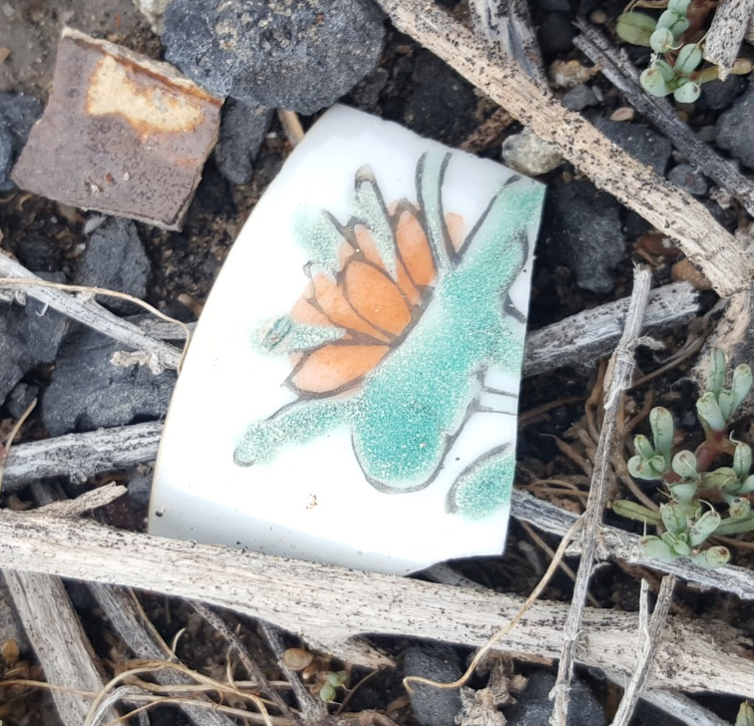
Archaeology Investigation
2
1
3
6
4
5
Notes:
An archaeologist rarely finds whole objects. Usually, they find only small broken pieces on the ground. They match each piece to known types of objects, glue together pieces of artifacts to understand how they fit together as a whole, and finally, think about how all the pieces fit together to tell a story that helps us understand the past. Given what you have learned about Chinese artifacts, identify the broken sherds and artifacts below and explain what these artifacts are telling us about Chinese railroad workers’ lives.
Many of these artifacts you have already seen. In the spaces below identify the object and its function. For the mystery object, Artifact #2, describe it, look at its details, and try to figure out its function and how it fits into the larger story.
An answer key for this exercise is provided at the end of the PDF packet. The mystery artifact is a kerosene railroad lantern.

Slide 16
