Slide 1
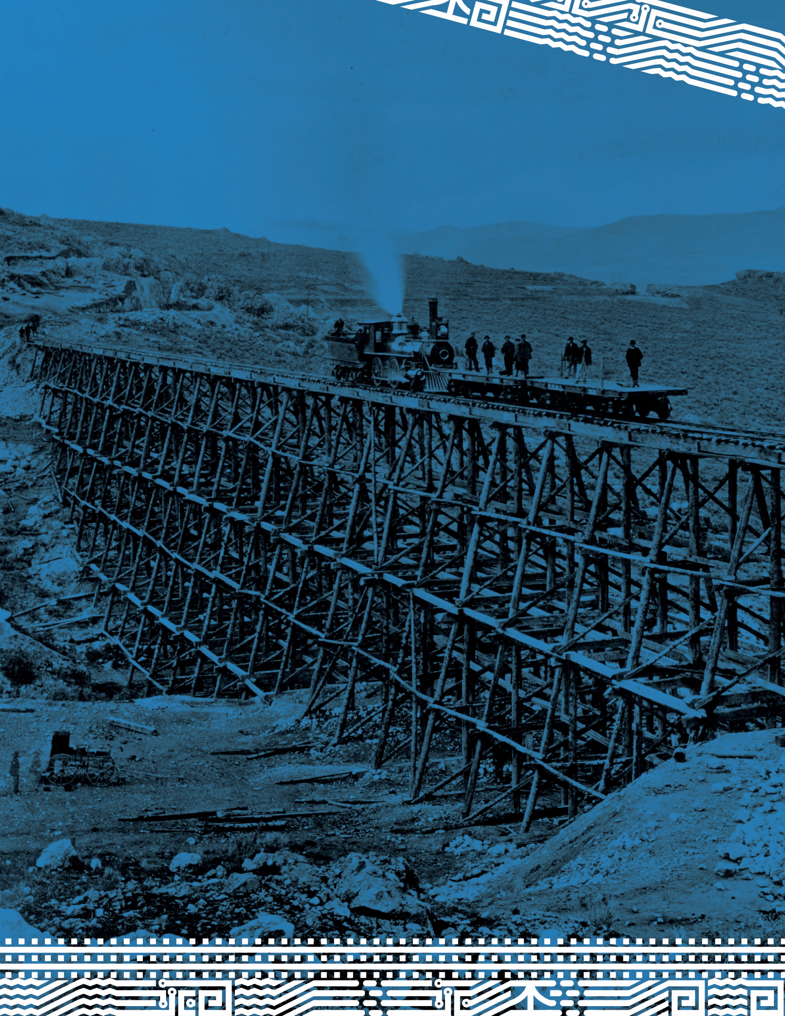
Indigenous Encounters with the Transcontinental Railroad

Slide 2
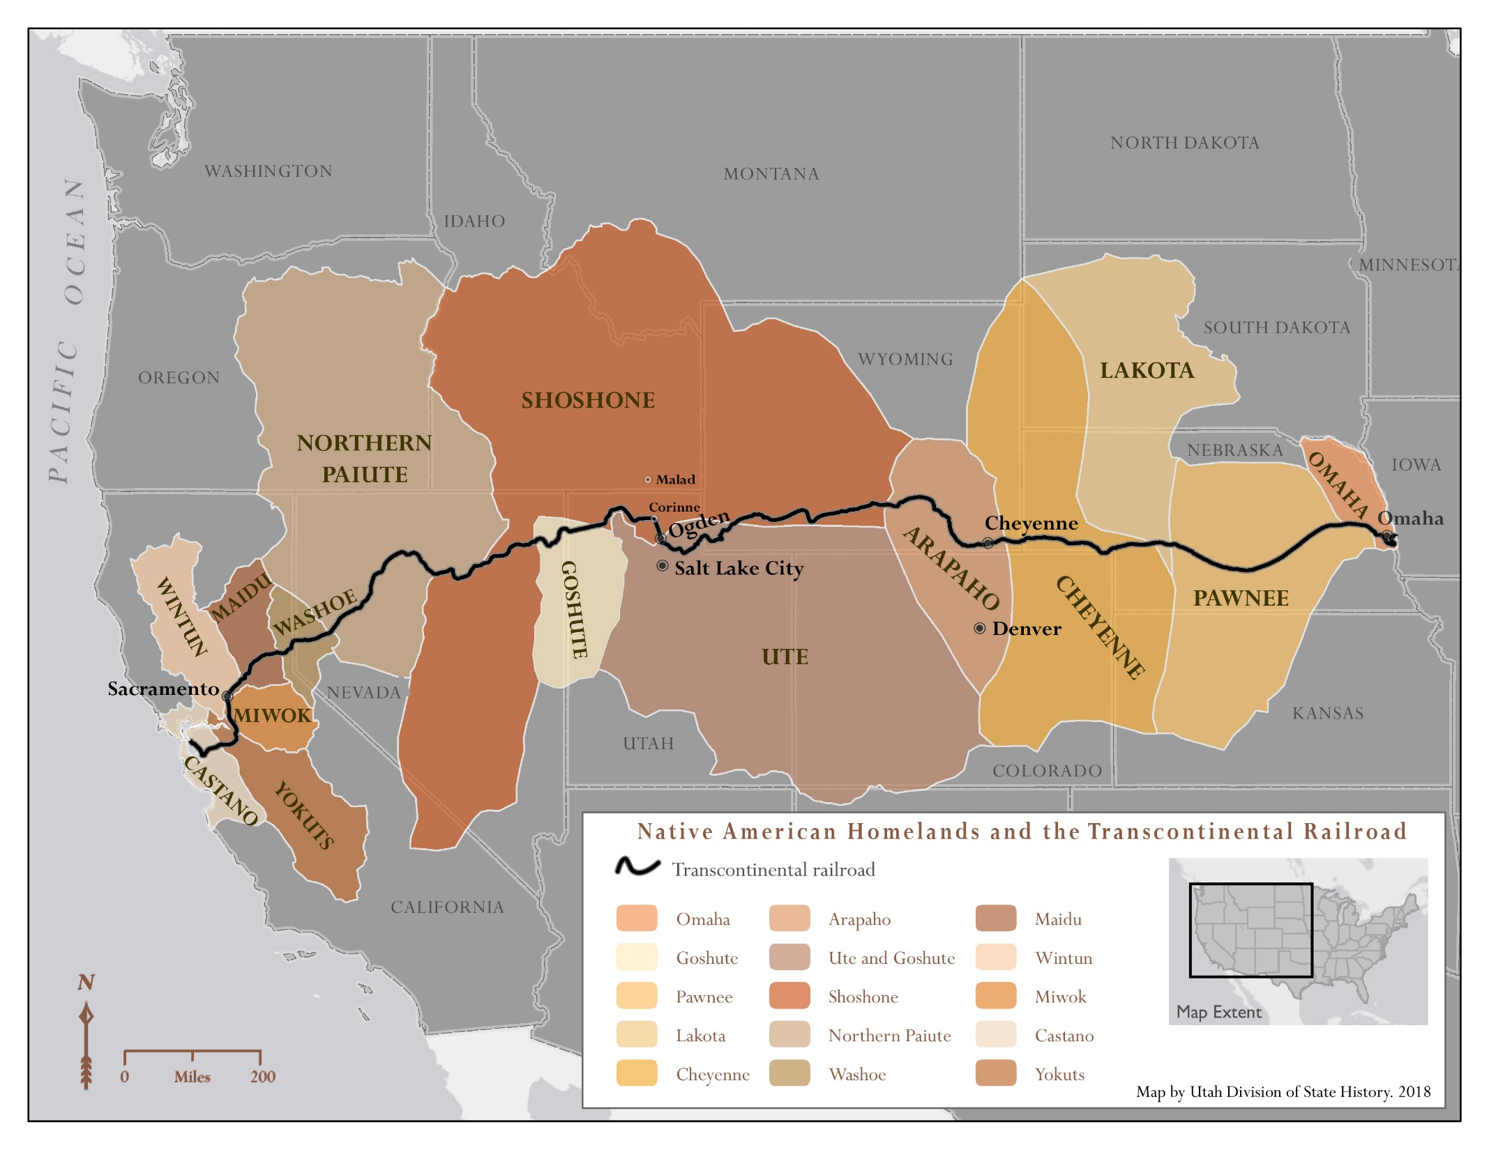

Slide 3
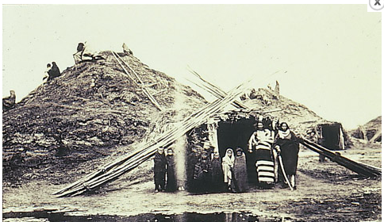
Pawnee Village Earth Lodges. Courtesy Kansas State Historical Society. https://www.kshs.org/kansapedia/pawnees/15611.

Slide 4
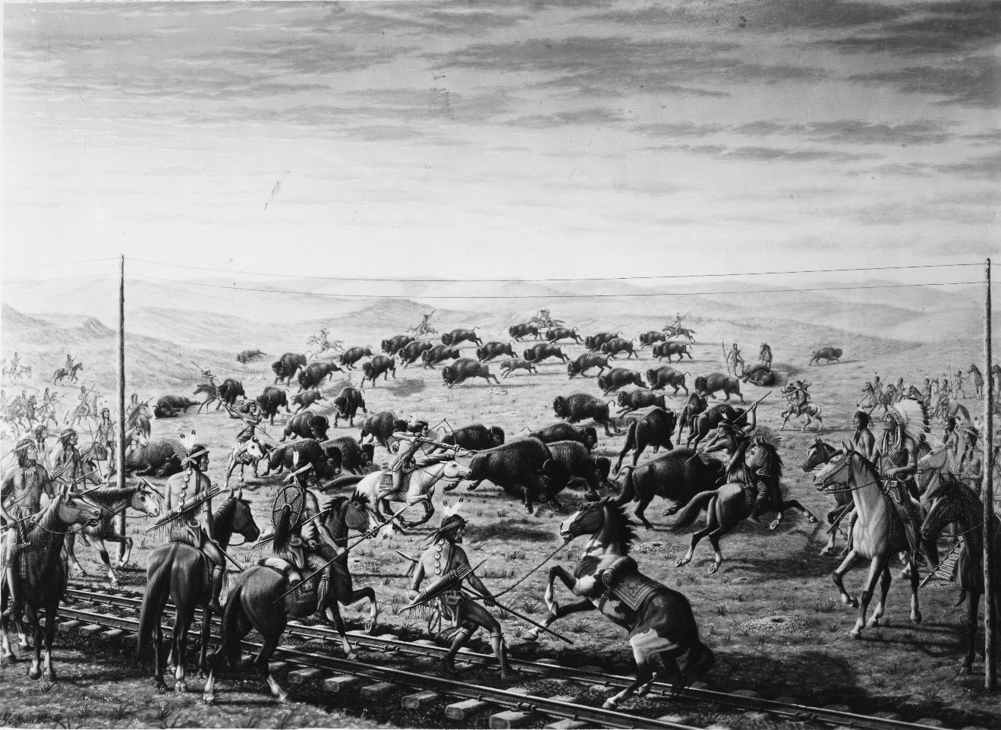
Image 1(a). “Cheyenne Indians and buffalo on Union Pacific railroad tracks.” Painting by Jakob Gogolin, 1930.
Courtesy Utah State Historical Society, https://collections.lib.utah.edu/details?id=440150

Slide 5
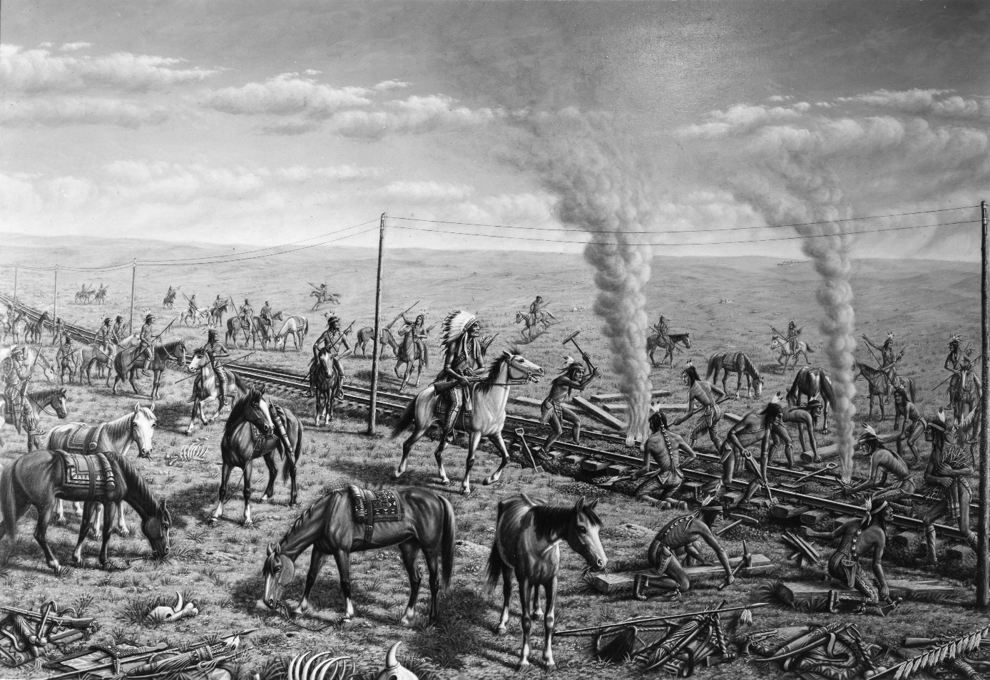
Image 1(b): “Cheyenne Indians tearing up the tracks of the Union Pacific R.R.” Painting by Jakob Gogolin, 1930.
Courtesy Utah State Historical Society, https://collections.lib.utah.edu/details?id=440151

Slide 6
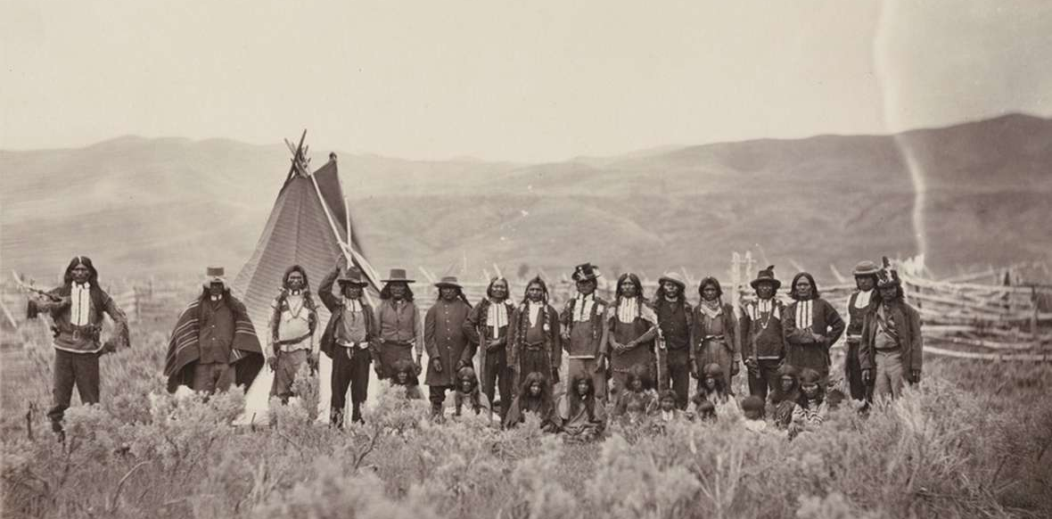
Image 2(a): Shoshone people, perhaps near Fort Bridger, Wyoming, 1868/1869. Photograph by A.J. Russell.
Courtesy Beinecke Library, Yale University. Source: wyohistory.org
Notes:
Union Pacific Railroad photographer A.J. Russell took a series of photos of Shoshone people, perhaps near Fort Bridger, in 1868 or 1869. In this view, the man fourth from the left, arm raised, is reportedly Washakie; Pocatello of the Bannacks, in a flat-crowned hat, is on Wahsakie's left.

Slide 7
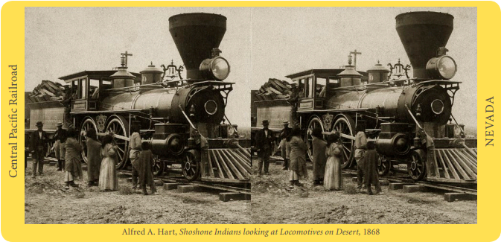
Image 2(b): “Shoshone Indians looking at Locomotives on Desert, 1868, Central Pacific Railroad, Nevada.” Photograph by Alfred A. Hart. Source: cprr.org.

Slide 8
Concluding Discussion
What changes did the completion of the railroad bring to Native Americans generally? Were these changes mostly positive or negative?
Why did Native American communities respond differently to the arrival of the railroad?
All of the images in this lesson were created by Euro-Americans. Does that fact change how you interpret the images?
What might a picture of the railroad and its impacts on native people look like if it were created by native people themselves?

Slide 9
For Further Exploration
Visit the site of the Bear River Massacre in Idaho.
Visit the site of the Sand Creek Massacre in Colorado.
Learn more about the ways Shoshone and Cheyenne people creatively adapted to the changes brought by American settlement.
Find out where Utah’s Indigenous peoples live today. Where are their reservations? Do they also live in cities?
Find out where Cheyenne and Arapaho people live today.

